Slide 1
CHE 112 Spring 2021
Lecture 20f – Biological Effects of Radiation
Overview/Topics
Ionizing vs nonionizing radiation
Penetration
6 Factors
Units
Decay Rates
Gray/Rad
RBE
Sievert/REM
Dose/Effect
Direct vs Indirect effect
Common sources of exposure
Skills to Master
HW 20 f
Read
OER 20.6
Better than OER - https://saylordotorg.github.io/text_general-chemistry-principles-patterns-and-applications-v1.0/s24-nuclear-chemistry.html
Another good Link - https://quantummechanics.mchmultimedia.com/2011/undergraduate-teaching/general-chemistry/nuclear-radiation/nuclear-radiation-3-biological-effects-of-radiation/

Slide 2
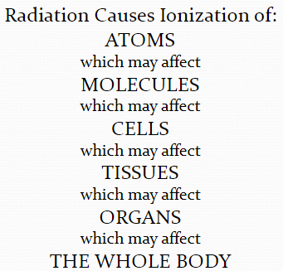
6 Factors
“can really be anywhere between 3-6 factors depending on book and how much detail it goes into!”
Type of radiation (Penetrating power)
Ionizing vs Nonionizing
Energy (effects amount/type of damage)
Length of Exposure (Particles/time)
Internal vs External (Can effect damage)
What is exposed (ie skin vs organs)

Slide 3
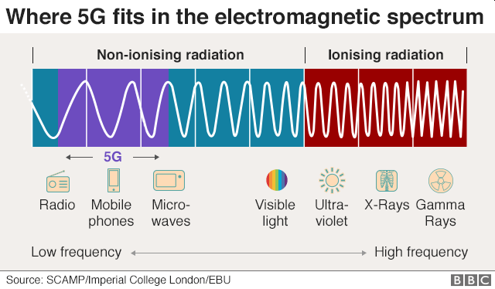
Ionizing vs Nonionizing Radiation
Nonionizing Radiation
Ionizing Radiation
Low Energy
Increase KE (motion/heat)
Need large exposure to cause damage
Ex: Light, Microwaves
High Energy
Create ions (knock e⁻ from molecule)
Make radicals
Break chemical bonds
Damage structure and function
Ex: α, β, γ, X-rays, High energy UV
https://en.wikipedia.org/wiki/Ionizing_radiation

Slide 4
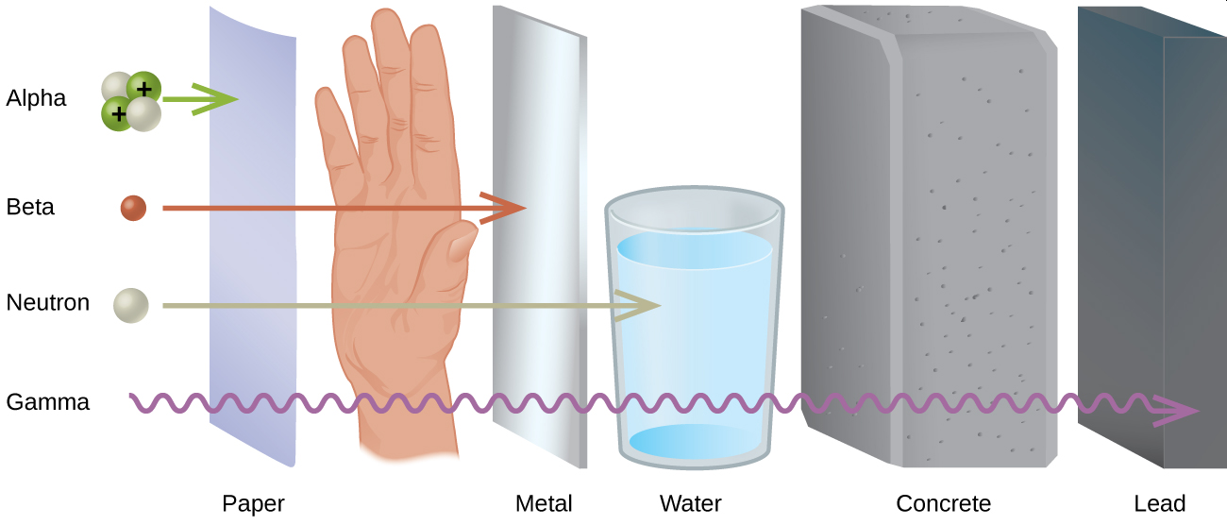
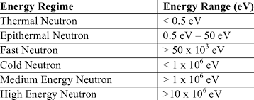
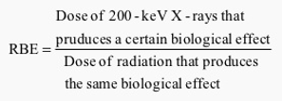
Type of Radiation
Energy
Penetration
Ionizing Ability
RBE
Radiation | Energy | Penetration | Ionizing | RBE (more later)
α | 3-9 MeV | 1 | Strong | 10
β | 0-3 MeV | 100 | Moderate | 1
γ | 10 KeV – 10 MeV | 10,000 | Very weak | 1
X-ray | 100 eV-10 KeV | 10,000 | Very weak | 1
$${}_{0}^{1}n$$ | Varies | 10,000 Varies | Varies | Fast = 1 Slow = 10
Relative Biological Equivalent
Standardized factor to measure radiation damage from different sources.
https://www.nuclear-power.net/nuclear-power/reactor-physics/atomic-nuclear-physics/radiation/shielding-of-ionizing-radiation/

Slide 5
Units for Measuring Radiation
Decay Events (Rates)
1 Becqueral (Bq) = 1 dis/sec
1 Curie (Ci) = 3.7 x 10¹⁰ dis/sec
Energy Absorbed/Kg Tissue
1 Gray (Gy) = 1 J/Kg
1 Rad = 0.01 Gy = 0.01 J/Kg
Tissue Damage
Energy J/Kg + Different biological effects (RBE – next slide)
Sv = RBE x Gray
1 Sievert (Sv) = J/Kg
1 rem = 0.01 Sv = 0.01 J/Kg
*rem = roentgen equivalent for man

Slide 6
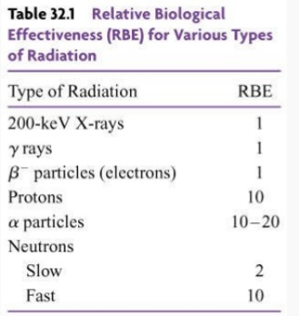
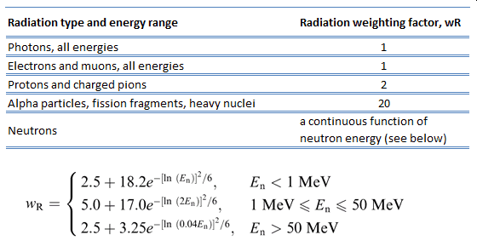
Relative Biological Effectiveness (RBE)
Standardized factor to measure radiation damage from different sources.

Slide 7
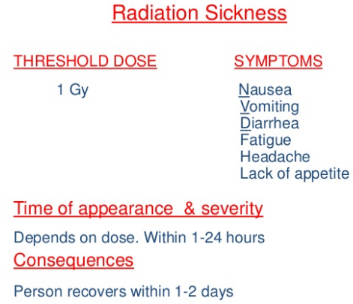
Impacts of Radiation Exposure

Slide 8
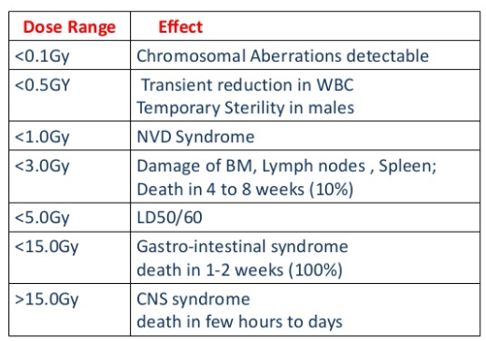
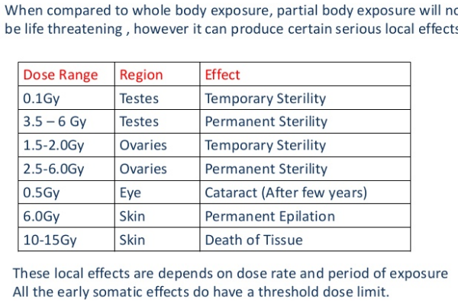
Impacts of Radiation Exposure

Slide 9
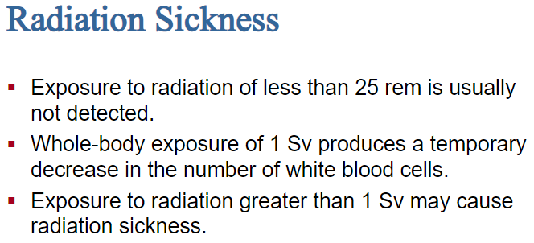

Slide 10
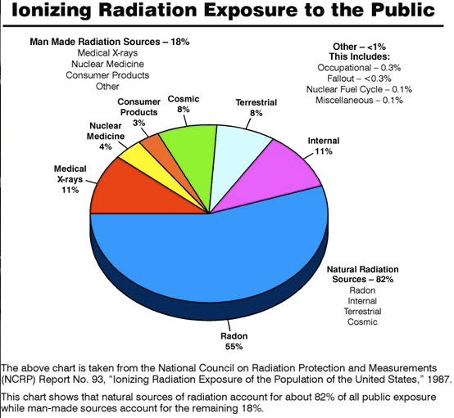
How much are we exposed too?
18% Man made
82% Natural

Slide 11
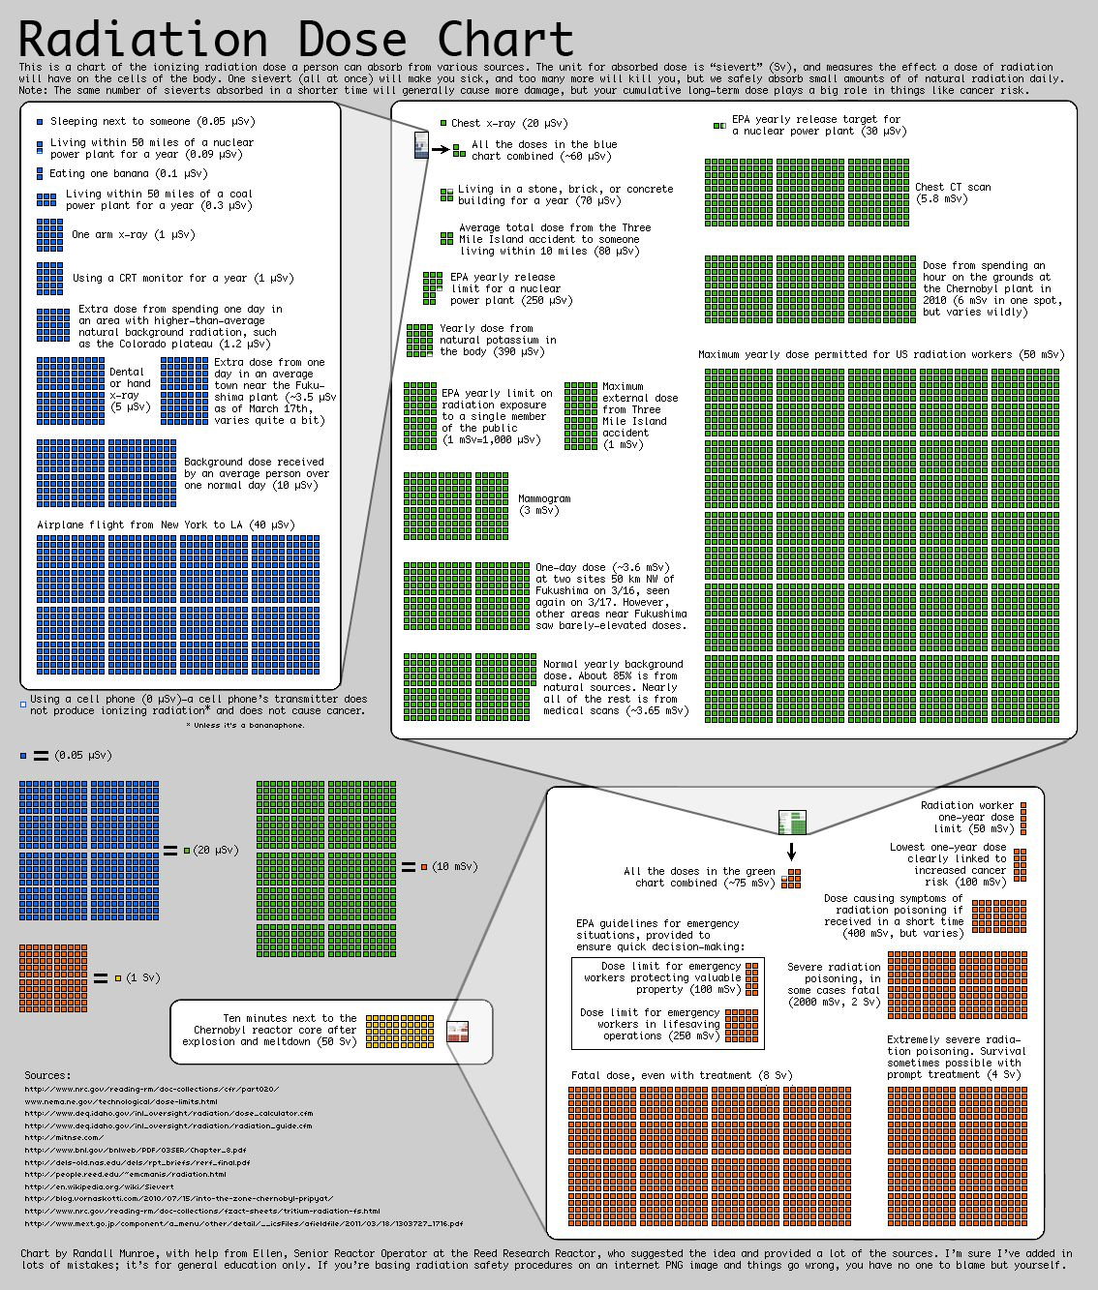

Slide 15
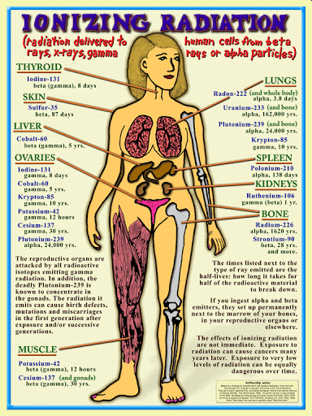
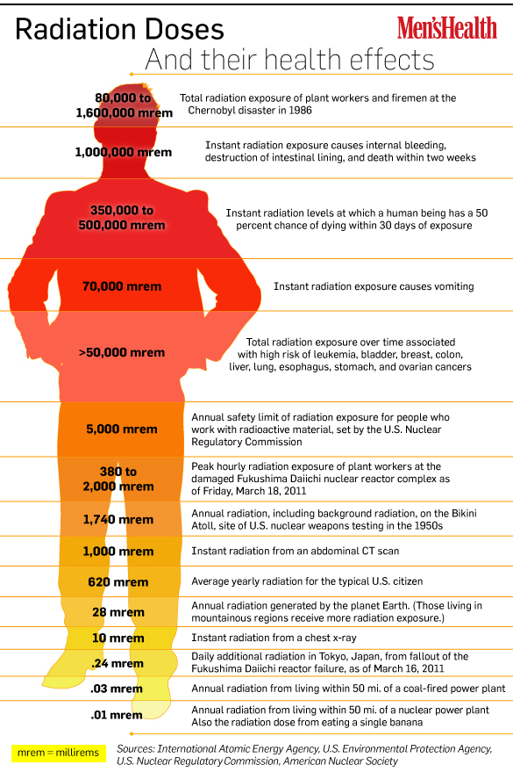
Type of Radioactive Isotope Matters
Damage depends on type of isotope
Uptake (breathing , diet etc)
Amount of exposure
Length of exposure

Slide 16
