Slide 1
CHE 112 Spring 2021
Lecture 20 e – Fission, Fusion, Transmutation
Overview/Topics
Applications of Nuclear Reactions
Fission
Fusion
Transmutation
Skills to Master
HW 20e
Read
OER 20.4
Excellent resource – lots of extra practice and answers at:
https://saylordotorg.github.io/text_general-chemistry-principles-patterns-and-applications-v1.0/s24-nuclear-chemistry.html

Slide 2
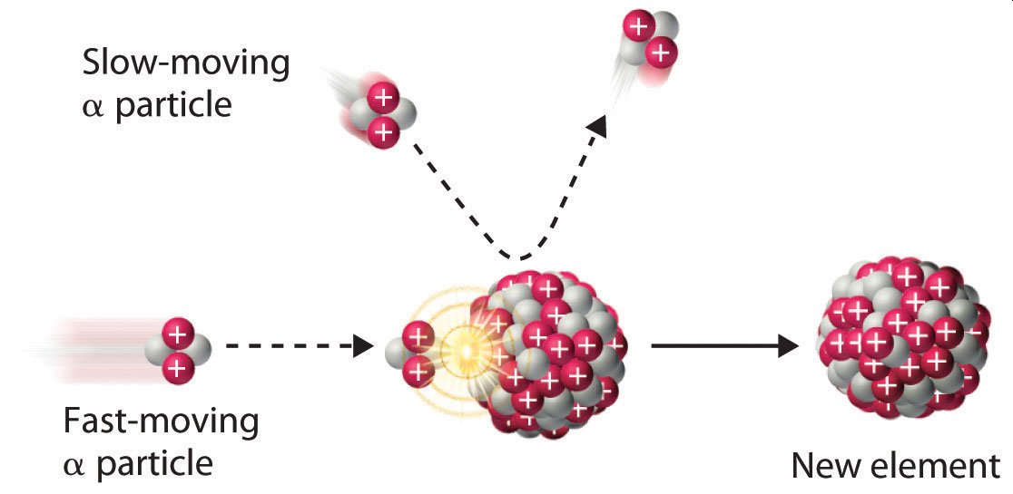
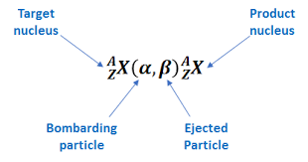
Transmutation
Change 1 element into another via bombardment with high energy particles (α, p, n, other nuclei)
Often also study Daughter products
300 naturally occurring isotopes
3600+ man-made isotopes
All transuranic elements > 92
1st done by Rutherford 1917
Short hand notation

Slide 3
Example:
Write the short hand notation for the following reaction studied by Rutherford
$${}_{7}^{14}N+ {}_{2}^{4}{He} → {}_{8}^{17}O+ {}_{1}^{1}p$$
α-particles from radium
Also lead to discovery of neutrons

Slide 4
Linear Particle Accelerator
Need high energy to overcome repulsive forces
Accelerate particle using alternating magnetic fields
An aerial view of the SLAC, the longest linear particle accelerator in the world; the overall length of the tunnel is 2 miles.
Rapidly reversing the polarity of the electrodes in the tube causes the charged particles to be alternately attracted as they enter one section of the tube and repelled as they leave that section. As a result, the particles are continuously accelerated along the length of the tube.

Slide 5
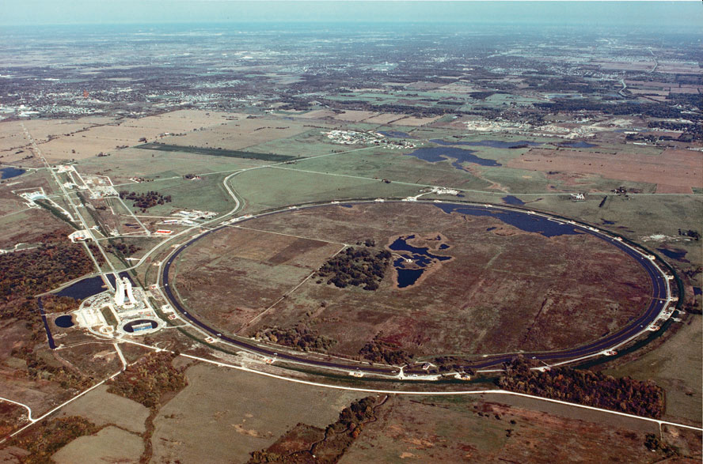
Synchrotron Particle Accelerator

Slide 6
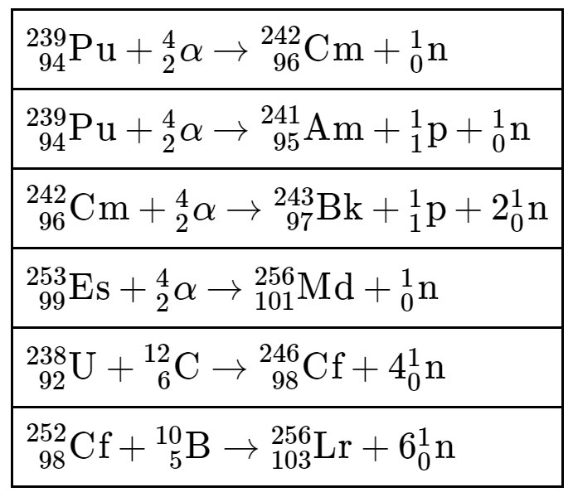
Creation of Transuranic Elements (E > 92)
The first of the transuranium elements to be prepared was neptunium (Z = 93), which was synthesized in 1940 by bombarding a ²³⁸U target with neutrons.
Neutron Bombardment
Radioactive Decay
Some other examples

Slide 7
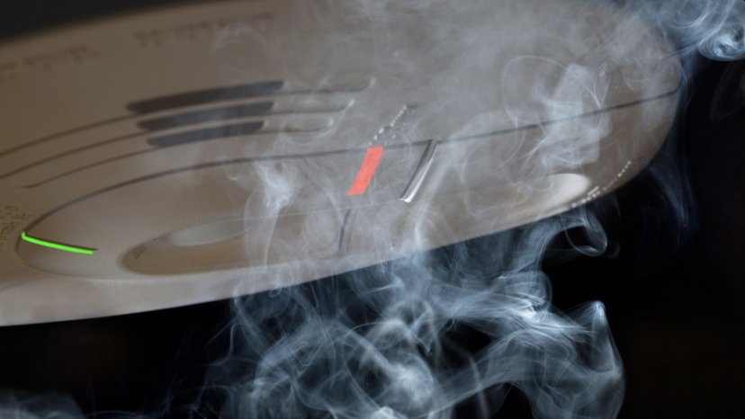
Smoke Detectors
https://en.wikipedia.org/wiki/Americium-241
https://www.livescience.com/39874-facts-about-americium.html
https://www.nrc.gov/reading-rm/doc-collections/fact-sheets/smoke-detectors.html
https://home.howstuffworks.com/home-improvement/household-safety/smoke.htm

Slide 8
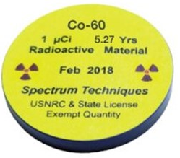
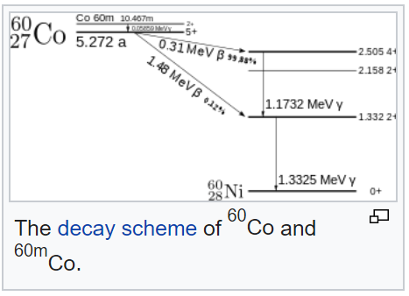
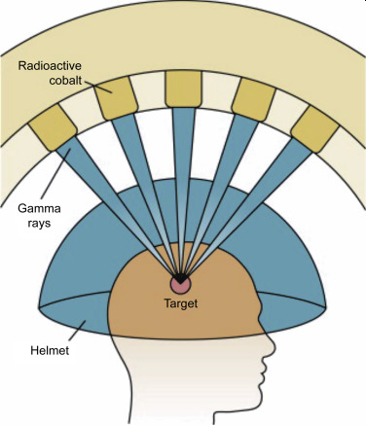
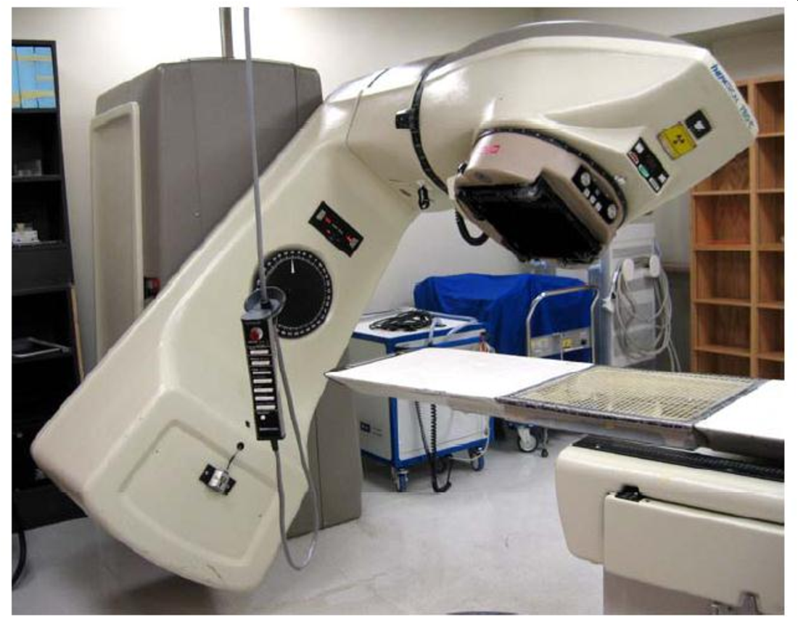
Used to generate γ-rays
Cancer treatments
Short ½ life = 5.27 years
https://en.wikipedia.org/wiki/Cobalt-60

Slide 9
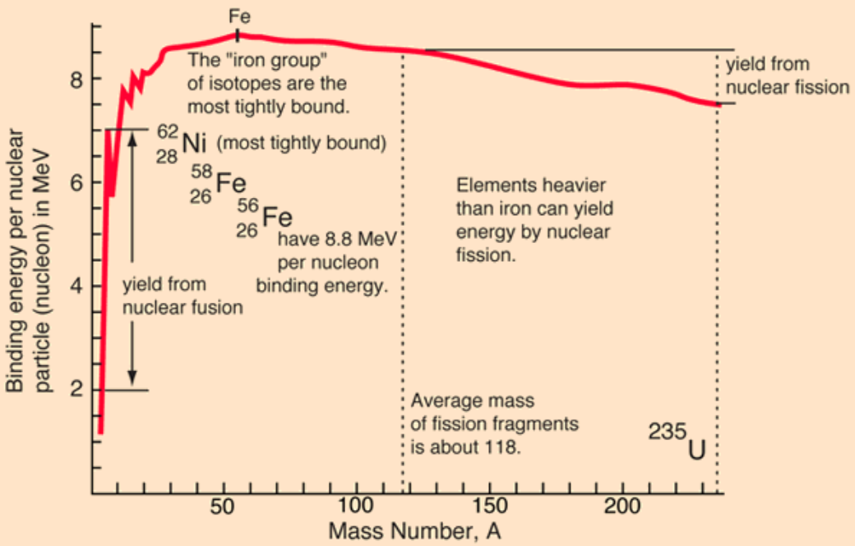
Nuclear Fission and Fusion
Lecture 20e
Lecture 20e

Slide 10
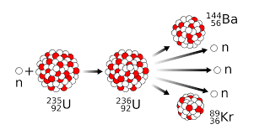
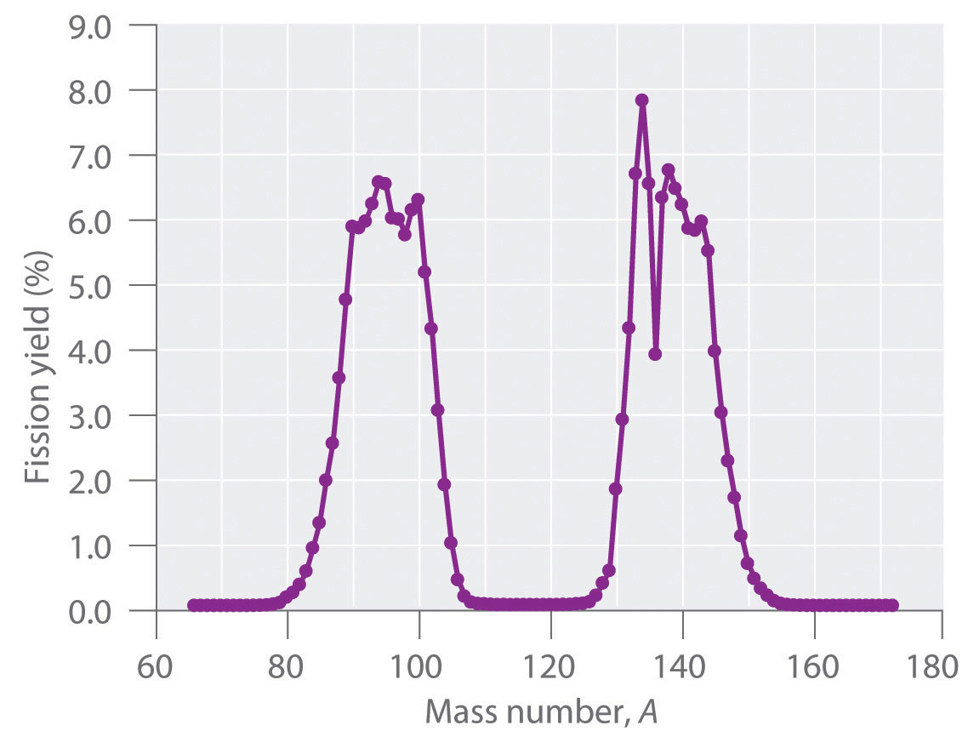
Nuclear Fission
Heavy element with low Binding Energy decomposes into more stable elements giving off excess energy
1 E (heavy) → 2 E (lighter)
Can occur naturally or triggered artificially
1939 – Meitner, Hahn, Straussman ²³⁵U
Products can vary
Nuclear fission usually produces a range of products with different masses and yields, although the mass ratio of each pair of fission products from a fission event is approximately 3:2. As shown in this plot, more than 50 different fission products are known for 235-U.
Data source: T. R. England and B. F. Rider, Los Alamos National Laboratory, LA-UR-94-3106, ENDF-349 (1993).

Slide 11
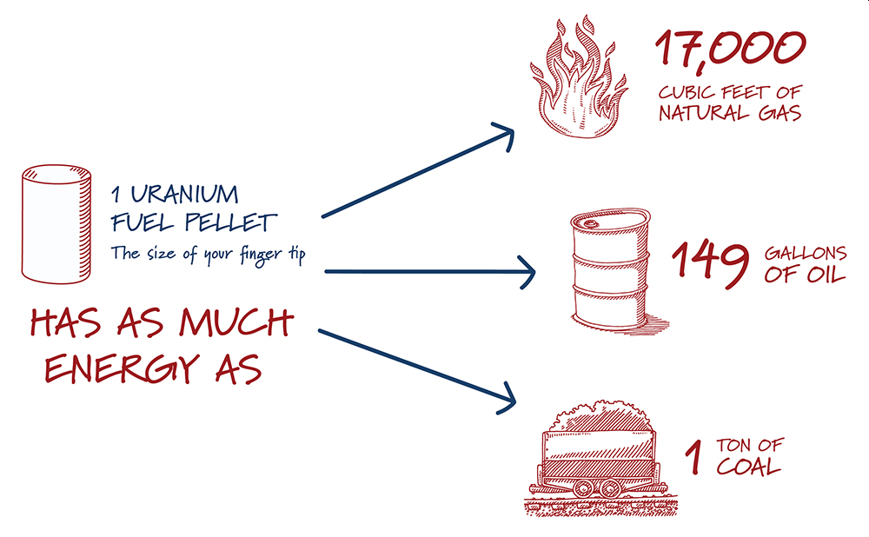
Large Energy Changes - Releases large amounts of energy ≈ 2.0 x 10¹³ J/mol (same as 400,000 tons of coal!)

Slide 12
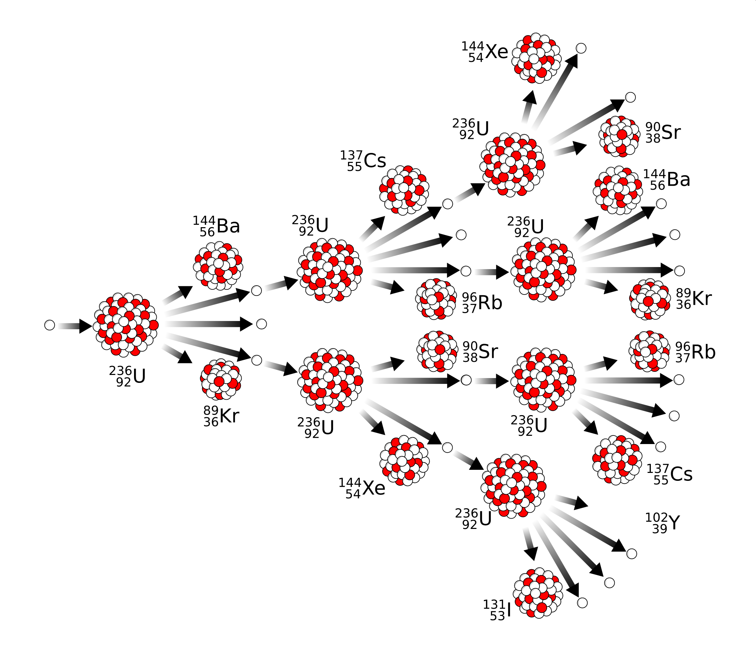
Nuclear Chain Reaction – a reaction that continues to occur if the outside influence is removed (self-sustaining)

Slide 13
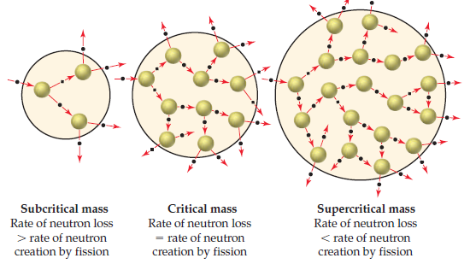
Critical Mass – minimum mass required to have a chain reaction
Subcritical Mass – can not sustain a chain reaction
Controlled Reactions
Chain Reactions
Nuclear Reactors
Nuclear Bomb

Slide 14
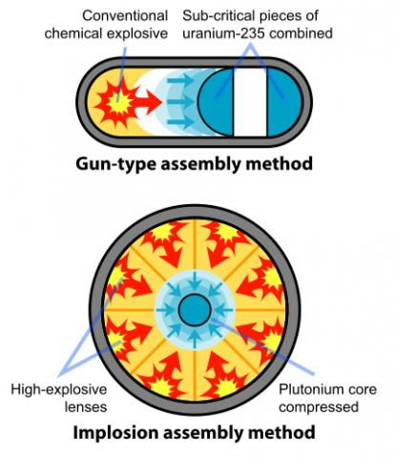
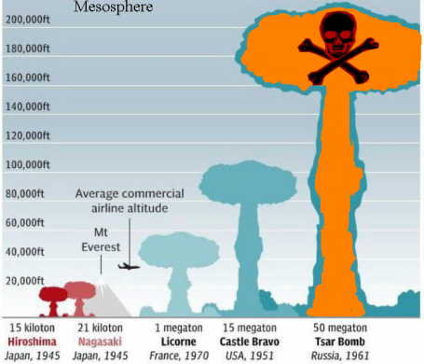
Nuclear Bombs
For U-235 enriched to "bomb-grade" uranium, the critical mass may be as small as about 15 kg in a bomb configuration.
Theory is “easy”
Subcritical mass → Critical Mass
Obtaining nuclear material “harder”

Slide 15
Mother Nature Wins

Slide 16
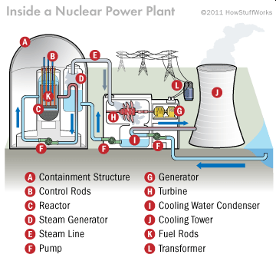
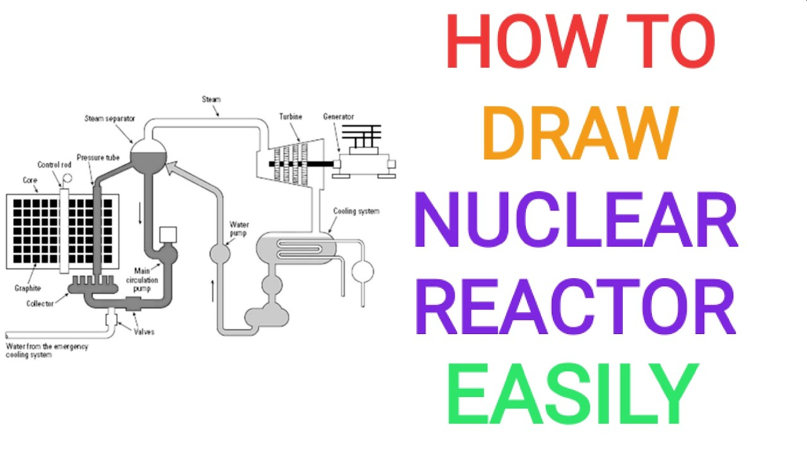
Nuclear Reactors
Controlled nuclear reaction used to heat water.
Many different variables
Fuel
Moderator
Coolant
Control Rods
Etc.
Quite complex with many different designs

Slide 17
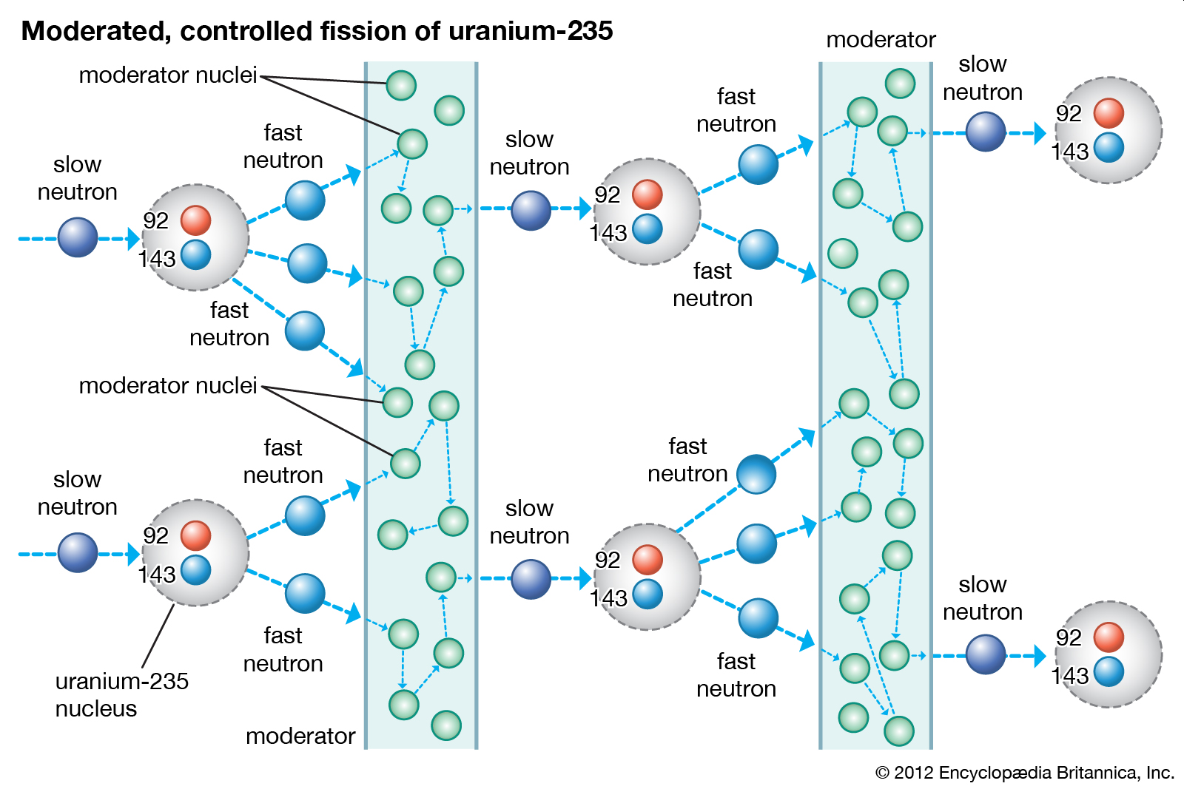
Fuel
https://en.wikipedia.org/wiki/Nuclear_fuel
Self-sustaining mass
Many different types ²³⁵U, Th, etc.
Sometimes in compounds (UO₂ or UO₃)
Enriched (natural = 0.3% enriched > 5%)
Many form factors (pellets, rods, balls)
A single pellet contains as much energy as there is in one tonne of coal. A typical reactor requires about 27 tonnes of fresh fuel each year. In contrast, a coal power station of a similar size would require more than two-and-a-half million tonnes of coal to produce as much electricity.
Moderator
Slow neutrons down so they can start another fission event
Many different types
Graphite (old)
Light Water (H₂O)
Heavy Water (D₂O)
Beryllium (Be)
Molten salts

Slide 18
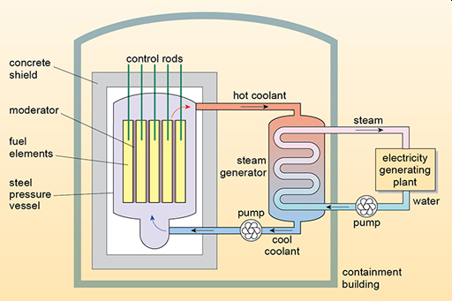
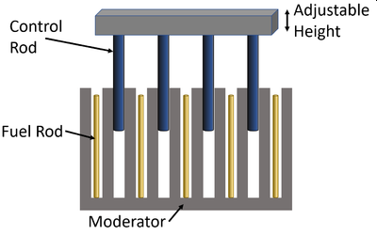
Coolant
Giant Steam Engine
Coolant/Boiler kept separate
Can be same as moderator
Many types
Water
Molten Salts
Pb/Bi mixture
Control Rods
Many other shapes
Control rate of fission by controlling number of “slow” neutrons
Many types – absorb ${}_{0}^{1}n$
Boron
Cadmium
Positive or Negative Control mechanism

Slide 19
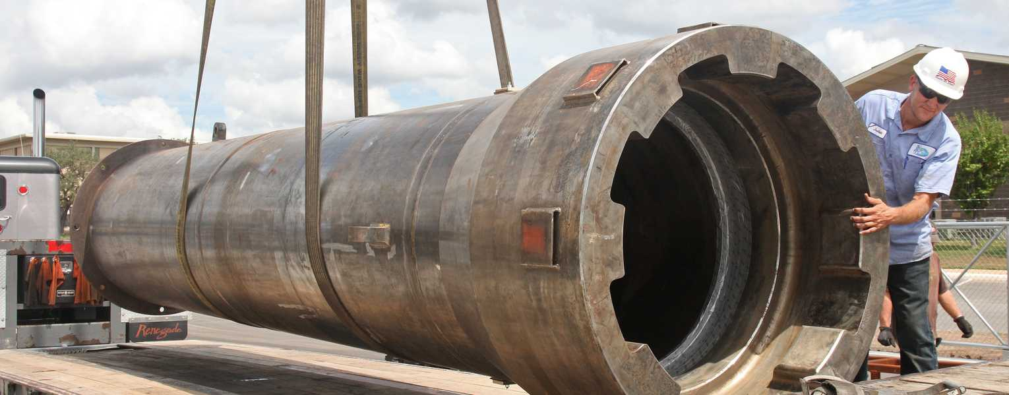
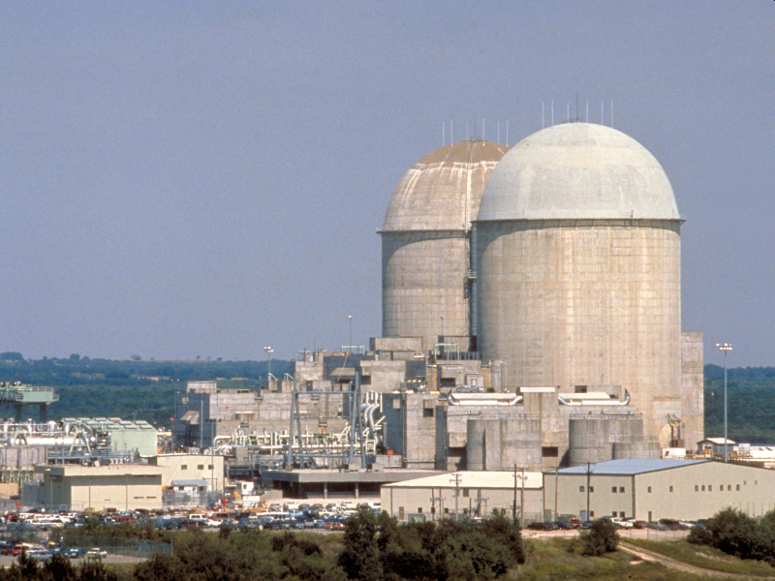
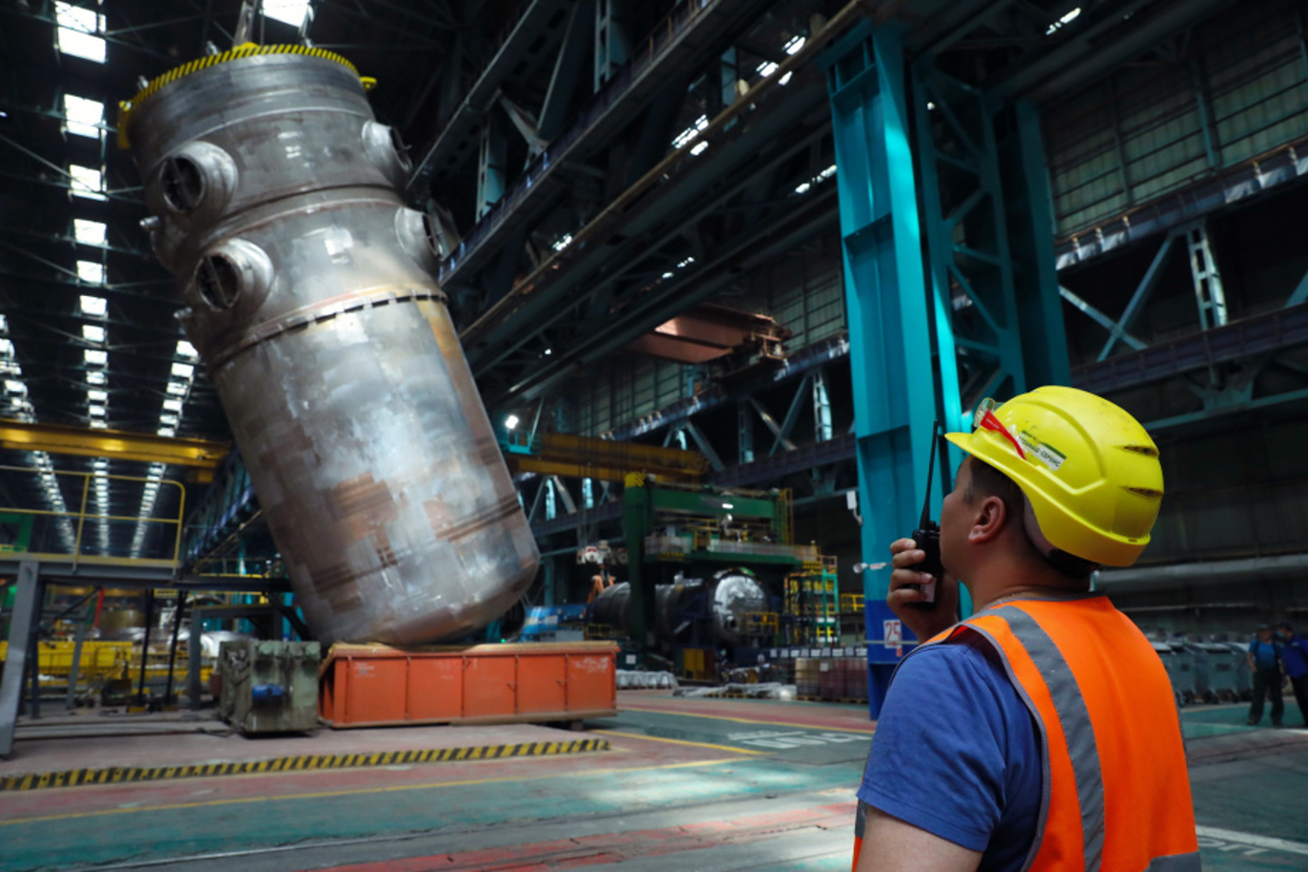
Shielding
Keep radioactive materials contained
Many levels
Control rods
Reactor Vessel
Coolant Circulation
Concrete Dome

Slide 20
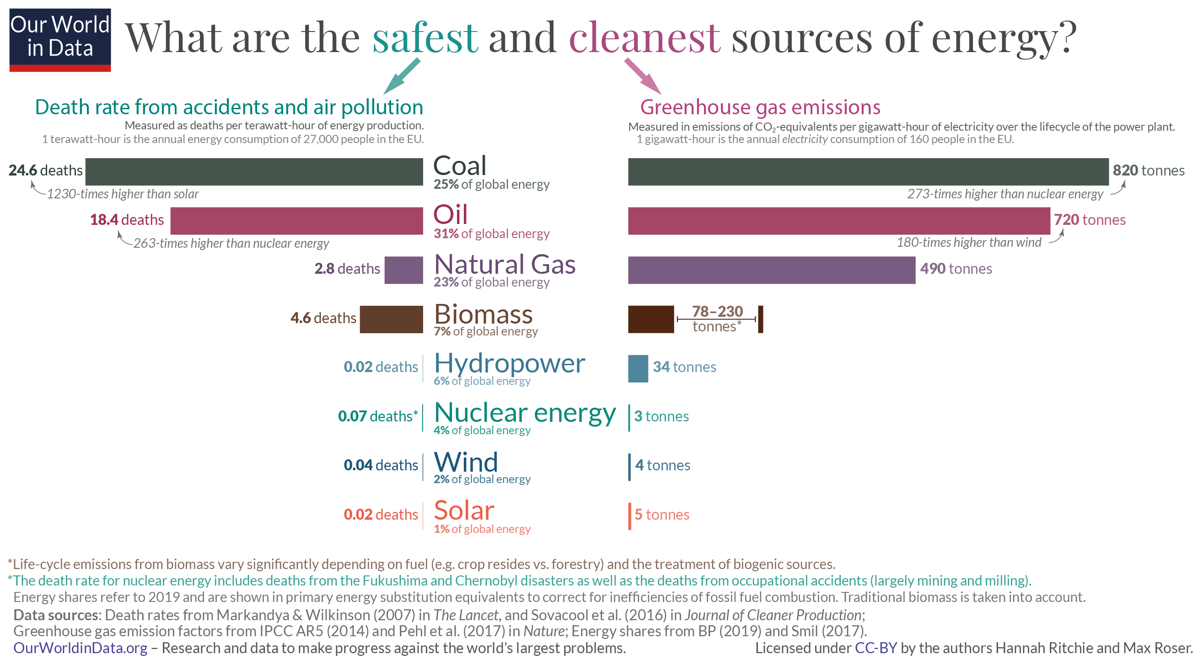
Miscellaneous
NIST – good video (2 min)
Safe or NOT Safe?
Green Energy?
Accidents (read book)
Disposal of radioactive waste (NIMBY)
Nuclear Proliferation
https://www.nbcwashington.com/investigations/maryland-nuclear-reactor-emitted-radioactivity-levels-safe-but-larger-than-reported-earlier/2625712/

Slide 21
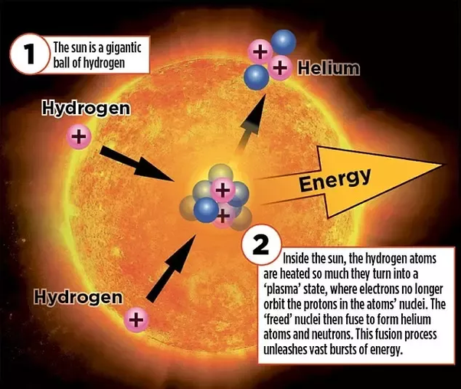
Nuclear Fusion
Light element with low Binding Energy combine into more stable elements giving off excess energy
2 E (light)→ 1 E (heavy)
Chemistry is complex
Require HIGH Temperature (4 million K!)

Slide 22
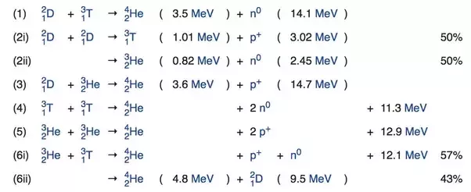
Lots of Reactions, Lots of Energy!

Slide 23
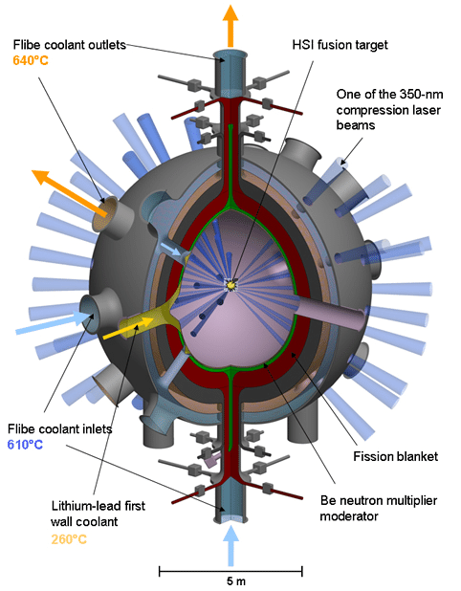
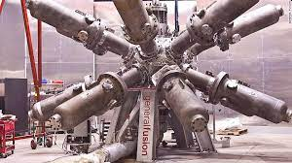
Fusion Reactors
Advantages
Disadvantages
Fuel = cheap (2 H₂O → 2 H₂ + O₂ )
Few radioactive products
No chance of uncontrollable reaction
Hard to get to 40 million K
Materials issues
Magnetic Confinement
Focused Laser Beams
20 years away!

Slide 24
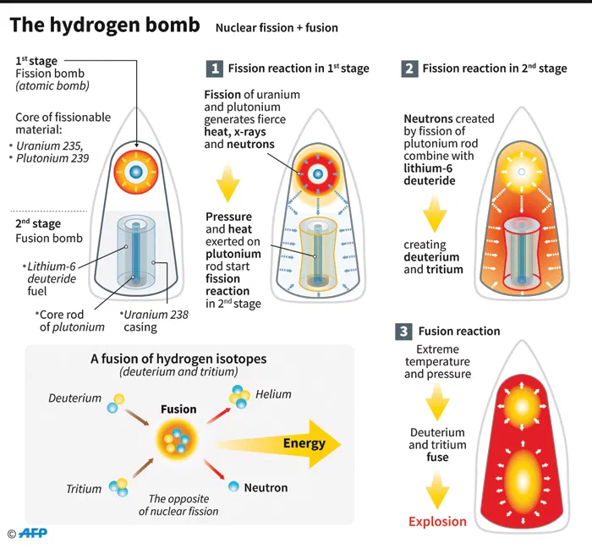
Fusion Bombs
Same principle as fission bomb except fusion reaction
Often uses fission reaction to ignite fusion reaction
Cleaner?

Slide 25
