Slide 1
CHE 112 Spring 2021
Lecture 20 d – Age of the Universe
Overview/Topics
Radioactive Decay Chain
Half-Life and Rate Constant
Using ½-life to calculate age of objects
Skills to Master
HW 20 d
Read
OER 20.3
https://www.newworldencyclopedia.org/entry/Radioactive_decay

Slide 2
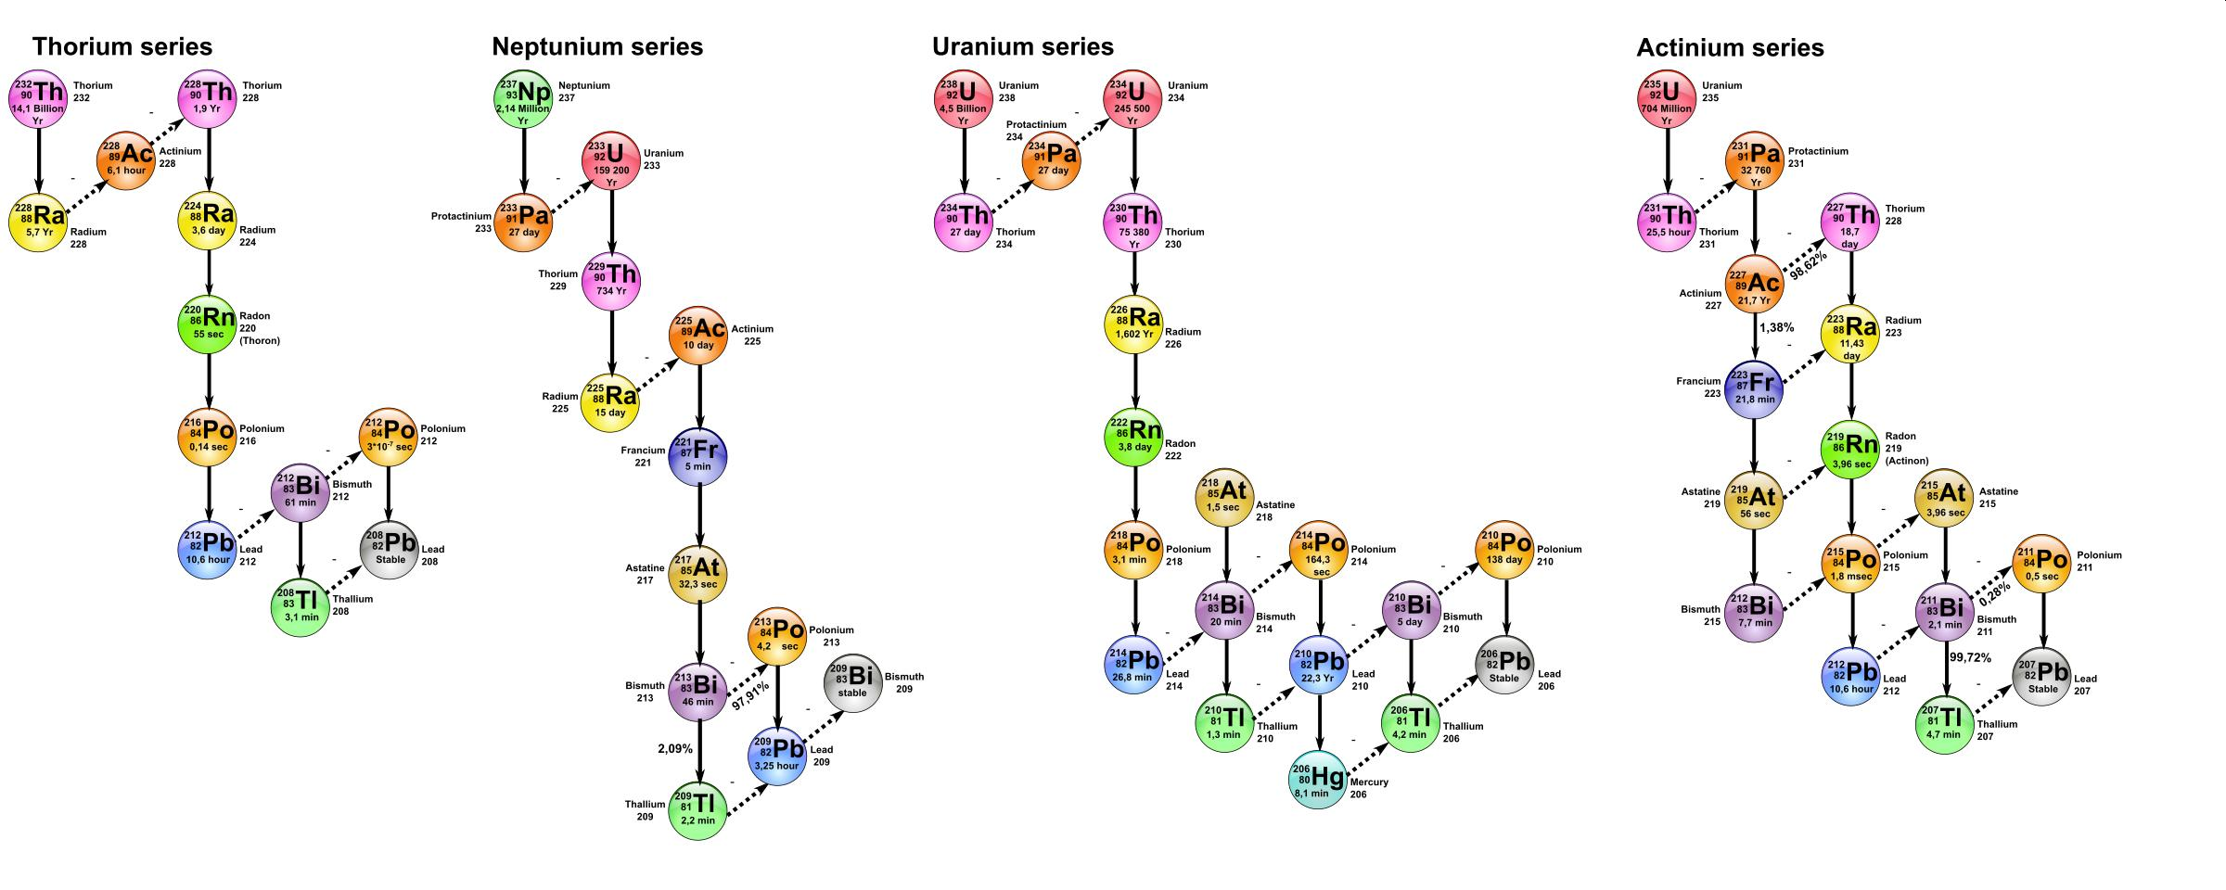
Radioactive Decay Series
“chain”
Series of radioactive decays an isotope undergoes to achieve stability (ultimately decaying to a stable isotope of lead
4 Series – Uranium, Actinide, Thorium, Neptunium (all gone!)
Parent = long ½ life
Daughter = shorter ½ lives

Slide 5
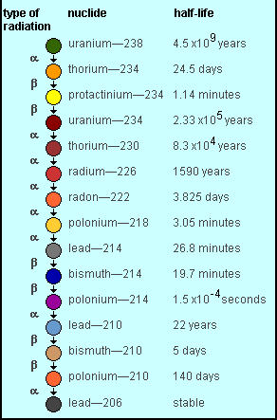

Slide 6
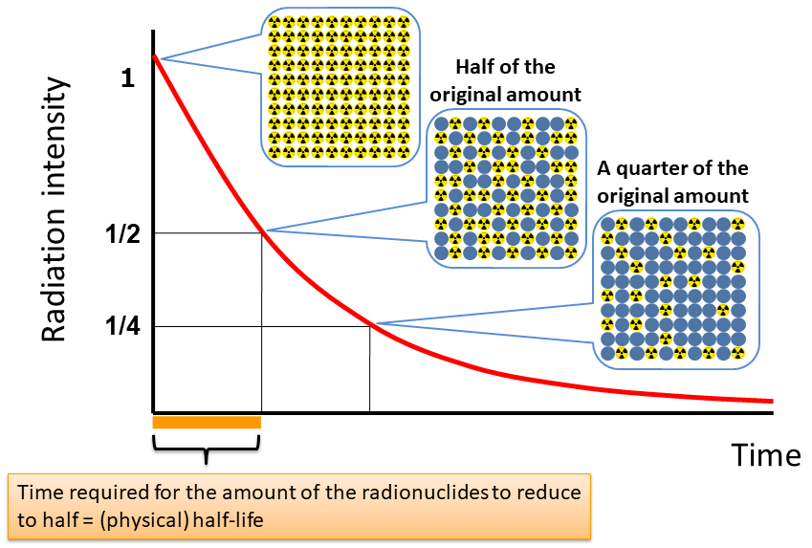
Radioactive Decay - Math
Review of 17.4
1st Order Kinetics
Integrated Rate Law
Rate Law
$$\ln\left(\frac{N_{t}}{N_{0}}\right)=−kt$$
Rate = k N
N₀ = # atoms time = 0
N_{t} = # atoms time = t
k = radioactive decay constant (s⁻¹)
t = time
k = radioactive decay constant (s⁻¹)
N = # of atoms
K = big → fast decay
= small → slow decay
Half Life (t_{1/2})
Units
$$t_{1/2}= \frac{0.693}{k}$$
1 Becquerel (Bq) = 1 disintegration/sec
1 Ci (Curie) = 3.7 x 10¹⁰ disintegration/sec
t_{1/2} = small → fast decay
= big → slow decay

Slide 7
Example:
1.000 g of ⁹⁰Sr decays to 0.953 g after 2.00 years
Calculate the ½ life
How much will remain after 5 years?
What is the initial activity in Bq and Ci?

Slide 9
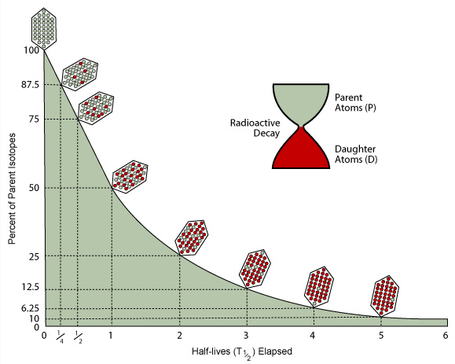
Radioactive Dating
More 1st order kinetics
Use decay rate of radioactive isotopes to determine age of substances
Ratio of Parent to Daughter atoms.

Slide 10
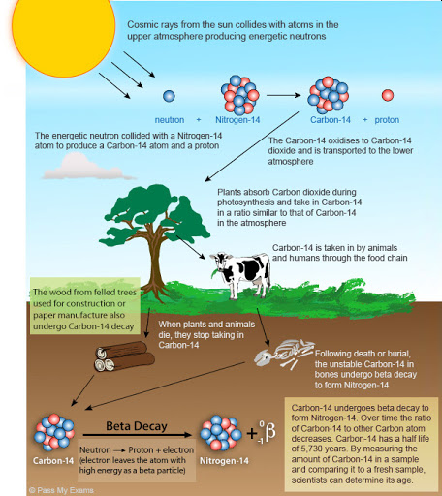
Carbon Dating
Make radioactive ¹⁴C
Incorporate into CO₂
Photosynthesis/Consume
Die/Decay
Ratio ¹⁴C/¹²C
t_{1/2} = 5730 years

Slide 11
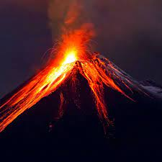
Example:
Determine the age of a volcanic eruption!
Charcoal formed in the eruption = 7 dis/min
Charcoal in a living tree = 15.3 dis/min
How long ago did the volcano erupt?

Slide 12
Example:
²³⁸U → ²⁰⁶Pb
t_{1/2} = 4.5 x 10⁹ years
A rock contains 0.257 mg of ²⁰⁶Pb for every 1.000 mg of ²³⁸U. How old is the rock?

