Slide 1
CHE 112 Spring 2021
Lecture 20 b/c – Nuclear Stability
Overview/Topics
Nuclear Stability
Nonradioactive/stable indefinitely
Radioactive/stable
Radioactive/unstable
What holds nucleus together
Strong nuclear force
General rules/magic numbers/even/odd
Belt of Stability
Decay patterns
Energy changes in chemical and nuclear reactions
Nuclear Binding Energy
Skills to Master
HW 20b and 20c
Read
OER 20.1-20.2

Slide 2
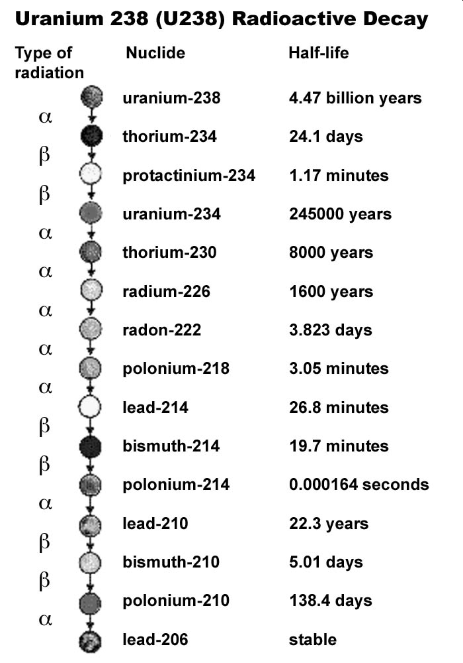
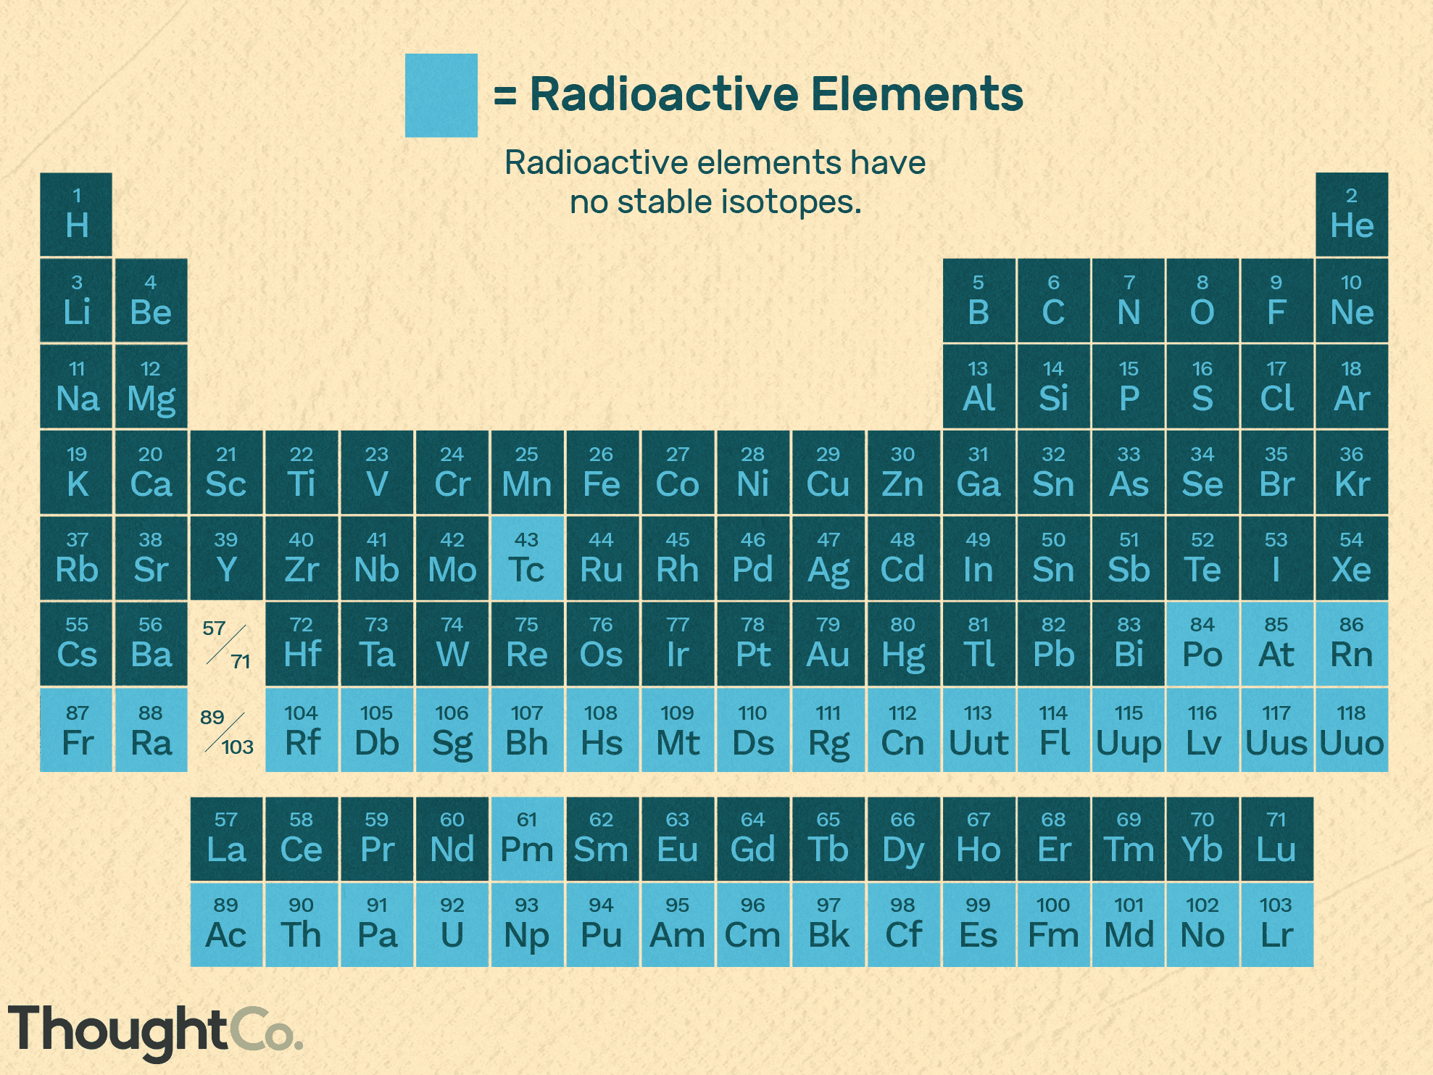
Nuclear Stability
Nonradioactive/Stable indefinitely
Radioactive/stable
Radioactive/unstable
250 stable isotopes out of ~3600 discovered

Slide 3
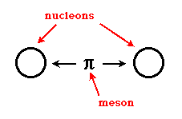
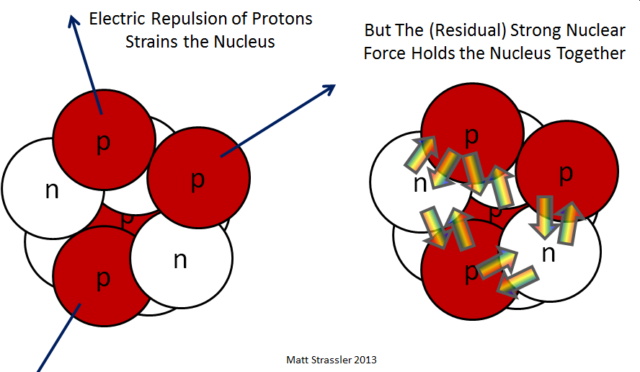
Why are nuclei stable/unstable?
https://aether.lbl.gov/elements/stellar/strong/strong.html
Learn Physics!
p/p interactions are repulsive (Coulombs Law)
The strong nuclear force overcomes p/p repulsion
Only occurs between nucleons (p and n)
Exchange of mesons
Very very very short range (~ rad of p/n)
Neutrons increase nuclear stability b/c no repulsions
All atoms with > 2 protons must have neutrons
# Neutrons ↑ faster that # protons↑

Slide 5
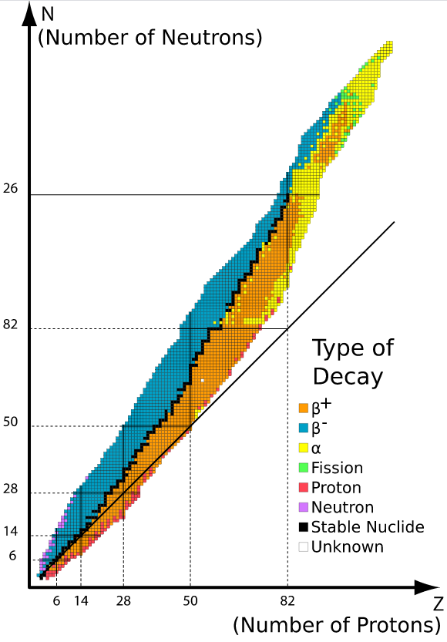
General Rules of Nuclear Stability
No single rule (unless you learn physics)
Many general observations
Belt of Stability
E < 20 protons have p/n ratio ≈ 1 (sometimes 1 more)
E > 20 protons have p/n ratio > 1 (curves upwards “rapidly”)
E > Pb-82/Bi-83 = unstable

Slide 6
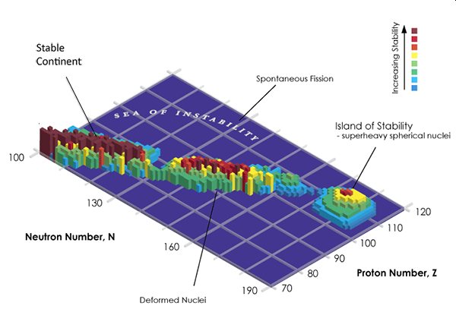
Island of Stability
> 82 E unstable, gradually decreases ½ life
114 protons
184 neutrons
First reported 1999
1st Island of Stability (90-92)
½ life ~ age of universe
https://physics.aps.org/articles/v5/115

Slide 7
General Rules of Nuclear Stability
Even/Odd Rule
Magic Numbers

Slide 8
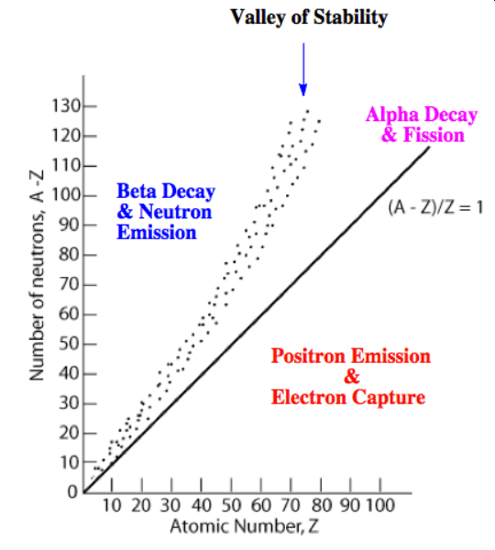
Radioactive Decay Patterns
Below the Band/Belt/Valley
Above the Band/Belt/Valley
Z > 84
α-emission
↓ p,n by 2
n/p ratio to HIGH
“Neutron Rich”
β-emission
n → p
Below the Band/Belt/Valley
n/p ratio to LOW
“Neutron poor”
Positron emission
Electron capture
p → n

Slide 9
Radioactive Decay Patterns
“another view”
Below the Band/Belt/Valley
Above the Band/Belt/Valley
Z > 84
α-emission
↓ p,n by 2
n/p ratio to HIGH
“Neutron Rich”
β-emission
n → p
Below the Band/Belt/Valley
n/p ratio to LOW
“Neutron poor”
Positron emission
Electron capture
p → n

Slide 10
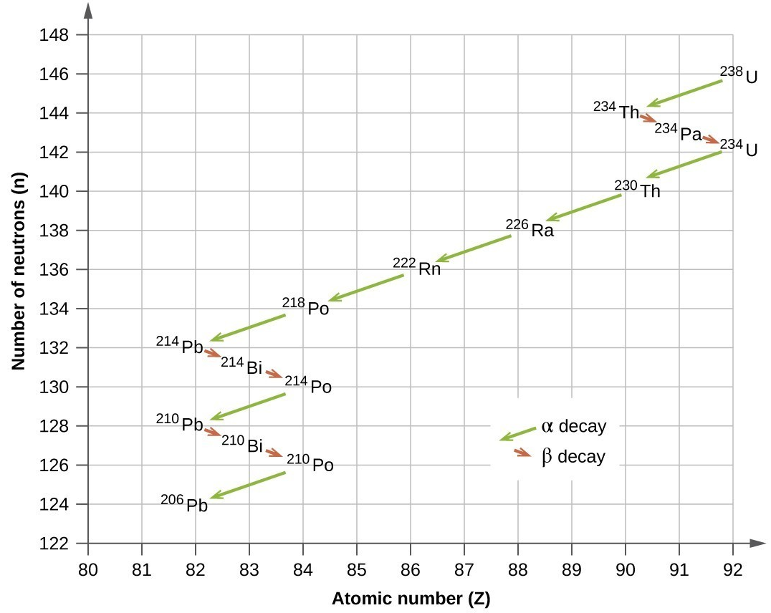
Example of Radioactive Decay Chain

Slide 11
Examples:
Write a decay reaction for each of the following:
(a) C-14 is above the belt of stability
(b) K-38 is below the belt of stability
(c) Ar-37 is below the belt of stability
(d) Pu-239 is below the belt of stability

Slide 12
Atoms form molecules to decrease energy
Nucleons form nuclei to decrease energy
Nuclear Stability - Math
Nuclear Binding Energy = energy gained when individual p/n form a nuclei.
Mass Defect = Small difference in mass of p/n and nuclei
Related by Einstein
E = mc²
C = speed of light (CF)
3.00 x 10⁸ m/s
Energy (kJ/mol)
“Binding Energy”
m = mass defect
m_{particle} - m_{atom}
Some useful masses
Some useful Conversion Factors
Mass proton = 1.0073 amu
Mass neutron = 1.0087 amu
Mass electron = 5.5 x 10⁻⁴ amu
1 amu = 1 gram/mol
$$J= \frac{Kg ∙m^{2}}{s^{2}}$$
(may or may not ignore e⁻)
1 eV = 1.60 x 10⁻¹⁹ J
1 MeV = 1.60 x 10⁻¹³ J

Slide 13
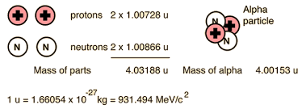
Example:
Ignored e⁻
Mass defect
4.03188 amu – 4.00153 amu = 0.03035 amu
E = mc²
$$\frac{0.03035 g}{mol}×\frac{1 kg}{1000g}×{\left(\frac{3.00 ×{10}^{8} m}{s}\right)}^{2}×\frac{1 J∙s^{2}}{m^{2}∙kg}=2.732×{10}^{12}J/mol$$
Calculate bind energy per nuclei
$$\frac{2.732 ×{10}^{12}J}{mol}×\frac{1 mol}{6.02×{10}^{23}nuclei}×\frac{1 MeV}{1.60×{10}^{−13} J}=28.36 MeV/nuceli$$
OER Book
Calculate bind energy per nucleon
$$\frac{28.36 MeV}{Nuclei}×\frac{1 Nuclei}{4 Nucleons}=7.09 MeV/nucleon$$
More Useful

Slide 14
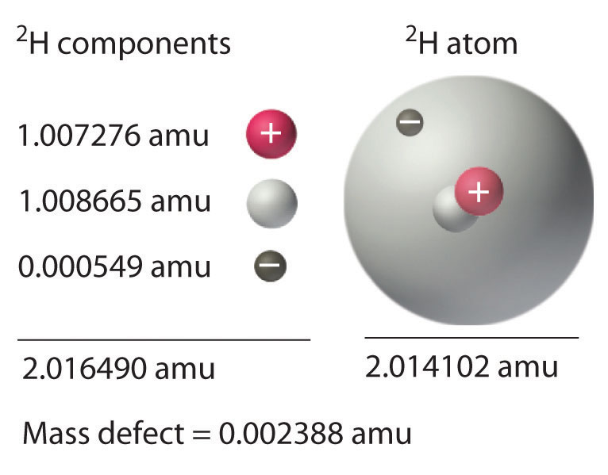
Example:
Include e⁻
Given the following information about Deuterium (²H)
Calculate the energy in J/mol
Calculate the Nuclear Binding Energy in MeV

Slide 16
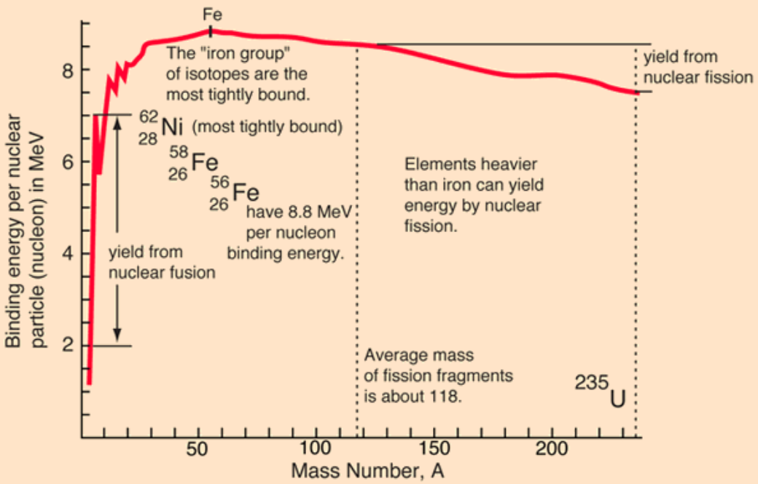
Binding Energy per Nucleon
Lecture 20e
Lecture 20e
http://hyperphysics.phy-astr.gsu.edu/hbase/NucEne/nucbin.html

Slide 17
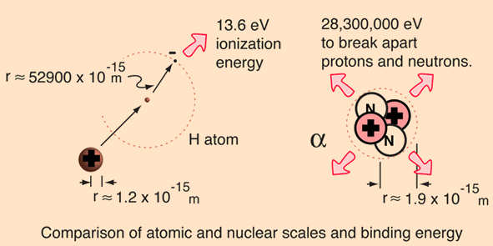
Chemical Reactions vs Nuclear Reactions
Factor of 2.1 million!
Must overcome
Coulombs Law
Must overcome
Strong Nuclear Force

Slide 18
If time permits…
Example:
Given the following chemical reaction and nuclear reaction.
Calculate the mass change in the chemical reaction
Calculate the energy change in the nuclear reaction
Compare!
C (s) + O₂ (g) → CO₂ (g) ΔH = -393.15 kJ
$${}_{92}^{238}U →{}_{90}^{234}{Th}+{}_{2}^{4}{He}$$
238.0003
amu
233.9942
amu
4.0015
amu

Slide 19
Energy and Mass Changes in Chemical
Reactions vs Nuclear Reactions
Mass change in chemical reaction
C (s) + O₂ (g) → CO₂ (g) ΔH = -393.15 kJ
$$m= \frac{E}{c^{2}}=\frac{−393.5 kJ}{mol}×\frac{1000 J}{1 kJ}×\frac{kg ∙m^{2}}{J∙s^{2}}×{(\frac{s}{3.00×{10}^{8} m})}^{2 }=−4.37×{10}^{−12} kg$$
$${}_{92}^{238}U →{}_{90}^{234}{Th}+{}_{2}^{4}{He}$$
Energy change in nuclear reaction
238.0003
amu
233.9942
amu
4.0015
amu
$$∆E={∆mc}^{2}=\frac{−0.0046g}{mol}×\frac{1 kg}{1000 g}×{\left(\frac{3.00 ×{10}^{8} m}{s}\right)}^{2}×\frac{1 J∙s^{2}}{m^{2}∙kg}×\frac{1 kJ}{1000 J}=−4.11×{10}^{8}kJ$$
Atoms form molecules to decrease energy
Nucleons form nuclei to decrease energy

Slide 20
Chemical Reaction
Nuclear Reaction
1 mol C
-393.15 kJ
−4.37 × 10⁻¹² kg
1 mol U
−4.11 × 10⁸ kJ
0.0046 g
v.s.
Conservation Laws
Conservation of Mass
Conservation of Energy
Neither mass nor energy is conserved individually, the law really should say Conservation of Mass AND Energy

