Slide 1
CHE 112 Spring 2021
Lecture 20a – Nuclear Chemistry Basics
Overview/Topics
Nuclear Reactions
Differences between Chemical Reactions and Nuclear Reactions (7)
Types of Radiation (6)
Types of Reactions (4)
Skills to Master
HW 20a
Read
OER 20.2-20.3

Slide 2
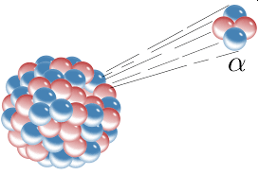
Nuclear Chemistry
Study of reactions involving the changes in the nuclei of atoms.
Changes in # of protons, neutrons and electrons
Crossroads of chemistry and physics
Important Uses
Radioactive Decay (Carbon dating)
Transmutation (discover new E)
Nuclear Energy (and bombs)
Commercial uses
Smoke detectors
Density meters
Scientific uses
Neutron scattering
Chemotherapy
Isotope Doping
Health effects of Exposure

Slide 3
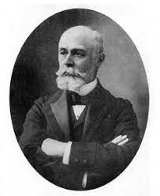
Henri Becquerel
March 1896 – uranium salts emit radiation
The story of Becquerel’s discovery is a well known example of an accidental discovery. Somewhat less well known is the fact that forty years earlier, someone else had made the same accidental discovery. Abel Niepce de Saint Victor, a photographer, was experimenting with various chemicals, including uranium compounds. Like Becquerel would later do, he exposed them to sunlight and placed them, along with pieces of photographic paper, in a dark drawer. Upon opening the drawer, he found that some of the chemicals, including uranium, exposed the photographic paper. Niepce thought he had found some new sort of invisible radiation, and reported his findings to the French Academy of Science. No one investigated the effect any further until decades later when Becquerel repeated essentially the same experiment on that gray day in March 1896.
https://www.aps.org/publications/apsnews/200803/physicshistory.cfm

Slide 4
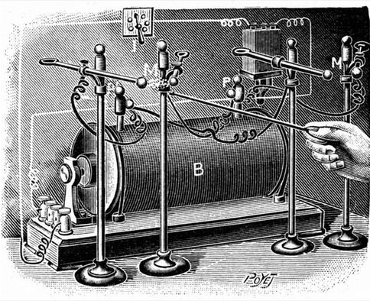
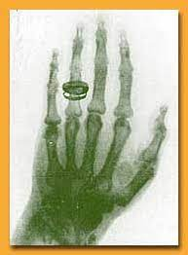
Marie Curie
(1867-1934)
1903 Nobel Prize (with husband and Henry Becquerel)
1911 Nobel Prize (for discovery of Po/Ra)
First person to win/share 2 Nobel prizes (and in diff fields)
Observed tumor cells died faster than healthy cells when exposed to radiation
X-rays for imaging broken bones and medical treatments
Cm – Curium named after her
https://en.wikipedia.org/wiki/Marie_Curie

Slide 5
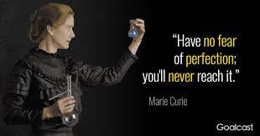

Slide 6
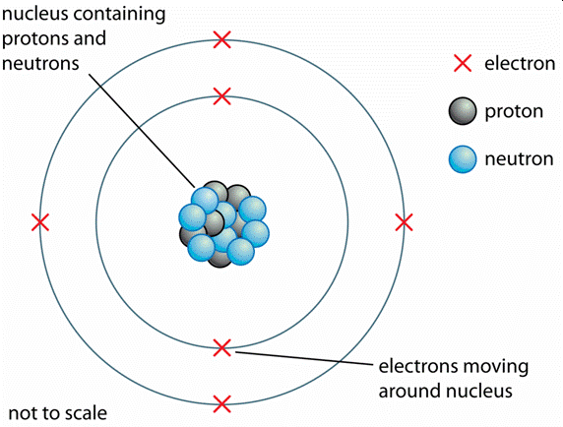
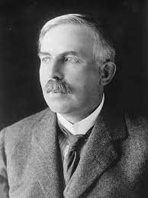
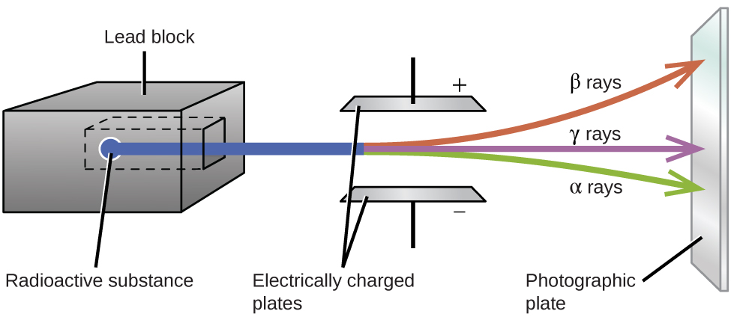
Ernest Rutherford
https://en.wikipedia.org/wiki/Ernest_Rutherford
Father of Nuclear Physics
Named α and β particles
Discovered ½ life
1908 Nobel Prize
Rutherford Model – 1911
Rf-104 Rutherfordium
(1871-1937)
New Zealand

Slide 7
Review – Isotopes
same # protons
diff # neutrons
Chemistry
Mass Number = #p + #n
Charge = #p- #e
A
X
e
Z
Atomic Number = #p
Nuclear Chemistry
A
X
Mass Number = #p + #n
Z
Atomic Number = #p
or “charge”
Lecture 20 c – Nuclear Stability

Slide 8
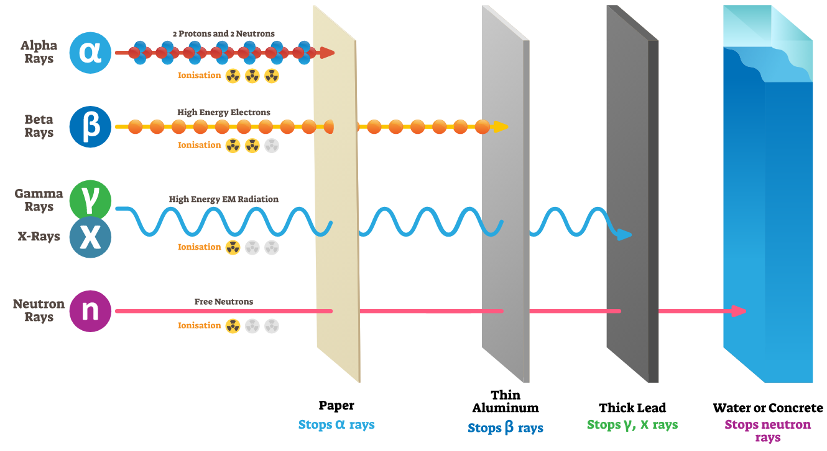
6 Types of Radiation
Many more types we will not talk about…
Lecture 20 d Health Effects

Slide 9
Chemical Reactions
vs
Nuclear Reactions
1
Changes in e⁻ around/between atoms
Elements stay the same
Changes in p/n in nucleus
Elements change
2
Different Isotopes have same reaction
(Except H₂, D₂, T₂)
Different isotopes often undergo different reactions
3
Rate of reaction effected by:
T and P
Rate of reaction NOT effected by:
T and P
3
Molecule/Compounds are important
(H₂O does not react like H₂O₂)
Molecules/Compound are NOT important.

Slide 10
Chemical Reactions
vs
Nuclear Reactions
5
Small Energy Changes
1 g CH₄ + O₂ → 56 kJ
Large Changes in Energy
1 g ²³⁵U → 8.2 x 10⁷ kJ
6
Conservation of Mass (and Energy)
Mass R = Mass P
Conservation of Atomic Number (p/n)
Mass R ≠ Mass P
7
Types of Reactions (Mechanism):
SD, DD, etc.
Types of Reactions:
α-emission, β-decay etc.

Slide 11
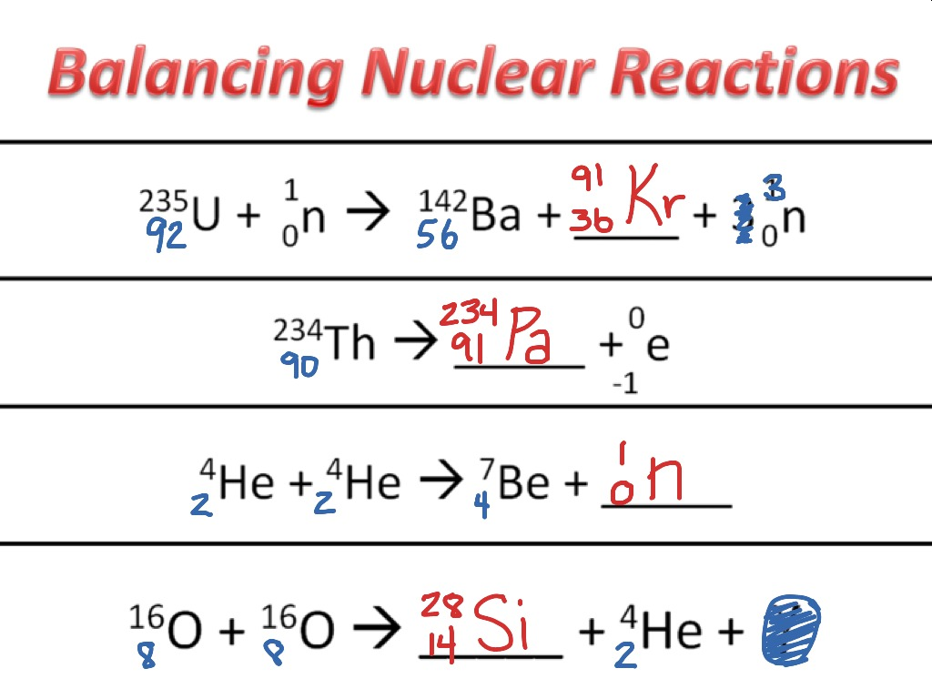
Writing Nuclear Reactions
Mass # is conserved R = P
Atomic # is conserved R = P
Charges are conserved R = P
Independent of states (ignore)
Ignore electrons (of E)
Ignore γ (energy, does not effect mass balance)
Example:
Complete the following reactions:
$${}_{84}^{212}{Po → {}_{82}^{208}{Pb+ _______}}$$

Slide 12
4 Types of Reactions
Alpha Decay (α-emission)
$${}_{92}^{238}{Po → {}_{82}^{234}{Th+{}_{2}^{4}{He}}}$$
Lose 2p
Gain 2 n
A: ↓ 4
Z: ↓ 2
Beta Decay (β-emission)
$${}_{53}^{131}{I → {}_{54}^{131}{Xe+{}_{−1}^{0}e}}$$
n → p
Lose n
Gain p
A: ---
Z: ↑ 1
OER Figure 20.7

Slide 13
4 Types of Reactions
Positron Emission
$${}_{19}^{40}{K → {}_{18}^{40}{Ar+{}_{+1}^{0}e}}$$
p → n
Lose p
Gain n
A: ---
Z: ↓ 1
Electron Capture
$${}_{80}^{197}{Hg+ {}_{−1}^{0}e→ {}_{79}^{197}{Au}}$$
p → n
Lose p
Gain n
A: ---
Z: ↓ 1
OER Figure 20.7

Slide 14
Example:
Complete the following reactions:
(a) Ra-226 undergoes α-decay
(b) Hg-201 undergoes electron capture
(c) What type of decay occurs when Th-231 decays to form Pa-231

Slide 15
Example:
Complete the following reactions:
(d) What element is created when O-15 undergoes positron emission
(e) What element undergoes α-decay to form Pb-208

Slide 17
Wilhelm Conrad Roentgen
Crookes tubes he had been using to study cathode rays emitted a new kind of invisible ray that was capable of penetrating through black paper. The newly discovered x-rays also penetrated the body’s soft tissue, and the medical community immediately recognized their usefulness for imaging.

Slide 18
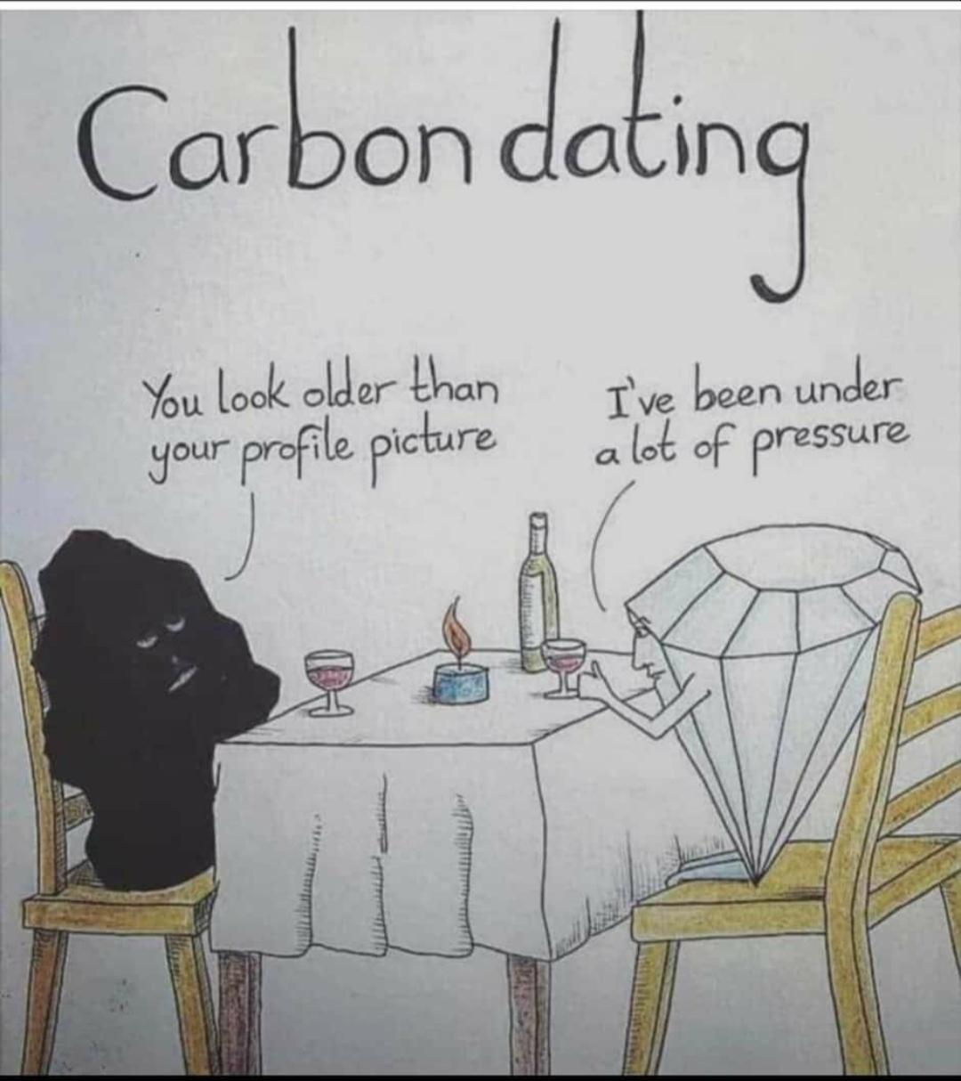
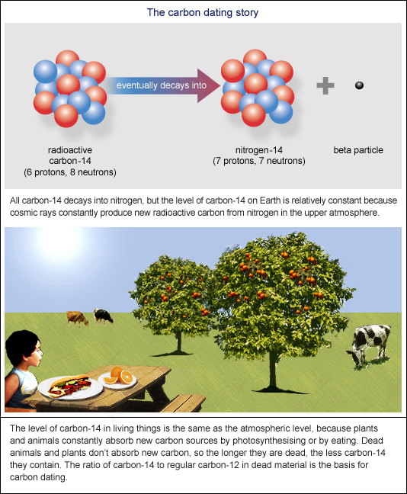
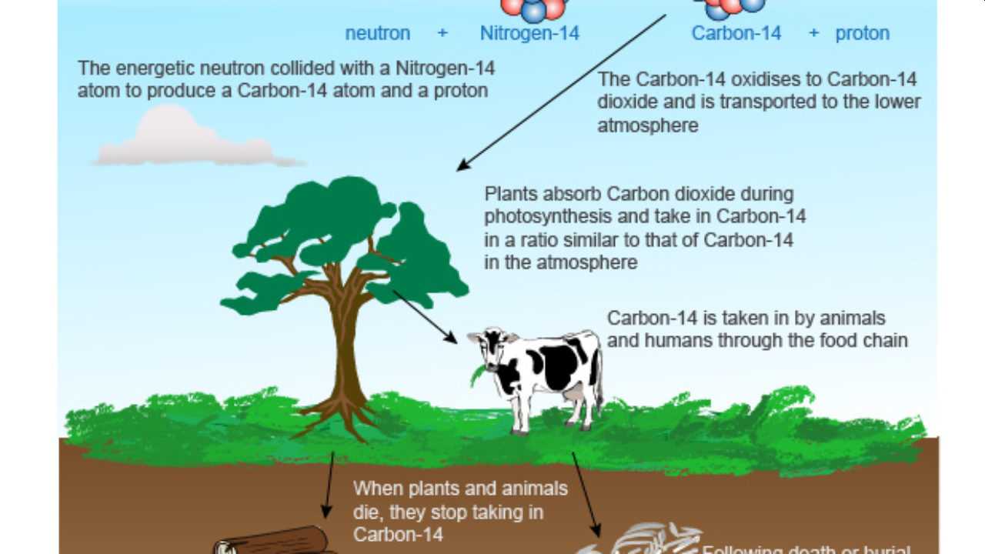
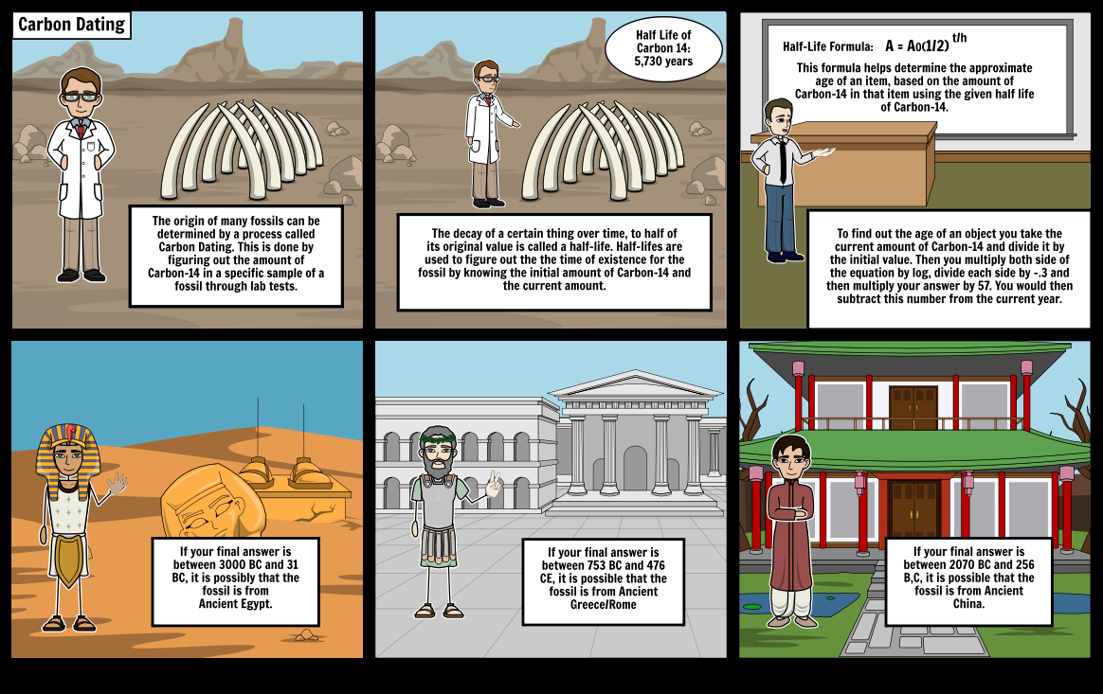

Slide 20
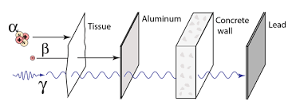

Slide 21
