Slide 1
CHE 112 Spring 2021
Lecture 17d – IMF and Liquids
Overview/Topics
Goal – Deeper Understanding of What happens in chemical reactions
Terminology
Rate mechanism
Elementary step
Rate Limiting step
Intermediates
Catalyst
Molecularity
Equilibrium
Theoretical vs Experimental Rate law
Relationship between Kinetics and Equilibrium
Final Result – “It’s complicated”
Skills to Master
HW 17d
Read
OER 17.6-17.7

Slide 2
Reaction Mechanism
Reactants rarely turn directly into the products in a reaction
Sequence of steps that describe the pathway from R to P
Explains difference between experimental rate law and theoretical rate laws
Provides insight into what “really” occurs
Can improve reactions
Faster/Slower
Predictive outcomes
Find new pathways or catalysts
Apply results to harder/more complicated reactions
Single Step
Two Steps
A + B
D
A + B
C
C + C
D

Slide 3
Molecularity
Unimolecular (1)
Number of reactant species (atoms, molecules or ions)
number of R that “collide” to react
A Products
Rate = k[A]
Bimolecular (2)
A + A Products
Rate = k[A]²
or
A + B Products
Rate = k[A][B]
Termolecular (3)
*Rare/Unlike, but can occur
Will ignore.

Slide 4
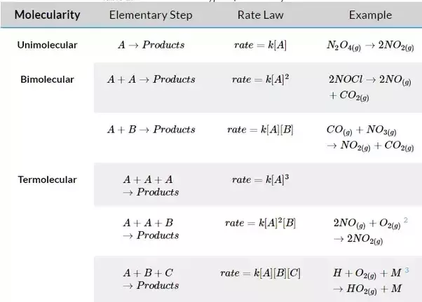
Molecularity

Slide 5
More Information!
Reaction Intermediate
Catalyst
Created in one step, destroyed in another
Does not appear in the overall reaction
Can’t appear in the rate law
Destroyed in one step, created in another
Does not appear in the overall reaction
Can appear in the rate law
A + B
C
A + B
C
A + C
C + A
B + D
D
2 A + B
D
2 A
D
Equilibrium
A + B C
Reaction Intermediate CAN NOT appear in the rate law, Catalysts can even though not in overall reaction
Rate (f) = k_{f}[A][B]
Rate (r) = k_{r}[C]

Slide 6
Elementary Steps (ES)
Single step in a reaction
Describes a singular event (reaction (1 collision, 1 decomposition, 1 bond broken, 1 bond made etc)
Sum of ES = overall reaction
Mechanism from ES must be consistent with rate laws
**Exponent of rate law = coefficient of ES**
Overall Reaction
Two Steps
A + B
C
Rate = k[A][B]
A + B + C
D
v.s.
C + C
D
Rate = k[C]²
Rate = k[A]^{m}[B]^{n}[C]^{p}
**can’t determine m,n,p from overall reaction
A + B + C
D
Can’s say until next slide!

Slide 7
Rate Determining Step
Experimental:
(Method of Initial Rates)
Rate = k[A]^{m}[B]^{n}[C]^{p}
SLOWEST step in a reaction
Limits the reaction rate (controls the reaction)
Rate Equation determined from this step
“Traffic Jam” or “Bottle Neck”
Theoretical (can be more than one theory)
Two Steps
A + B
C
(Slow)
(Fast)
Or
C + C
D
(Fast)
(Slow)
A + B + C
D
Rate = k[A][B]
Rate = k[C]²
Experimental and Theoretical should result in the same rate law

Slide 8
Experimental Rate Law
Example:
2 O₃ (g) 3 O₂ (g)
Rate = k[O₃]¹
Single step reaction – both molecules collide and break up to make 3 molecules
Can also calculate chance of 2 molecules colliding with enough energy to break apart, and it does not match the experiment
Theoretical Rate Law
Rate = k[O₃]²
Two step reaction
O₃ (g) O₂ (g) + O (g)
(Slow Decomposition)
O + O₃ (g) 2 O₂ (g)
(Fast Collision)
2 O₃ (g) 3 O₂ (g)
Theoretical Rate Law
Rate = k[O₃]¹
Bonus: ID any Reaction Intermediates or Catalysts

Slide 9
Example:
For the following reaction:
ID any Reaction Intermediates or Catalysts
Write the rate law assuming the first reaction is slow:
Step 1:
A + B
C
Step 2:
A + C
D
Overall:
2 A + B
D

Slide 10
Example:
For the following mechanisms
Write the rate law for a single step reaction
Write the rate law based on the mechanism provided
ID any Reaction Intermediates or Catalysts
Which is the correct mechanism?
Experimental Rate Law:
Rate = k[NO₂]²
Single Step Rate Law:
Two Step Rate Law:
Slow
Fast

Slide 11
A more complicated example…
https://www.youtube.com/watch?v=lXnCouGBvyE
Reaction: 2 N₂O₅ (g) 4 NO₂ (g) + O₂ (g)
Expt. Rate Law: k[N₂O₅]
Proposed Mechanism (3 Steps, with an equilibrium!)
Bonus: ID Reaction Intermediates + Catalysts
k₁
Step 1:
2 N₂O₅ (g)
2 NO₂ + 2 NO₃
(fast equilibrium)
k₋₁
k₂
Step 2:
NO₂ + NO₃
NO + NO₂ + O₂
(slow)
k₃
Step 3:
NO₃ + NO
2 NO₂
(fast)
Overall Reaction:
Rate Law:
BUT……

Slide 12
k₁
Step 1:
2 N₂O₅ (g)
2 NO₂ + 2 NO₃
(fast equilibrium)
k₋₁
k₂
Step 2:
NO₂ + NO₃
NO + NO₂ + O₂
(slow)
k₃
Step 3:
NO₃ + NO
2 NO₂
(fast)
Overall Reaction:
2 N₂O₅ (g) 4 NO₂ (g) + O₂ (g)
Rate Law:
Rate = k₂[NO₂][NO₃]
BUT……need to rewrite w/o intermediates

Slide 14
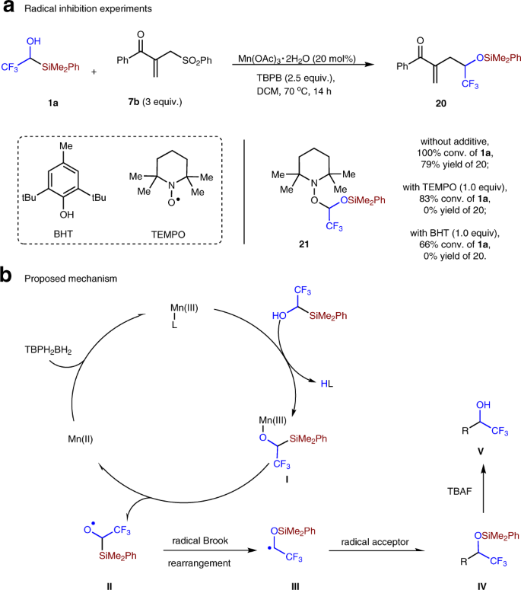
Real Life Examples
To support a reaction mechanism/theory:
Look for reaction intermediates
Alter the reaction to test predictions
Add “extra” molecules
Many Experimental techniques
Isotope doping
NMR
IR/UV spectroscopy
List is almost endless

Slide 15
Isotope Doping:
Use a radioactive element to provide insight into a reaction mechanism or trace a reaction mechanism
O
O
=
=
CH₃-C---O---CH₃
+ H₂O¹⁸
CH₃-C-OH
+ CH₃OH
Which bond breaks?
Two possible products depending on which bond breaks?
O
=
¹⁸
¹⁸
CH₃-C-OH
+ HO-CH₃
Experimentally only the first product is found
Therefore bond #1 is broken.

Slide 16
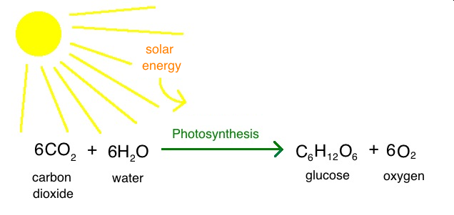
Example
Photosynthesis
Where does the O₂ produced come from?
CO₂
H₂O
How would you design the experiment?

Slide 17
Answer:
18
18
Perform two experiments, doping the CO₂ in the first experiment and the H₂O in the second.
After performing the experiment the O₂ produced is radioactive only if the H₂O was doped
18
18
18
18

