Slide 1
CHE 112 Spring 2021
Lecture 17c – Collision Theory
Overview/Topics
Factors effecting reaction rates
States (s,l,g)
Temperature
Concentration
Catalyst
Collision Theory
Arrhenius Equation
Solving problems
Graphing problems
Catalysts
Skills to Master
HW 17c
Read
OER 17.3 and 17.5
https://www.chemguide.co.uk/physical/basicratesmenu.html#top

Slide 2
4 Factors Affecting Reaction Rates
Review – Solubility
Review – Activation Energy
Review – Solubility
Review - Energy
Physical States
s, l, g
Particle Size
Temperature
Concentration of [R]
Presence of a Catalyst

Slide 3
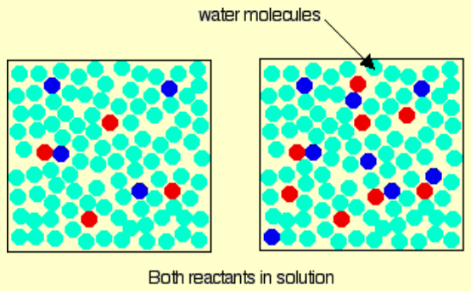
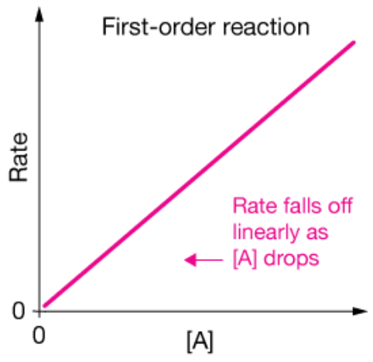
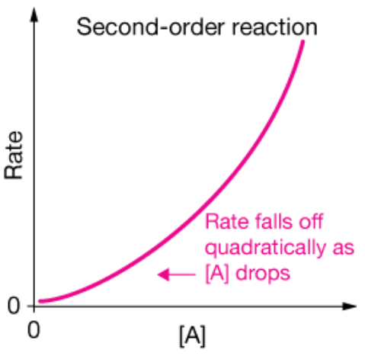
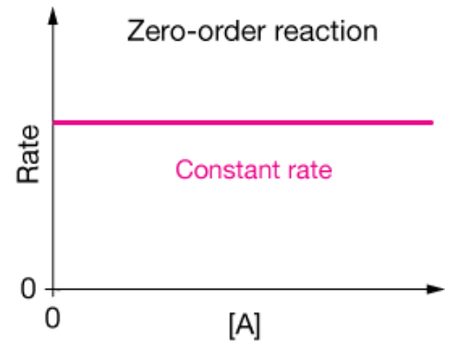
Concentration
Reactions occur when molecules interact (contact each other)
More molecules = more reactions

Slide 4
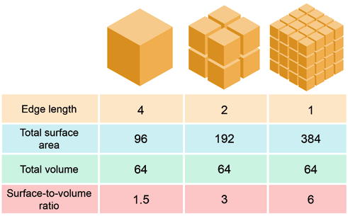
Physical States
Reactions occur when molecules interact (contact each other)
Solid < liquid < gas (KE of molecules)
Small vs Large particle size (Surface area)
v.s.

Slide 5
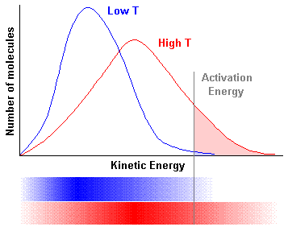
Temperature
Exothermic
Molecules must have enough energy to break/make bonds
Activation Energy
↑Temp = ↑# molec. with AE
Rule of Thumb ↑ 10 °C = ↑ Rate x2
Distribution of Energy with Temperature
Endothermic

Slide 6
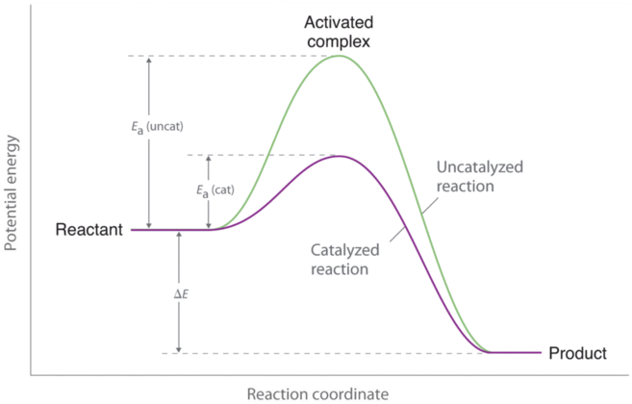
Catalyst
Speed up reactions by providing a new, lower energy reaction pathway or Transition state
Chemical Catalysts (metals, acidic, basic conditions etc)
Biological Catalysts (Enzymes)
Could write an entire book on it!
Transition State
Intermediate State
Activated Complex
E_{A} (uncat)
E_{A} (cat)
ΔH

Slide 7
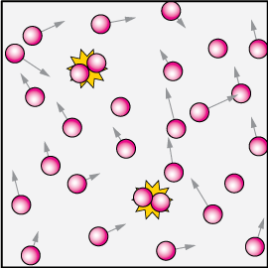
Collision Theory
“3 Primary Factors”
1
Reactions occur when molecules interact (collide)
Rate is DP to # collisions (Z)
Flaw:
Based on Kinetic Molecular Theory of Gases (Ch. 8)
≈ 1 x 10²⁷ binary collisions in 1 mL/sec
Assumes 1/3 are A-A, 1/3 are B-B and 1/3 are A-B ≈ 1 x 10⁹
Predicts k = 10⁻⁹ many reactions are much much slower
2
Only collisions with the proper orientation can occur
Stearic Factor (p)
v.s.
Flaw:
Reactions still too fast
d/n explain temperature dependence

Slide 8
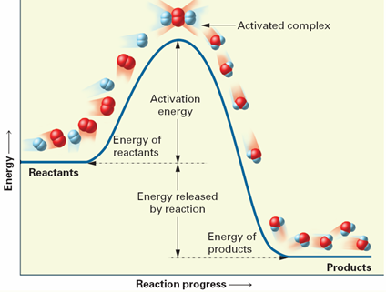
Only collisions with the proper energy can occur
Must overcome e⁻/e⁻ repulsions
Must break and make bonds
3
Transition State
Intermediate State
Activated Complex
E_{A}
and
ΔH
# collisions with E_{A} > RT is given by
Example:
R = 8.314 J/K·mol
T = temp (K)
E_{A} = kJ/mol
Assume E_{A} = 75 kJ/mol results in f = 7 x 10⁻¹⁴
or 7 in 1 trillion collisions lead to a reaction
$$f= e^{−{E_{A}}/{RT}}$$

Slide 9
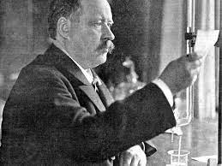
Arrhenius Equation
Svante Arrhenius (1859-1927)
Proposed theory in 1889
Nobel Prize in 1903
Acids/Bases
Cation/Anions
Climate Change
$$f= {p Z e}^{−{E_{A}}/{RT}}$$
p = stearic factor
Z = collision frequency
Last term = Fraction of collisions with enough E to react
https://www.thoughtco.com/svante-arrhenius-4137940
$$K= {Ae}^{−{E_{A}}/{RT}}$$
General Form
A = “pZ” – frequency factor
E_{A} = Activation Energy (kJ/mol)
R = 8.314 J/mol·K
T = Temp (K)
$$\ln{K= \frac{{−E}_{A}}{R} \frac{1}{T}+\ln{A}}$$
Graphing
Form
Ratio
Form
$$\ln\left(\frac{k_{1}}{k_{2}}\right)= \frac{E_{A}}{R} \left(\frac{1}{T_{2}} −\frac{1}{T_{2}}\right)$$

Slide 10
Example:
A reaction with E_{A} = 50.2 kJ/mol has a rate constant of k = 3.46 x 10⁻² s⁻¹ at 298 K.
Is the reaction 0th, 1st or 2nd order?
What is the rate constant at 350 k?
$$\ln\left(\frac{k_{1}}{k_{2}}\right)= \frac{E_{A}}{R} \left(\frac{1}{T_{2}} −\frac{1}{T_{2}}\right)$$

Slide 12
Example:
Temp (K) k (M/s)
462.9 2.52 x 10⁻⁵
472.1 5.25 x 10⁻⁵
503.5 6.30 x 10⁻⁴
524.4 3.16 x 10⁻³
Given the following experimental data for a reaction
Is the reaction 0th, 1st or 2nd order?
Make an Arrhenius plot
Calculate E_{A}
What is the rate constant at 430.0 K
$$\ln{K= \frac{{−E}_{A}}{R} \frac{1}{T}+\ln{A}}$$
Graphing
Form

Slide 13
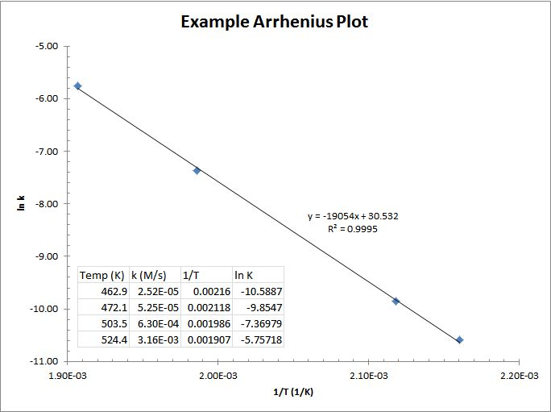

Slide 16
Relationship between Reaction Rates and Equilibrium
A ↔ B
For a 1st order reaction at equilibrium
Rate (forward) = K_{f} [A]
and
Rate (reverse) = K_{r} [B]
At Equilibrium
rate forward reaction = rate of the reverse reaction
and
Equilibrium Equation
Rate (forward) = Rate Reverse
K_{f} [A] = K_{r} [B]
$$K_{eq}= \frac{[B]}{[A]}$$
Rearrange Eqn.
$$\frac{k_{f}}{k_{r}}= \frac{[B]}{[A]}$$
$$\frac{k_{f}}{k_{r}}= K_{eq}$$

