Slide 1
CHE 112 Spring 2021
Lecture 17b – Integrated Rate Laws
Overview/Topics
Integrated Rate Laws
Graphing
Half-Life
Skills to Master
HW 17b
Read
OER 17.4

Slide 2
Integrated Rate Laws
Rate Laws: [reactants] vs rate
Integrated Rate Laws : [reactants] vs time
Three Rate Laws
1st Order
2nd Order
0th Order
Type of Problems
Integrated Rate Laws
Solve for initial [ ]
Solve for final [ ]
Solve for time
Solve for rate order constant
Solve for ½ life
Graphing
y=mx+b
Slope
Determine type of reaction

Slide 3
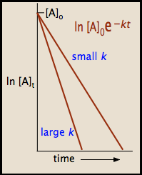
First Order Reaction's
A → B
$Rate= \frac{−∆[A]}{∆t}$ = k[A]
Ugly Calculus
$$\ln\left(\frac{{[A]}_{t}}{{[A]}_{0}}\right)=−kt$$
$$\ln{{[A]}_{t}= e^{−kt}}$$
$$\ln{{[A]}_{t}=−kt+ln{[A]}_{0}}$$
[A]_{t} = [ ] at a specific time
[A]₀ = initial conc.
K = constant (1/s or s⁻¹)
t = time
Equations on CS

Slide 4
Example:
The decomposition of cyclopropane is a 1st order chemical reaction with a rate constant = 6.7 x 10⁻⁴ s⁻¹ at 500 K
Given [X]₀ = 0.25 M, what is the [ ] after 8.8 minutes?
How long will it take for the concentration to change from 0.25 M to 0.15 M?
How long will it take to decrease to 74% of the initial value?

Slide 6
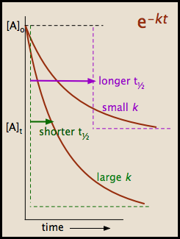
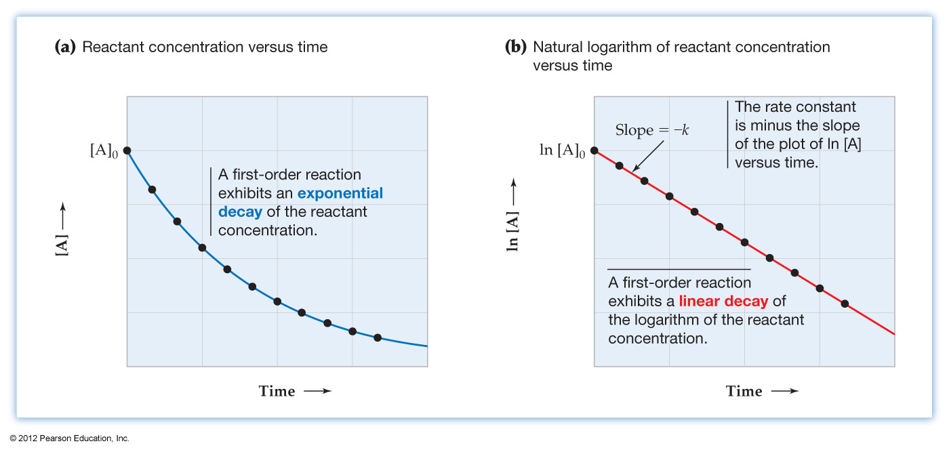
Graphing 1st Order Reactions
$$\ln{{[A]}_{t}=−kt+ln{[A]}_{0}}$$
$$y = mx + b$$

Slide 7
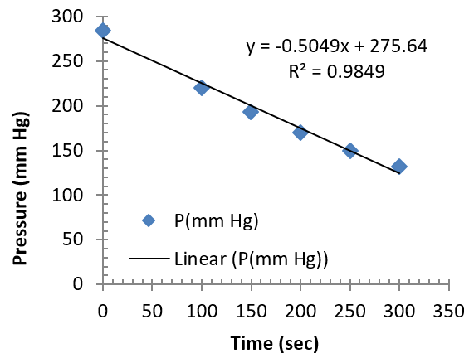
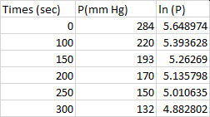
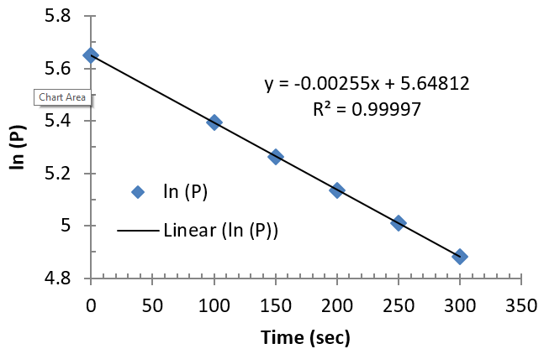
Example:
In lab the following data was collected for the decomposition of azomethane:
$$k=−slope=2.55 ×{10}^{−3} s^{−1}$$

Slide 8
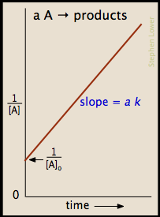
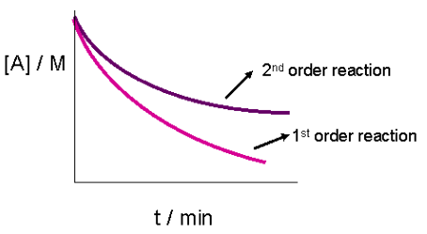
2nd Order Reactions
[A]_{t} = [ ] at a specific time
[A]₀ = initial conc.
K = constant (1/M·s or M⁻¹ ·s⁻¹)
t = time
2A → B
Ugly Calculus
$$\frac{1}{{[A]}_{t}}=kt+ \frac{1}{{[A[}_{0}}$$
Rate = k[A]²
$$y = mx+ b$$
Equations on CS

Slide 9
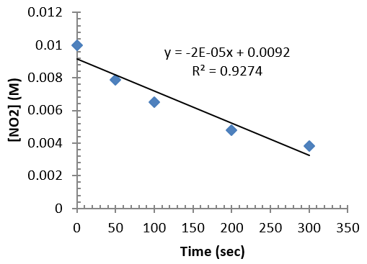
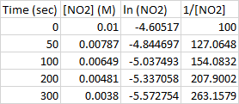
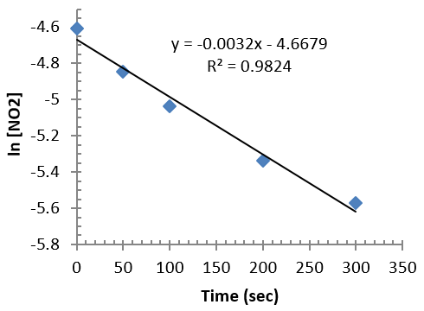
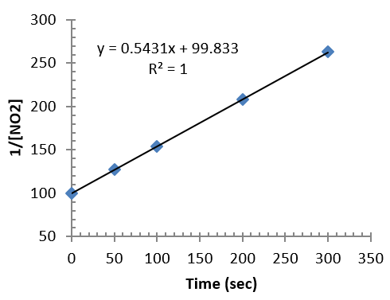
Example:
In lab the following data was collected for the reaction of NO₂:
2 NO₂ (g) → N₂O₄ (g)

Slide 10
Example:
The reaction of individual iodine atoms to form diatomic iodine gas is a second order reaction with k = 7.0 x 10⁹ 1/M·s at 23°C
I (g) + I (g) → I₂ (g)
If the initial concentration of [I] = 0.086 M, what is the [I] after 2.0 minutes?
If the initial concentration of [I] = 0.60 M, ow long does it take for 50% of the [I] to react?

Slide 12
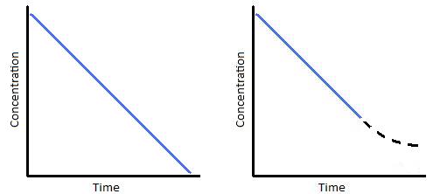
[A]_{t} = [ ] at a specific time
[A]₀ = initial conc.
K = constant (M/s or M·s⁻¹)
t = time
0th Order Reactions
A → B
Ugly Calculus
Rate = k[A]⁰ = k
$${[A]}_{t}=−kt+ {[A]}_{0}$$
$$y = mx+ b$$
Equations on CS

Slide 13
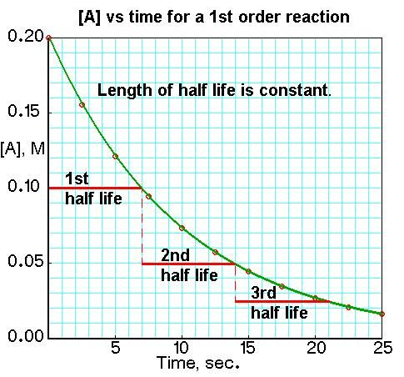
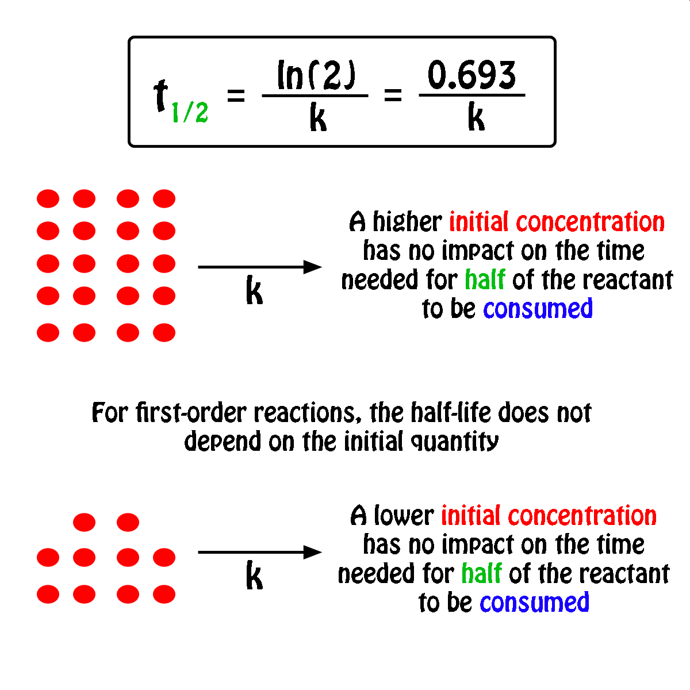
Half-Life ( ½-life)
Alternative format of representing the rate constant (k)
Amount of time required to decrease initial concentration by ½
Often more “intuitive”
Used often in nuclear chemistry (Ch. 20)
First Order Reactions

Slide 14
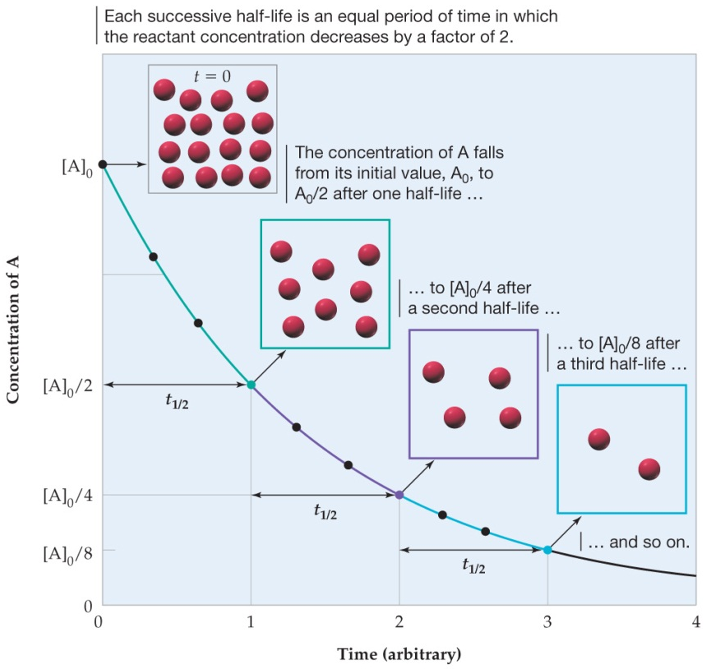
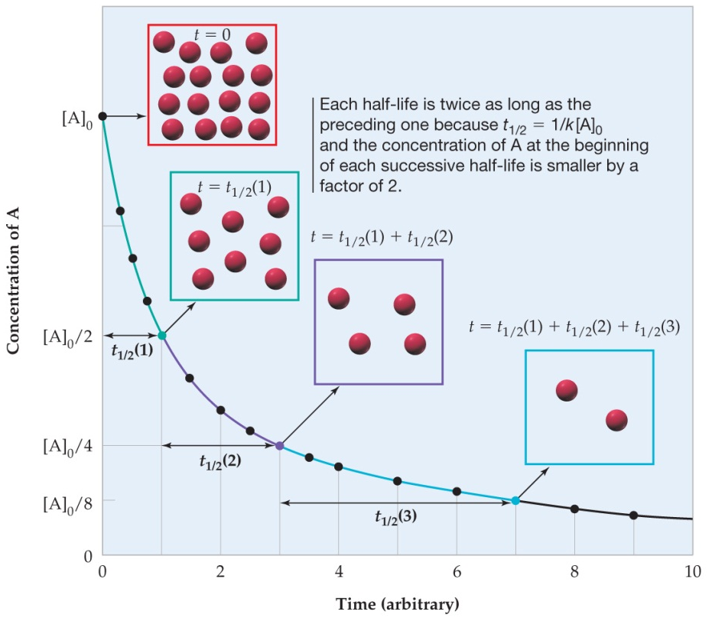
0th Order
1st Order
2nd Order
$$\frac{{[A]}_{0}}{2 k}$$
$$\frac{0.693}{k}$$
½ life =
$$\frac{1}{k{[A]}_{0}}$$
½ life =
½ life =
t_{1/2} : DP to the initial [ ]
t_{1/2} : Indept. of initial []
t_{1/2} and K are IP (short ½ = larger k)
t_{1/2} : IP to the initial [ ]
t_{1/2} : ↑ as [ ] ↑
Equations on CS

Slide 15
Example:
Calculate the ½ life (in minutes)of a 1st order reaction given k = 5.36 x 10⁻⁴ s⁻¹ at 700. K

Slide 16
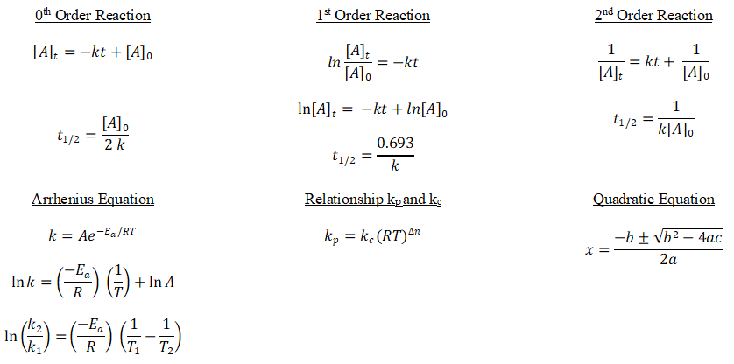
Cheat Sheet
You need to know:
How to graph!

Slide 17
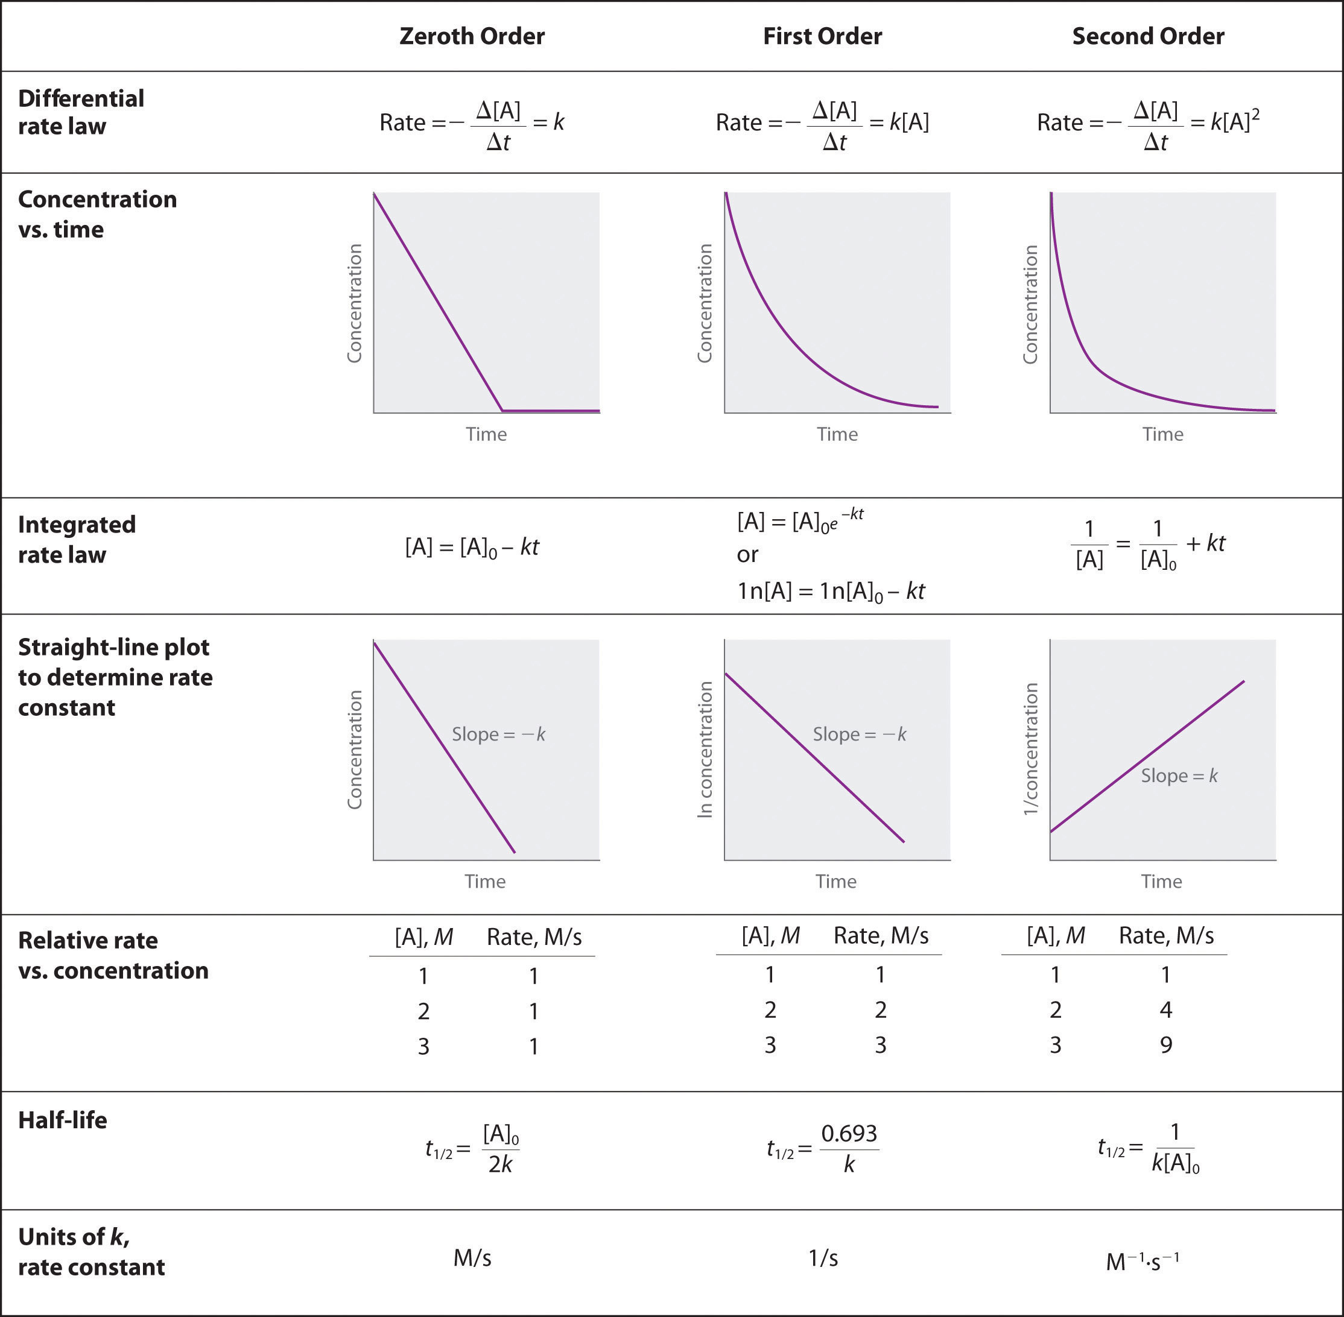
Good Review

