Slide 1
CHE 112 Spring 2021
Lecture 17a – Kinetics
Overview/Topics
Terminology
Rate of reaction
Rate expression
Instantaneous rate
Initial rate
Average rate
Rate Equation Relationships (Relative rates)
Rate Laws
Reaction orders
Overall reaction order
Method of Initial Rates
Skills to Master
HW 17a
Read
OER 17.1-17.3

Slide 2
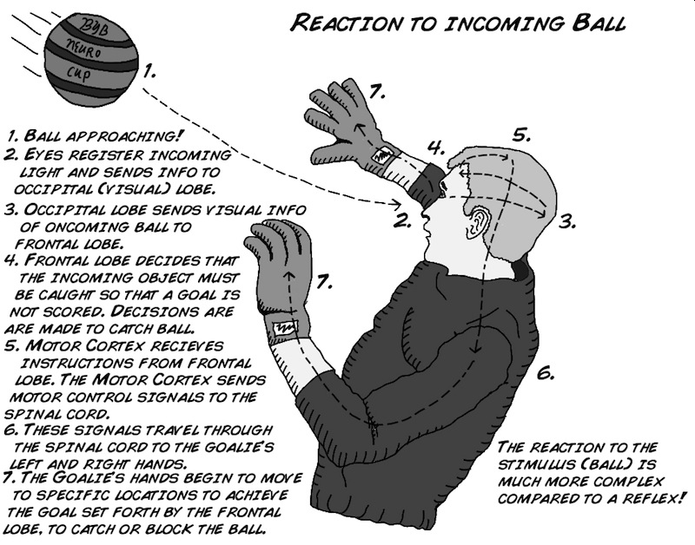
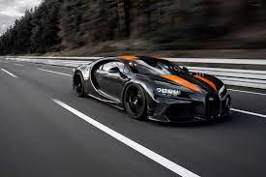
Kinetics
What happens? (Ch. 6)
Will it happen? (Ch. 12)
How much will it happen? (Ch. 13)
How fast does it happen (Ch. 17) !!
Important in every day life
How fast does your car rust?
Ozone depletion/repair rates
How long until dinner is cooked?
“Time is Money”
Broad Range of Rates
10⁻¹² vision
10⁻⁶ nuclear
10⁺¹ cement drying
10⁺⁹ C to Diamonds

Slide 3
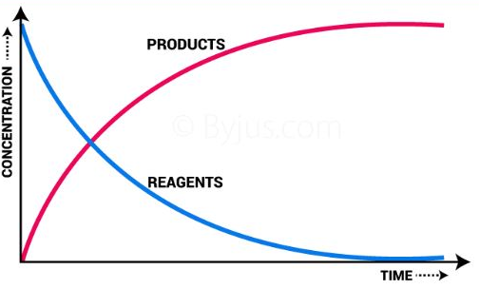
Reaction Rate
How fast the concentration of R or P changes with time
$$Rate= \frac{Change in [ ]}{Change in Time}= \frac{∆[ ]}{∆t}= \frac{{[ ]}_{t2}−{[ ]}_{t2}}{t_{2}−t_{1}}$$
Units – M/s or mol/L·s
Stoichiometry (General Rate of Reaction)
Sign Conventions
2 A + 3 B → 5 C
$$rate=−\frac{∆ [R]}{∆t}$$
General
Rate
$$=−\frac{1}{2}\frac{∆\left[A\right]}{∆t}=−\frac{1}{3}\frac{∆\left[B\right]}{∆t}=\frac{1}{5}\frac{∆[C]}{∆t}$$
$$rate=+\frac{∆ [P]}{∆t}$$
*normally rates specify which compound the rate is measured for (not all of them)

Slide 4
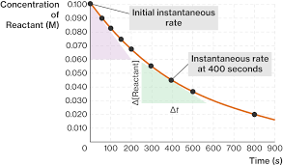
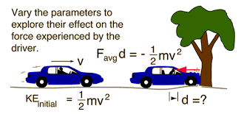
Time
Must specify time interval of rate
Generally ↓ over time
$$Average Rate= \frac{\left[end\right]−[start]}{t_{end}−t_{start}}$$
Instantaneous
Rate
= rate at a specific time
Car analogy
Estimate using short time intervals
Slope of straight line at time (Tangent)
Initial Rate = rate at time = 0

Slide 5
Another Example

Slide 6
Time(sec)
0
100
200
300
400
[N2O5](M)
0.0200
0.0169
0.0142
0.0120
0.0101
Example:
2 N₂O₅ (g) → 4 NO₂ (g) + O₂ (g)
Calculate the average rate of decomposition of N₂O₅
Calculate the instantaneous rate at 200 s
Calculate the average rate of decomposition of NO₂

Slide 7
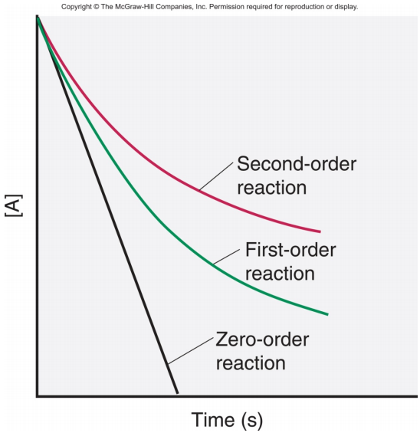
Rate Laws
Relationship between rate chemical reaction and [ ] of Reactants
2 A + 3 B → C + 3 D
Rate = k[A]^{m}[B]^{n}
General Rules
m/n have NO relationship to the coeffecients and must be determined experimentally
m,n can have any value
Reaction Order = value of m or n
Overall Reaction Order = m + n
Coeffecients give insight into the reaction mechanism (Lecture 17c)
Next Page

Slide 8
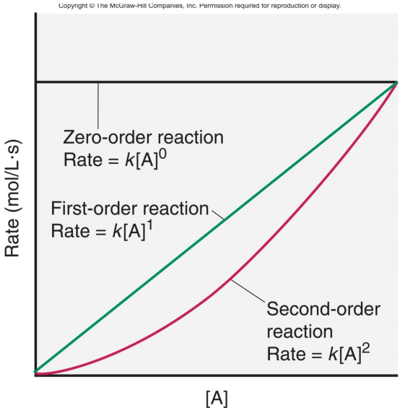
General Rules (cont)
Exponent Rate
[A]⁻¹ Rate ↓ as [A] ↑
[A]⁰ Rate is Independent of [A]
[A]¹ Rate is DP [A], Double A, Double Rate
[A]² Double [A], rate Quadruples

Slide 9
General Rules (cont)
K = rate constant (independent of [ ], Temp Dependant. (Lecture 17b)
Units of K
Rate Law Order Units
Rate = k 0th M/s
Rate = k[A] 1st 1/s
Rate = k[A]² 2nd 1/M·s
Rate = k[A]³ 3rd 1/M²·s

Slide 10
Determining Rate Laws
Inspection Method
Method of Initial Rates
Inspection Method
Good for “easy” data
Good for made up data
Method of Initial Rates
Good for “hard” data
Good for experimental data

Slide 11
Example:
Inspection Method
Reaction: A → B
Exp. | [A] (M) | [B] | Rate (M/s)
1 | 0.1 | 0.1 | 4 x 10⁻⁵
2 | 0.1 | 0.2 | 4 x 10⁻⁵
3 | 0.2 | 0.1 | 16 x 10⁻⁵
Calculate rate coefficients (m, n)
Calculate rate constant (k)
Write the rate equation
What is the rate when
[A] = 0.05 M and [B] = 0.1 M

Slide 12
Example:
Method of Initial Rates
Reaction: A → B
Exp. | [A] (M) | [B] | Rate (M/s)
1 | 0.1 | 0.1 | 4 x 10⁻⁵
2 | 0.1 | 0.2 | 4 x 10⁻⁵
3 | 0.2 | 0.1 | 16 x 10⁻⁵
Calculate rate coefficients (m, n)
Calculate rate constant (k)
Write the rate equation
What is the rate when
[A] = 0.05 M and [B] = 0.1 M

Slide 13
You Try It:
Inspection Method
1/2 = 1.41
1/3 = 1.73
Etc…
Reaction: A → B
Exp. | [A] (M) | [B] | Rate (M/s)
1 | 0.25 | 0.25 | 6.25
2 | 0.50 | 0.25 | 25.0
3 | 0.25 | 0.50 | 8.84
Calculate rate coefficients (m, n)
Calculate rate constant (k)
Write the rate equation
What is the rate when
[A] = 0.05 M and [B] = 0.1 M

Slide 14
You Try It:
Method of Initial Rates
Reaction: A → B
Exp. | [A] (M) | [B] | Rate (M/s)
1 | 0.25 | 0.25 | 6.25
2 | 0.50 | 0.25 | 25.0
3 | 0.25 | 0.50 | 8.84
Calculate rate coefficients (m, n)
Calculate rate constant (k)
Write the rate equation
What is the rate when
[A] = 0.05 M and [B] = 0.1 M

