Slide 1
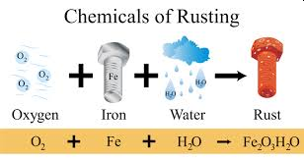
CHE 112 Spring 2021
Lecture 16e – Corrosion and Electrolysis
Overview/Topics
Terminology
Corrosion/Rust
Cathodic protection
Sacrificial anodes
Electrolysis
Skills to Master
HW 16e
Read
OER 16.6-16.7

Slide 2
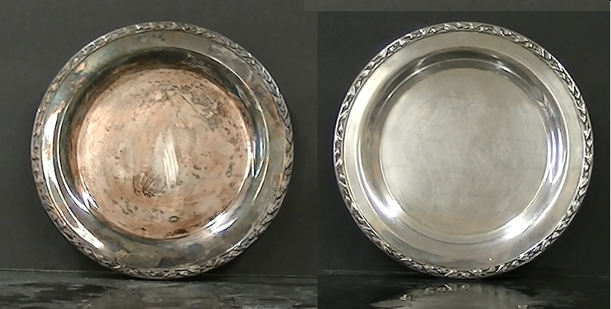
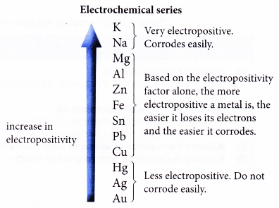
Corrosion
Fe
Degradation of metals by a naturally occurring electrochemical process
Rust, Tarnish, Patina etc.
Costs $500 billion a year!
20% of Fe production used to replace rusted parts
The more reactive a metal the faster it corrodes. Ex: Na
Normally forms an oxide layer
Ag
Cu

Slide 3
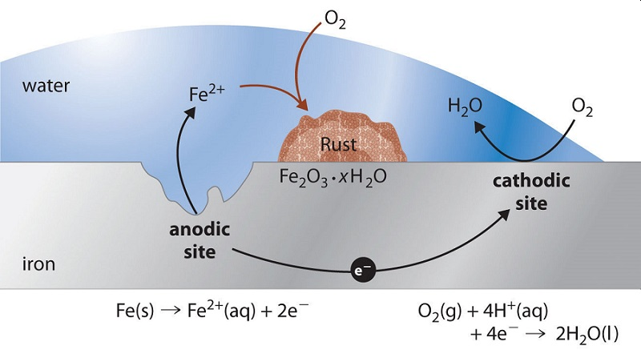
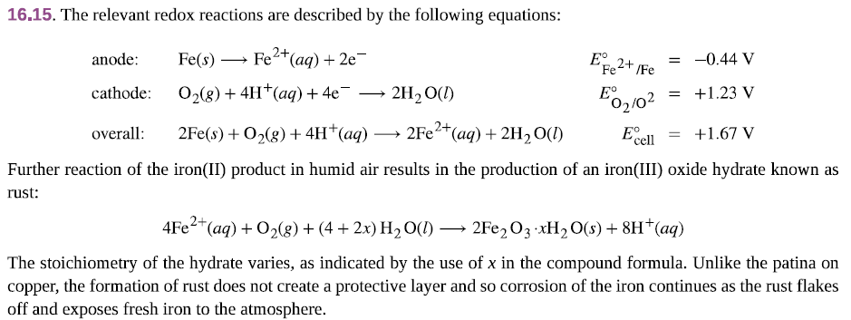
Rust - Fe
Anode loses mass
Cathode gains mass
Combination of reactions
No protective layer formed
Speeds up if:
Aqueous (wet)
acidic solution
salts NaCl etc
Temperature

Slide 4
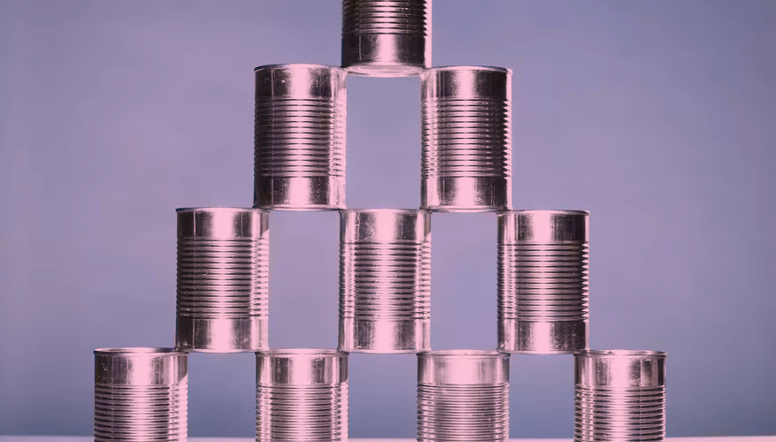
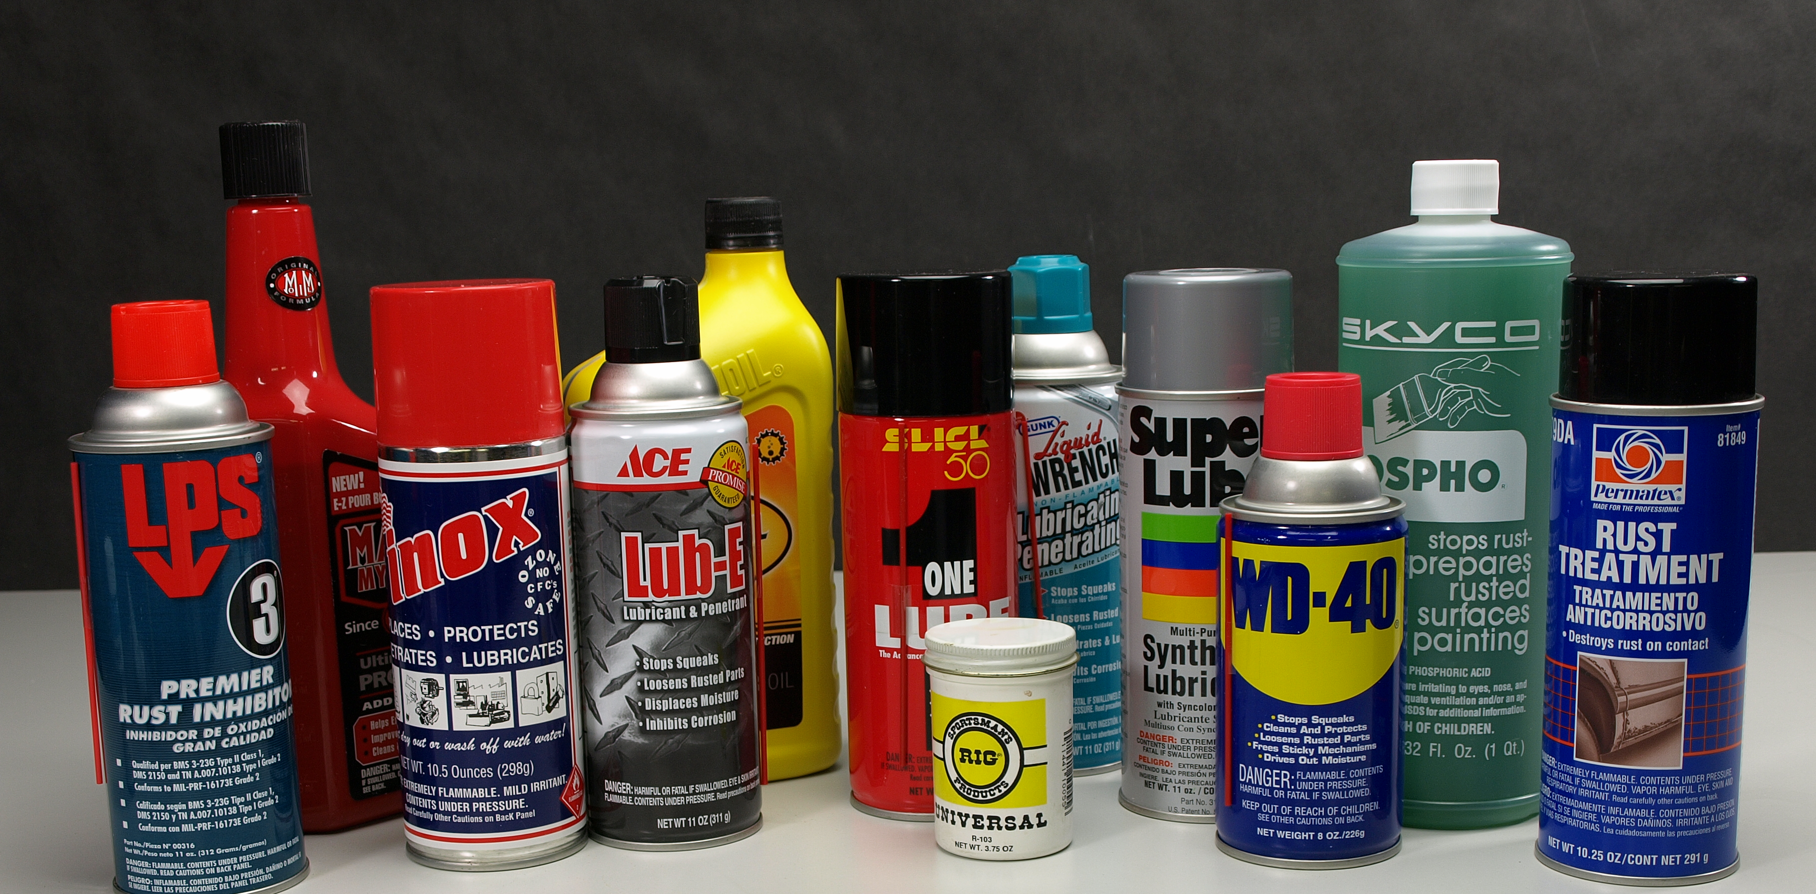
Corrosion Prevention
Protective Layers
Formation of alloys
Galvanization
Cathodic Protection
Sacrificial Anodes
https://oceanfootprint.co.uk/rust-prevention-101-nyalic-the-guide/
Protective Layers
Prevent contact between metal and O₂
Paint, Oil, Plastic, Grease, Tin (Sn cans)
Electroplating Cr (Chrome plating)
https://sciencing.com/tin-cans-made-5344942.html

Slide 5
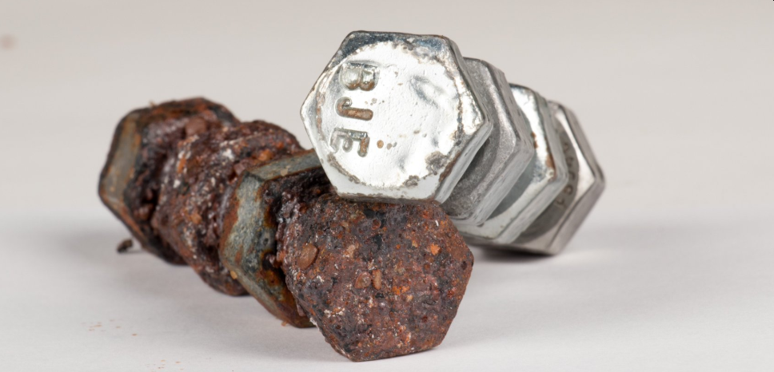
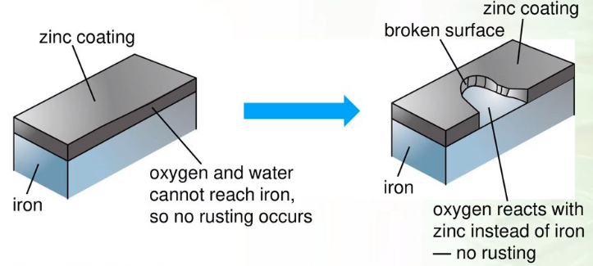
Galvanization
Layer of more readily oxidized metal
Oxidizes first, forms protective layer
Ex: Zn reacts to form ZnO or Al forms Al₂O₃
Two types of protection
Oxidized first, Protective Layer

Slide 6
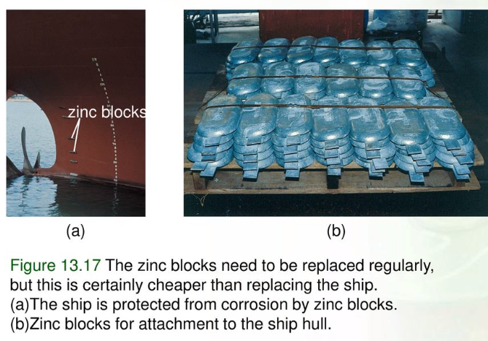
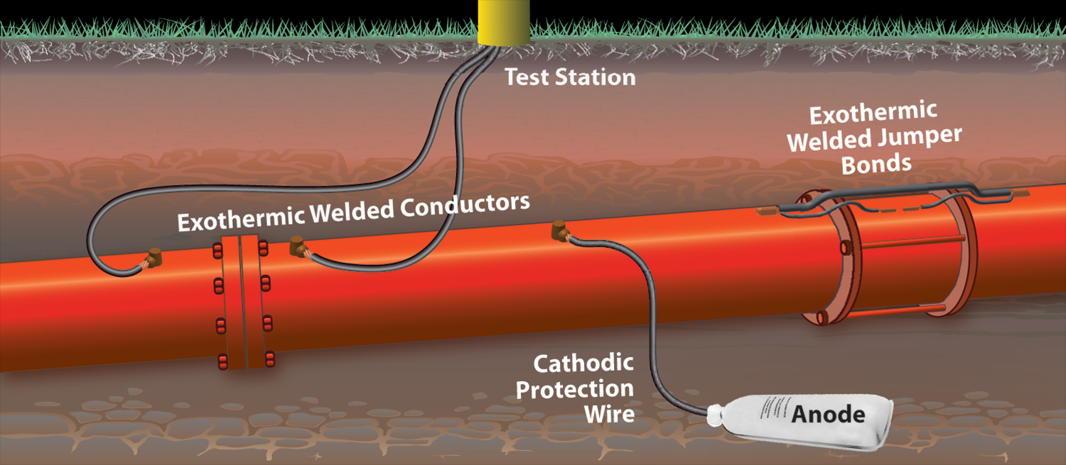
Cathodic Protection
Cathodic protection (CP) is a technique used to control the corrosion of a metal surface by making it the cathodic side of an electrochemical cell. The simplest method to apply CP is by connecting the metal to be protected with another more easily corroded metal to act as the anode of the electrochemical cell
Sacrificial Anode
Connect Iron to a more reactive metal to supply e⁻ instead of Fe
Commonly Zn – ships (right) or Mg – pipe (book)
“Sacrificial” because used up.
Cheaper to replace sacrificial anode than iron in ships/pipes

Slide 7
Example
Fe (s) → Fe⁺² (aq) + 2 e⁻
Anode:
$$E_{cell}^{°}=−− 0.447 V$$
Replace Fe with more active metal
i.e. easier to oxidize
(lower on chart)
Zn (s) → Zn⁺² (aq) + 2 e⁻
$$E_{cell}^{°}=−− 0.7618 V$$
Mg (s) → Mg⁺² (aq) + 2 e⁻
$$E_{cell}^{°}=−− 2.372 V$$
Zn or Mg is the new anode, therefore Fe would act as an cathode and not lose electrons
http://www.dynamicscience.com.au/tester/solutions1/chemistry/corrosion/rustpreventionsacanode.htm

Slide 8
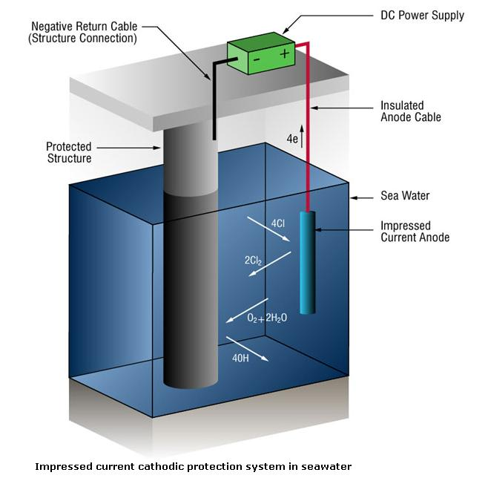
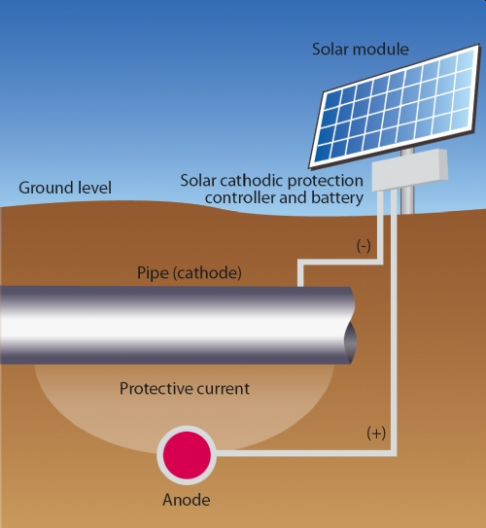
https://www.metallurgyfordummies.com/how-cathodic-protection-works.html
Cathodic Protection
Connect to battery or other source to supply e⁻ instead of the Fe

Slide 9
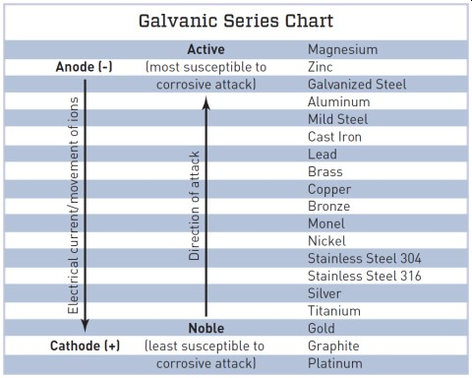

Slide 10
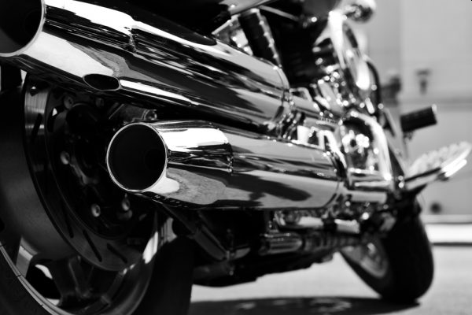
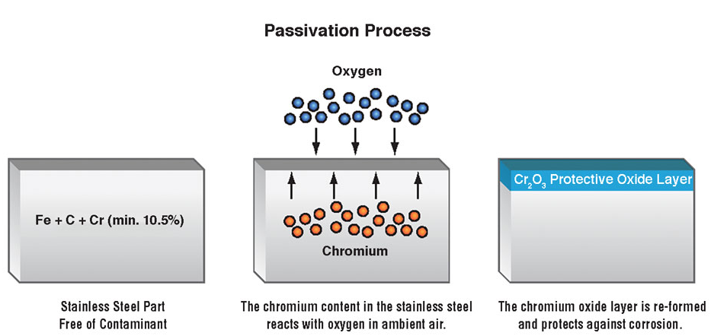
Alloys
Alloy Fe with other metals that oxidize easier to form protective layers
Stainless steel
Chrome plating Cr₂O₃ (s)
Expensive
https://www.engineeringclicks.com/chrome-plating/

Slide 11
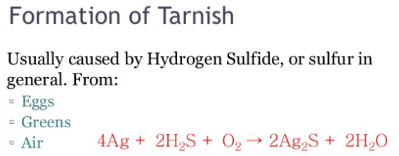
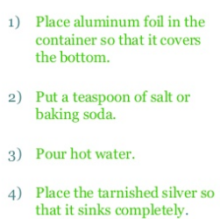
Ag
Which E is oxidized?
Which E is reduced?
Try it:
https://www.instructables.com/Polishing-Silver-Two-Fast-Effortless-Methods/

Slide 12
Try it:
Write the chemical reactions for Ag and Al.
Label the Anode and Cathode.
Calculate $E_{cell}^{°}$
Spontaneous or Nonspontaneous?

Slide 13
Real Life is a bit more complicated…

Slide 14
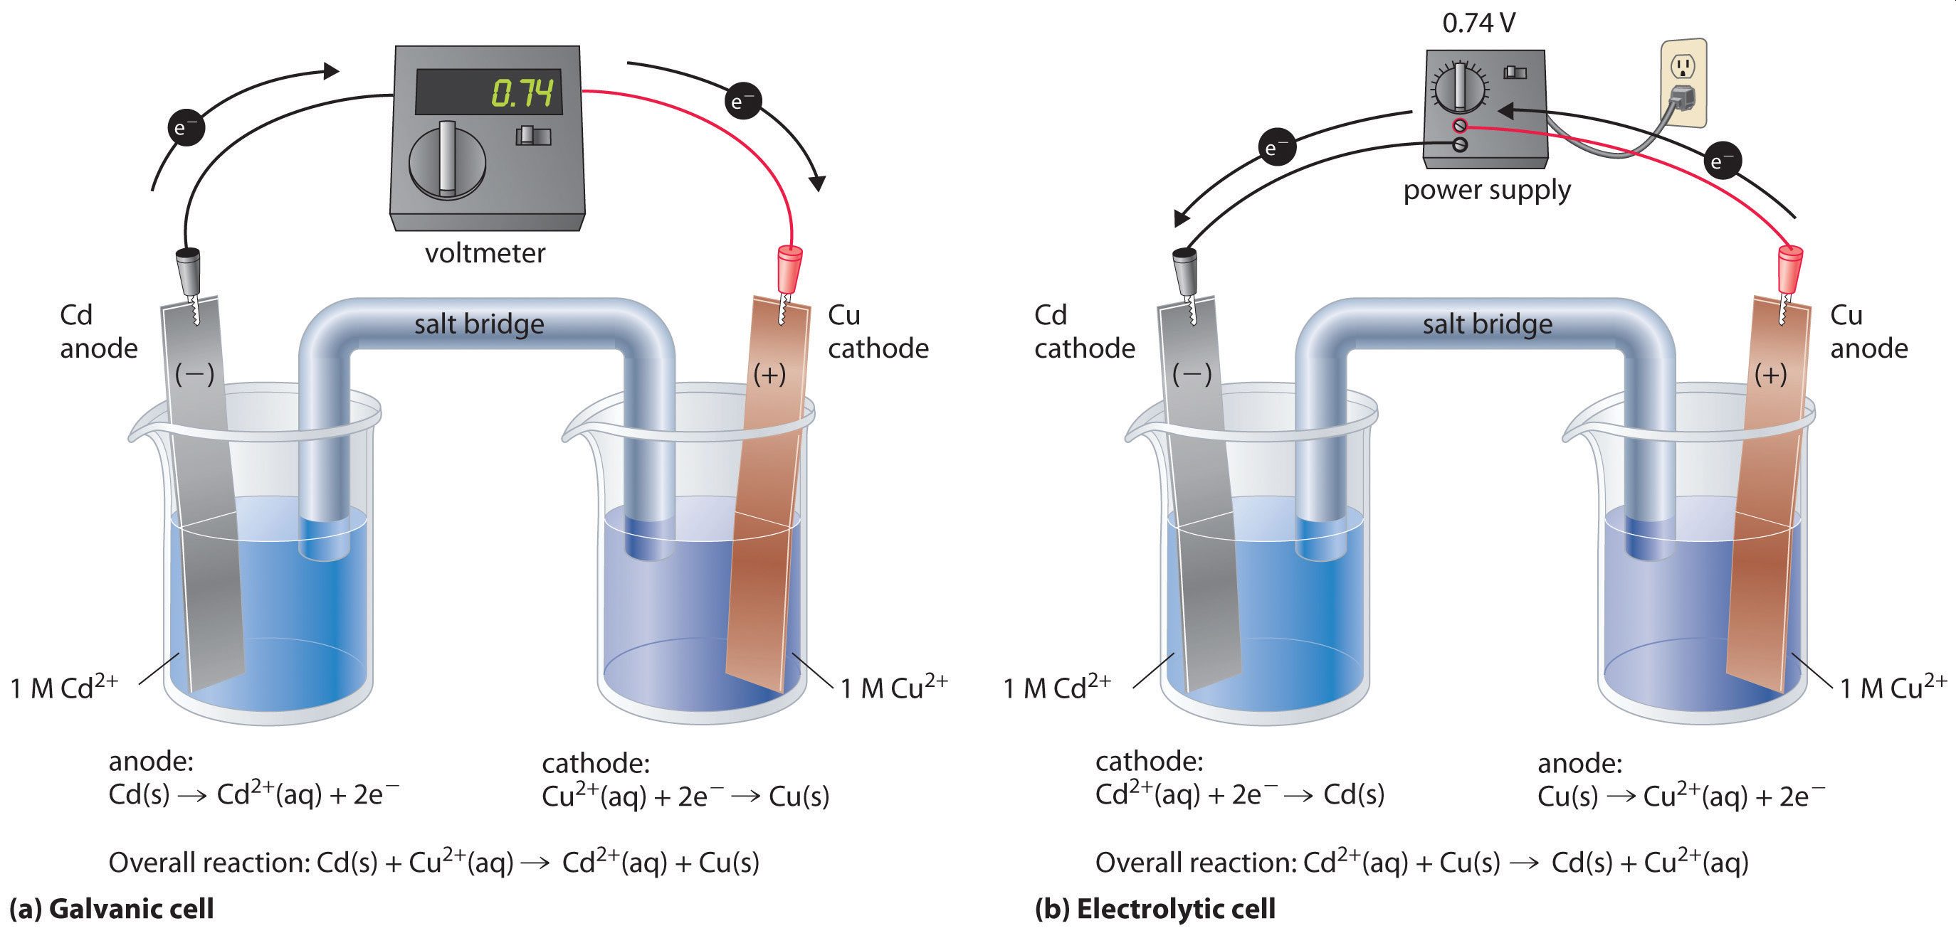
Electrolysis
“electrolytic cells”
Examples from Book:
Reverse of a galvanic cell
External source of e⁻ to drive a redox reaction in the reverse (nonspontaneous) direction
Many important uses
Recharge batteries
Separation and Purification of metals
Production of many chemical
Electroplating of metals
Molten NaCl to produce Na (s) + Cl₂ (g)
Water to produce H₂ and O₂ gas
Aqueous NaCl to produce NaOH and Cl₂ (g)
Electroplating Ag

Slide 15
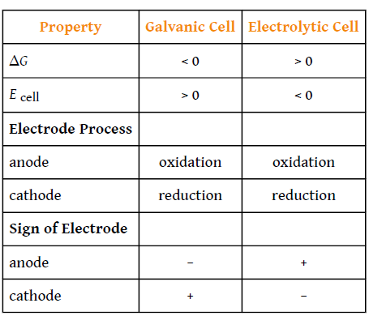
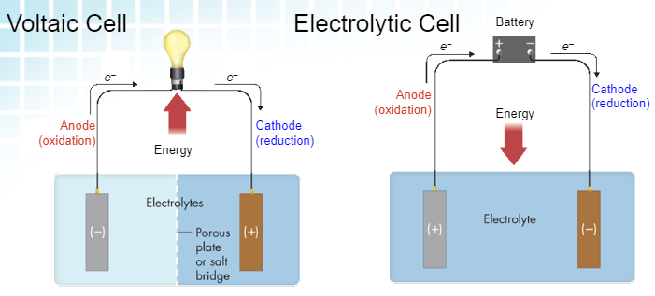
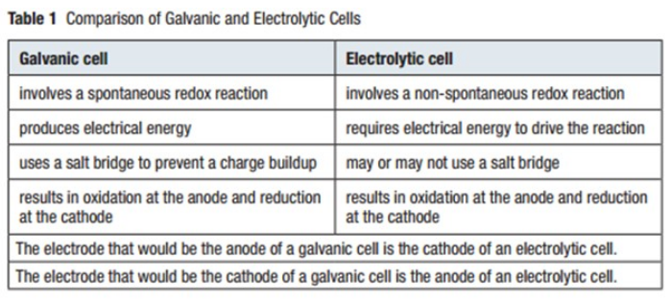
What does 0 tell us?

Slide 16
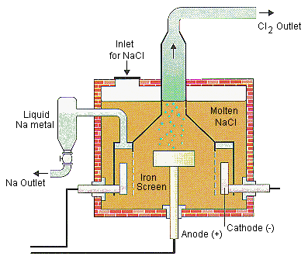
Applications of Electrolysis
$4 billion/year industry
13 million tons Cl₂
10 million tons NaOH
Examples from Book (read them)
Water to produce H₂ and O₂
NaCl (s) to produce Na (s), Cl₂
NaCl (aq) to produce H₂ , Cl₂ + 2 OH⁻
Molten NaCl (l)
https://chemed.chem.purdue.edu/genchem/topicreview/bp/ch20/faraday.php#:~:text=The%20deciding%20factor%20is%20a,water%20to%20O2%20gas.

Slide 17
Analyzing Electrolytic Cells
Identify all possible reactions (including water if (aq))
Determine reaction most likely to be reduced)
Determine reaction most likely to be oxidized)
Write and balance ½ reactions
Determine $E_{cell}^{°}$
Sketch picture of cell (ie HW 16b)
“Reverse of a battery”
Strongest OA = + value closest to zero
Strongest RA = - value closest to zero
$E_{cell}^{°}$ < 0 (non-spont)
Overvoltage
$E_{cell}^{°}$ = minimum amount of energy to reverse a reaction in “ideal” conditions
Extra voltage that must be applied to a reaction to get it to occur at the rate at which it would occur in an ideal system
Often quite substantial
Complicated – hard to calculate
Ignore it in calculations!

Slide 18
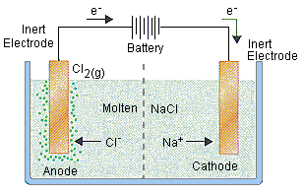
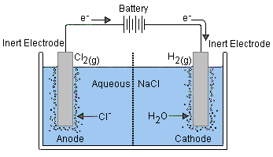
Molten NaCl (l)
Aqueous NaCl (aq)
Reactions that can occur
Reactions that can occur
Choose reactions/write ½ reactions
$E_{red}^{°}$ = +1.36 V
$E_{red}^{°}$ = -2.71 V
$E_{red}^{°}$ = +1.23 V
$E_{red}^{°}$ = 1.36 V
Choose reactions/write ½ reactions
$E_{red}^{°}$ = +1.36 V
HW/Test Question – what is the difference in the Electrolytic Cells between NaCl (s) and NaCl (aq)?

Slide 19
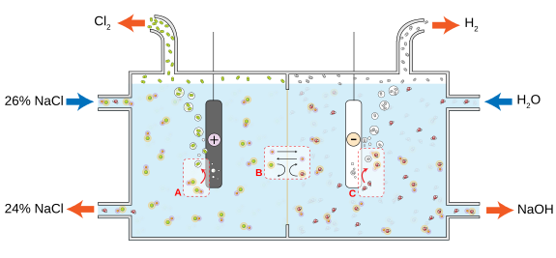
Aqueous NaCl (aq)

Slide 20
Try It:
In electrolytic cell composed of aqueous KI:
List possible reactions
Determine most likely to be oxidized (smallest +)
Determine most likely to be reduced (smallest -)
Write ½ cell reactions
Calculate $E_{cell}^{°}$

Slide 22
Try It:
List possible reactions
Determine most likely to be oxidized
Determine most likely to be reduced
Sketch the Cell
Write ½ cell reactions
Calculate $E_{cell}^{°}$

Slide 24
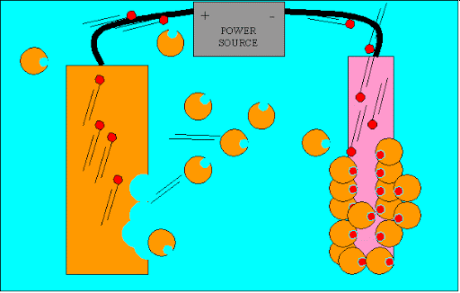
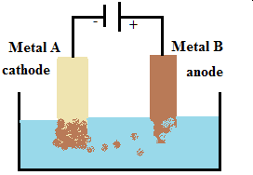
Electroplating
Metal A more reactive than Metal B
Metal A is lower on the chart
e-
e-
B⁺ (aq) + e⁻ → B (s) + e⁻
B (s) → B⁺ (aq) + e⁻
e-
C⁺
Solution: Salt of metal B
Opposites attract

Slide 25
Try It
Sketch an electrolytic cell for a Ni electrode and an Fe electrode
Label Cathode, Anode, +/-, battery, direction of e⁻ flow, solution, gain/loss of mass
Write the possible reactions occurring at the anode
Write the possible reactions occurring at the cathode
Write the ½ reactions and net reaction that will occur.

Slide 27
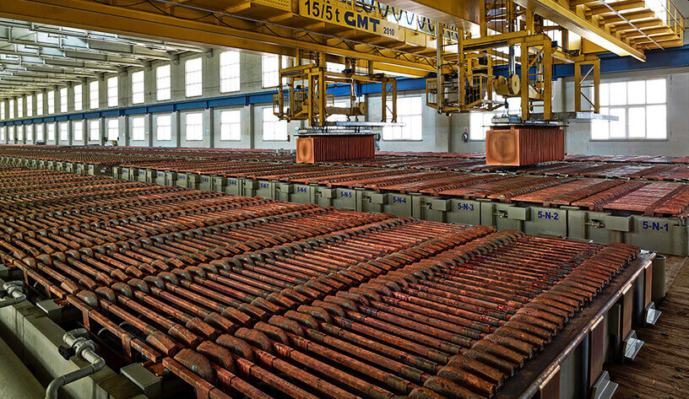
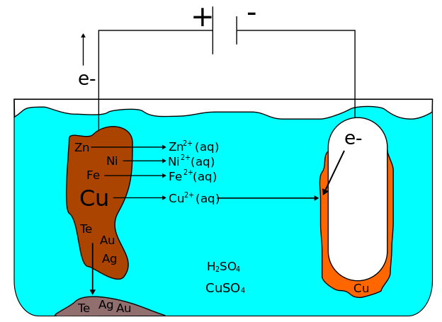
Electrorefining
Similar to Electroplating but used to purify metals
Impure
Pure
Cu⁺
e-
https://www.ausetute.com.au/electrorefine.html#:~:text=Electrorefining%20Copper&text=The%20electrolyte%20containing%20the%20copper,push%20them%20to%20the%20cathode.

Slide 28
Try It
Label Anode and Cathode
Write the ½ reactions for Zn, Fe, Ni, Ag, Au, Cu.
Which ½ reactions occur at the anode?
Which ½ reactions occur at the cathode?
Which ½ reactions won’t occur?
Calculate $E_{cell}^{°}$

Slide 29
Electrolysis Math
F = Faraday Constant
charge on 1 mole of e⁻
96,500 C/mol e⁻
96,500 J/V·mol
Current x Time
Amount of Charge
Moles e⁻
Moles
R or P
g/L etc
R or P
Current = Rate of e⁻ flow (a)
Time = how long it flows (varies)
mol/mol ratio
MW or M
$$1 A= \frac{1 C}{1 sec}$$
$$1 W= \frac{1 J}{1 sec}$$
$$1 V= \frac{1 J}{1 C}$$

Slide 30
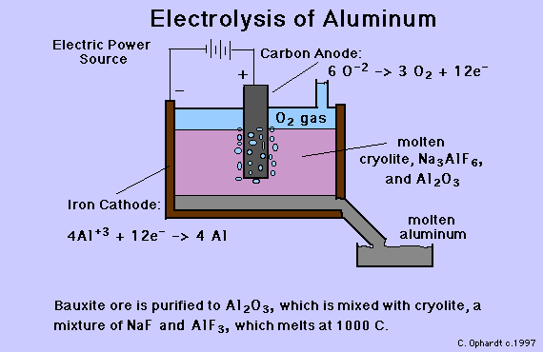
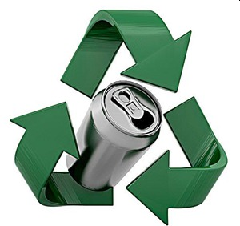
Production of Al
Hall-Heroult Process (1866)
Hall = 22
Heroult = 23
Low voltage (5-6 V)
High Current (250,000 A)
1 mol e⁻ makes 9 g Al
5% of energy production in US
Recycling costs 1/70th amount
Al (mp) = 2045 °C
Cryolyte = 800-1000 °C
https://www.aluminum.org/industries/production/primary-production

Slide 31
Example:
How many grams of Al are produced in 1 hour by the electrolysis of AlCl₃ if the applied current is 10 A?

Slide 32
Example:
Calculate the number of kilowatt-hours (kW·hr) required to produce 1000. kg of Al at an applied EMF of 4.50 V.

Slide 33
Example:

Slide 34
Example:

Slide 39
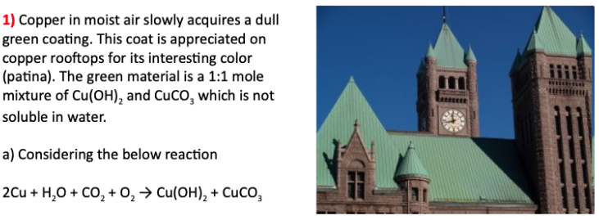
Patina - Cu
Try It
In the reaction below:
What is oxidized?
What is reduced?
Forms long lasting coating that is water resistant (useful property) Often desirable because “pretty”
Artificial methods for patina formation
https://en.wikipedia.org/wiki/Patina

Slide 40
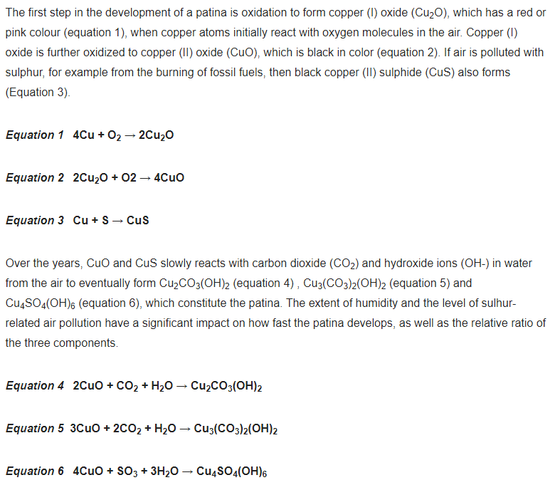
Complex Process
Involves lots of chemical reactions
Time/Temperature variables
Too much work for us!
https://copperalliance.org.uk/knowledge-base/education/education-resources/copper-reactivity-patination/

Slide 41
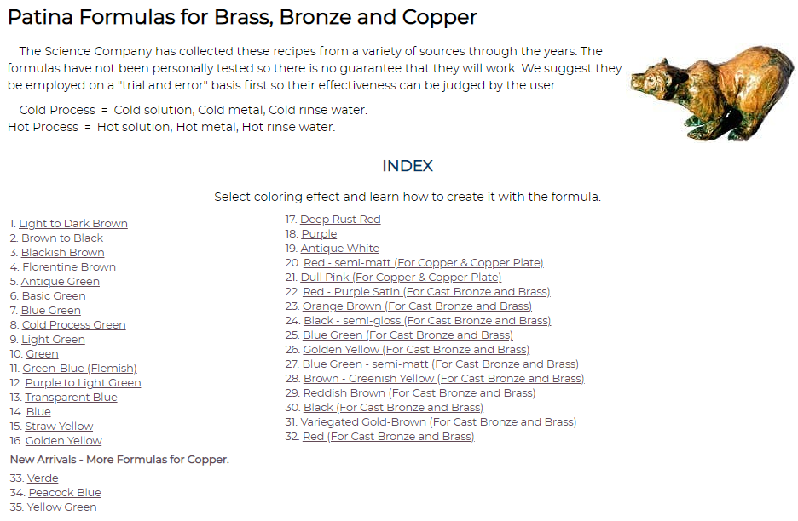
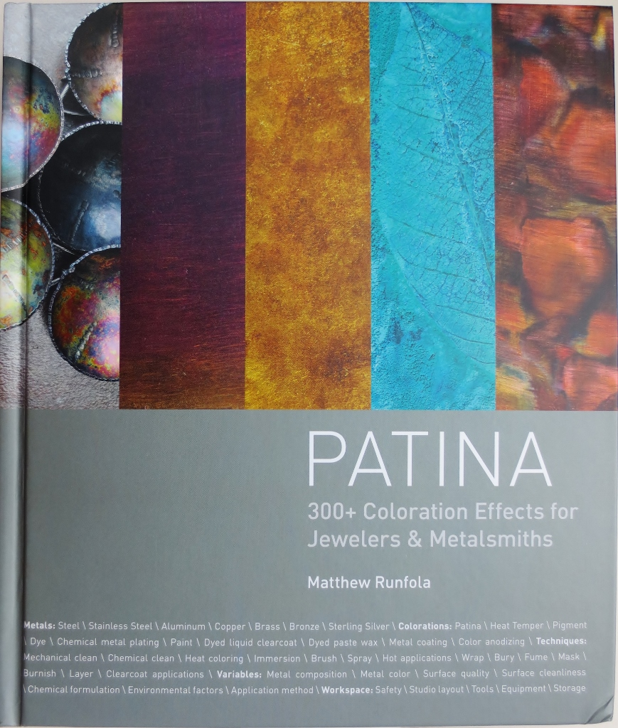
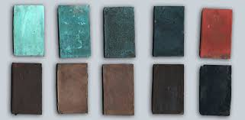
Artificial Patina’s
https://www.sciencecompany.com/Patina-Formulas-for-Brass-Bronze-and-Copper.aspx

