Slide 1
CHE 112 Spring 2021
Lecture 16 c,d – Electrode and Cell Potentials
Overview/Topics
Cell Potential E_{cell} or Cell Voltage
Relationship between ΔG and K_{eq} and E_{cell}
Nernst Equation
Lots of Calculations!
Skills to Master
HW 16
Read
OER 16.3-16.4

Slide 2
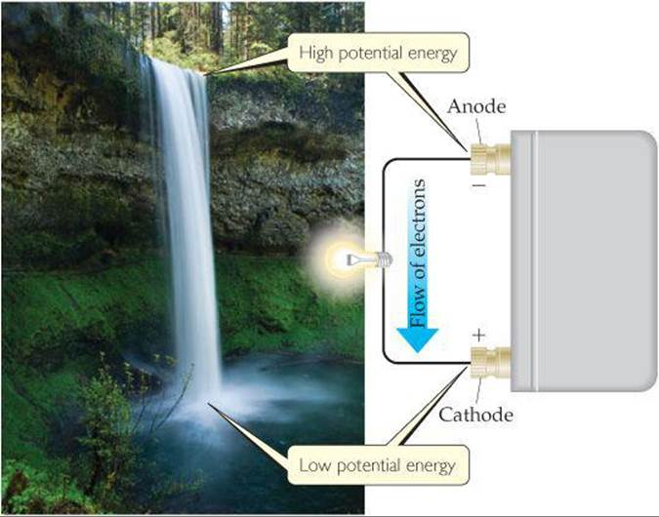
Cell Potential/Voltage - Basics
“E_{cell} (EMF)“
Potential energy difference between cathode and anode responsible for the flow of electrons from the anode → cathode
Determine spontaneity of redox reactions
Opposite Sign Convention for ΔG
Units: Volt (V)
Other Units
E_{cell} = E_{cathode} - E_{anode}
E_{cell} = E_{ox} + E_{red}
$$1 V= \frac{1 J}{1 C}$$
E_{anode}
$$1 C= \frac{1 A}{1 sec}$$
$$1 W= \frac{1 J}{1 sec}$$
On Cheat Sheet
E_{cathode}

Slide 3
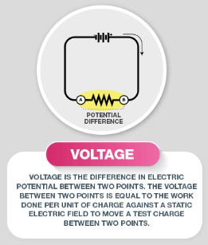
Cell Potential/Voltage – cont.
Opposite Sign Convention for ΔG
EMF Depends on:
[R] and [P]
Temperature
Identity of Cation/Anion
E° = standard state (STP)
STP = 25 °C, 1 bar (~1 atm), 1 M solutions
Tabulated Values in Table 16.1 or Appendix L
EMF > 0 (+) = spontaneous
EMF = 0 = equilibrium
EMF < 0 (-) = nonspontaneous

Slide 4
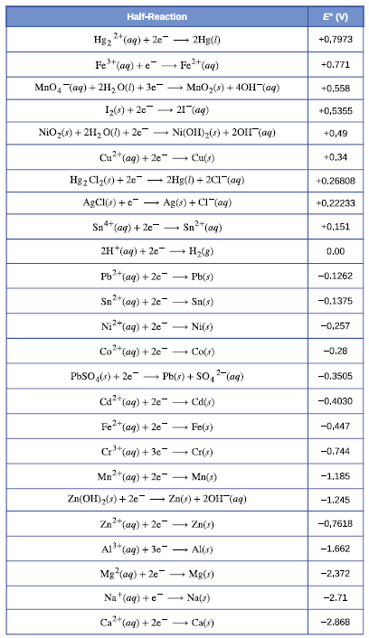
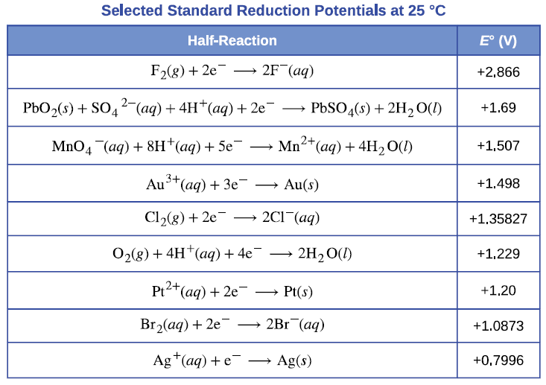
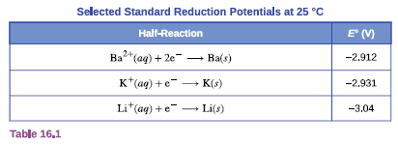
Same concept as tables for ΔH, ΔG, ΔS etc.
Appendix L
Standard Reduction Potentials
Middle
Top
Table 6.1
Can’t tabulate every possible electrochemical cell
Tabulated values for ½ cell reactions (written as reductions E°_{red})
Zero arbitrary “Standard Hydrogen Electrode” (SHE)
Bottom
E_{cell} = E_{cathode} - E_{anode}
E_{cell} = E_{ox} + E_{red}

Slide 5
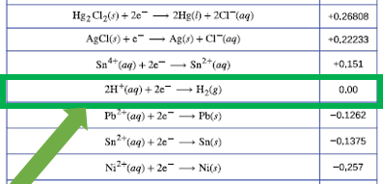
Top of Table
Favored
Strongest Oxidizing Agent
Most reduced (lowest E element)
Good Cathodes (most + value)
Miscellaneous
Diagonal Rule – any species on the left will react spontaneously with a species that is lower/right. (Only applies Table 16.1)
More + reaction always reacts with a more negative reaction
“Same” as the Activity Series (1st semester, SD reactions).
Bottom of Table
Strongest Reducing Agent
Most oxidized (highest E element)
Good Anodes (most – value)
Favored

Slide 6
Diagonal Rule
Diagonal Rule – any species on the left will react spontaneously with a species that is lower/right. (Only applies Table 16.1)
More + reaction always reacts with a more negative reaction
Note:
Table 16.1 = in order high to low
Appendix L = alphabetical order
Example
Will occur spontaneously
F₂ (g) + 2 Li (s) → 2 F⁻ (aq) + 2 Li⁺
Example
Will NOT occur spontaneously
Sn⁺² (aq) + 2 Ag (s) → Sn (s) + 2 Ag⁺¹ (aq)

Slide 7
Activity Series ↔ Standard Reduction Potentials

Slide 8
Lets Try It
You have a Galvanic Cell with the following reaction:
Write the anode ½ reaction
Write the cathode ½ reaction
Calculate the Cell potential
Spont. or Nonspont.?
Cd (s) + Sn⁺² (aq) → Cd⁺² (aq) + Sn (s)

Slide 9
Lets Try It
You have a Galvanic Cell with the following reaction:
Write the anode ½ reaction
Write the cathode ½ reaction
Calculate the Cell potential
Spont. or Nonspont.?
2 Cr⁺³ + 3 I₂ + 7 H₂O → Cr₂O₇⁻² + 14 H⁺ 6 I⁻

Slide 10
Problem Types
Solve for E_{cell}
Solve for E_{cathode}
Solve for E_{anode}
Spontaneous/Nonspontaneous
Given elements make a battery
Picture + any of above

Slide 11
Relationship between E_{cell} ΔG and K_{eq}
On Cheat Sheet
F = Faraday Constant
charge on 1 mole of e⁻
96,500 C/mol e⁻
96,500 J/V·mol
$$ΔG=−nFE_{cell}^{°}$$
$E_{cell}^{°}=\left(\frac{RT}{nF}\right)\ln{K_{eq}}$
R = 8.31 J/K·mol
T = Temp (K)
n = mols of e⁻
- b/c sign conventions are opposite
Michael Faraday
(1971-1867)
Developed foundations for understanding electricity

Slide 12
Relationship between E_{cell} ΔG and K_{eq}
(Ch. 12)
Equilibrium
(K_{c})
ΔG° = -RT ln K_{c}
$E_{cell}^{°}=\left(\frac{RT}{nF}\right)\ln{K_{eq}}$
$$K_{c}=e^{−\frac{{∆G}^{°}}{RT}}$$
(Ch. 13)
(Ch. 16)
Thermodynamics
(ΔG)
Electrochemistry
$$E_{cell}^{°}$$
$$ΔG=−nFE_{cell}^{°}$$

Slide 13
Lets Try It!
For the given reaction at 25°C, you solved for $E_{cell}^{°}$ = +0.2655 V
Calculate
ΔG
K_{eq}
ΔG_{f} (Sn⁺²)
Cd (s) + Sn⁺² (aq) → Cd⁺² (aq) + Sn (s)

Slide 15
Nernst Equation
“non-equilibrium”
Concentration Cells
pH meters
Heartbeat
Standard State = 1.0 M or 1.0 atm and 298K
Just like for Gibbs Free Energy, K_{eq}
ΔG = ΔG° + RT lnQ
$$E_{cell}=E_{cell}^{°}−\frac{RT}{nF}\ln{Q}$$
$$E_{cell}=E_{cell}^{°}−\frac{0.0592 V}{n}\log{Q}$$
Replace Constants, 298K switch to log
Useful in pH problems

Slide 17
Lets Try It
Given the following electrochemical cell at the given concentrations at 298 K, calculate $E_{cell}^{}$. Is the reaction spontaneous as written?
Cr₂O₇⁻² + 14 H⁺ 6 I⁻ → 2 Cr⁺³ + 3 I₂ + 7 H₂O
Note - solved previously
reversed so now spontaneous
$E_{cell}^{°}$ = 0.6965V
[2.0 M]
[1.0 M]
[1.0 M]
[(s) = ignore]
[1.0x10⁻⁵ M]
[(l) = ignore]

Slide 19
Lets Try It
Given a Zn-H⁺ cell with [Zn⁺²] = 1.0 M, P(H₂) = 1.0 atm, E_{cell} = 0.45 V at 25 °C
Calculate the pH (ie [H⁺])

Slide 21
Lets Try It
A Concentration Cell is constructed according to the following picture. Calculate $E_{cell}^{°}$

Slide 23
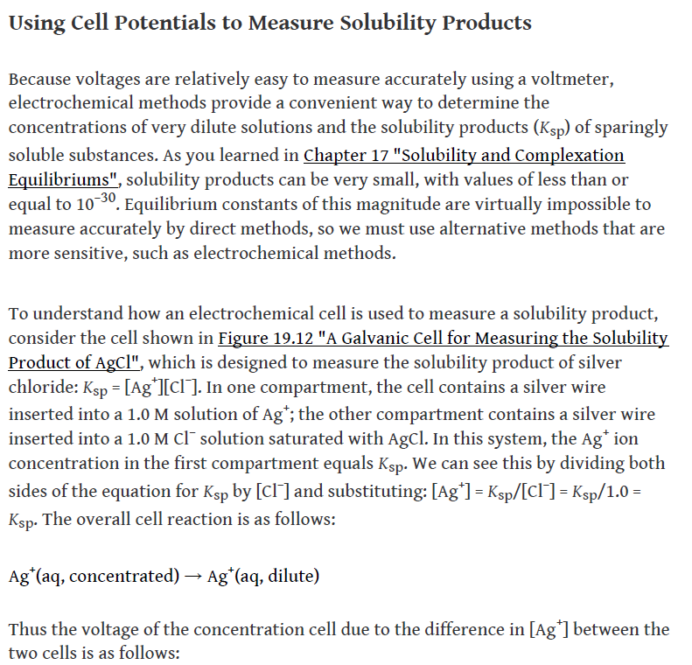
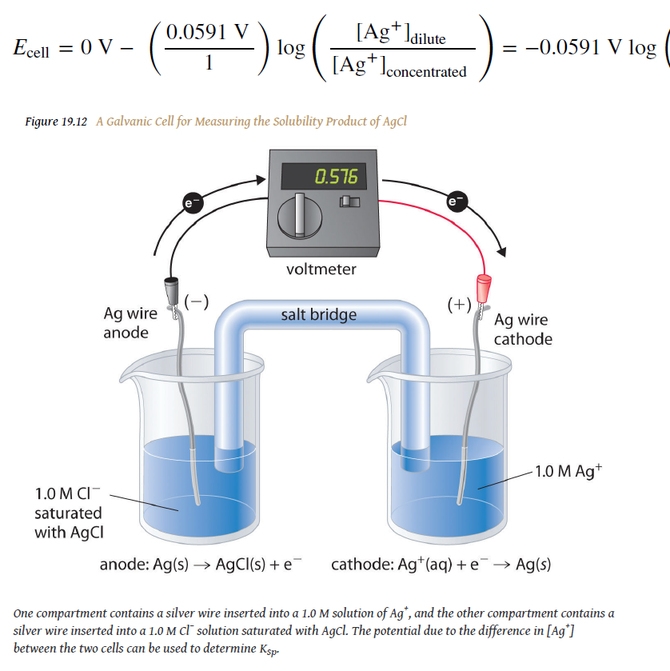
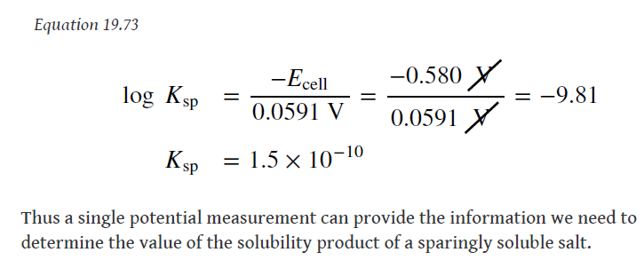
Stop here, possible lab/addition to lecture

