Slide 1
CHE 112 Spring 2021
Lecture 16b – Electrochemical Cells
Overview/Topics
2 Types of Cells
Terminology
Anode/Cathode
Salt Bridge
Inert/Active Electrode
Complete a Galvanic Cell Diagram
Galvanic Cell shorthand
Skills to Master
HW 16b
Terminology
Label Galvanic Cell
Calculate Cell Potential
Shorthand notation
Additional Useful Links
Galvanic Cells - https://www.youtube.com/watch?v=kDkBKjMAlmk
Read
OER Textbook – 16.2

Slide 2
Can you:
Identify and/or Draw a Saturated or Unsaturated FA?
Structure -> Physical Properties -> Biological Property
Cheat Sheet: You will have Table 28.1 on all exams

Slide 3
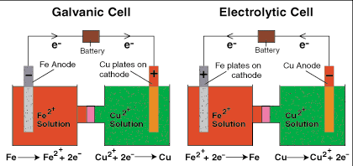
Electrochemical Cells - Overview
Galvanic Cells – use a spontaneous reaction to generate e⁻
(Luigi Galvoni 1737-1798)
Voltaic Cells – use an e⁻ current to drive a nonspontaneous reaction
(Alessandro Volta 1754-1827)
A + B
Galvanic
C + D + electricity
Voltaic

Slide 4
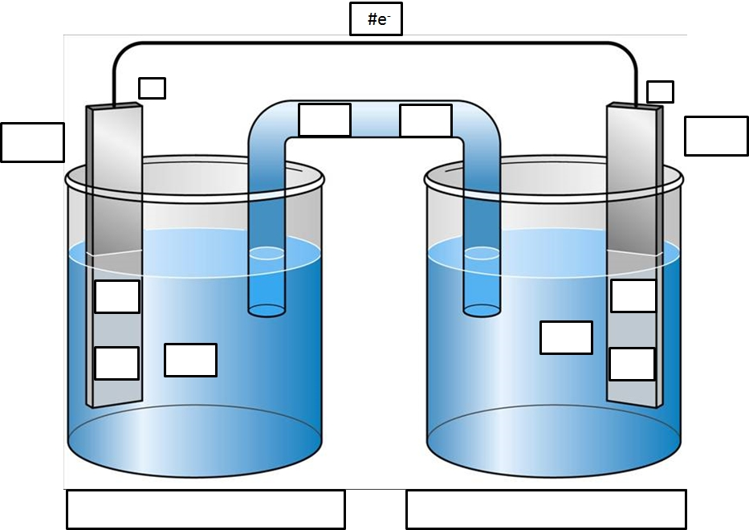
Galvanic Cell
Cd (s) + Sn⁺² (aq) → Cd⁺² (aq) + Sn (s)
Assign Oxidation Numbers
Balance the ½ reactions
Label Anode and Cathode
LEO (oxid – anode)
GER (red – cathode)
Write ½ reactions in proper boxes
Label the metal/solution
Direction of e- flow and # e⁻
Label the Salt Bridge
Miscellaneous
Active Electrode
conduct e⁻
phase separated
part of reaction
Salt Bridge
Maintains charge balance

Slide 5
Galvanic Cell - Answer
2
-
+
NO₃⁻
Na⁺
Anode
Cathode
(LEO)
(GER)
Lose Mass
Gain Mass
Low E
High E
2 e⁻
2 e⁻
Sn⁺² (aq)
Cd (s)
Cd⁺² (aq)
Sn (s)
Cd (s) → Cd⁺² (aq) + 2 e⁻
Sn⁺² (aq) + 2 e⁻→ Sn (s)

Slide 6
Galvanic Cell – short hand notation
Anode
Cathode
Cd (s) | Cd⁺² (aq) || Sn⁺² (aq) | Sn (s)
Phase Boundary
Salt Bridge
Phase Boundary
May or May not include concentrations Ex: Cd⁺² (aq) (1.0 M)

Slide 7
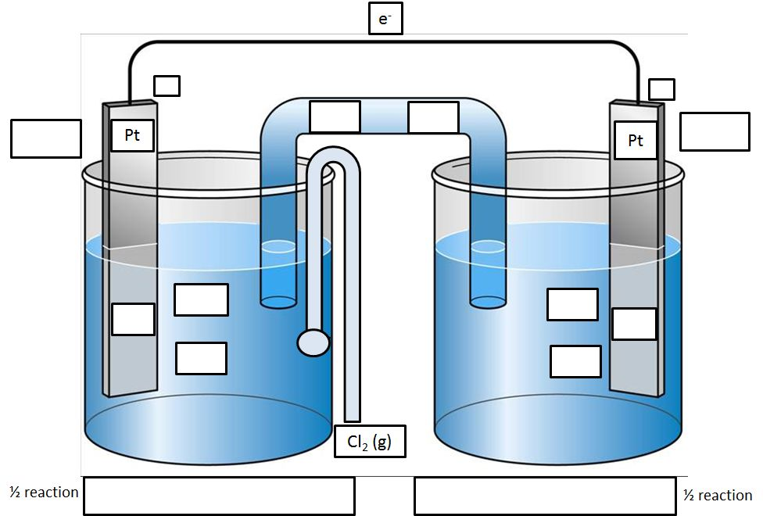
Galvanic Cell – Gases
Assign Oxidation Numbers
Balance the ½ reactions
Label Anode and Cathode
LEO (oxid – anode)
GER (red – cathode)
Write ½ reactions in proper boxes
Label the metal/solution
Direction of e- flow and # e⁻
Label the Salt Bridge
Miscellaneous
You Try It!
Complete the Diagram
Write the Cell Notation
Inert Electrode
conduct e⁻
phase separated
d/n react
Gas – generally
bubbled into the solution
Given the reaction: Cr⁺¹ (aq) + Cl₂ (g) → Cr⁺³ (aq) + 2 Cl⁻¹ (aq)

Slide 8
Galvanic Cell – You try it!
Cr⁺¹ (aq) + Cl₂ (g) → Cr⁺³ (aq) + 2 Cl⁻¹ (aq)

Slide 9
Cr⁺¹ (aq) + Cl₂ (g) → Cr⁺³ (aq) + 2 Cl⁻¹ (aq)
2
+
-
Na⁺
NO₃⁻
Cathode
Anode
(GER)
(LEO)
Cl₂ (g)
Cr⁺³
2e⁻
2e⁻
2 Cl⁻¹ (aq)
Cr⁺¹
Cl₂ (g) + 2e⁻ → 2 Cl⁻¹ (aq)
Cr⁺¹ (aq) → Cr⁺³ (aq) + 2e⁻

Slide 10
Galvanic Cell – short hand notation
Anode
Cathode
Pt|Cr⁺¹ (aq), Cr⁺³ (aq) || Cl₂ (g), 2Cl⁻ (aq) | Pt
Phase Boundary
Salt Bridge
Phase Boundary

