Slide 1
CHE 112 Spring 2021
Lecture 16a – Review – Oxid/Red Reactions
Overview/Topics
Definition of Oxidation and Reduction
Calculation of Oxidation Numbers
Determine what is Oxid/Red in a reaction
Balancing Redox Reactions
Acidic Solution
Basic Solution
Skills to Master
HW 16a
Read
OER 16.1

Slide 2
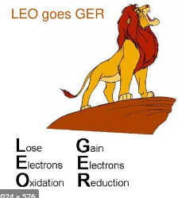
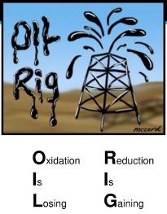
Oxidation and Reduction
aka – Redox, Electron Transfer
Transfer of an e⁻ from one E to another E
Always paired
Many important uses
Batteries
Bioenergetics
Metal Plating
Rust
Oxidation
Reduction
Lose electrons
Lose energy
Addition of H or Loss of O
Oxidation # ↑
Gain electrons
Gain energy
Loss of H or Gain of O
Oxidation # ↓
Review
OER Ch. 7.2
Lecture 7e

Slide 3
Oxidation Number
“fictional” or “pretend” charge
the charge its atoms would possess if the compound was ionic
1. Pure Elements in natural state oxidation # = zero charge
Mg (s)
H₂ (g)
Cl₂ (g)
2. Monoatomic ions, oxidation # = ionic charge
Mg⁺² (aq)
H⁺ (aq)
Cl⁻ (aq)

Slide 4
Oxidation number are per atom
3. Elements in a polyatomic ion or molecule
H = +1 (except metal hydrides MH, H = -1)
O = -2 (except peroxides H₂O₂, O = -1)
Halogens = -1
4. Sum of oxidation numbers
Molecules = 0
Polyatomic ion = charge
Examples:
SO₂ vs SO₃ vs SO₄⁻²
H₃PO₄
Fe₃O₄
Can be “fraction”

Slide 5
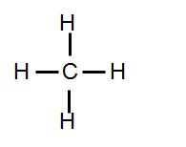
Biological Example
Lose Bonds to H, Gain Bonds to O
High Energy
“Fatty Acid”
“Carbohydrate”
Low Energy
H
H
C
C
C
C
C
C
O
C
O
H
OH
Most Reduced
Most Oxidized

Slide 6
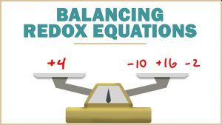
Balancing Redox Reactions
Easy – by inspection
Hard – follow rules below
Assign Oxidation Numbers
Determine which E is O and R
Write ½ Reactions, Balance
Balance atoms (except H, O)
Balance O by adding H₂O
Balance H by adding H⁺
Balance electrons
Oxid – e⁻ on right/prod.
Red – e⁻ on left/react
Combine ½ Reactions
Balance e⁻ on each side
Add Reactions
Cancel Like Terms
Acidic/Basic Solutions
Acidic = do nothing
Basic = Add OH⁻ to each side to cancel H⁺
Recheck Like Terms
Double Check!
Google – lot of video’s and examples

Slide 7
Example:
Write the balanced equation in an acidic solution
H₂S + NO₃⁻ → S + NO

Slide 9
Example:
Write the balanced equation in an basic solution
MnO₄⁻ + C₂O₄⁻² → Mn⁺² + CO₂

Slide 11
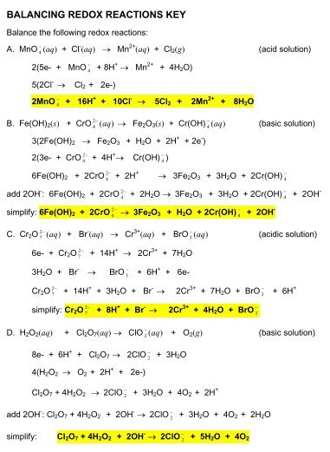
Extra Practice Problems

