Slide 1
CHE 112 Spring 2021
Lecture 15b – Equilibrium Problems
Overview/Topics
Whatever didn’t fit in 15a!
Lewis Acids and Bases
Couple Equilibrium
Skills to Master
HW 15 b
Read
OER 15.2-15.3

Slide 2
Review 14.1
Arrhenius Definition
Acid – dissociates to produce excess H⁺ ions in water
Base – dissociates to produce excess OH⁻ ions in water
Bronsted-Lowry Definition
Acid – Proton (H⁺) donor
Base – Proton (H⁺) acceptor
Lewis Definition
Acid – electron pair acceptor
Base – electron pair donor

Slide 3
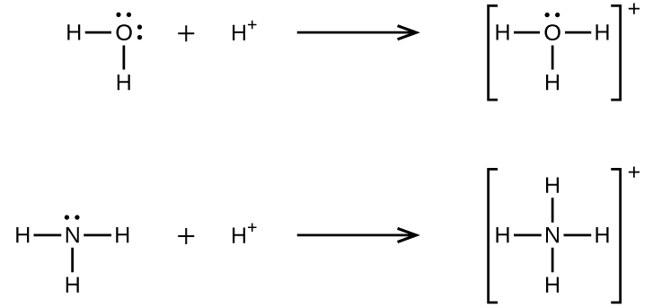
Lewis Definition
Acid – electron pair acceptor
Base – electron pair donor
Coordinate Covalent Bond
1 molec. Supplies both e⁻ in a bond
Explains existing acids/bases:
Lewis Acid-Base Adduct

Slide 4
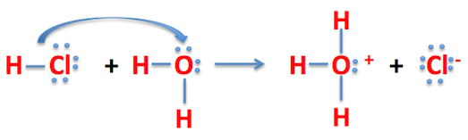
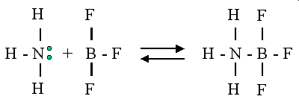
Which compound is the Acid/Base in each reaction?
Even more compounds can be Acids or Bases
Acid – needs electrons
Base – unshared pair of electrons

Slide 5
Formation of Complex Ions
“Coordination Complex”
“Ligands”
Identify:
Lewis Acid
Lewis Base
Acid-Base Adduct
Complex Ion

Slide 6
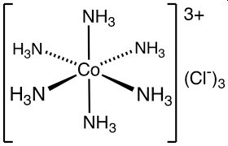
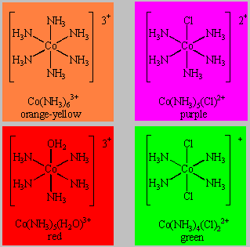
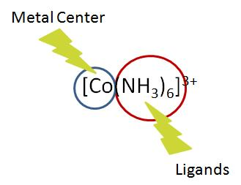
Identify:
Lewis Acid
Lewis Base
Acid-Base Adduct
Complex Ion
Co⁺³ + 6 NH₃

Slide 7
Very Colorful Chemistry!

Slide 8
Very Colorful Chemistry!

Slide 9
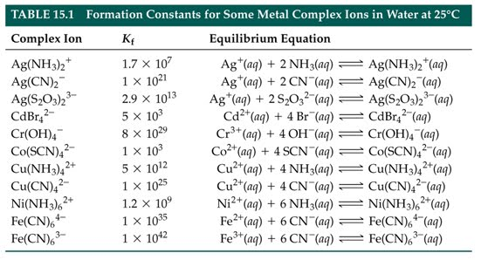
Complex Ions and Equilibrium
Appendix K
Just another example of K_{c} or K_{eq}
K_{f} = formation constant (forward)
K_{d} = decomposition constant (reverse)

Slide 10
Try It:
Calculate the concentration of each species in solution for a 0.2 M solution of [AlF₆]⁻³ given that K_{f} = 7 x 10⁺¹⁹

Slide 12
Coupled Equilibria
Equilibria = plural of equilibrium (2+)
Really just Le Chatlier’s Principle again
AgCl (s)
Ag⁺¹ (aq) + Cl⁻¹ (aq)
K_{sp} = 1.6 x 10⁻¹⁰
Calculate Solubility in Pure H₂O

Slide 13
Add a second reaction that removes Ag⁺¹ from solution (and forms a complex ion)
Apply Le Chatlier’s Principle (reaction shifts…)
AgCl (s)
Ag⁺¹ (aq) + Cl⁻¹ (aq)
K_{sp} = 1.6 x 10⁻¹⁰
Now Prove it Mathematically
AgCl (s)
Ag⁺¹ (aq) + Cl⁻¹ (aq)
K_{sp} = 1.6 x 10⁻¹⁰
Ag⁺¹ (aq) + 2 NH₃ (aq)
Ag(NH₃)₂⁺² (aq)
K_{sp} = 1.5 x 10⁷

Slide 14
Add 1.0 M NH₃ solution, what is the solubility of Ag⁺
AgCl (s) + 2 NH₃ (aq)
Ag(NH₃)₂⁺² (aq) + Cl⁻¹ (aq)
K = 2.4 x 10⁻³

Slide 15
Another Example:
Calculate:
Solubility in pure water
pH in pure water
Solubility in 0.1 M NaOH
Given: K_{sp} for Zn(OH)₂ = 4.1 x 10⁻¹⁷
K_{f} for Zn(OH)₄⁻² (aq) = 3.0 x 10¹⁵

