Slide 1
CHE 112 Spring 2021
Lecture 14e – Titrations
Overview/Topics
Titrations – 4 steps
Initial
Base < > Acid
Neutralization
Base <> Acid
Titration Calculations for:
SA/SB
wa/SB
SA/wb
Titration Qualitative
wa/wb
Polyprotic Acids
Skills to Master
HW 14d
Read
OER 14.7
https://chem.libretexts.org/Bookshelves/General_Chemistry/Map%3A_Principles_of_Modern_Chemistry_(Oxtoby_et_al)/UNIT_4%3A_EQUILIBRIUM_IN_CHEMICAL_REACTIONS/15%3A_AcidBase_Equilibria/15.6%3A_Acid-Base_Titration_Curves

Slide 2
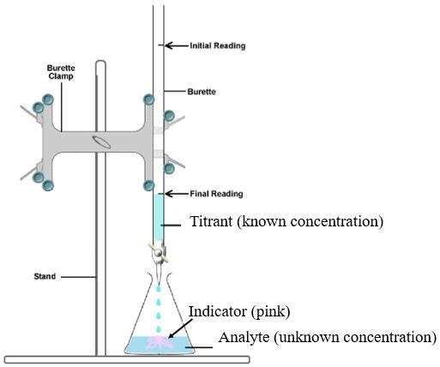
Titration
“Neutralization”
Method to determine the concentration or amount of an unknown substance by reacting it with a known substance
A + B → C + D
Conc. (M)
Vol. (V)
Conc. (M)
Vol. (V)
Known Concentration
Known Volume
Given any 3 value’s can solve for the missing value.
Indicator – Changes color when:
[A] = [B]
Review
OER Textbook – Ch 7.5
Lecture 7h
Lab 5
Unknown Concentration
Known Volume or Mass

Slide 3
Titrations - Overview
Previously - solved only at neutralization using know values and strong acids/bases
New Goal – Solve for pH for any point (volume of acid and base) for any combination of SA/SB/wa/wb
Types of Problems
4 Calculations for Each Problem
SA/SB
wa/SB
wb/SA
Wa/wb
Polyprotic Acid/SB
Adding base to acid
or
Adding acid to base
Initial/Starting pH
[Acid] > [Base]
[Base] = [Base]
[Acid] < [Base]
Initial/Starting pOH
[Base] > [Acid]
[Base] = [Acid]
[Base] < [Acid]
Tools:
M₁V₁ = M₂V₂
ICE Charts
pH = -log[H+] etc
Units: mol/L = mmol/mL
Extra Step:
pOH → pH

Slide 4
pH in Pure Water
Titration SA/SB
B > A
Acid = Base
A > B
Initial

Slide 5
Strong Acid + Strong Base
B > A
Initial – Normal SA or SB problem
[Base] < [Acid]
[Base] = [Acid]
[Base] > [Acid]
Acid = Base
pH = -log[H⁺]
A > B
Initial
$$pH=−log\left(\frac{mmol H^{+}extra}{TV}\right)$$
Calculate M₁V₁ = M₂V₂
pH = 7
$$pOH=−log\left(\frac{mmol {OH}^{−}extra}{TV}\right)$$

Slide 6
Example:
Titrate 30.0 mL of 0.10 M HCl is titrated with 0.20 M NaOH.
Calculate the pH at the following values:
0.0 mL of NaOH
10.0 mL of NaOH
15.0 mL of NaOH
20.0 mL of NaOH
Initial = 30.0 mL 0.10 M HCl
0.0 mL of 0.20 M NaOH

Slide 7
B < A = 30.0 mL 0.10 M HCl
10.0 mL of 0.20 M NaOH
B = A 30.0 mL 0.10 M HCl
15.0 mL of 0.20 M NaOH

Slide 8
B > A = 30.0 mL 0.10 M HCl
20.0 mL of 0.20 M NaOH

Slide 9
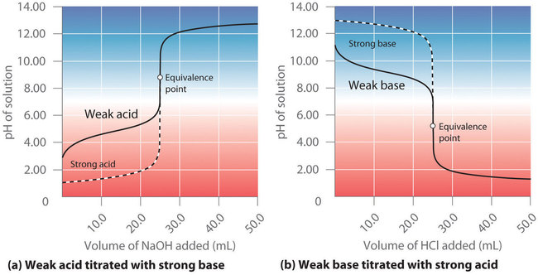
weak acid + Strong Base
Initial – all wa
[Base] < [Acid]
[Base] = [Acid]
[Base] > [Acid]
ICE Chart - wa
$$pH=pK_{a}+log\left(\frac{mmol base}{mmol acid}\right)$$
Calculate M₁V₁ = M₂V₂
Double Check:
wa + SB – pH >7
wb + SA – pH < 7
ICE Chart – wb (conjugate)
$$pOH=−log\left(\frac{mmol {OH}^{−}extra}{TV}\right)$$

Slide 10
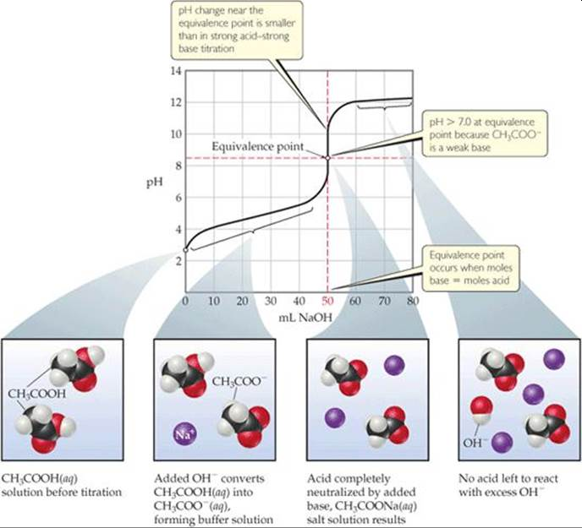
weak acid + Strong Base
Just another way to view the information
ICE - wa
HHE - buffer
ICE - cb
SB

Slide 11
Example:
Titrate 30.0 mL of 0.10 M Acetic Acid (AA) is titrated with 0.10 M NaOH.
K_{a} = 1.81x10⁻⁵
Calculate the pH at the following values:
0.0 mL of NaOH
15.0 mL of NaOH
30.0 mL of NaOH
45.0 mL of NaOH
Initial = 30.0 mL 0.10 M AA
0.0 mL of 0.10 M NaOH

Slide 12
B < A = 30.0 mL 0.10 M AA
15.0 mL of 0.10 M NaOH

Slide 13
B = A 30.0 mL 0.10 M AA
30.0 mL of 0.10 M NaOH

Slide 14
B > A = 30.0 mL 0.10 M HCl
45.0 mL of 0.10 M NaOH

Slide 15
Effect of wa strength on titration curve

Slide 16
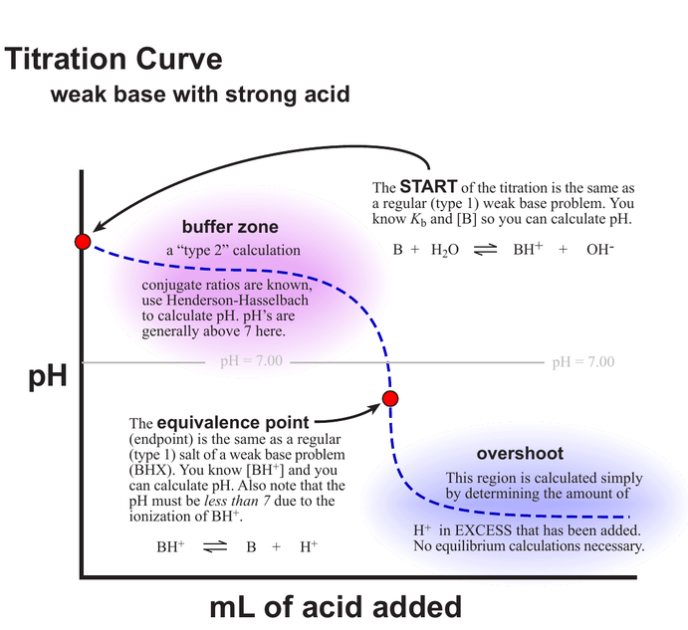
weak base + Strong Acid
Opposite of last problem
Different way to illustrate the 4 regions
Use this or 4 step process

Slide 17
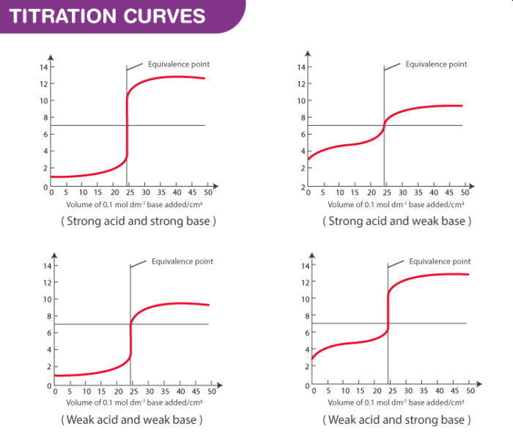
weak acid + weak base
Complicated – won’t do calculations

Slide 18
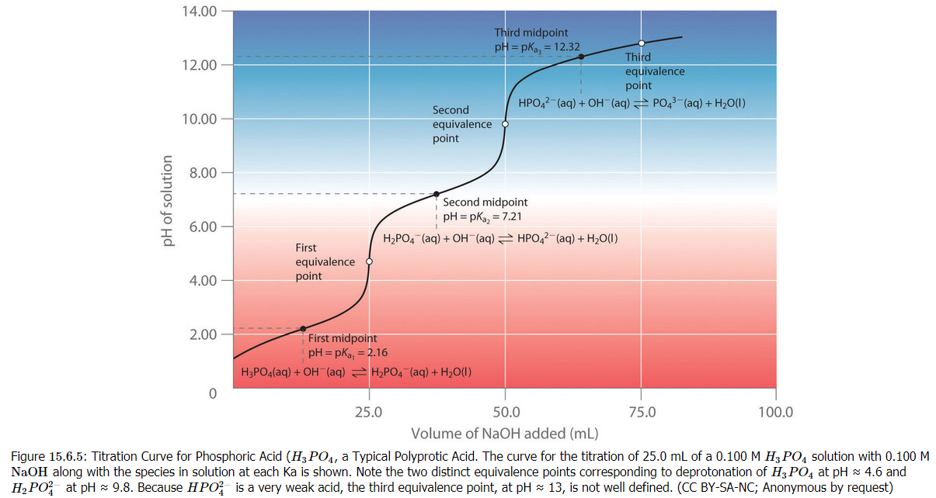
Polyprotic Acid+ Strong Base
Complicated – won’t do calculations

Slide 19
Summary
2 Types of Titrations
SA/SB vs SB/SA
wa/SB vs wb/SA
4 Step process x2
Excel is your friend?

