Slide 1
CHE 112 Spring 2021
Lecture 14 d – Buffer Solutions
Overview/Topics
Definition of Buffers
Buffer Strengths
Making Buffer Solutions
Examples of Buffer Systems
Buffer Math
Henderson-Hasselbalch Equation (HHE)
Skills to Master
HW 14 d
Read
OER 14.5-14.6

Slide 2
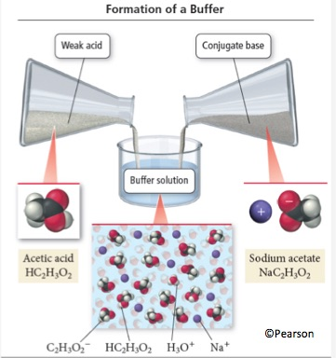
Buffers
Solutions that are resistant to changes in pH
wa + salt of conjugate base
wb + salt of conjugate acid
Salt = anion of SA
cation of SB
Weak Acid
Salt of Weak Acid
Replace H with Metal Ion

Slide 3
How Buffers Work
Acid + Base = Salt + Water
HC₂H₃O₂ + NaOH → NaC₂H₃O₂ + H₂O
Salt CB + Acid = Weak Acid + Salt
NaC₂H₃O₂ + HCl → HC₂H₃O₂ + NaCl
Equilibrium
HC₂H₃O₂ (aq) + H₂O (l) ↔ H₃O⁺ (aq) + C₂H₃O₂⁻ (aq)

Slide 4
You Try It:
Which of the following is a Buffer Systems?
H₂SO₄ / Na₂SO₄
HF / KF
NH₃ / NH₄Cl
NaOH / KOH
HC₂H₂O₂ / HF
You Try It:
To make a buffer system you could add which of the following to HNO₂:
HNO₃
NaNO₂
NaOH
Mg(NO₂)₂
KC₂H₃O₂

Slide 5
Buffer Capacity
Buffer Effectiveness
DP to [ ]
DP to Volume
Ratio of [A]:[B]
Most effective near 1
Acceptable 0.1-10
pKa = +/- 1 of desired pH

Slide 6
Review Ch. 13
Buffer Math
Write eqn
ICE chart
Choose x
Solve
Calc. pH
pH HF
Initial pH of Buffer
pH after addition of base
pH after addition of acid
pH of pure HF Solution:
0.1 M HF K_{a} (HF) = 7.1 x 10⁻⁵

Slide 7
pH Initial Solution:
0.1 M HF + 0.1 M NaF K_{a} (HF) = 7.1 x 10⁻⁵

Slide 8
pH after addition of Base:
0.1 M HF + 0.1 M NaF K_{a} (HF) = 7.1 x 10⁻⁵
Add 0.01 M NaOH
Compare to 0.01 M NaOH alone

Slide 9
pH after addition of Acid:
0.1 M HF + 0.1 M NaF K_{a} (HF) = 7.1 x 10⁻⁵
Add 0.01 M HCl
Compare to 0.01 M HCl alone

Slide 10
Summary:
Solution | pH
Pure 0.1 M HF: | 2.07
Buffer 0.1 M HF and 0.1 M NaF | 4.15
After adding Base: | 4.23
After adding Acid: | 4.06

Slide 11
Buffer vs No Buffer:
Calculate the [HCl] required to have the same pH as a 0.1 M HF + 0.1 M (4.15)
Calculate the pH after addition of 0.01 M NaOH
Compare the Buffered system and Non-buffered system

Slide 12
Henderson-Hasselbalch Equation
“Buffer Shortcut”
$$pH=pK_{a}+log\frac{[Base]}{[Acid]}$$
Double Check!
[Acid] > [Base] then pH < pK_{a}
[Acid] = [Base] then pH = pK_{a}
[Acid] < [Base] then pH > pK_{a}

Slide 13
Example:
What is the pH of a buffer made from 0.2 M NH₃ and 0.3 M NH₄Cl?
From Appendix
K_{b} = 1.8 x 10⁻⁵

Slide 14
Example:
Prepare a buffer with pH = 4.0
From Appendix
Compound | pK_{a}
Formic Acid | 3.77
Lactic Acid | 3.85
Ascorbic Acid | 4.10
Benzoic Acid | 4.20

Slide 15
Example:
Prepare a buffer with pH = 9.0
From Appendix

Slide 16
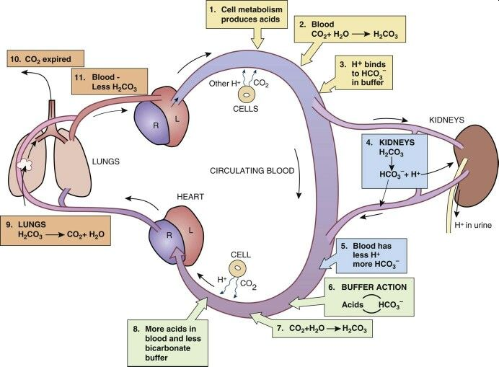
Important Buffer Systems
Not on exam

Slide 17
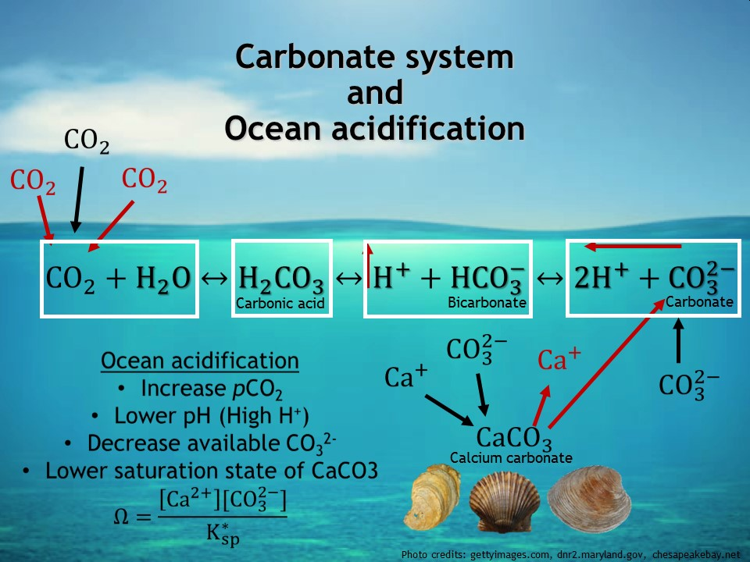
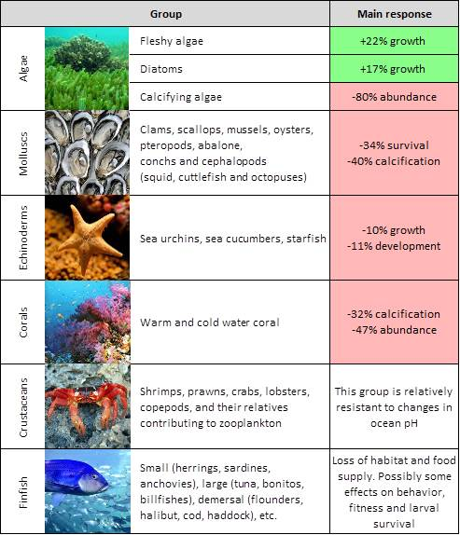
Ocean Acidification
Not on exam

