Slide 1
CHE 112 Spring 2021
Lecture 14 c – Acid/Base Properties of Salts
Overview/Topics
Writing Acid/Base Reactions
A/B Properties of Salts (Hydrolysis of Salts)
SA/SB
wa/SB
SA/wb
wa/wb
Hydrated Cations
Amphoteric Compounds
Skills to Master
HW 14 c
Read
OER 14.4-14.5

Slide 2
Writing Acid/Base Reactions
Acids
Bases
donate H⁺ ions
make H₃O⁺
Cations react with water to produce acids
accept H⁺ ions
make OH⁻
Anions react with water to produce bases
Opposites Attract
Example:
Complete the following reaction of caffeine, a weak base with water.
C₈H₁₀N₄O₂ (aq) + H₂O (l) ↔
Example:
Complete the following reaction of Nitrous acid, a weak acid with water.
HNO₂ (aq) + H₂O (l) ↔

Slide 3
Opposites Attract
Example:
Complete the following reactions:
C₆H₅NH₃⁺ (aq) + H₂O (l) ↔
SO₄⁻² (aq) + H₂O (l) ↔

Slide 4
Hydrolysis of Salts or pH of Salt Solutions
Salt = cation/anion
Cation + Water ↔ ??
Anion + Water ↔ ??
4 Types of Solutions
SA + SB
wa + SB
SA + wb
wa + wb
Cl⁻¹, Br⁻¹, I⁻¹,
NO₃⁻¹, ClO₄⁻¹, SO₄⁻²
Li⁺, Na⁺, K⁺,
Ca⁺², Sr⁺², Ba⁺²
Cation
Anion
Will the cation react with water?
Will the anion react with water?
If both react….
Memorize?
Cation | Anion | pH | Examples
SB | SA | Neutral | Cation = above Anions = above | NaCl
wb | SA | Acidic | Cation = not listed above Anion = listed above | NH₄Cl
SB | wa | Basic | Cations = listed above Anion = not anion of SA | NaF
wb | wa | Depends on ka/Kb | Cation = not listed above Anion = not listed above | NH₄F

Slide 5
Cation of SB + Anion SA
Li⁺, Na⁺, K⁺,
Ca⁺², Sr⁺², Ba⁺²
Cl⁻¹, Br⁻¹, I⁻¹,
NO₃⁻¹, ClO₄⁻¹, SO₄⁻²
Cation
Anion
Example:
NaCl
Example:
Ba(NO₃)₂

Slide 6
Cation of wB + Anion SA
Li⁺, Na⁺, K⁺,
Ca⁺², Sr⁺², Ba⁺²
Cl⁻¹, Br⁻¹, I⁻¹,
NO₃⁻¹, ClO₄⁻¹, SO₄⁻²
Cation
Anion
Example:
NH₄Cl
Example:
(C₆H₅NH₃)⁺¹ ₂SO₄

Slide 7
Cation of SB + Anion wA
Li⁺, Na⁺, K⁺,
Ca⁺², Sr⁺², Ba⁺²
Cl⁻¹, Br⁻¹, I⁻¹,
NO₃⁻¹, ClO₄⁻¹, SO₄⁻²
Cation
Anion
Example:
NaF
Example:
Ca(C₂H₃O₂)₂

Slide 8
Cation of wB + Anion wA
Li⁺, Na⁺, K⁺,
Ca⁺², Sr⁺², Ba⁺²
Cl⁻¹, Br⁻¹, I⁻¹,
NO₃⁻¹, ClO₄⁻¹, SO₄⁻²
Appendix H and I or given
K_{w} = K_{a} x K_{b}
Cation
Anion
Strength of wa/wb | pH
K_{a} (cation) > K_{b} (anion) | Acidic
K_{a} (cation) > K_{b} (anion) | Basic
K_{a} (cation) ≈ K_{b} (anion) | Neutral
Example:
NH₄F
Appendix H and I
K_{a} (HF) = 6.4 x 10⁻⁴
K_{b} (NH₃) = 1.8 x 10⁻⁵

Slide 9
You Try It:
LiBr
Na₂SO₄
Al₂(CO₃)₃
AlCl₃

Slide 10
You Try It:
LiBr
Na₂SO₄
Al₂(CO₃)₃
AlCl₃

Slide 11
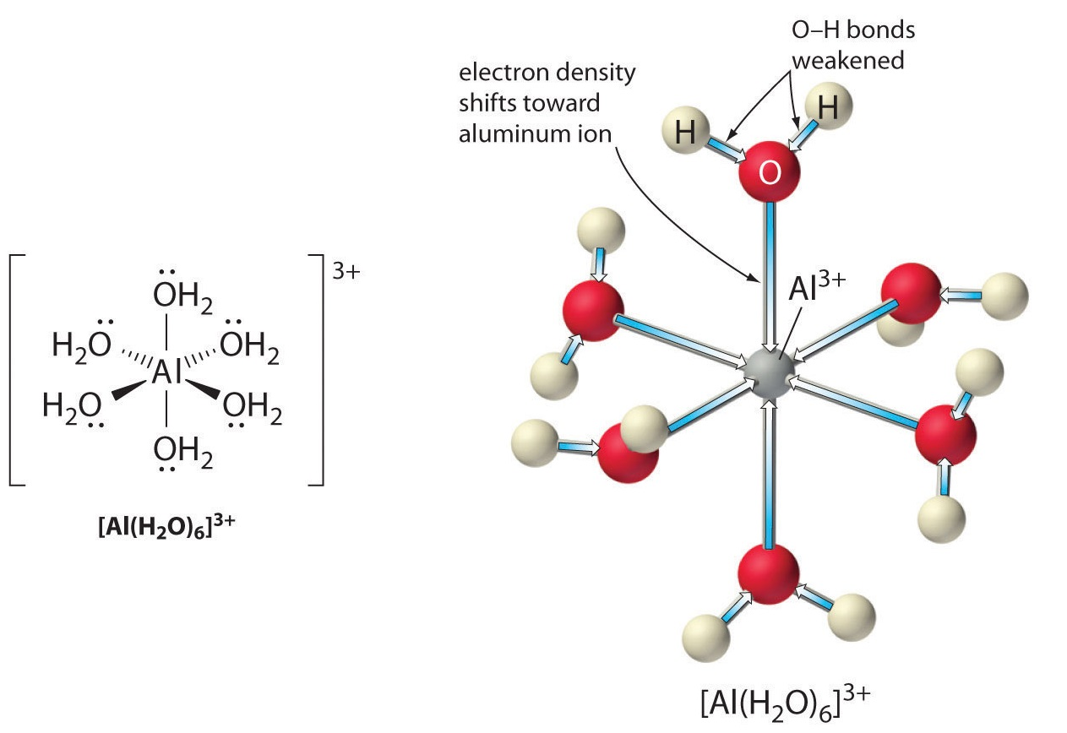
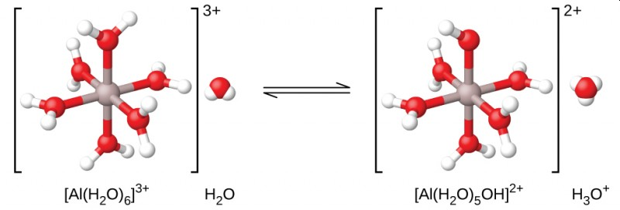
Small, highly charged metal cations react with water to for ma hydration shell (or complex ion) which allows them to act as acids
Hydrated Metal Ions
≠alkali or alkaline earth metals
DP to charge
IP to size
Al⁺³ (aq) + 6 H₂O (l) ↔ Al(H₂O)₆⁺³ (aq)
Al(H₂O)₆⁺³ (aq) + H₂O (l) ↔ [Al(H₂O)₅OH]⁺² (aq) + H₃O⁺ (aq)
K_{a} = 1.4 x 10⁻⁵
Know Concept
Don’t memorize the ions

Slide 12
Amphoterism
a molecule or ion that can react both as an acid and as a base.
Also applies to ions like: HCO₃⁻
HCO₃⁻ (aq) + H₂O ↔ CO₃⁻² (aq) + H₃O⁺ (aq)
HCO₃⁻ (aq) + H₂O ↔ H₂CO₃ (aq) + OH⁻ (aq)
Know Concept
Don’t memorize the ions

Slide 13
Other Amphoteric Compounds
H₂O!
HPO₄-², HPO₄⁻¹
HSO₃⁻¹
ZnO, PbO, Al₂O₃, VO₂ (and just about every other metal!)

