Slide 1
CHE 112 Spring 2021
Lecture 14b – K_{a}/K_{b}
Overview/Topics
Relative Strength Acids and Bases
Strong Acid/Base
Weak Acid/Base
Acid/Base Equilibrium Problems
Solve for K_{a} or K_{b}
% ionization
[ ] or pH/pOH
Skills to Master
HW 14b
Read
OER 14.3

Slide 2
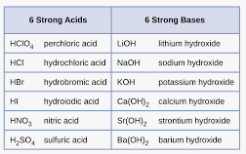
Strength of Acids and Bases
Strong Acids/Bases (SA/SB)
Weak Acids/Bases (wa/wb)
Dissociate 100% into ions
→
Memorize!
Dissociate < 10% into ions
↔ or
*If its not SA/SB it’s a wa/wb

Slide 3
Aqueous Solutions
Review
Strong Electrolytes (SE)
Weak Electrolytes (WE)
Non-Electrolytes (NE)
Dissociate 100% into ions
Conduct electricity
SA, SB, Ionic (aq)
Dissociate < 10% into ions
May conduct electricity
wa, wb
Do not dissociate
Do not conduct electricity
Molecular (nm/nm) + Ionic (s)
NaCl (s) → Na⁺ (aq) + Cl⁻ (aq)
HF (s) ↔ H⁺ (aq) + F⁻ (aq)
C₆H₁₂O₆ (s) → C₆H₁₂O₆ (aq)
0% 100%
90% 10%
0% 100%

Slide 4
Strength of wa/wb
Review – its just
Ch. 13 Equilibrium
HA (aq) + H₂O (l)
H₃O⁺ (aq) + A⁻ (aq)
B (aq) + H₂O (l)
HB⁺ (aq) + OH⁻ (aq)
[ H₃O⁺][A⁻]
[ HB⁺][OH⁻]
K_{a} =
K_{b} =
[ HA ]
[ B ]
acid-ionization constant
acid-dissociation constant
base-ionization constant
base-dissociation constant
Bigger K_{a} stronger Acid
Appendix H
Strong Acid K_{a} ≈ ∞
Bigger K_{b} stronger Base
Appendix H
Strong Base K_{b} ≈ ∞
[ H₃O⁺]_{eq}
[OH⁻]_{eq}
% Ionization =
% Ionization =
[ HA ]
[ B ]
pK_{a} = - log [K_{a}]
K_{a} = 10^{-Ka}
pK_{b} = - log [K_{b}]
K_{b} = 10^{-Kb}

Slide 5
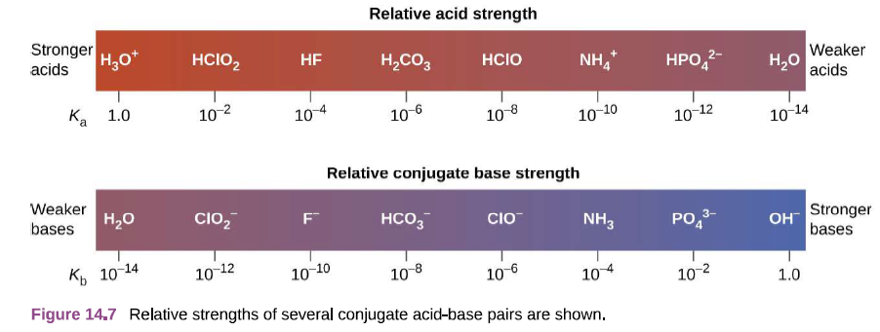
Review - Equilibrium
Relationship between K_{w} K_{a} and K_{b}
Or Conjugate acid/base pairs (HA/A⁻)
[ H₃O⁺][A⁻]
HA (aq) + H₂O (l)
H₃O⁺ (aq) + A⁻ (aq)
K_{a} =
[ HA ]
[ HA][OH⁻]
A⁻ (aq) + H₂O (l)
HA(aq) + OH⁻ (aq)
K_{b} =
[ A ]
H₂O (l) + H₂O (l)
H₃O⁺ (aq) + OH⁻ (aq)
K_{w} = [H₃O⁺][OH⁻] = 1 x 10⁻¹⁴
K_{a} · K_{b} = K_{w}
pK_{a} + pK_{b} = 14
Stronger the acid/base
he weaker the conjugate

Slide 6
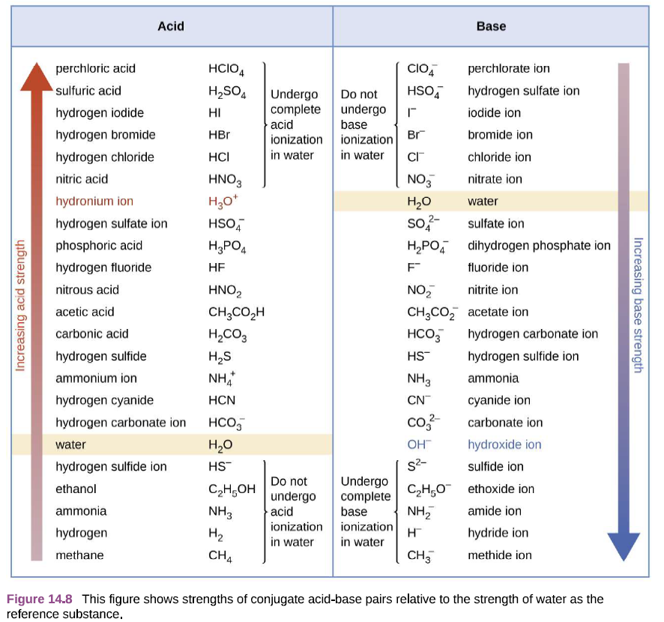

Slide 7
Example:
Calculate the % ionization for a 0.150 M solution of HF in with a pH = 2.85
(14.7)
[ H₃O⁺]_{eq}
% Ionization =
[ HA ]

Slide 8
K_{a} · K_{b} = K_{w}
Example:
Calculate the K_{b} for the HAsO₄⁻² ion given K_{a} = 3.0 x 10⁻¹²
(14.8)

Slide 9
Types of Problems
Given K_{a} find K_{b}
Calculate pH of:
SA/SB
wa/wb
Given [HA] and pH calculate K_{a}
Given [HA] and K_{a} calculate pH
% Dissociation
Tools
Write chemical equation
Write K_{eq} equations
Write ICE Charts

Slide 10
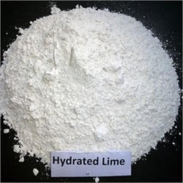
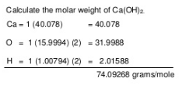
Example:
SB
What is the pH of a solution in which 5.0 g of Ca(OH)₂ is dissolved in 350. mL of water ?

Slide 11
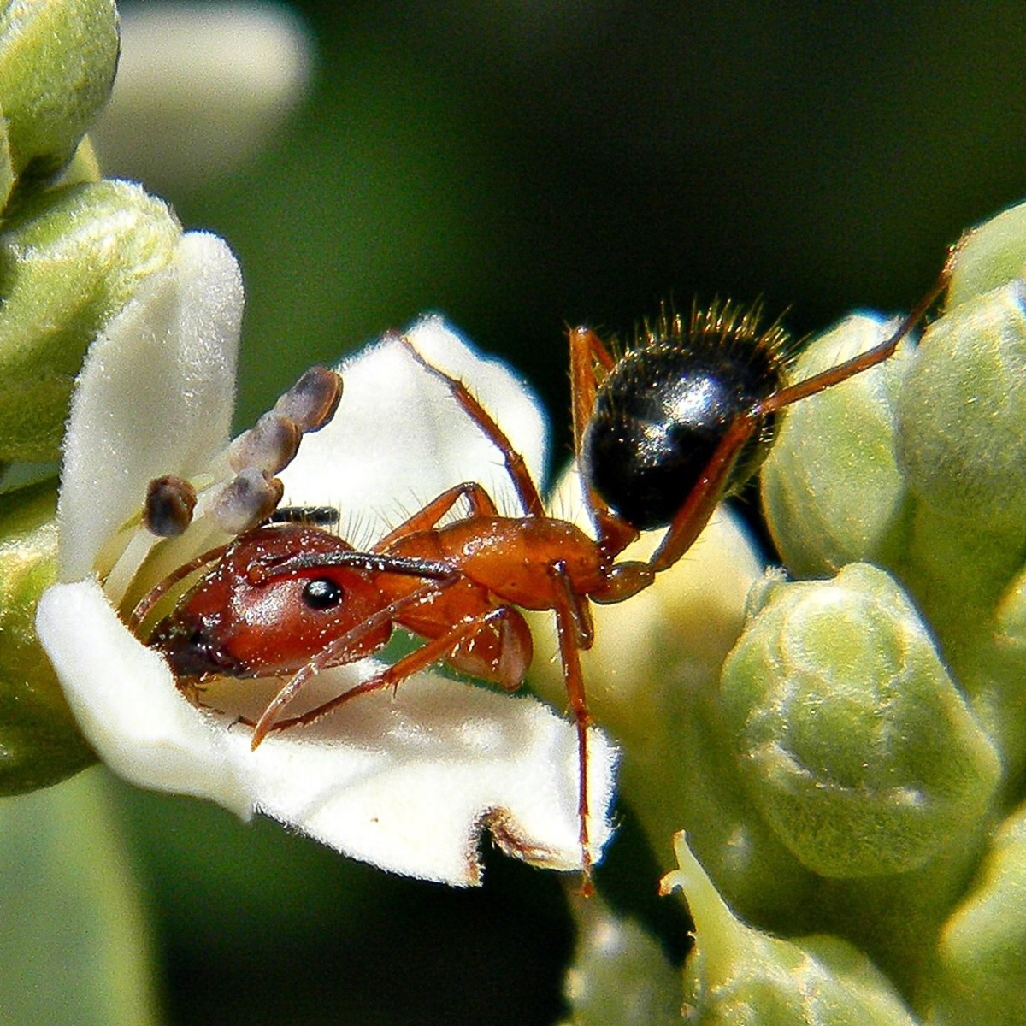
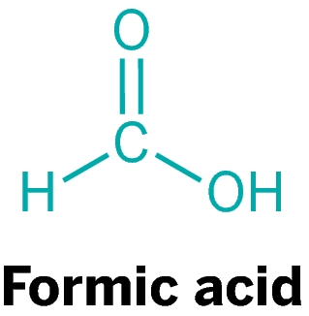
Example:
(14.11)
Given a 0.10 M solution of Formic Acid (HCHO₂) with pH = 2.38
Calculate K_{a}
Calculate % dissociation
Calculate pK_{a}
wa

Slide 13
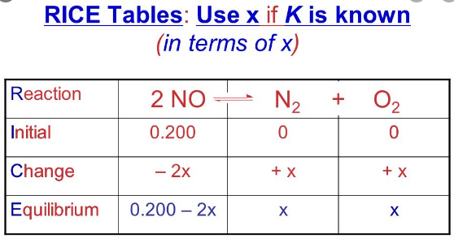
Assumptions – Making life easy…
“weak” acids or bases dissociate a small amount (<5%)
Shortcut to avoid solving some quadratics
Always double check your assumptions (essentially same as % dissociation)
Assume x << 0.200
Examples – next slides

Slide 14
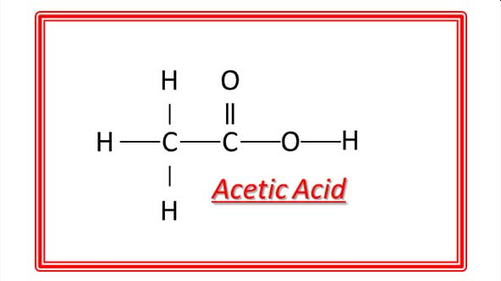
Example:
(14.12)
Given a 0.30 M solution of Acetic Acid (CH₃COOH) with K_{a} =1.8 x 10⁻⁵
Calculate [H⁺]
Calculate pH
Calculate % dissociation
wa

Slide 16
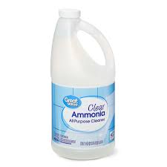
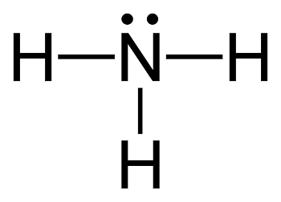
Example:
(14.13)
Given a 0.15 M solution of Ammonia (NH₃) with K_{b} =1.8 x 10⁻⁵
Calculate [H⁺]
Calculate pH
Calculate % dissociation
wb

Slide 18
Example:
(14.14)
I’m tired, look in your book!

