Slide 1
CHE 112 Spring 2021
Lecture 14a – Acids and Bases
Overview/Topics
Acid-Base Definitions
Arrhenius
Bronsted-Lowry
Lewis
Terminology
Conjugate acid/base
Proton/Hydronium Ion
Autoionization
Amphoteric
pH and pOH scales
Measuring pH
Skills to Master
HW 14a
Read
OER 14.1-14.2

Slide 2
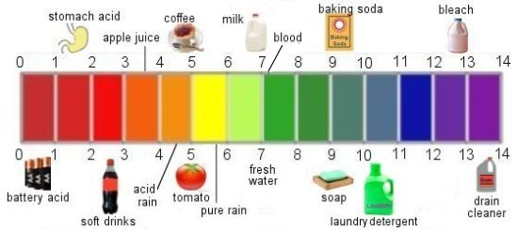
Acids
Bases
H
Anion or Polyatomic
Metal Atom
OH
Naming - Memorize (10)
Naming – Normal Ionic Rules
General Properties
Taste Sour
Litmus: B → R
General Properties
Taste Bitter
Slippery to touch
Litmus: R → B

Slide 3
(1859-1927)
Also discovered ion’s
Named Cation/Anion
Arrhenius Definition
Acid – dissociates to produce excess H⁺ ions in water
Base – dissociates to produce excess OH⁻ ions in water
Alternative Format
Limitations
must be in water
Miss’s some bases
HCl (aq) + H₂O → H₃O⁺ (aq) + Cl⁻ (aq)

Slide 4
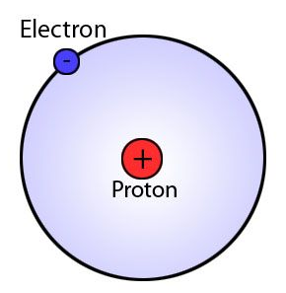
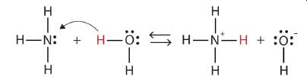
Bronsted-Lowry Definition
(1923)
Acid – Proton (H⁺) donor
Base – Proton (H⁺) acceptor
HCl (aq) + H₂O → H₃O⁺ (aq) + Cl⁻ (aq)
Donor
Acceptor
Acid - same definition
Base – broader definition
A base without OH!
Acceptor
Donor

Slide 5
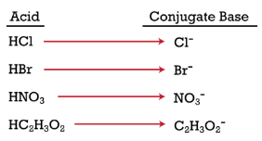
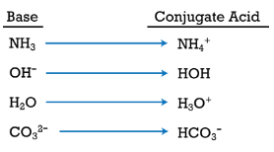
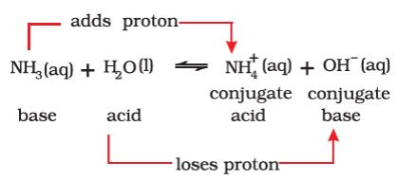
Conjugate Acids/Bases

Slide 6
Water is both an Acid and a Base
Amphoteric – can act as an acid or a base
Example
Write 2 reactions showing how the bicarbonate ion (HCO₃⁻) is amphoteric

Slide 7
Ch. 13 – Equilibrium!
Autoionization of Water
Example
Write the equilibrium equation for the autoionization of water
At equilibrium what is the concentration of each ion?
K_{w} = 1.0 x 10⁻¹⁴ at 25°C

Slide 8
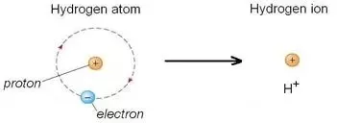
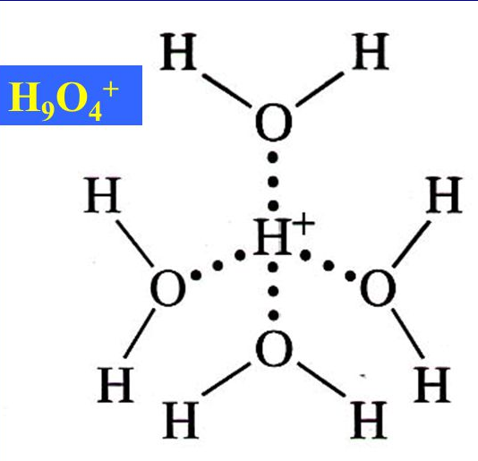
Different Ways to Write Acid Reactions
Hydrogen Ion
Bare Proton
HCl (aq) + H₂O → H₃O⁺ (aq) + Cl⁻ (aq)
Hydronium Ion
Don’t learn this
Its all the same:
H⁺, Proton
Hydronium Ion

Slide 9
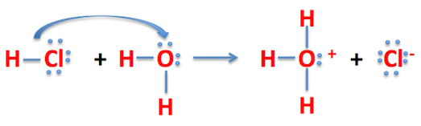
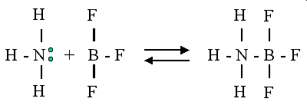
Lewis Definition
Acid – electron pair acceptor
Base – electron pair donor
Even more compounds can be Acids or Bases
Acid – needs electrons
Base – unshared pair of electrons

Slide 10
Summary
Acid – dissociates to produce excess H⁺ ions in water
Base – dissociates to produce excess OH⁻ ions in water
Expands dfn. of Base
Acid – Proton (H⁺) donor
Base – Proton (H⁺) acceptor
Expands dfn. of A and
Acid – electron pair acceptor
Base – electron pair donor
H₃O⁺
Its all the same:
H⁺, Bare Proton, H₃O⁺
Hydronium Ion

Slide 11
[ ] = concentration
Acidic, Basic and Neutral Solutions
Acid – dissociates to produce excess H⁺ ions in water
Base – dissociates to produce excess OH⁻ ions in water
1 M
1 M
1 x 10⁻⁷ M
1 x 10⁻⁷ M
New Definitions
Acid: [H⁺] > [OH⁻] or [H⁺] > 1 x 10⁻⁷ M
Neutral: [H⁺] = [OH⁻] or [H⁺] = 1 x 10⁻⁷ M
Base: [H⁺] < [OH⁻] or [H⁺] < 1 x 10⁻⁷ M
In 1 billion water molecules
You will have 1 H⁺ and 1 OH⁻

Slide 12
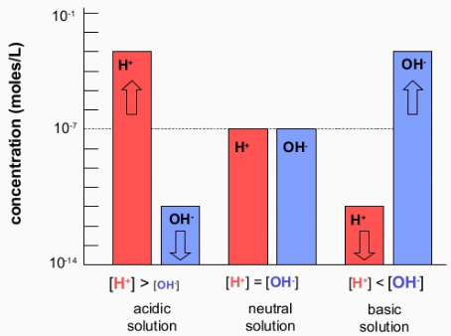
Concentration Scale
[ ] = concentration
Acid: [H⁺] > [OH⁻] or [H⁺] > 1 x 10⁻⁷ M
Neutral: [H⁺] = [OH⁻] or [H⁺] = 1 x 10⁻⁷ M
Base: [H⁺] < [OH⁻] or [H⁺] < 1 x 10⁻⁷ M
Acidic
Basic
Neutral
[H⁺] > 1 x 10⁻⁷ M
[H⁺] = 1 x 10⁻⁷ M
[H⁺] < 1 x 10⁻⁷ M

Slide 13
pH Scale
Calculator
Huge range of value - [H⁺] can go from 10¹-10⁻¹⁴ M
People don’t like M
Convenience (1-14 is easier)
10^{x}
log
pH = - log [H⁺]
[H⁺]= 10^{-pH}
[H⁺] > 1 x 10⁻⁷ M
[H⁺] = 1 x 10⁻⁷ M
[H⁺] < 1 x 10⁻⁷ M
Acidic
Neutral
Basic

Slide 14
pH = - log [H⁺]
SF and Log Scales
[H⁺]= 10^{-pH}
# in front is NOT as SF
Only numbers after . Are SF
Example
pH = 5.25
Example
3 SF
2 SF
Convert [H⁺] = 8.65 x 10⁻⁹ M to pH
Not a SF
[H⁺] = 5.6 x 10⁻⁶ M
pH = 8.063
2 SF
3 SF
Not a SF

Slide 15
You Try It:
Convert pH = 9.25 to [H⁺]
Is the solution A/B/N?
Convert [H⁺] = 4.56 x 10⁻⁵ M to pH
Is the solution A/B/N?

Slide 16
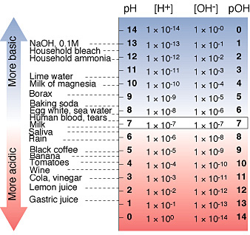
[OH]- and pOH Scales
Same as [H⁺] and pH scales
Reversed definitions of Acid/Base/Neutral

Slide 17
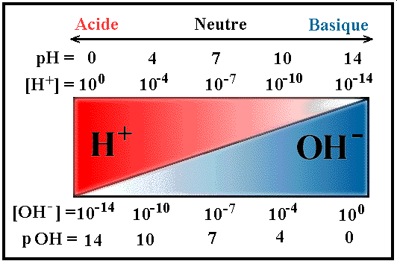
Summary
 | Acidic | Neutral | Basic
[H⁺] | > 10⁻⁷ M | = 10⁻⁷ M | < 10⁻⁷ M
pH | < 7 | = 7 | > 7
[OH⁻] | < 10⁻⁷ M | = 10⁻⁷ M | > 10⁻⁷ M
pOH | > 7 | =7 | < 7
pH to [Conc]
[Conc] to pH
[H⁺] = 10^{-pH}
pH = - log [H⁺]
[OH⁻] = 10^{-pOH}
pOH = - log [OH⁻]
[H⁺] [OH⁻] = 10⁻¹⁴ M
pH + pOH = 14
Double Check
pH = 1.50 then [H+] = 3.2 x 10⁻² M
pH = 7 then [H+] = 1 x 10⁻¹⁴ M
pH = 10.805 then [H+] = 1.57 x 10⁻¹¹ M
SF’s

Slide 18
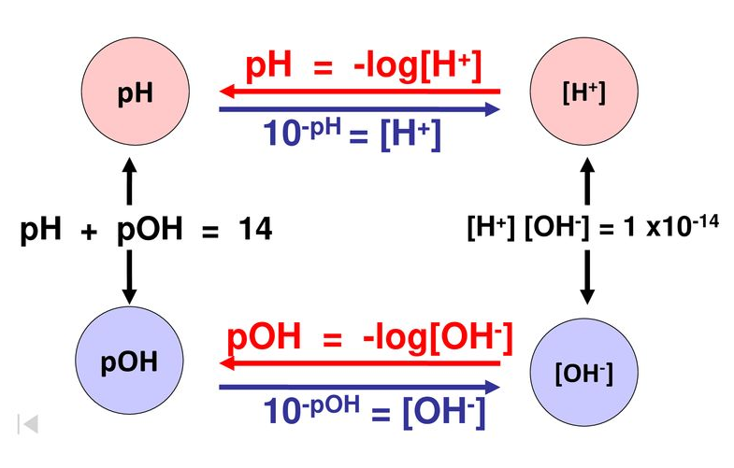
Acid/Base Calculations

Slide 19
Acid/Base Square
pOH = -log[OH⁻]
[OH⁻]
[OH⁻] = 10^{-pH}
pOH
10⁻¹⁴ M
Basic
14
10⁻⁷ M
Neutral
7
[H⁺][OH⁻] = 10⁻¹⁴ M
pH + pOH = 14
10⁻¹ M
Acidic
1
[H⁺]
pH = -log[H⁺]
pH
[H⁺] = 10^{-pH}

Slide 20
You Try It:
Convert pOH = 4.55 to [OH⁻]
Is the solution A/B/N?
Convert [OH⁻] = 1.25 x 10⁻¹² M to pOH
Is the solution A/B/N?
Convert pOH = 8.25 to [H⁺]
Is the solution A/B/N?
Convert [OH⁻] = 2.9 x 10⁻⁹ M to pH
Is the solution A/B/N?

