Slide 1
CHE 112 Spring 2021
Lecture 13d – Gibbs Free Energy and Equilibrium
Overview/Topics
Review of Spontaneous/Nonspont.
Review of Gibbs Free Energy
Linking Gibbs Free Energy and Equilibrium
Problems!
Skills to Master
HW 13d
Read
OER 13.4

Slide 2
Relationship Between Free Energy (ΔG) and Equilibrium (K_{c})
Gibbs Free Energy – measure of driving force behind a reaction
Relationship between
ΔG | Spont/Non | Equilibrium | Value K_{c}
- | Spontaneous | Forward Reaction (Qc < Kc) | > 1 (Favors P)
0 | Equilibrium | Equilibrium (Qc = Kc) | = 1 (R = P)
+ | Nonspontaneous | Reverse Reaction (Qc > Kc) | < 1 (Favors R)
Similar Fig 13.10

Slide 3
Free Energy (ΔG) and Equilibrium (K_{c}) under Nonstandard Conditions
At Equilibrium:
Q_{c} = K_{c} and ΔG = 0
ΔG = ΔG° + RT ln Q_{c}
° = STP (from tables)
R = gas constant 8.314 J/mol·K
T = Temp (K)
$$K_{c}=e^{−\frac{{∆G}^{°}}{RT}}$$
ΔG° = -RT ln K_{c}

Slide 4
Example:
N₂ (g) + 3 H₂ (g) 2 NH₃ (g)
Given the following non-equilibrium conditions:
[N₂] = 1.0 M
[H₂] = 3.0 M
[NH₃] = 0.5 M
ΔG° = 33.1 kJ/mol (from tables)
Calculate ΔG at 298 K
Is the reaction spontaneous or nonspont.?
In what direction does the reaction proceed?
ΔG = ΔG° + RT ln Q_{c}

Slide 6
Example:
ΔG° = -RT ln K_{c}
N₂ (g) + 3 H₂ (g) 2 NH₃ (g)
Calculate K_{c} for the reaction given ΔG° = 33.1 kJ/mol
$$K_{c}=e^{−\frac{{∆G}^{°}}{RT}}$$
Aside:
K_{c} (300 °C) = 4.31x10⁻³
K_{c} (600 °C) = 2.25x10⁻³
Strongly Favors R, but much much faster at higher temperatures

Slide 7
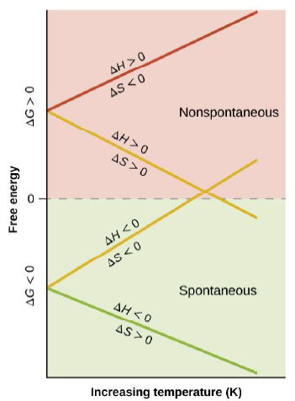
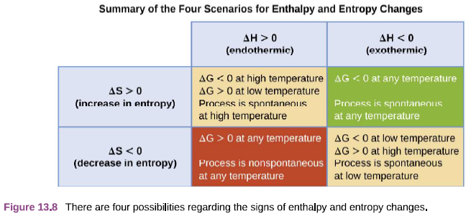
Review – Ch. 12b
Temperature and Spontaneity

Slide 8
Summary…sorta
Equilibrium
(K_{c})
ΔG° = -RT ln K_{c}
$$K_{c}=e^{−\frac{{∆G}^{°}}{RT}}$$
Kinetics
Rates
Ch. 17
Thermodynamics
(ΔG)

