Slide 1
CHE 112 Spring 2021
Lecture 13b – Equilibrium Problems I
Overview/Topics
3 Types of Problems
Extent of the Reaction (Favor R/P/Both)
Direction of Reaction
[ ] of R and P at equilibrium (2 versions)
Skills to Master
HW 13b
Read
OER 13.4

Slide 2
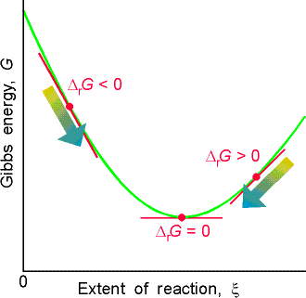
Q_{c} = Reaction Quotient
Reaction Quotient (any value)
Calculated
Current state of the reaction
Allows determination of Direaction
Method 1 - Memorize
K_{c} = 50
Q_{c} < K_{c} : R → P
Q_{c} = K_{c} : Equilibrium
Q_{c} > K_{c} : R ← P

Slide 3
Example
Given
K_{c} = 2.79x10⁻⁵
[N₂] = 61.2 M
[H₂] = 122 M
[NH₃] = 130 M
N₂ (g) + 3 H₂ (g)
2 NH₃ (g)
Does the reaction favor the R/P/Both?
In which direction will the reaction proceed?

Slide 4
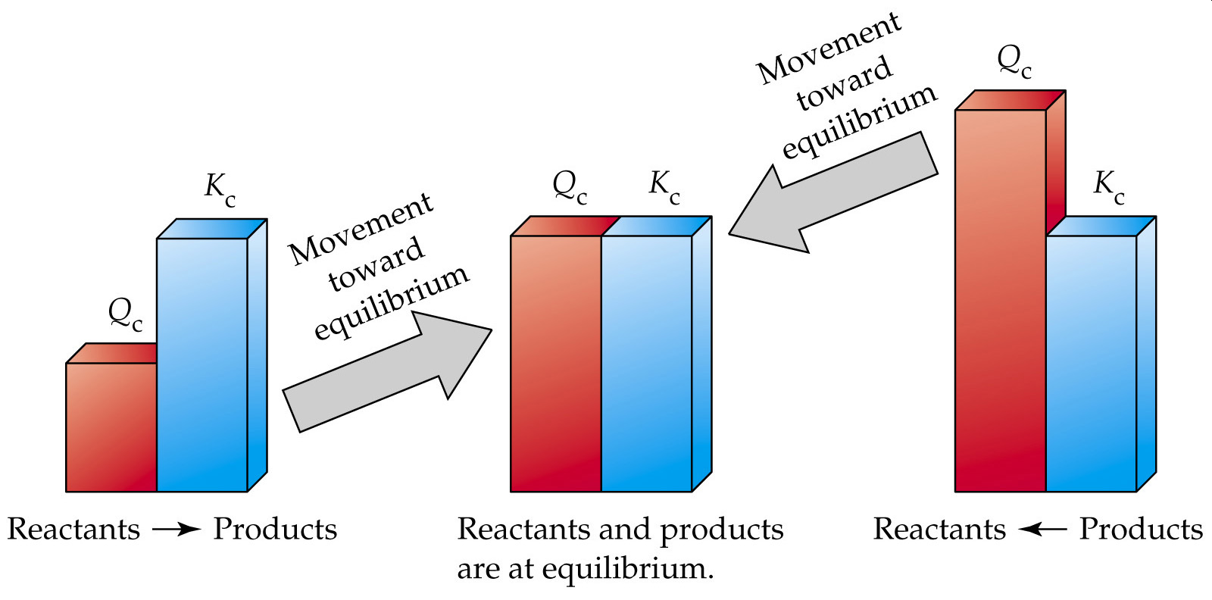
Method 2 – “Visual”
Method 3 – Math
[ P ]
[ P ]
Q_{c} =
Q_{c} =
[ R ]
[ R ]
Q_{c} < K_{c}
Q_{c} > K_{c}

Slide 5
Solving for Missing Value
2 variables
K_{c}
[ ] /Molarity
Example:
2 NO (g) + O₂ (g)
2 NO₂ (g)
Given:
K_{c} = 6.44x10⁵
[O₂] = 0.127 M
[NO₂] = 15.5 M
Does the reaction favor the R/P/Both?
What is the [NO] at equilibrium?

Slide 6
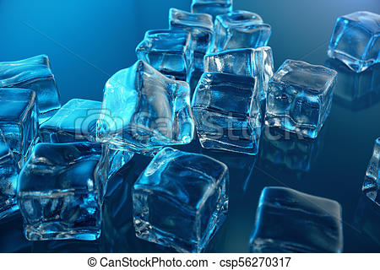
Problem Type – Given Initial [ ]
And K_{c} calculate Final [ ]
Write a balanced equation
Create an “ICE” chart
Let x = change in one [ ]
Substitute into the K_{c} equation
Solve for X
Double check answer
Initial
Change
Final
Google: equilibrium ice chart = lots of good results

Slide 7
Example:
“easy”
Given:
[A]_{o} = 0.850 M
[B]_{o} = 0 M
Kc = 24.0 at 25 °C
A
B
Does the reaction favor the R/P or both?
Does the reaction proceed in the forward or reverse direction
What is the final [ ] of all R and P?
Double Check

Slide 8
Example:
“hard”
K_{c} = 54.3 at 25°C
[H₂] = 0.50 M
[I₂] = 0.50 M
[HI] = 0
H₂ (g) + I₂ (g)
2 HI
Does the reaction favor the R/P or both?
Does the reaction proceed in the forward or reverse direction
What is the final [ ] of all R and P?
Double Check

Slide 10
Example:

