Slide 1
CHE 112 Spring 2021
Lecture 13a – Equilibrium
Overview/Topics
Definition of Equilibrium
Examples of Equilibrium
Link between Eq and Thermo
Equilibrium Constant
Examples of Important Equilibrium Phenomena
Equilibrium Math
Constant
Homo vs Heterogeneous
K_{c} vs K_{p}
Skills to Master
HW 13a
Read
OER 13.1-13.2

Slide 2
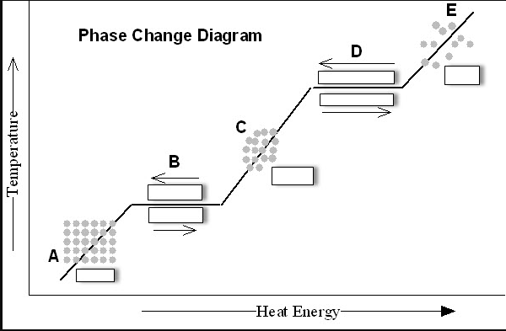
Past Examples
Phase Changes (Ch. 10)
Solid
Liquid
Vapor (gas)
Liquid

Slide 3
Dynamic Equilibrium
Dynamic Equilibrium
Dynamic
Equilibrium
constantly evaporating and condensing
rate is equal
Rate of Evaporation = Rate Condensation
Amount of Liquid ≠ Amount of Vapor
Evaporation: liquid → gas
Condensation gas → liquid
We see this again in Ch. 13-15

Slide 4
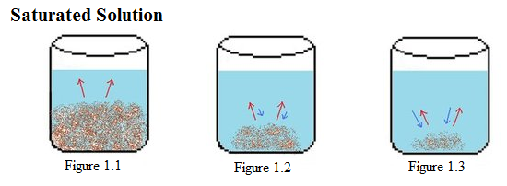
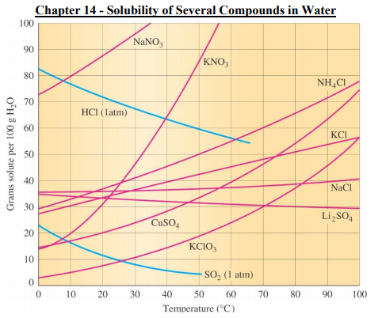
Solubility (Ch. 11)

Slide 5
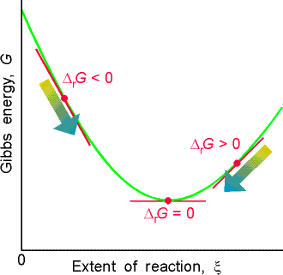
Thermodynamics Equilibrium
What happens when you open the connection between boxes?
What happens if you add more in the Right?
What happens if you add more in the Left?
K_{c} = 50

Slide 6
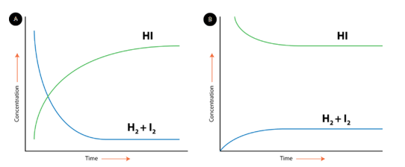
Equilibrium and Chemical Reactions
Rate Forward Rxn = Rate of Reverse Rxn
Amount of R ≠ Amount of P
A + B C
vs
A + B C
C
C
A + B
A + B

Slide 7
Mathematics of Equilibrium
a A + b B
c C + d D
K_{c} = Equilibrium Constant
Temperature Dependent
Unit less
Include State = (aq) or (g)
ignore s, and l
[ Products ]
[ C ]^{c} [ D ]^{d}
K_{c} =
=
[ Reactants ]
[ A ]ª [ B ]^{b}
Large K – favors the Products (K > 10³)
Small K – favors the Reactants (K < 10⁻³)
Medium K – both R and P exist in appreciable amounts
(10⁻³ < K < 10³)
K_{c} = Equilibrium Constant
Q_{c} = Reaction Quotient

Slide 8
K_{c} = Equilibrium Constant
Q_{c} = Reaction Quotient
Equilibrium Constant (1 value)
Given (or calculated)
Occurs at Equilibrium
Reaction Quotient (any value)
Calculated
Current state of the reaction
K_{p} = Gas Equilibrium Constant
K_{whatever}
Same as K_{c} except uses Pressure
Only use if all R and P are gasses
Lots of others K’s
K_{eq}
K₁, K₂
K_{c} , K_{c’} K_{c’’}
Etc…
R = 0.0821
L·atm
mol·K
K_{p} = K_{c} (RT)^{Δn}
T = Temp (K)
Δn = change in mols gas
P-R

Slide 9
Reverse of a Reaction is the Inverse of the K_{c}
K_{c} =
[ C ]^{c}
A + B C
[ A ]ª [ B ]^{b}
K_{c} =
1
K_{c’}
K_{c’} =
[ A ]ª [ B ]^{b}
C
A + B
[ C ]^{c}
Sum of the Reactions is the Product of the K_{c}’s
2 NOBr (g)
2 NO (g) + Br₂ (g)
K₁ = 0.42
Br₂ (g) + Cl₂ (g)
2 BrCl(g)
K₂ = 7.2
2 NOBr (g) + Cl₂ (g)
2 NO (g) + 2 BrCl(g)
K₁·K₂ = 3.0

Slide 10
Multiplication of a Reaction is the Square of the K_{c}
N₂O₄ (g)
2 NO₂ (g)
K_{c} =
[ NO₂ ]²
= 4.63x10⁻³
[ N₂O₄ ]
½ N₂O₄ (g)
1 NO₂ (g)
K_{c’} =
[ NO₂ ]
= 0.0680
[ N₂O₄ ]^{1/2}
K_{c} = (K_{c’})² or (K_{c})^{1/2} = K_{c’}

Slide 11
Writing Equilibrium Equations (aq)
Standard State for (aq) = 1 M
Ignore pure Solids and Liquids
Examples
P₄ (s) + 6 Cl₂ (g)
4 PCl₃ (l )
HF (aq) + H₂O (l)
H₃O⁺ (aq) + F⁻ (aq)

Slide 12
K_{p} – Gas Phase Equilibriums
Same as K_{c} except uses Pressure
Only use if all R and P are gasses
[ Products ]
( P_{C} )^{c} ( P_{D} )^{d}
K_{p} =
=
[ Reactants ]
( P_{A} )ª ( P_{B} )^{b}
Ugly Derivation/Math
Relationship between K_{p} and K_{c}
Review:
PV = nRT
P =
$$\left(\frac{n}{V}\right)$$
RT
R = 0.0821
L·atm
mol·K
K_{p} = K_{c} (RT)^{Δn}
T = Temp (K)
Δn = change in mols gas
P-R

Slide 13
Examples
2 NO (g) + O₂ (g)
2 NO₂ (g)
Write K_{c}
Write K_{p}
Given that K_{c} = 2.4x10³ at 400.K, Calculate K_{p}
Does the reaction favor: P/R/Both?

Slide 14
Summary
[ ] = concentration (mol/L) or atm
K_{p} =K_{c}(RT)^{Δn}
Ignore pure solids and liquids
K_{c} value are Temperature Dependent
K_{c} values are reaction/equation specific
Sum of reactions = product of K_{c}
K_{f} = 1/K_{f} (reverse reaction, inverse K_{c})
K > 1 Favors Products
K < 1 Favors Reactants
Reactants 10⁻³ < K (both)< 10³ Products

