Slide 1
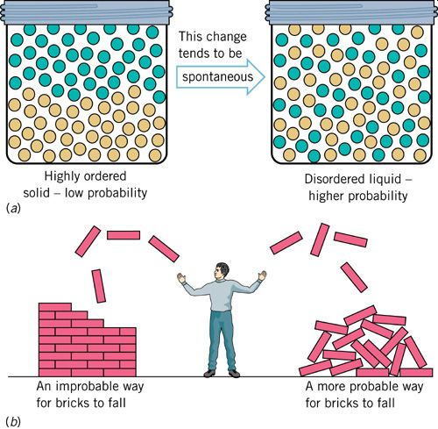
CHE 112 Spring 2021
Lecture 12b – Gibbs Free Energy
Overview/Topics
2nd Law of Thermodynamics
3rd Law of Thermodynamic
Gibbs Free Energy (ΔG)
Spontaneous vs Non-spontaneous
Skills to Master
HW 12b
Read
OER 12.3-12.4

Slide 2
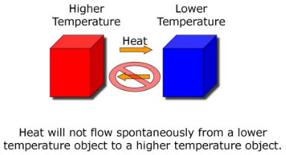
2nd Law of Thermodynamics
ΔS_{univ} = ΔS_{sys} + ΔS_{surr}
In a spontaneous process the entropy of the universe (system + surroundings) always increases
Hard to Measure
Use
q_{rev}
ΔS =
T
Δs_{univ} > 0 $∴$ Spontaneous
Δs_{univ} = 0 $∴$ Equilibrium
Δs_{univ} < 0 $∴$ Nonspontaneous

Slide 3
Case I - Occurs
System loses energy (-) and
Surrounding gain energy (+)
1.
-q_{rev} = + q_{rev}
2.
T_{sys} > T_{surr}
3.
ΔS_{sys} <
ΔS_{surr}
System
Surrounding
-q_{rev}
>
+q_{rev}
ΔS_{sys} =
| |
| |
= ΔS_{surr}
T_{sys}
T_{surr}
ΔS_{univ} = ΔS_{sys} + ΔS_{surr} > 0
Small -
Big +

Slide 4
Case II – NEVER Occurs
System gains energy (+) and
Surrounding lose energy (-)
1.
+q_{rev} = - q_{rev}
Heat
2.
T_{sys} > T_{surr}
3.
ΔS_{sys} <
ΔS_{surr}
System
Surrounding
q_{rev}
>
-q_{rev}
ΔS_{sys} =
| |
| |
= ΔS_{surr}
T_{sys}
T_{surr}
ΔS_{univ} = ΔS_{sys} + ΔS_{surr} < 0
Small +
Big -

Slide 5
Case III - Equilibrium
System gains energy (+) and
Surrounding lose energy (-)
1.
+q_{rev} = - q_{rev}
Equilibrium
2.
T_{sys} = T_{surr}
3.
ΔS_{sys} =
ΔS_{surr}
System
Surrounding
q_{rev}
=
-q_{rev}
ΔS_{sys} =
| |
| |
= ΔS_{surr}
T_{sys}
T_{surr}
ΔS_{univ} = ΔS_{sys} + ΔS_{surr} = 0
Same +
Same -

Slide 6
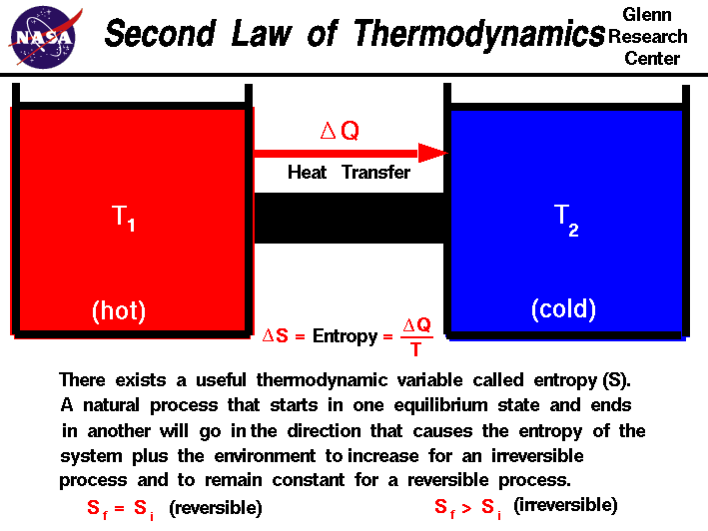

Slide 7
3rd Law of Thermodynamics

Slide 8
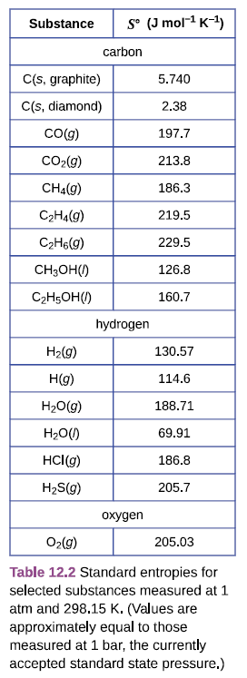
Standard Values for Entropy - S°
J/mol·K
Tabulated in Table 12.2 page 670 or Appendix G
Same as ΔH° and Hess’s Law
Read 9.3 (page 493)
ΔS° = S° (products) - S° (reactants)
ΔS° ≠ 0 (unlike ΔH)
Pay attention to states
Solid < liquids < gases
Increases with mass/size/complexity
° = STP - 1 bar/298.15K

Slide 9
Example:
Calculate ΔS° at STP for the reaction: N₂ (g) + 3 H₂ (g) → 2 NH₃ (g)
Double Check

Slide 10
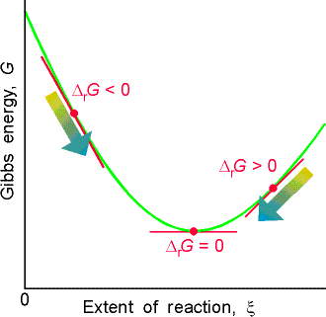
Review
Gibbs Free Energy - ΔG
KJ/mol
ΔH < 0 (-) spontaneous
ΔH = 0 equilibrium
ΔH > 0 (+) nonspontaneous
J. Willerd Gibbs (1839-1903) – first U.S. PhD
Difficult to calculate ΔS_{univ}
Reformulation of 2nd Law of Thermodynamics
Relies on system information only (“ignore” universe)
ΔS < 0 (-) nonspontaneous
ΔS = 0 equilibrium
ΔS > 0 (+) spontaneous
ΔG = ΔH - TΔS
ΔG < 0 (-) spontaneous
ΔG = 0 equilibrium
ΔG > 0 (+) nonspontaneous
In any spontaneous process (at constant T,P) the free energy of the system always decreases (b/c ΔS_{univ} ↑)

Slide 11
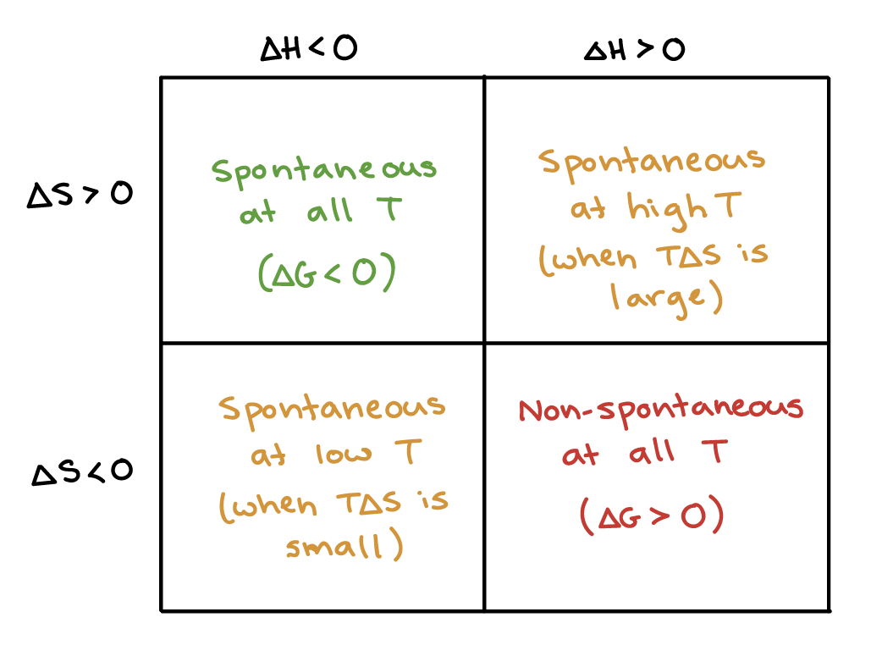
Four Possibilities
ΔG = ΔH - TΔS

Slide 12
Equilibrium
ΔG = ΔH - TΔS
At equilibrium ΔG = 0, which implies
T_{eq} =
ΔH
ΔS
Lots of equilibrium studied so far
Phase changes (Mp, Bp)
Vapor Pressure
Solubility
More in Ch. 13-15

Slide 13
Example:
What is the Boiling Point of water given: H₂O (s) ↔ H₂O (l)

Slide 14
Example:
For the reaction: N₂ (g) + 3 H₂ (g) → 2 NH₃ (g)
(a) Calculate ΔG° at STP
(b) Calculate ΔG° at 500. K
(c) At what temperature does the reaction become spontaneous

Slide 16
ΔG and Hess’s Law
If a process can be written as the sum of several stepwise process the enthalpy change of the overall process is the sum of the enthalpy’s of the individual steps
Process = ∑ steps
Really just Conservation of Mass and Energy
Useful for difficult/impossible to perform reactions
5 Rules
R always appear on the LEFT
P always appear on the RIGHT
Intermediates = both sides
Reverse Reaction = Reverse Sign
Can M/D Reactions and ΔH values
Review:
Chapter 9.3
page 494-499
Lecture 9b

Slide 17
Example:
Calculate ΔG∘_{rxn} for the reaction: 3 C(graphite) + 4 H₂ (g) → C₃H₈ (g)
C₃H₈ (g) + 5 O₂ (g) → 3 CO₂ (g) + 4H₂O (g) ΔG∘_{rxn} = −2074 kJ/mol
C(graphite) + O₂ (g) → CO₂ (g) ΔG∘_{rxn} = −394.4 kJ/mol
2 H₂ (g) + O₂ (g) → 2 H₂O (g) ΔG∘_{rxn} = −457.22 kJ/2 mol H2O(g)

Slide 18
What does “Free” means?
ΔG = w_{max}
Represents the amount of useful work (w) that a system can perform
ΔG = ΔH - TΔS
=
-
Amount of Useful Work
Energy
Produced
Energy lost to Surrounding

