Slide 1
CHE 112 Spring 2021
Lecture 12a – Thermodynamics I
Overview/Topics
Spontaneity
Definition
Sign Conventions
Entropy
Definition
Microstate
Calculations
Enthalpy
Skills to Master
HW 12a
Read
OER 12.1-12.2

Slide 2
Overview of Next Few Chapters
Ch. 12 – Thermodynamics – “Will it happen”?
Ch. 13 – Equilibrium – “How much will it happen”?
Ch. 17 – Kinetics – “How fast will it happen”?
Thermodynamics – study of the interconversion of heat and other forms of energy (work)
Enthalpy (ΔH)
– change in energy of a system
Entropy (Δ S)
– change in energy dispersal of a system

Slide 3
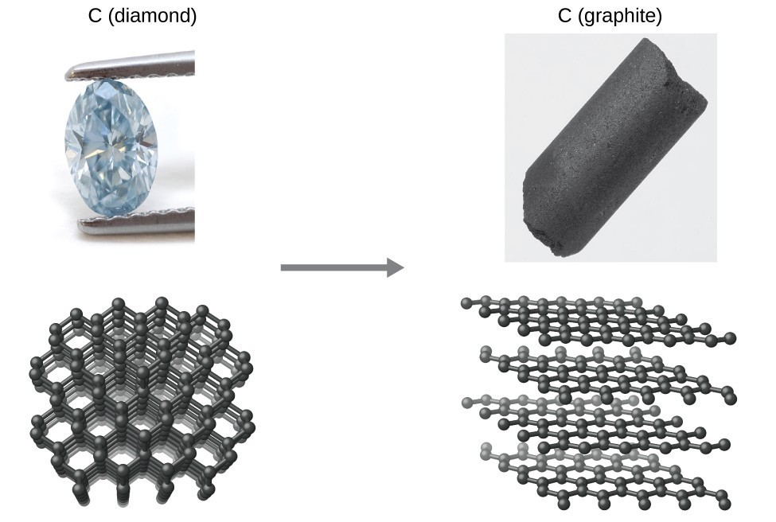
Will it occur vs How Fast it will occur (not related!)
Spontaneous
Will take “forever”
Thermodynamically – unstable
Kinetically - stable

Slide 4
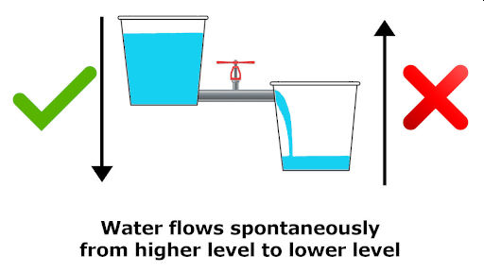
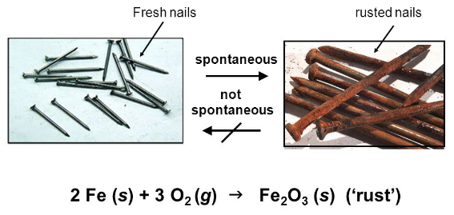
Spontaneous
Nonspontaneous
– proceeds on it’s own without any external influence
– the reverse of a spontaneous reaction
- occurs only in the presence of a continuous external influence
Change in Energy
“Gravitational”
Change in Energy
“Chemical”

Slide 5
Spontaneous
Nonspontaneous
NO Change in Energy
Change in dispersal of energy (matter)
Increase Disorder

Slide 6
Spontaneous
Nonspontaneous
– proceeds on it’s own without any external influence
– the reverse of a spontaneous reaction
- occurs only in the presence of a continuous external influence
Spontaneous | Nonspontaneous
Expansion of a Gas | Requires work to compress
2 H₂ (g) + O₂(g) → 2 H₂O (g) | Electrolysis to reverse
Drop an Apple (gravity) | Takes E to pick up
Combustion C₆H₁₂O₆ + O₂ → 6 CO₂ (g) + 6 H₂O (g) | Photosynthesis 6 CO₂ (g) + 6 H₂O (g) → C₆H₁₂O₆ + O₂ (g)
Water Runs downhill | Pump
Sugar Dissolving | Boil to separate
Diamond → graphite (slooooooow) | C → Diamond (high P and T)

Slide 7
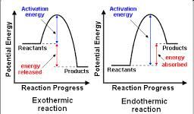
Review
Enthalpy
ΔH
Entropy
ΔS
(KJ/mol)
(J/mol·K)
Change in Energy of a system
(at constant P)
Change in Energy Dispersal
(Order/Disorder)
Endothermic (+) – system gains energy (non-spont.)
Exothermic (-) – system loses energy (spont.)
Increase Disorder (+): spontaneous
Increase Order (-): non-spontaneous

Slide 8
Entropy
ΔS
Carnot (steam engine efficiency) +
Clausius (called it entropy)
(J/mol·K)
q_{rev}
ΔS =
Change in Energy Dispersal
(Order/Disorder)
T
Amount of energy to reverse a process at a given temperature
Increase Disorder (+): spontaneous
Increase Order (-): non-spontaneous
Things that Increase Entropy (+)
We have seen it already…
Change in State: s → l → g
Increase in # molecules/ions
Increase in Volume
Increase in total energy
Increase in molecular complexity/size/mass
Phase transitions
Expansion/mixing of gasses
Dissolving of compounds

Slide 9
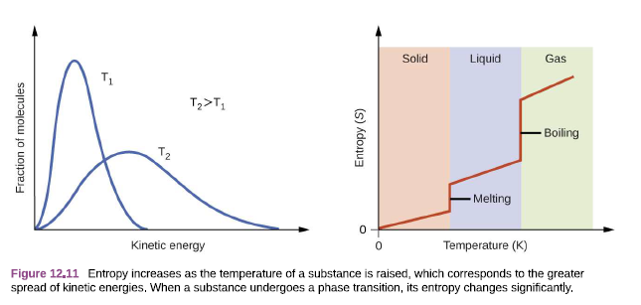
Kinetic Energy of Molecules/Temperature
Ch. 8 and 10.
Phase Transitions
Ch. 11

Slide 10
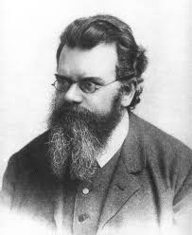
Entropy Mathematics
“Counting Microstates”
Ludwig Boltzmann
(1896)
Q: Why is increasing entropy spontaneous?
A: Probability – the more disordered a system the more probable
S = entropy
k = Boltzmann Constant
W = number of microstates (possibilities)
S = k ln W
R
k =
= 1.38 x 10⁻²³ J/K
N_{a}
ΔS > 0 (+) if Entropy ↑/# microstates ↑
ΔS = k ln
W_{f}
W_{i}
ΔS < 0 (-) if Entropy ↓/# microstates ↓

Slide 11
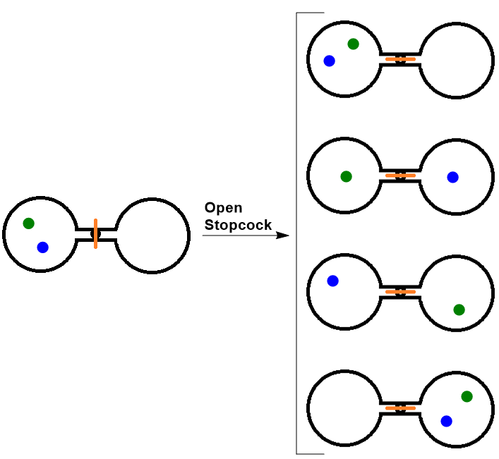
Example:
Counting Microstates/Probabilities – Gas Expansion
n = # boxes/bulbs
N = # particles
# microstates = n^{N}
Twice as likely to be equally split as in the left side

Slide 12
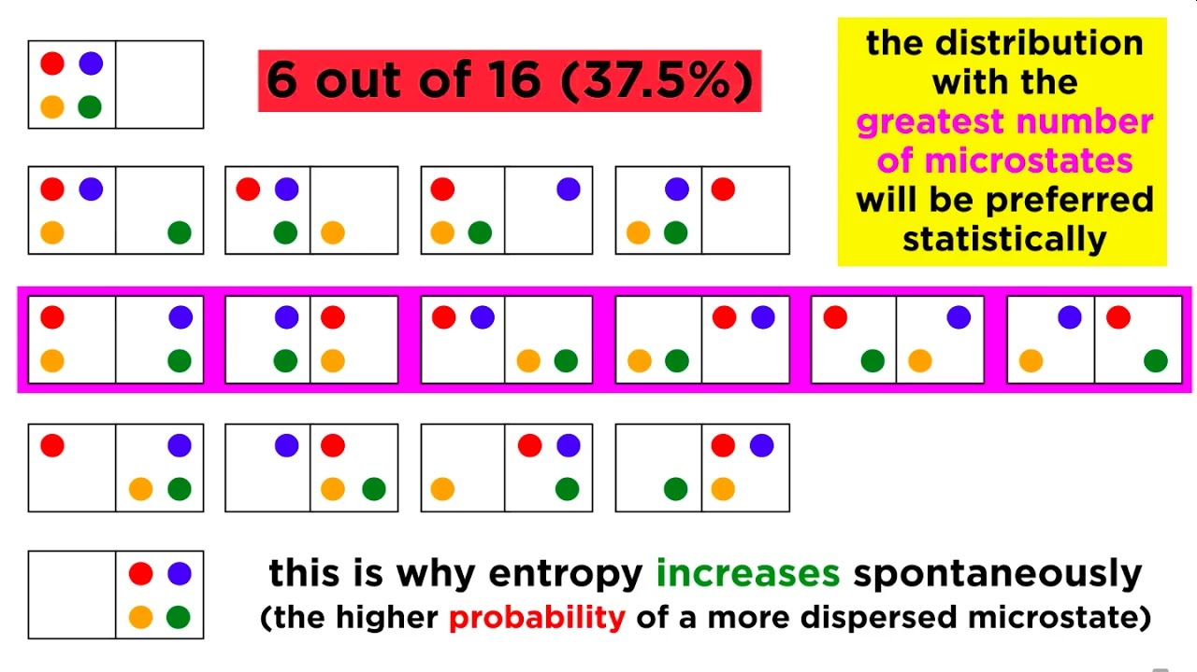
OER Fig 12.8 p. 663
Expanding our Experiment

Slide 13
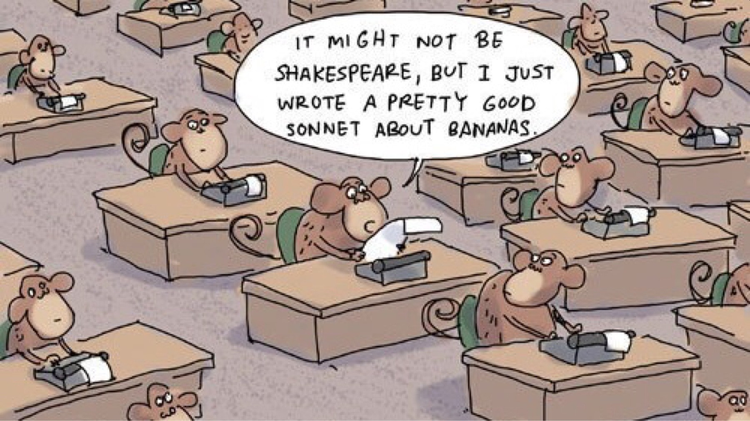
Expanding the Experiment
# atoms | Probability on left
3 | (1/2)³ | 1/8 or 0.125
20 | (1/2)²⁰ | 9.54 x10⁻⁴
100 | (1/2)¹⁰⁰ | 8.0 x 10⁻³¹
1 mol | (1/2)^{6.02x10^23} | Broke my calc!
Entropy increasing is spontaneous because the probability of being in the equilibrium state much more likely than all the atoms being on the left.

Slide 14
Calculating the Absolute Entropy or Change in Entropy
S = entropy
k = Boltzmann Constant
W = number of microstates (possibilities)
# microstates W = n^{N}
S = k ln W
R
k =
= 1.38 x 10⁻²³ J/K
n = # boxes/bulbs
N = # particles
N_{a}
S = k ln Boxes^{Particles}
ΔS = k ln
W_{f}
W_{i}

Slide 15
Example:
Calculate the entropy of each system
S = k ln W
S = k ln Boxes^{Particles}
S=k ln (4) = 1.91x10⁻²³ J/K
# atoms | Entropy of System
3 | S=k ln (2)³ = 2.87x10⁻²³ J/K
20 | S=k ln (2)²⁰ = 1.91x10⁻²² J/K
100 | S=k ln (2)¹⁰⁰ = 9.57x10⁻²² J/K
1 mol | S=k ln (2)^{6.02x10^23} = 5.76 J/K
ln A^{B} = A ln B

Slide 16
Example:
Calculate the change in entropy of each system
ΔS = k ln
W_{f}
W_{i}
A
# microstates W = n^{N}
B
n = # boxes/bulbs
N = # particles
C
D
S = k ln Boxes^{Particles}
E
What is the entropy change between:
State A to State C?
State B to State D?
State D to state A?

Slide 18
2nd Law of Thermodynamics
In any spontaneous reaction the total entropy of the system and its surrounding (universe) increase
Any change in energy is accompanied by a loss of some of that energy to the surrounding “Energy Tax”

