Slide 1
CHE 112 Spring 2021
Lecture 11c – Colligative Properties
Overview/Topics
Molarity, Molality, Mol Fraction (review)
Definition Colligative Properties
Dependent on
Independent of
4 Properties
Boiling Point Elevation
Freezing Point Depression
Vapor Pressure Lowering
Osmotic Pressure
Math Problems
Skills to Master
HW 11c
Read
OER 11.4

Slide 2
Review of Units – Ch. 6
Units of Concentration
Molarity (M)
Molality (m)
Mol Fraction (Χ)
Can measure volume easier
Temperature Dependent
Can measure mass easier
Temp Independent
When mols matter
Temp Independent
Σ Χ_{A} = 1
M = $\frac{mol solute}{L solution}$
m = $\frac{mol solute}{Kg solvent}$
Χ_{A} = $\frac{mol A}{total mols}$
Density
Molecular Weight (MW)

Slide 3
Colligative Properties
Properties that depend on the amount (# molecules or moles) of *solute molecules dissolved in the solution, not on their chemical identity
4 Examples
Freezing Point (Depression)
Boiling Point (Elevation)
Vapor Pressure (Lowering)
Osmotic Pressure
*Non-volatile solutes
*Unionized solutes

Slide 4
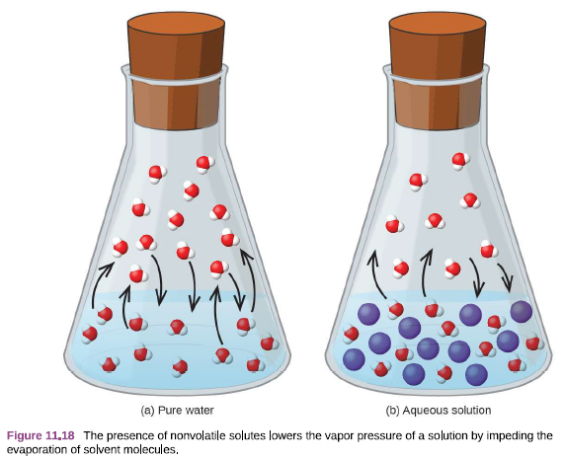
Vapor Pressure
Lowering
Non-volatile solute = less particles at surface, therefore less particles evaporate therefore the Lower the Vapor Pressure
Gas
Evaporation
Condensation
Liquid
Dynamic Equilibrium
Good Picture but…
One tiny mistake?
Review 10c

Slide 5
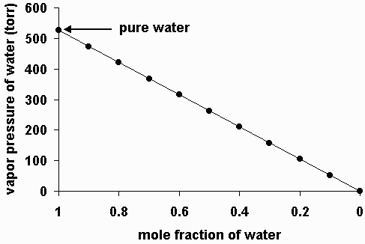
Raoult’s Law
“Ideal Solution” – Solute = non-volatile
P_{soln} = P_{solv} · Χ_{solv}
ΔP_{soln} = P_{solv} · Χ_{solute}

Slide 6
Example:
What is the vapor pressure of a solution in which 2 mols of HC₂H₃O₂ is dissolved in 12 mols of H₂O? The vapor pressure of pure H₂O at 25 °C = 23.8 mmHg.
Make it Harder?

Slide 7
Example:
Ionic Compounds = Ions
What is the vapor pressure of a solution in which 2 mols of MgCl₂ is dissolved in 12 mols of H₂O? The vapor pressure of pure H₂O at 25 °C = 23.8 mmHg.

Slide 8
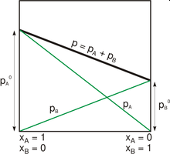
Raoult’s Law
“Non-Ideal Solution” – Solute = volatile
P_{total} = P_{A} + P_{B}
P_{total} = Χ_{A}P_{A} + Χ_{B}P_{B}

Slide 9
Example:
Non-idea = Volatile Solute
What is the vapor pressure of a solution in which 25.0 g of Ethanol [C₂H₅OH] (46 g/mol) is dissolved in 100.0 g of H₂O (18.01 g/mol)?
The vapor pressure of pure H₂O at 25 °C = 23.8 mmHg.
The vapor pressure of pure Ethanol at 25°C = 61.2 mmHg.

Slide 10
Ideal vs Non-ideal Solutions
“ways to make it more complicated”
High Solute Concentrations – lead to deviations (solute/solute IMF)
IMF effect vapor pressure
Solute/Solvent << Solvent/Solvent
molecules held less tightly than expected
P_{v} > Raoults law
Solute/Solvent >> Solvent/Solvent
Molecules held tighter than expected
P_{v} < Raoult’s Law
Van’t Hoff Factor
-ionic compounds rarely dissociate 100%
- Correction factor
Actual # of ions produced
i =
Theory # of ions produced
Know deviations
Won’t use deviations

Slide 11
Just Cool Pictures

Slide 12
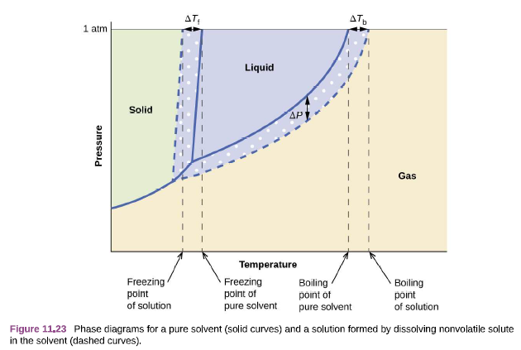
Boiling Point
Elevation
Boiling Point occurs when P_{v} = P_{atm}
If P_{v} is lowered then it takes more energy to get P_{v} = P_{atm}
Freezing Point
Depression
Opposite for Freezing
The line does not intersect until below the normal F_{p}
Harder for solvent particles to form a lattice (due to impurity)

Slide 13
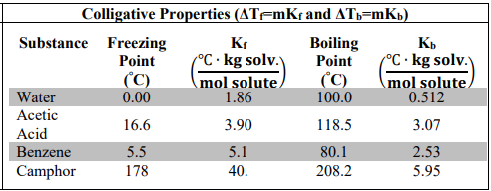
Cheat Sheet
Table 11.2 p626
Calculating B_{p} and F_{p} of Impure Solutions
ΔT = change in temperature (°C)
ΔT_{f} = mK_{f}
$$\frac{mols solute}{kg of solvent}$$
m = molality =
or
ΔT_{b} = mK_{b}
K_{f} = molal freezing point depression constant
K_{b} = molal boiling point elevation constant
$$\left(\frac{℃ ∙kg solvent}{mol solute}\right)$$
Depends on solvent

Slide 14
Example:
What is the freezing point of a radiator that is filled with 50% anti-freeze (ethylene glycol) and 50% water?

Slide 15
Example:
What is the boiling point of a solution in which 45.0 grams of Acetic Acid (CH₃COOH) is dissolved in 100.0 grams of Benzene (C₆H₆)?
Make it Harder?

Slide 16
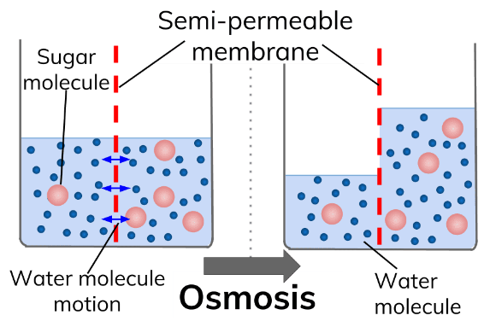
Allows small molecules (H₂O) through but stops larger molecules
Osmotic Pressure (π)
Osmotic Pressure is pressure required to equalize the water levels
Water flows from high concentration of water to low concentration of water to equalize the concentrations

Slide 17
Osmotic Pressure
Π = mmHg or atm
i = Van’t Hoff factor (Ignore)
M = Molarity (mols solute/Liter Solution)
R = gas constant 0.0821 L·atm/mol·K
T = Temperature (K)
Π= iMRT
Incredibly sensitive to MW, can calculate up to 4 SF
Example:
What is the osmotic pressure inside a red blood cell with concentration = 0.15 M if it is placed into a solution of 1.0 M concentration at 25 °C?
What will happen to the red blood cell?

Slide 18
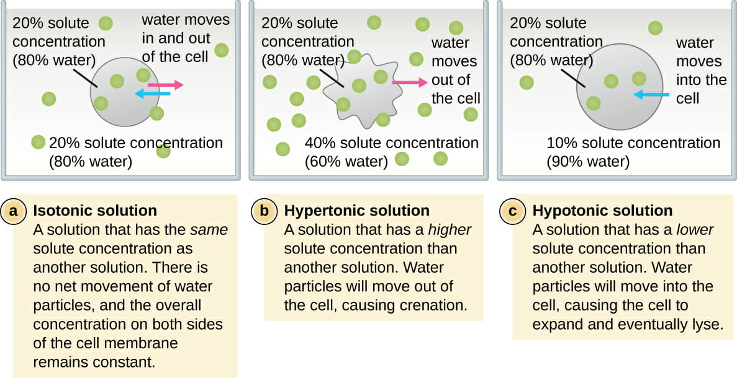
Osmotic Pressure (π)
Crenation
Hemolysis

Slide 19
Reverse Osmosis Desalinization
Expensive
Energy Intensive
Brine Waste

