Slide 1
CHE 112 Spring 2021
Lecture 11b – Solubility
Overview/Topics
Terminology
Unsaturated (U)
Saturated (S)
Supersaturated (SS)
Measuring Solubility
Charts (aq), (s)
Tables – g/100g H₂O
Ratios/Proportions
Interpolation and Extrapolation
Equations
Effect of Temperature on Solubility
Effect of Pressure on Solubility
4 Factors effecting the rate of dissolving
Skills to Master
HW 11b
Read
OER 11.3

Slide 2
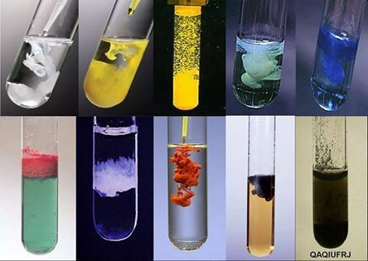
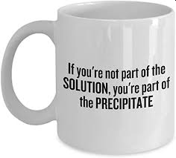
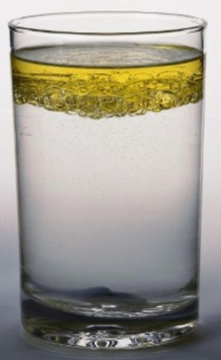
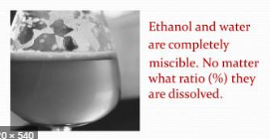
Solubility
Vocabulary
Soluble
Dissolves in solution (aq)
Insoluble
Does not dissolve in solution (s)
Liquids that mix homogeneously to form a solution
Miscible
Immiscible
Liquids that do not mix, form a phase boundary

Slide 3
Solubility
Vocabulary
Unsaturated (U)
Saturated (S)
Supersaturated (SS)
[Solute] < Max
Clear Solution
[Solute] = Max
Clear Solution + tiny amount solid
Equilibrium
[Solute] > Max
Clear Solution
Inherently unstable
or

Slide 4
Supersaturated (SS)
[Solute] > Max
Clear Solution
Inherently unstable
or

Slide 5
Example:
Cheat Sheet
Solubility of NaCl in H₂O at 20.0 °C is
36.0 g NaCl
100. g H₂O
Unsaturated (U)
[Solute] < Max
Clear Solution
Saturated (S)
[Solute] = Max
Clear Solution + tiny amount solid
Equilibrium
Supersaturated (SS)
SS – will ppt or grow crystals if disturbed o
[Solute] > Max
Clear Solution
Inherently unstable

Slide 6
Lots more in Chapter 13!
Equilibrium
Unsaturated (U)
Rate of Dissolving < Rate of Precipitating
Saturated (S)
Rate of Dissolving = Rate of Precipitating
Dynamic Equilibrium

Slide 7
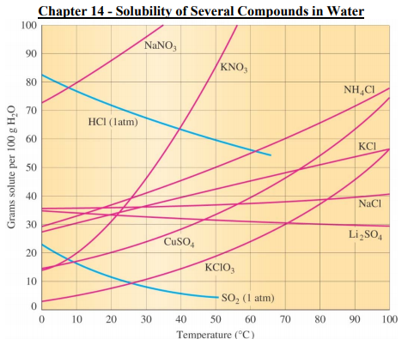
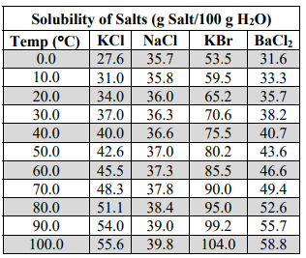
Cheat Sheet
Graphs
Tables
Equations
y = mx + b (or other equation)
Red = solid in liquid
Blue = gas in liquid

Slide 8
Supersaturated (SS)
[Solute] > Max
ABOVE LINE
Saturated (S)
[Solute] = Max
Equilibrium
ON LINE
Unsaturated (U)
[Solute] < Max
BELOW LINE

Slide 9
Solubility Problems
Ratio’s and Proportions
Example:
What is the solubility of KClO₃ at 40 °C?
Example:
Is 25.0 grams of KClO₃ dissolved in 100 g of H₂O
U/S/SS at 70°C?
Example:
At what temperature(s) would a solution of 10.0 grams of KClO₃ dissolved in 100 g of H₂O be unsaturated?

Slide 10
Solubility Problems
Ratio’s and Proportions
Example:
Is 7.50 grams of KClO₃ dissolved in 35 g of water U/S/SS at 70 °C?
Example:
If you have a saturated solution of KClO₃ at 90 °C how much KClO₃ will precipitate out if the solution is cooled to 10 °C?

Slide 11
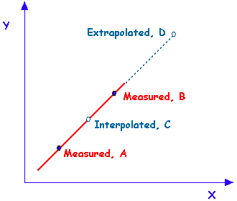
Solubility Problems
Equations of Lines and
Interpolation/Extrapolation
y = mx + b (or other equation)
Review – Linear equations
m – slope
b – y-intercept

Slide 12
Example - Interpolation
Given: Solubility of AgCl = 15.0 g at 20.0 °C
29.0 g at 30.0 °C
Question: What is the solubility at 24.0 °C?
Types of problems
Given 2 points
Given equation of line

Slide 13
Example - Extrapolation
Given: Solubility of Cu(NO₃)₂ is given the equation
y = 0.6518 x + 42.224 (R² = 0.9867)
Question: What is the solubility of Cu(NO₃)₂ at 25 °C
Types of problems
Given 2 points
Given equation of line

Slide 14
2 Factors that Affect Amount Dissolved
4 Factors that Affect Rate of Dissolving
Temperature
Solids generally DP
Gases its IP
Particle Size (IP)
Temperature (DP)
Concentration (IP)
Agitation/Stirring (DP)
vs.
Pressure
Solids Independent
Gases its DP

Slide 15
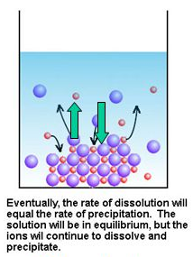
Temperature
Solids in Liquids
Gases in Liquids
Generally DP
Complicated due to IMF’s
More energy = more molecules can dissolve, therefore solubility increases
IP
Review Ch. 10
More energy = more molecules can evaporate, therefore solubility decreases
KE >> IMF
KE << IMF
Dynamic Equilibrium

Slide 16
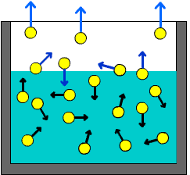
Pressure
Gases in Liquids
Solids in Liquids
Little or no effect
Liquids and Solids are incompressible
Pressure does not effect the equilibrium
DP
Review Ch. 10
Gasses are very compressible
Increased pressure means more energy required to leave solution (break the IMF’s) therefore more gas in solution
↑ P has little effect
↑ P has large effect

Slide 17
Henry’s Law
C_{g} = kP_{g}
Relationship between pressure and solubility for gas in liquid
Many applications
C = concentration (various units)
k = Henry’s law constant
P = pressure (various units)

Slide 18
Example
Bromomethane (CH₃Br) is an antifungal compound with k = 0.159 mol/L·atm at 25 °C. If the partial pressure is 125 mmHg what is the solubility of Bromomethane in M?

Slide 19
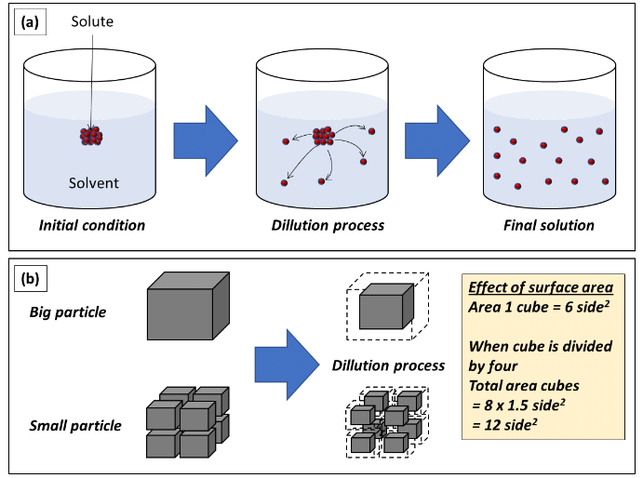
4 Factors that Affect Rate of Dissolving
Particle Size (IP)
Temperature (DP)
Concentration (IP)
Agitation/Stirring (DP)

Slide 20
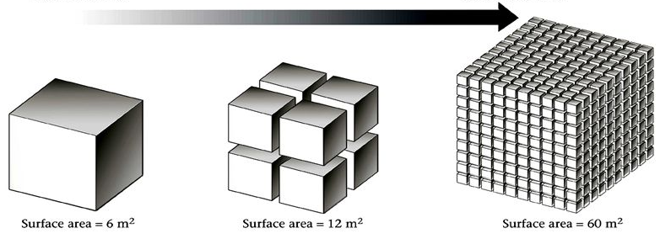
Effect of Particle Size (PS) or Surface Area (SA) on Rate of Dissolving
Rate is IP to Particle Size
Rate is DP to Surface Area
Surface Area is IP to Particle Size
Solute/Solvent must interact for dissolving to occur
More Surface Area = More Interactions

Slide 21
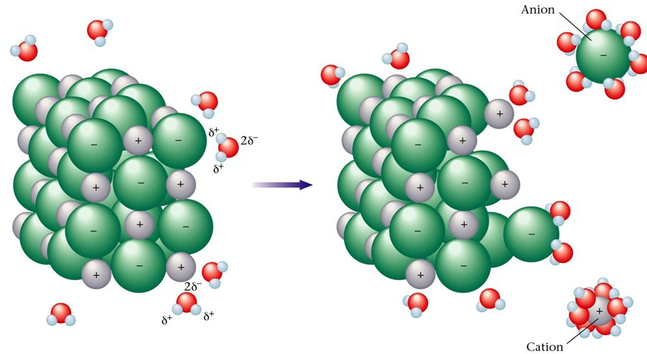
Effect of Temperature on Rate of Dissolving
Solvent molecules have more KE
Hit solid more often
Hit solid harder
Easier to break solute-solute IMF

Slide 22
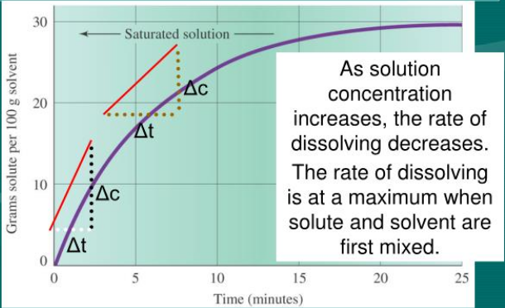
Effect of Concentration on Rate of Dissolving
Rate is IP to Concentration because particles must be near each other to interact/dissolve
Concentration Gradients slow dissolving
Decreased Solute-Solvent interaction

Slide 23
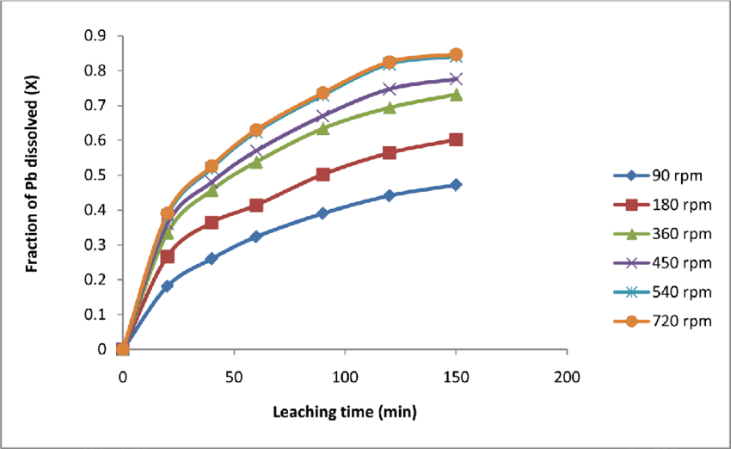
Effect of Agitation/Stirring on Rate of Dissolving
Breaks up Concentration Gradients
Increases Solute-Solvent Interaction
Increases # of collisions
No Stirring
With Stirring

