Slide 1
CHE 112 Spring 2021
Lecture 11a – Solutions and Electrolytes
Overview/Topics
Solutions – Terminology
Solute, solvent, solution
Miscible, immiscible
Solution – Formation Process (3 steps)
Strong, Weak, Non-electrolytes
Review – IMF’s
Review - Energy
Skills to Master
HW 11a
Read
OER 11.1-11.2

Slide 2
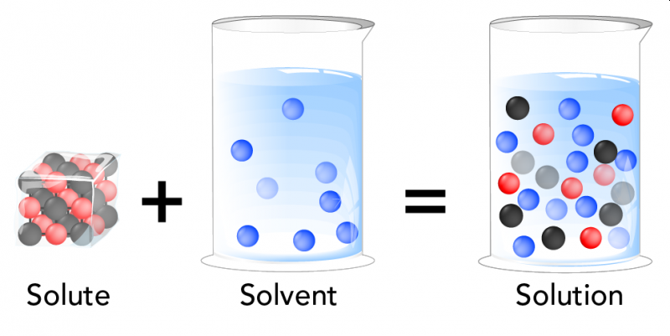
Solutions/Homogeneous Mixtures
Solution
One or more substances homogeneously mixed or dissolved in another substance
Solute
Component that is dissolved (least abundant)
Solvent
Dissolving agent (most abundant)
Solute
+
Solvent
=
Solution
Review Ch. 1

Slide 3
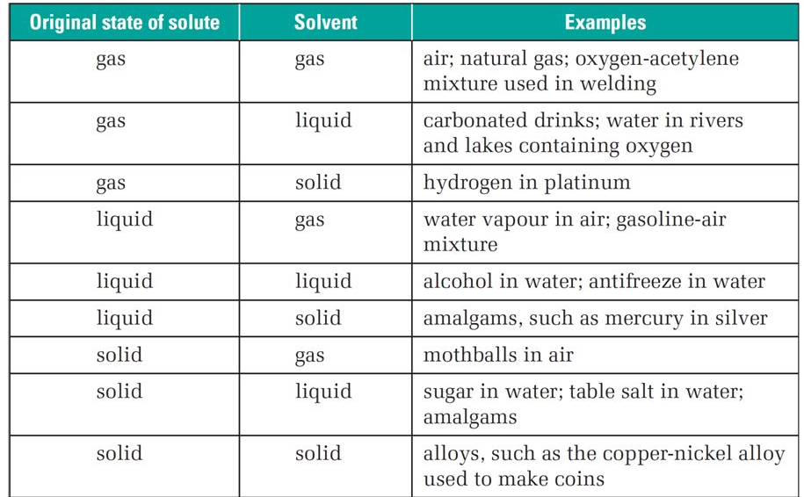
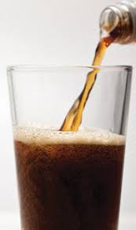
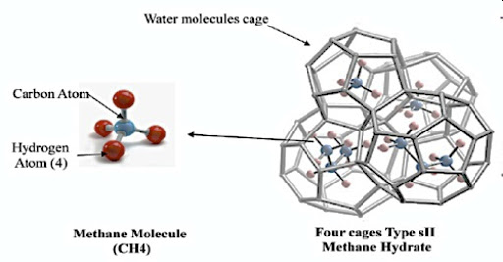
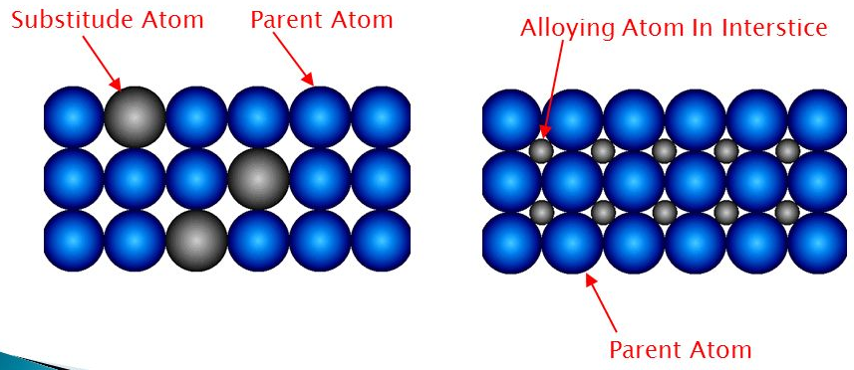
Different Types of Solutions

Slide 4
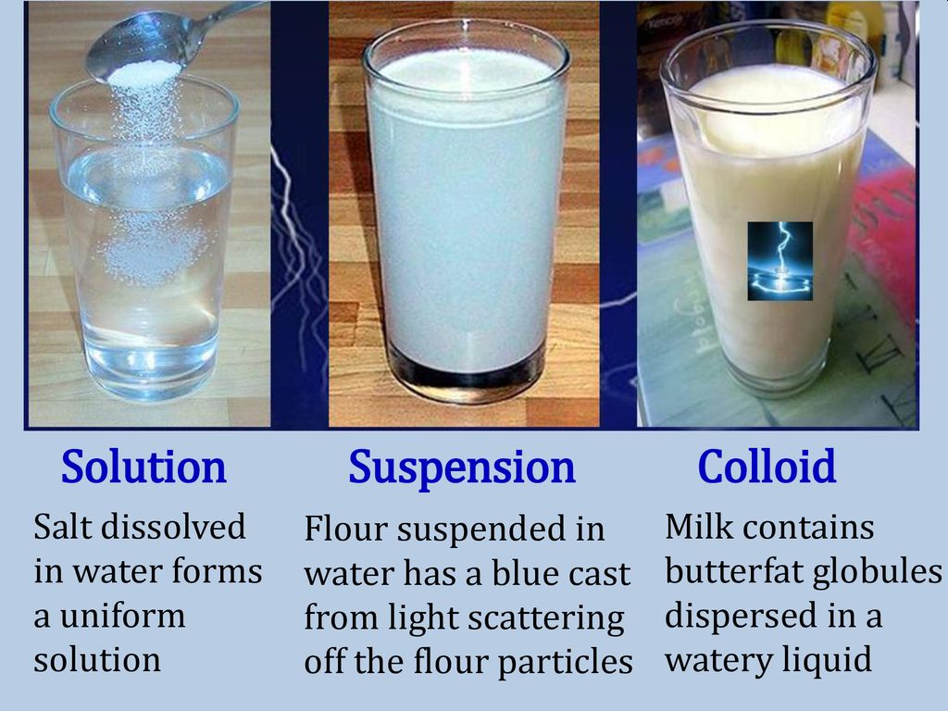
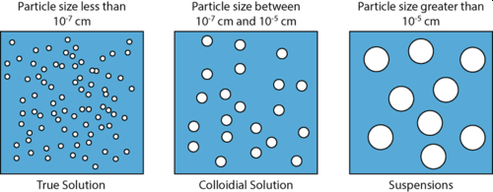
Review Ch. 1
General Properties of Solutions
Mixtures – Homogeneous, variable composition
Solute – generally molecular sized
Dispersed (solute surrounded by solvent)
Colored or colorless but usually transparent (liquids)
Solute is uniformly distributed (will not settle out)
Physically separable (ex: Evaporation)

Slide 5
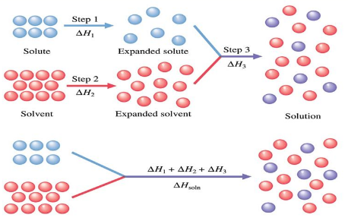
Formation of Solutions
Depends on 2 Factors
Entropy (ΔS) – spontaneous mixing, similar to gases (Ch. 12)
Energy (ΔH) - Can be Endothermic or Exothermic
3 Types of Interactions (IMF’s)
Solute-Solute
Solvent-Solvent
Solute-Solvent

Slide 6
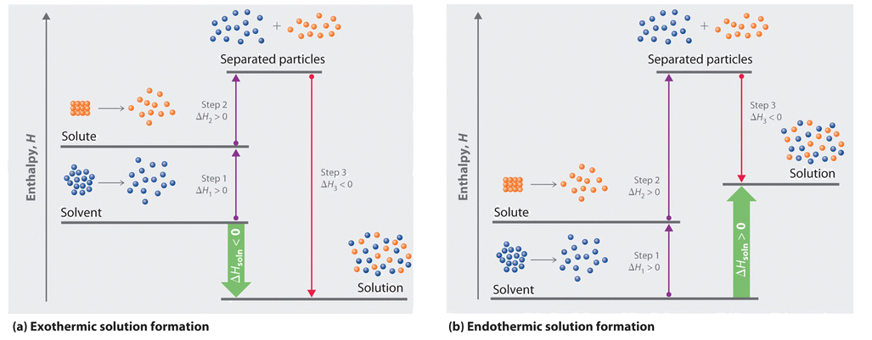
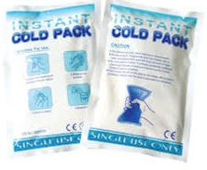
Energy Level Diagram

Slide 7
Aqueous Solutions
Strong Electrolytes (SE)
Weak Electrolytes (WE)
Non-Electrolytes (NE)
Dissociate 100% into ions
Conduct electricity
SA, SB, Ionic (aq)
Dissociate < 10% into ions
May conduct electricity
wa, wb
Do not dissociate
Do not conduct electricity
Molecular (nm/nm) + Ionic (s)
NaCl (s) → Na⁺ (aq) + Cl⁻ (aq)
HF (s) ↔ H⁺ (aq) + F⁻ (aq)
C₆H₁₂O₆ (s) → C₆H₁₂O₆ (aq)
0% 100%
90% 10%
0% 100%

Slide 8
Jay’s Awesome Drawing - NaCl
Strong Electrolyte

Slide 9
Jay’s Awesome Drawing - HF
Weak Electrolyte

Slide 10
Jay’s Awesome Drawing – C₆H₁₂O₆
Non-electrolyte

Slide 11
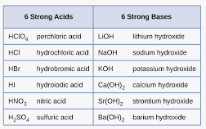
Strong Electrolytes (SE)
Weak Electrolytes (WE)
Dissociate 100% into ions
Conduct electricity
SA, SB, Ionic (aq)
Dissociate < 10% into ions
May conduct electricity
wa, wb
Not a SA or SB
Non-Electrolytes (NE)
Do not dissociate
Do not conduct electricity
Molecular (nm/nm) + Ionic (s)
Review: p 346-347 and 351-355

Slide 12
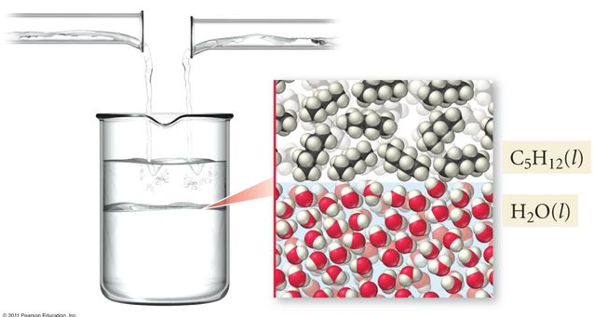
2 General Rules for Solutions
Like Dissolves Like
Oil and Water Don’t Mix
Substances with similar IMF will form solutions
Substances with different IMF will not form solutions
Phase Boundary
ID
HB
DD
LDF
Polar
Nonpolar
Substances are usually soluble +/- one category

Slide 13
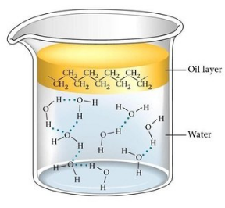
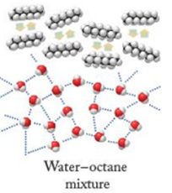
Water = polar forms DD/HB/ID
Hexane = nonpolar forms LDF
Oil and Water Don’t Mix
Example
Substances with different IMF will not form solutions
Phase Boundary
Oil Layer
H₂O Layer

