Slide 1
CHE 112 Spring 2021
Lecture 10e – Properties of Solids
Overview/Topics
Crystalline vs Amorphous
Classes of Solids
Ionic Solids
Metallic Solids
Covalent Networks
Molecular
Lattice Structures
Unit cell
Coordination number
SC, BCC, FCC cells
Packing Efficiency
Lattice Problems/Calculations
Calculate radius
Calculate density
Calculate cell length
Molecular formula
X-ray Crystallography
Skills to Master
HW 10e
Determine Chemical Formula
Determine (denstiy, atomic radius, cell length)
Read
OER 10.5-10.6

Slide 2
General Properties
Atoms are held in place by strong IMF or Chemical Bond
KE << IMF
Definite Shape/Volume
Atoms can rotate and vibrate in place
Wide range of properties
Hard/inflexible/conduct electricity – metals
Soft/flexible/insulators - plastics
Crystalline Solid
Amorphous Solid

Slide 3
Crystalline Solid
Amorphous Solid
Long Range Order (LRO)
No LRO
Atoms or molecules are arranged in a regular 3D lattice
Fixed Bond Length and Angle
Well defined Melting Point
Cleave with well defined surfaces
Atoms or molecules “randomly” distributed
Variability in Bond Length and Bond Angles
Broad Melting Points
Cleave with curved surfaces
Minerals - Quartz
Gemstones – Diamonds
Metals
Glass – Windows, Volcanic
Plastics
Metallic glasses

Slide 4
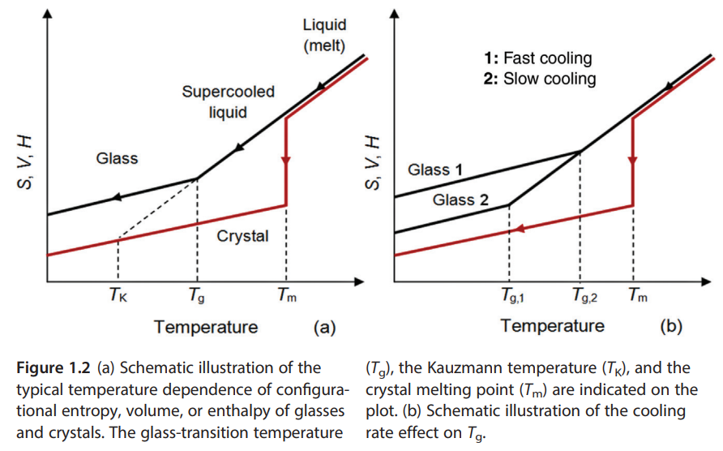
Review – Covalent Bonds
Chapter 5.1 (p.265)
Energy diagrams (Gibbs Free Energy)
Rate of cooling from liquid to solid state
Too fast – trapped in amorphous state (High Energy)
Slow – reach's crystalline state (Lowest Energy)

Slide 5
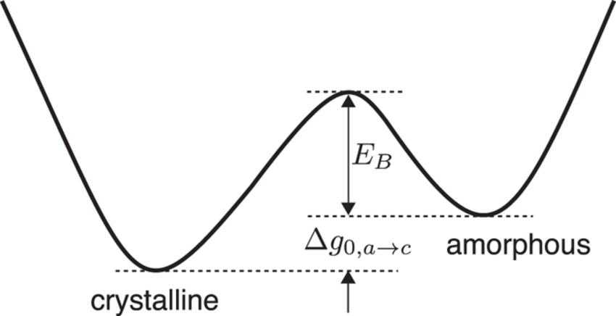
Review – Covalent Bonds
Chapter 5.1 (p.265)
Energy diagrams (Gibbs Free Energy)
Very similar to minimizing energy for chemical bonds

Slide 6
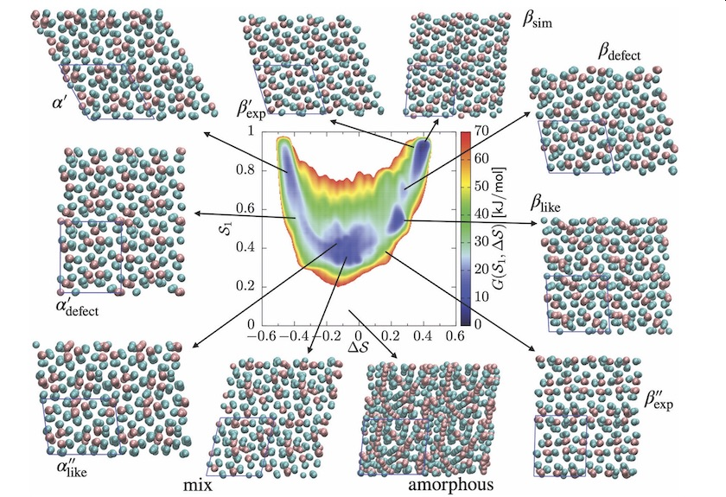
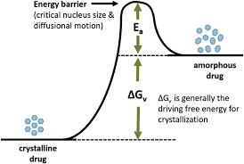
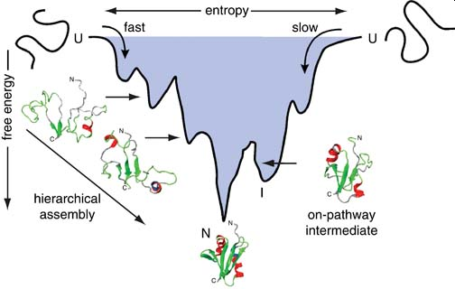
Very Complex (large number of forms)
Drugs – aka “Breaking Bad”
Protein Folding Dynamics

Slide 7
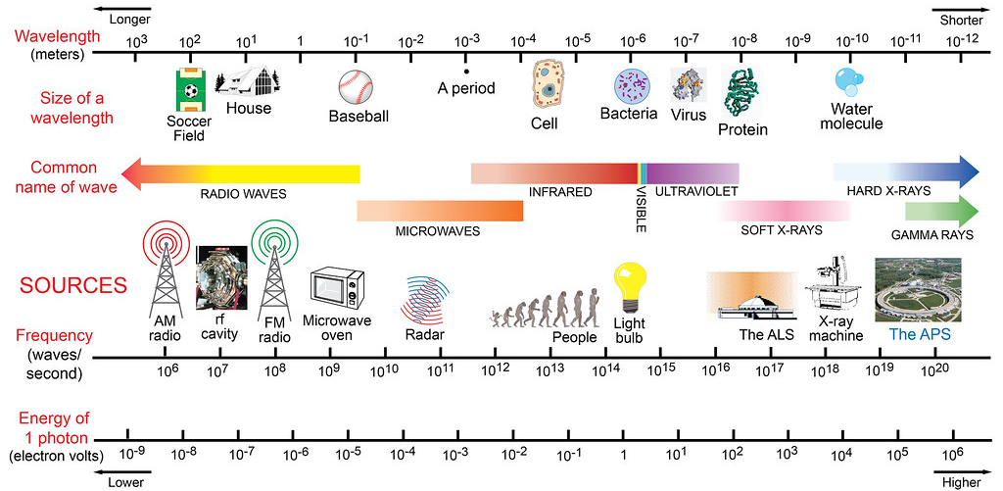
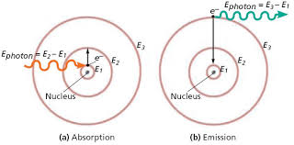
Measuring the Structure
Long range order (LRO) – regular/repeated structure
Bond length and angles same
Determined by “Diffraction Experiments” with X-rays
Review – Line spectra
Chapter 3.1-3.2
Constructive and Destructive Interference
Incoming light energy is absorbed as the electron moves from a low energy to high energy (close orbital to larger orbital) from the spectrum leaving black spaces at specific energy levels.
Energy is emitted as electrons fall from high energy to low energy level (far orbital to close orbital), resulting only in light of specific energy being emitted.

Slide 8
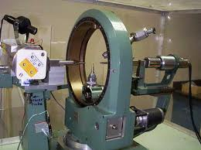
X-Ray Diffraction
Interaction of EM radiation with the regular spaced lattice of a crystalline solid
Occurs due to constructive and destructive interference pattern
Discovered Max Von Lau – 1912
Mathmatics by Bragg – 1913 (Noble Prize at 25 years old!) + Structure of NaCl
$$d= \frac{nλ }{2\sin{θ}}$$
d = distance
n = layer
λ = wavelength (nm)
θ = Angle of x-ray
Equations on CS

Slide 9
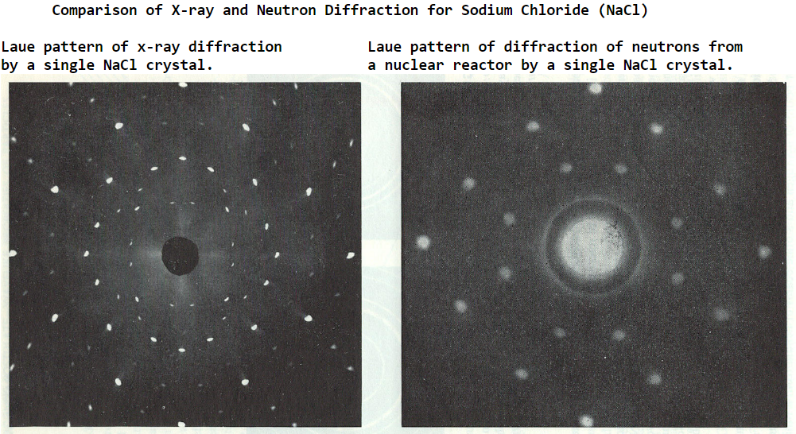
X-ray - Misc.
Dorothy Crowfoot Hodgkin – Penicillin (1949), Vitamin B-12 (1957) – Noble Prize
Watson and Crick - Structure of DNA (1953) – Noble Prize
Max Perutz (1962) – Hemoglobin/Protein – Nobel Prize
Etc.

Slide 10
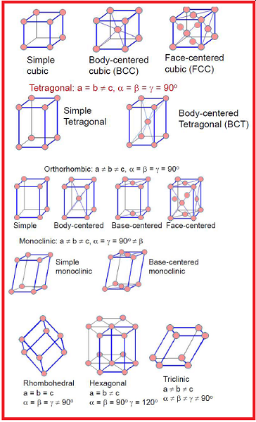
Structure of Crystalline Solid
Unit Cell
smallest repeat unit of a crystal 14 different unit cells
Coordination
Number (CN)
# of atoms in direct contact
Density
# atom/unit cell
Corner = 1/8
Edge = 1/4
Face = 1/2
Body = 1
Packing Efficiency
% of space filled by atoms

Slide 11
3 Easiest Crystal Structures
SC
BCC
FCC
# atom/cell
Coordination
Number
6
8
12
Packing
Efficiency
52%
68%
74%

Slide 12
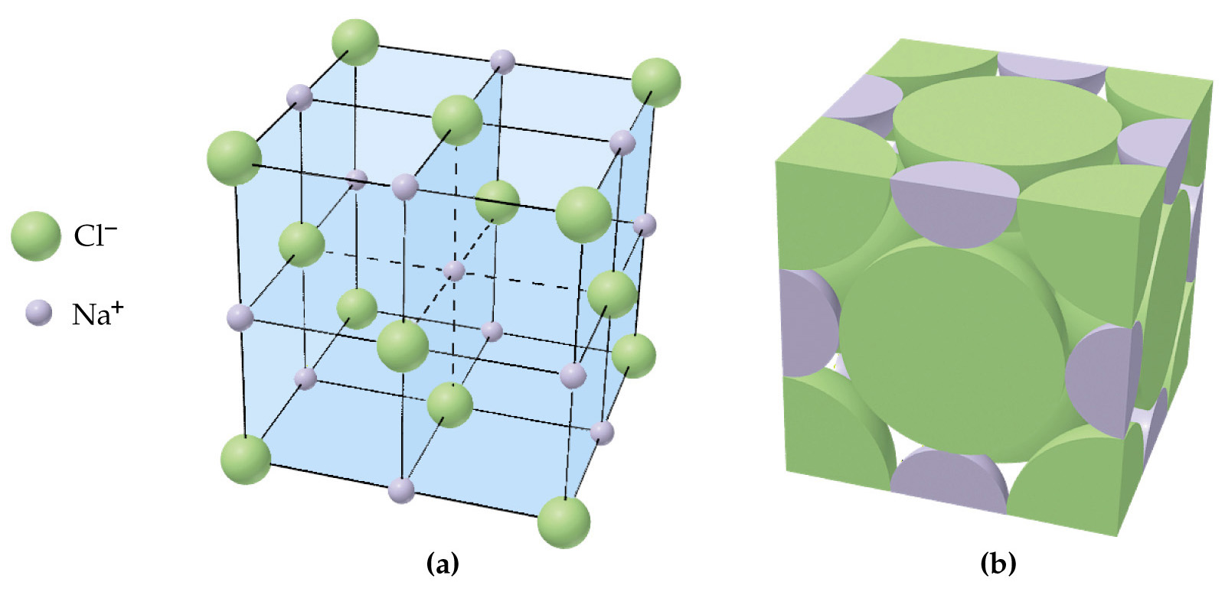
Example: NaCl
What is the chemical formula for NaCl?

Slide 13
Example: BaCl₂
Example: CuCl

Slide 14
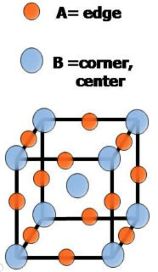
What is the chemical composition of the following compound? (assume A is a cation and B is anion)
You Try It:

Slide 15
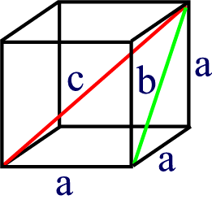
Unit Cell Math
a = cell length
r = atom radius
D = density (mass/volume)
MW = molecular weight
On Cheat Sheet

Slide 16
Example:
If gold (Au) crystallizes in a FCC structure with a density of 19.3 g/mL, what is the atomic radius of an Au atom (in pm)?

Slide 18
CHE 112 - Chapter 10 – Flow Chart
Crystal Structures
SC: 1 atom/cell
BCC: 2 atom/cell
FCC: 4 atom/cell
Atoms
Unit Cell
Avagadro’s Number
6.022 x 10²³ items/mol
Mols
Mass
g/cell
Volume
cm³
a
(cm or pm)
Molecular Weight
g/mol
Density
g/mL
Geometry
V = a³
*Metric System
1 cm³ = 1 mL
1 cm = 0.01 m
1 pm = $1×{10}^{−12}$
SC: $a = 2r$
BCC: $a=\frac{4r}{√3}$
FCC: $a=\sqrt{8}∙r$
radius
(cm or pm)

Slide 19
You Try It:
X-ray diffraction of Silver (Ag) determined it crystallizes as FCC with an edge length of 408. pm. What is the Density of Ag? (Hint: 2x your answer on your CS)

Slide 20
Types of Crystalline Solids
OER Textbook p. 562
Same – regular crystalline structure with short and long range order
Different – what is at each crystalline lattice point, attractive forces, C and P properties
Nonbonding | Noble Gas | IMF (LDF) | Low boiling points, melting points | Ar, Xe

Slide 21
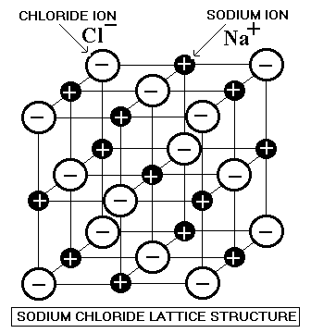
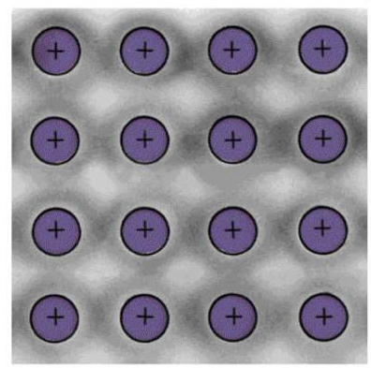
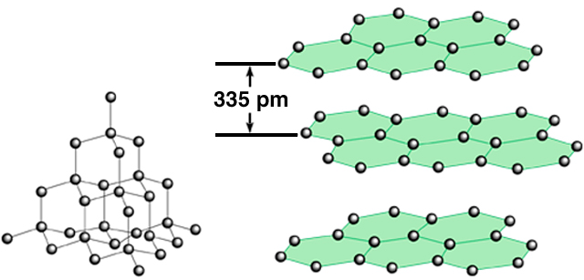
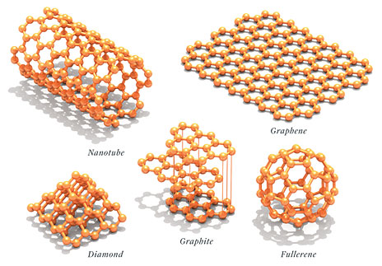
Types of Crystal Structures
Ionic
Covalent Network
Metallic
Molecular

Slide 22
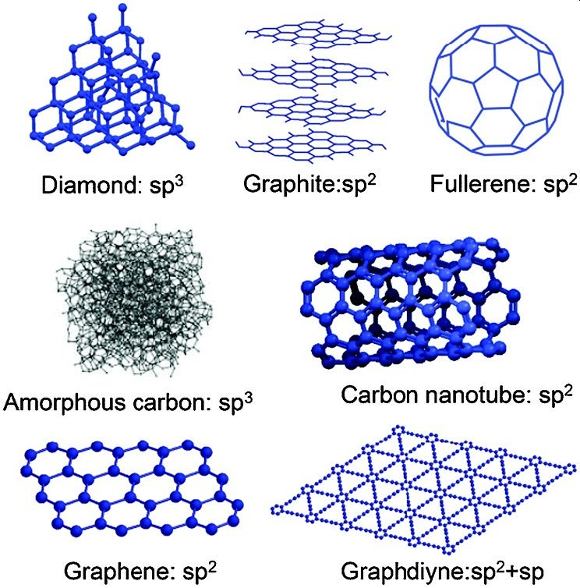
Super Soft!
(2D network)
Carbon
Container!
Super Hard!
(3D network)
Fuel and more!
Super Light and Strong!
Conducts Electricity!
Catalyst and more!

Slide 23
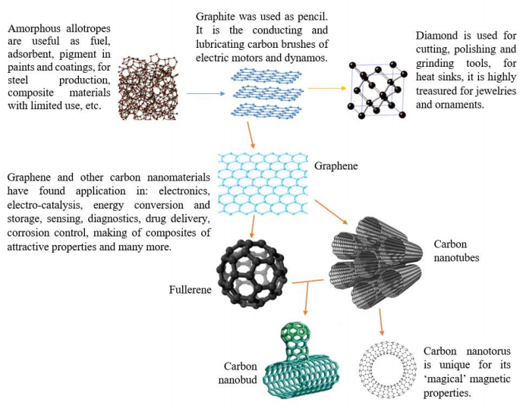
https://pdfs.semanticscholar.org/54dd/37111f016f4defc929d4eb598ac04a76d265.pdf

