Slide 1
CHE 112 Spring 2021
Lecture 10d – Phase Diagrams
Overview/Topics
Phase Diagrams
Terminology
Label s/l/g
Label Phase Transitions
Triple Point Critical Point
Supercritical Fluid
Slope s/l line and density
Melting, Vaporization and Sublimation Curves
Skills to Master
HW 10d
Read
OER 10.4

Slide 2
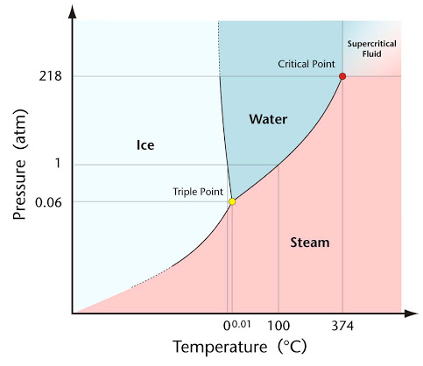
Phase Diagram – H₂O

Slide 3
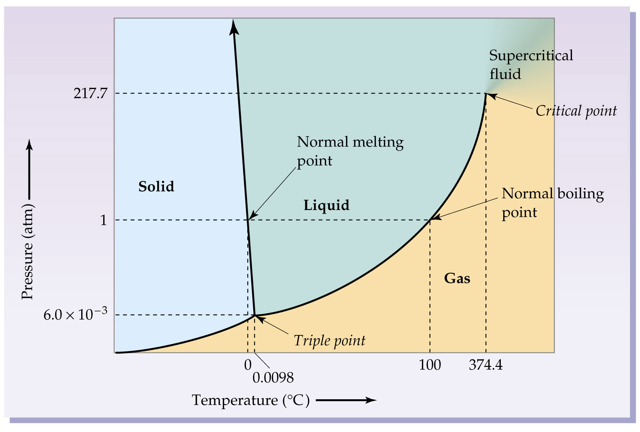
Phase Diagram – H₂O

Slide 4
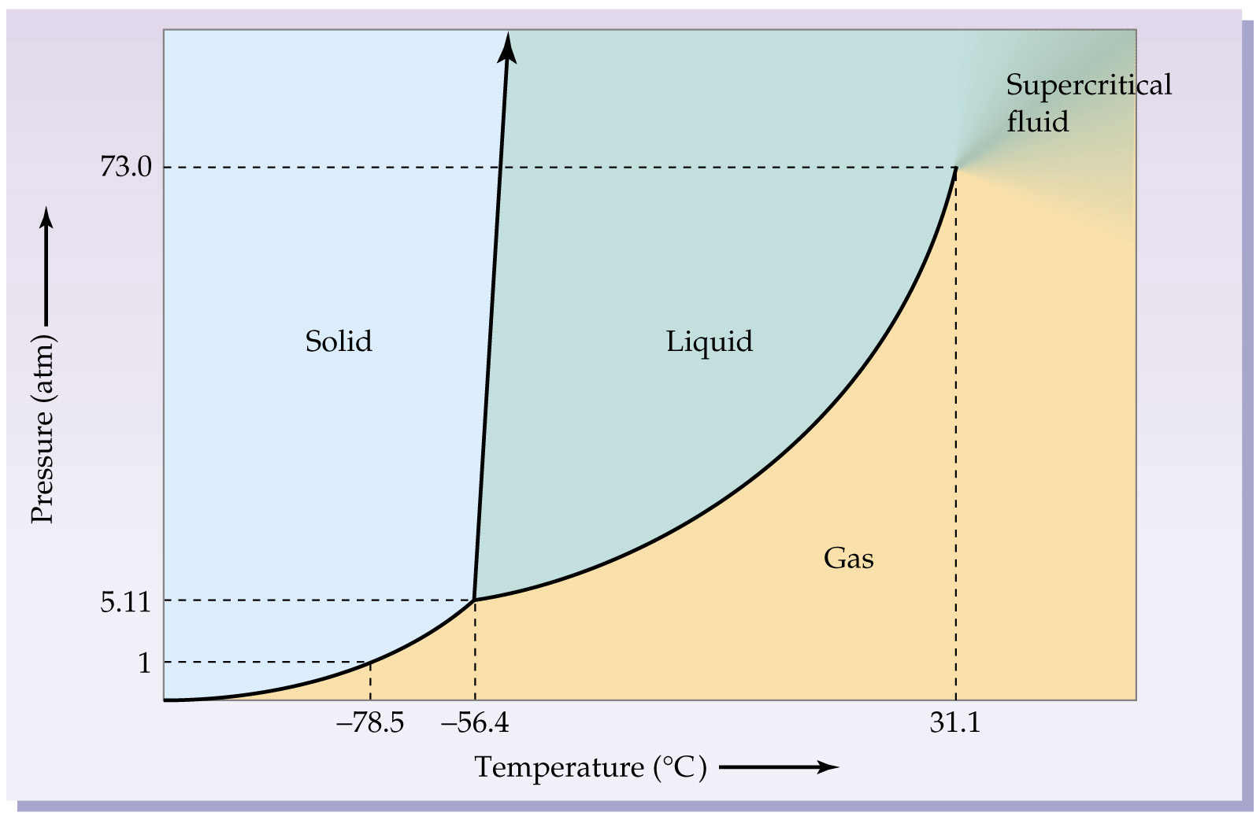
Phase Diagram – CO₂

Slide 5
Critical Point
Triple Point
P and T at which l, g are indistinguishable
Gas can not be liquefied beyond this temperature
all 3 phases (s,l,g) coexist
https://www.techeblog.com/mind-bending-video-shows-liquid-that-boils-and-freezes-at-the-same-time/
Supercritical Fluid
New state of matter with properties of both liquid and gas
It can effuse (Ch 9.)
It can dissolve (Ch 10a or Ch 11)
Many important uses

Slide 6
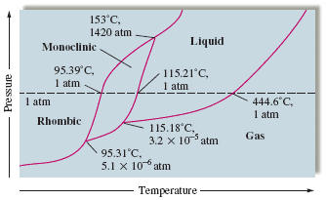
Phase Diagram – Sulfur

Slide 7
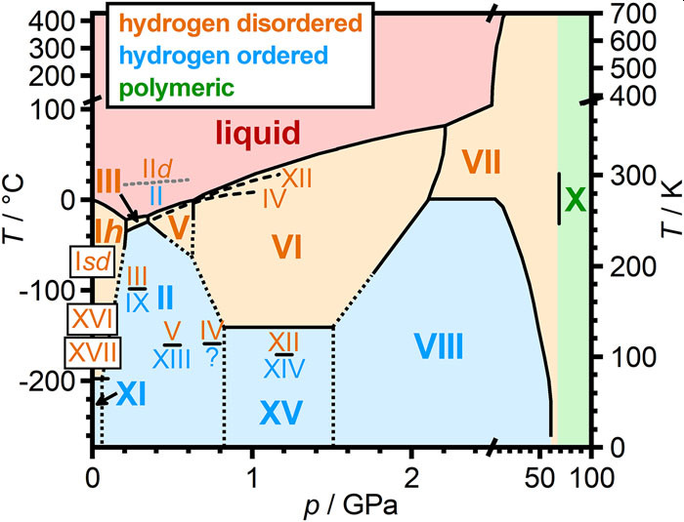
Phase Diagram – H₂O
https://aip.scitation.org/doi/pdf/10.1063/1.5085163
https://aip.scitation.org/doi/10.1063/1.5085163

Slide 8
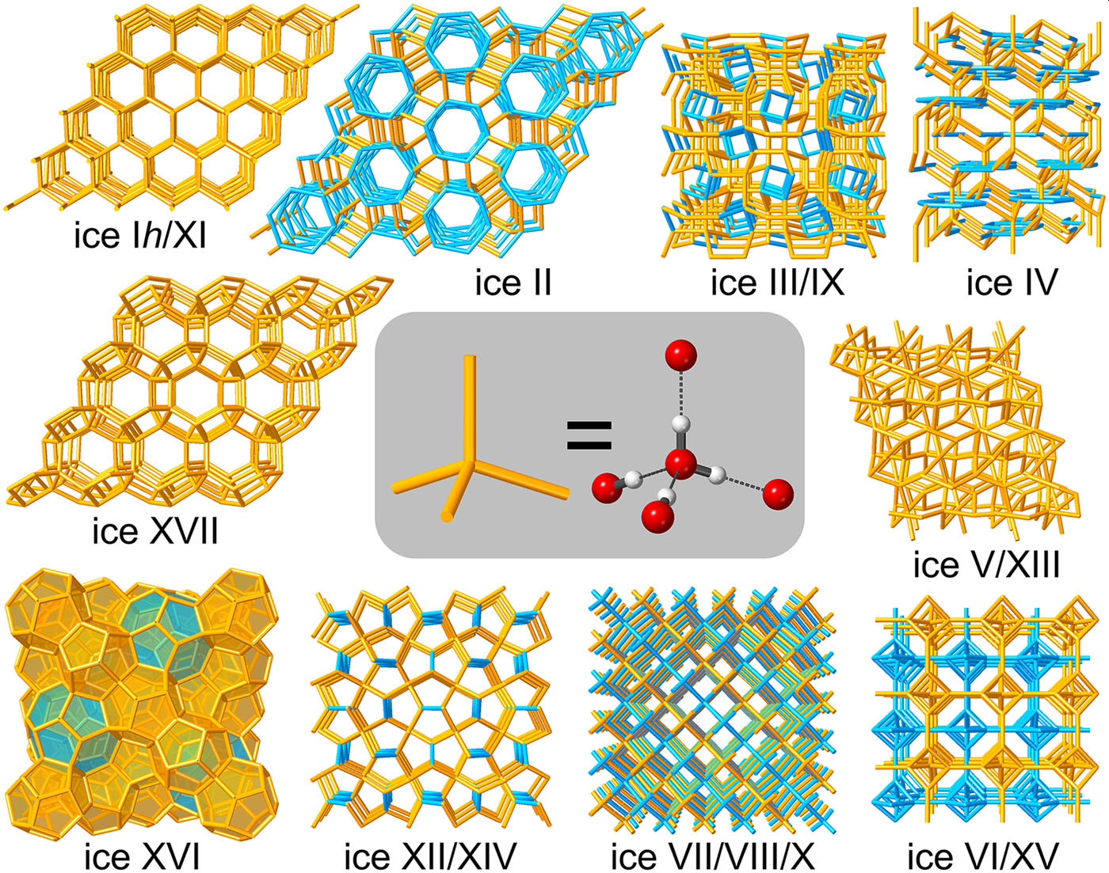
Structures of Ice – H₂O

Slide 9
