Slide 1
CHE 112 Spring 2021
Lecture 10c – Vapor Pressure and CCE
Overview/Topics
Vapor Pressure
Dynamic Equilibrium
CCE Equation
Skills to Master
HW 10c
Read
OER 10.3-10.4

Slide 2
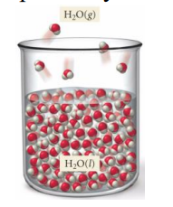
Evaporation
Process of turning a liquid into a gas (below the boiling point)
aka Vaporization
Evaporation: liquid → gas
Rate of Evaporation is DP to Temperature
Rate of Evaporation is IP to IMF
Rate of Evaporation is Independent of the amount of water
KE >> IMF
NOT Equilibrium
KE = IMF
Swamp Coolers

Slide 3
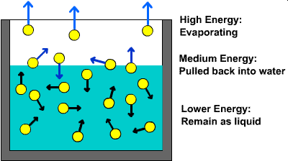
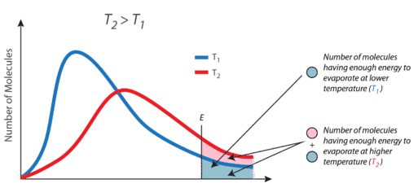
Temperature – KE Relationship
KE >> IMF
KE = IMF
KE << IMF
KE << IMF
KE = IMF
KE >> IMF

Slide 4
Vapor Pressure
The pressure exerted on a liquid by a vapor at equilibrium
(torr, mm Hg, Atm, Pa)
Review Pressure – Ch. 8a
VP or P_{v}
Evaporation: liquid → gas
Condensation gas → liquid
Evaporation: liquid → gas
Time
Dynamic Equilibrium
NOT Equilibrium
Rate of Evaporation = Rate Condensation
Amount of Liquid ≠ Amount of Vapor

Slide 5
Dynamic Equilibrium
Dynamic Equilibrium
Dynamic
Equilibrium
constantly evaporating and condensing
rate is equal
Rate of Evaporation = Rate Condensation
Amount of Liquid ≠ Amount of Vapor
Evaporation: liquid → gas
Condensation gas → liquid
We see this again in Ch. 13-15

Slide 6
Vapor Pressure
Dependent on:
Independent of:
DP to Temperature
IP to IMF’s
Size/Shape of the Container
Amount of Liquid Present

Slide 7
Clausius-Clapeyron Equation (CCE)
P = Pressure (Pa)
A = Constant (unique for each substance)
$∆H_{vap}$ = Enthalpy of Vaporization (J/mol)
R = Gas constant (8.341J/mol·K)
T = Temp (K)
Exponential Form
$$P_{vap}=Ae^{{−∆H_{vap}}/{RT}}$$
Comparison (Ratio) Form
$$\ln\left(\frac{P_{2}}{P_{1}}\right)= \frac{∆H_{vap}}{R}(\frac{1}{T_{1}}−\frac{1}{T_{2}})$$
Linear Form
$$\ln{P=−\frac{{∆H}_{vap}}{R}\left(\frac{1}{T}\right)}+\ln{A}$$

Slide 8
Example
Given (on CS)
ΔH_{vap} = 40.7 kJ/mol
P_{v} = 760 mmHg at 100 °C
Calculate the P_{v} (H₂O) at 85.0 °C.

Slide 9
Example
Calculate the ΔH_{sub} of diethyl ether (CH₃CH₂OCH₂CH₃) given that at 18 °C the vapor pressure is 400. mmHg and at 35 °C it is 760 mmHg.

Slide 10
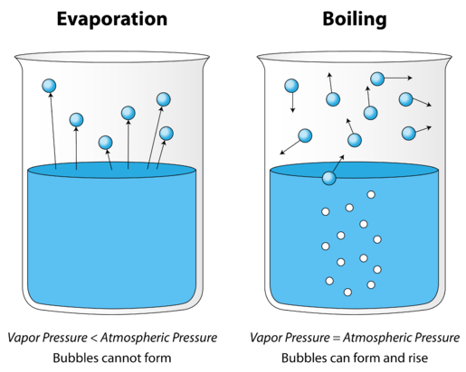
Boiling Point and Vapor Pressure
P_{vap} = P_{atm}
Review Ch. 12
Boiling point occurs when the vapor pressure of a liquid is equal to the external (atmospheric) pressure
Atmospheric Pressure is IP to Elevation

Slide 11
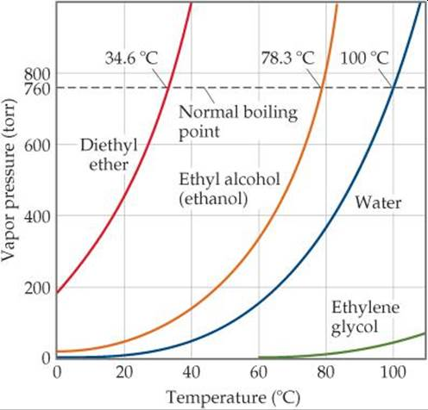
Vapor Pressure
Boiling Point
Intermolecular Forces
Boiling Point is DP IMF
Vapor Pressure is IP IMF
Similar Graph on CS

Slide 12
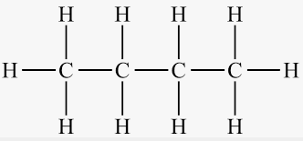
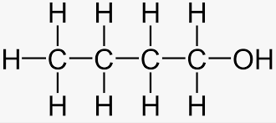
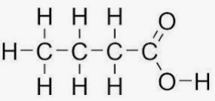
Example
Label all IMF in the following molecules
Order them from Lowest P_{v} to Highest P_{v}
(a)
(b)
(c)
(d)

