Slide 1
CHE 112 Spring 2021
Lecture 10b – Phase Changes and Heating Curve
Overview/Topics
Heating Curves
Phase Transitions (6)
Skills to Master
HW 10b
Read
OER 10.3-10.4

Slide 2
Phase Changes
Process by which matter changes from one state to another
Physical Changes therefore IMF are important
CF on CS
ΔH_{sub}
Can you:
ID 6 phase transitions
Sublimation
Melting
Evaporation
ΔH_{fus}
ΔH_{vap}
Freezing
Condensation
Deposition
Exothermic
Endothermic
Low Energy
High Energy

Slide 3
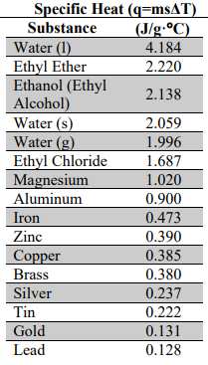
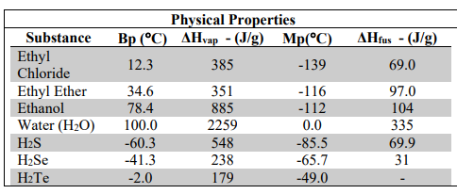
Values on CS
ΔH_{sub} = ΔH_{fus} + ΔH_{vap}
Review: 9b
Review: 9a
Alternative Symbols and Units

Slide 4
Heating Curve

Slide 6
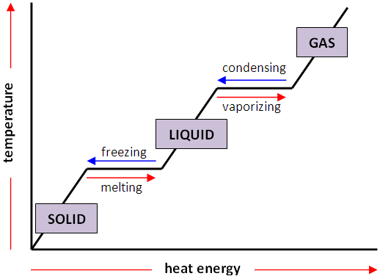
Heating Curve
q = mΔH_{vap}
q = msΔT
Liquid + Gas
q = mΔH_{fus}
q = msΔT
Solid + Liquid
q = msΔT

Slide 7
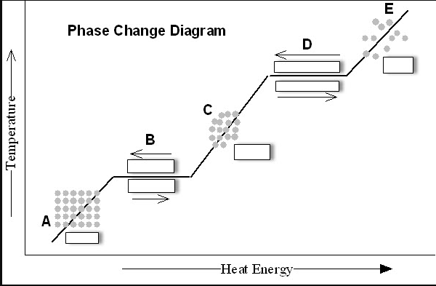
Heating Curve
q = mΔH_{vap}
Liquid + Gas
q = msΔT
q = mΔH_{fus}
Solid + Liquid
q = msΔT
q = msΔT

Slide 8
Heating Curve
2 Different Process’s
$$E∝\frac{q_{1}q_{2}}{r}$$
Heating a Substance
Phase Change
Add Energy
Molecules move faster (↑ KE)
Temperature Increases
Add Energy
Molecules move further apart
IMF is weakened
Temperature Stays Same
q = msΔT
q = mΔH_{vap}
q = mΔH_{fus}
q = mΔH_{sub}

Slide 9
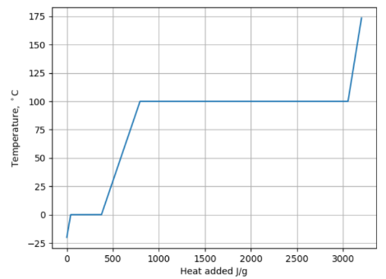
Heating Curve with #’s
Other
Possible
Units
Other Possible Units
Making a heating curve: http://chemistry.bd.psu.edu/jircitano/heatcurv.html

Slide 10
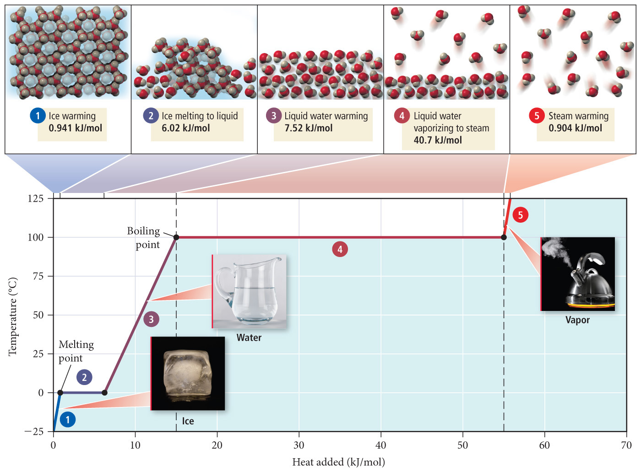

Slide 11
Heating Curve
Mathematics
Values on CS
q = msΔT
Change in energy required to heat a substance (s, l, g)
q = mΔH_{fus}
Change in energy required to melt/freeze a substance
q = mΔH_{vap}
Change in energy required to evaporate/condense a substance
ΔH_{sub} = ΔH_{fus} + ΔH_{vap}

Slide 12
Example:
How much energy does it take to transform 200.0 g of Ice at 0.0°C to Steam at 100°C?

