Slide 1
CHE 111 Fall 2020
Lecture 9c – BDE’s and Born-Haber Cycles
Overview/Topics
Bond Dissociation Energy (BDE)
Born-Haber Cycles
Lattice Energy (ΔH_{Lattice} )
Skills to Master
HW 9c
Read
OER 9.4

Slide 2
Review Ch. 5a – VBT/MO
Bond Dissociation Energies (BDE)
Amount of energy required to break a chemical bond
“Average” values of many different bonds
Useful because 30 million compounds exist, only a few have experimentally determined values
Tabulate in Table 9.3 p 500 OER Book
Cl₂ (g) → _2_ Cl (g)
ΔH_{BDE} = 243 kJ/mol

Slide 3
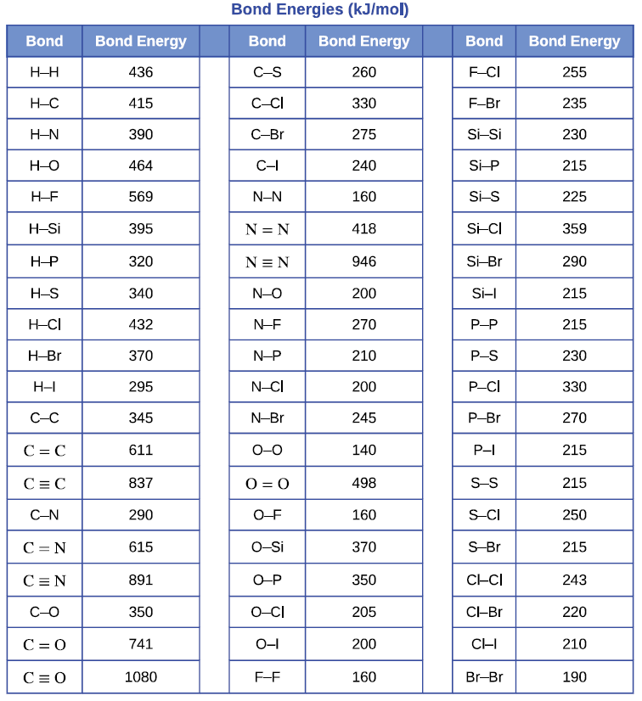
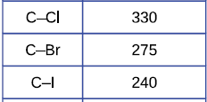
Bond Dissociation Energies (BDE)
↑ # bonds (e⁻ shared) α ↑ BDE
BDE ↓ Down a Column
Tabulate in Table 9.3 p 500 OER Book

Slide 4
BDE’s and VBT
ΔH_{BDE} = 436 kJ/mol
H-H
H-F
ΔH_{BDE} = 569 kJ/mol
F-F
ΔH_{BDE} = 160 kJ/mol

Slide 5
BDE’s and VBT
sp³ – hybridization
sp² – hybridization
sp – hybridization

Slide 6
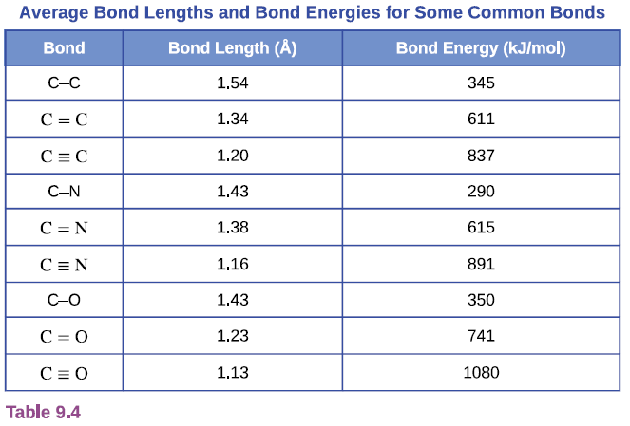
BDE + VBT

Slide 7
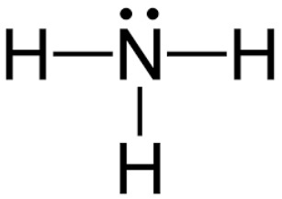
ΔH_{rxn} and BDE
ΔH_{rxn} = ∑ BDE - ∑ BDE
Bonds
Broken
Bonds
Formed
Example
_1_ N₂ (g) + _3_ H₂ (g) → _2_ NH₃ (g)
ΔH_{rxn} =
Break N=N + Break 3 (H-H) – Make 6 N-H
ΔH_{rxn} =
945 kJ + 3 × (436) kJ – 6 × (390) kJ
ΔH_{rxn} = -87 kJ/mol
Tabulated Value
-92.6 kJ/mol

Slide 8
Example
Using BDE’s calculate Enthalpy of Reaction for the combustion of butane
_ C₄H₁₀ (g) + __ O₂ (g) → __ CO₂ (g) + __ H₂O (g)
Tabulated Value
-2877 kJ/mol

Slide 9
Lattice Energy (ΔH_{lattice})
Energy change when an Ionic chemical bond is broken
Difficult to measure and calculate
DP stability of bond/molecule (more negative more stable)
Endothermic (+)
Endothermic (+) as defined, some books use the opposite definition
CA (s) → C⁺ (g) + A⁻ (g)
Exothermic (-)
Coulomb's Law
C = constant (depends on crystal structure)
Z⁺ = charge cation
Z⁻ = charge anion
R = bond length (sum of ion radii)
$$∆H_{lattice}=\frac{C{(Z}^{+})(Z^{−})}{R}$$
DP to charge on ions
IP to size of ions

Slide 10
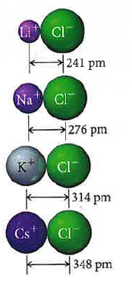
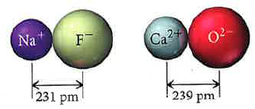
Trends in Lattice Energy
$$∆H_{lattice}=\frac{C{(Z}^{+})(Z^{−})}{R}$$
Lattice Energy is IP to Size
Lattice Energy is DP to Charge
Size
-834 kJ/mol
Energy
-788 kJ/mol
-701 kJ/mol
-910 kJ/mol
-3414 kJ/mol
-657 kJ/mol

Slide 11
Example
Which will have a greater Lattice Energy? Explain.
MgF₂ vs MgI₂
NaCl vs MgCl₂

Slide 12
Born-Haber Cycles
Hard to measure lattice energies experimentally
Easier to calculate
Similar to Hess’s Law
Can solve for any value, though normally its Lattice Energy or Enthalpy of Reaction
ΔH_{rxn} = ΔH_{sub} + BDE + E_{IE} + E_{EA} + ΔH_{lattice}
Need to know 6 values (Tables in OER Book)
Energy | Symbol | Table
Enthalpy of Sublimation (metal) | ΔH_{sub} | *Given in problem
BDE (nonmetal) | BDE | Table 9.3
Ionization Energy | IE or E_{IE} | Figure 3.34 Table 3.3
Electron Affinity | EA or E_{EA} | Figure 3.35
Lattice Energy | ΔH_{lattice} | Not in Book
Enthalpy of Formation (rxn) | ΔH_{f} | Appendix G
*All Values Given for HW and Exam

Slide 13
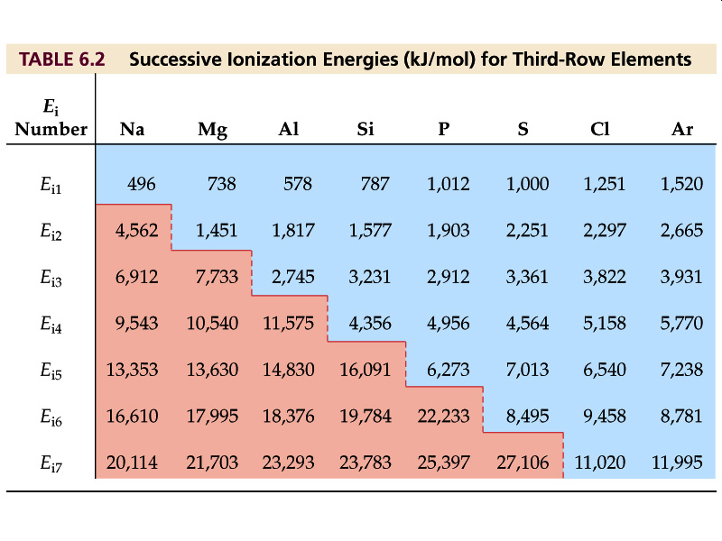
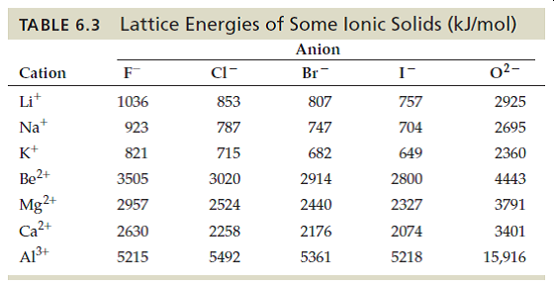
Ionization Energy
* Additional values not from book
Use values in book first!
Lattice Energy
*Not from book, use with care!

Slide 14
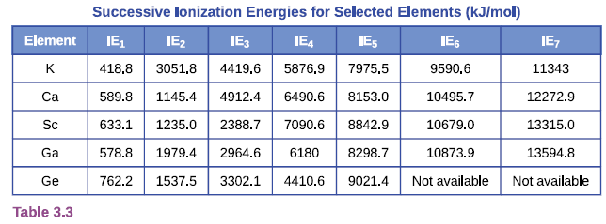
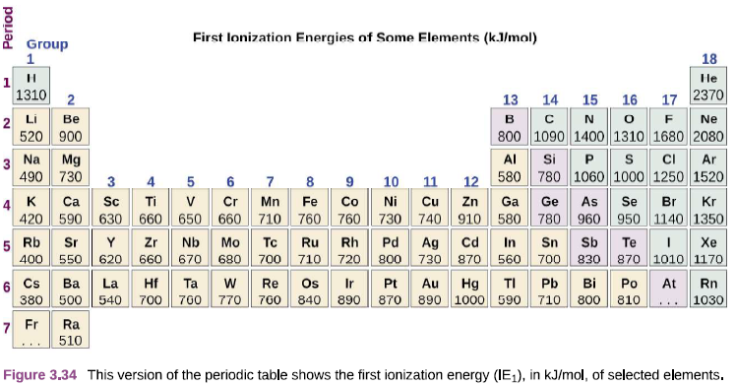
Ionization Energy

Slide 15
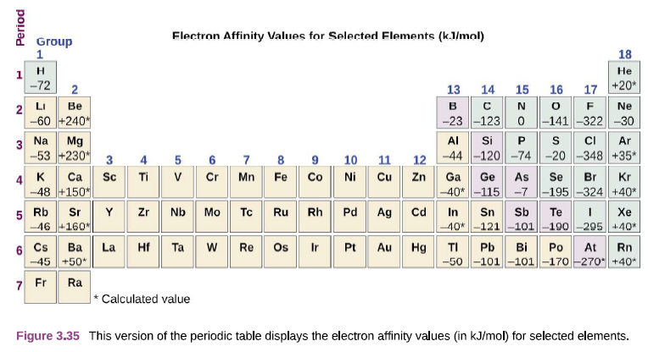
Electron Affinities

Slide 16
Bond Dissociation Energy (BDE)
Tabulate in Table 9.3 p 500 OER Book

Slide 17
Example
Calculate the Lattice Energy for NaCl using a Born-Haber Cycle.
Na (s) + ½ Cl₂ (g) → NaCl (s)
Na⁺¹ (g) + Cl⁻¹ (g) → NaCl (s)
ΔH_{rxn} = ΔH_{sub} + BDE + E_{IE} + E_{EA} + ΔH_{lattice}
Given:
ΔH_{sub} (Na) = 107.3 kJ/mol

Slide 18
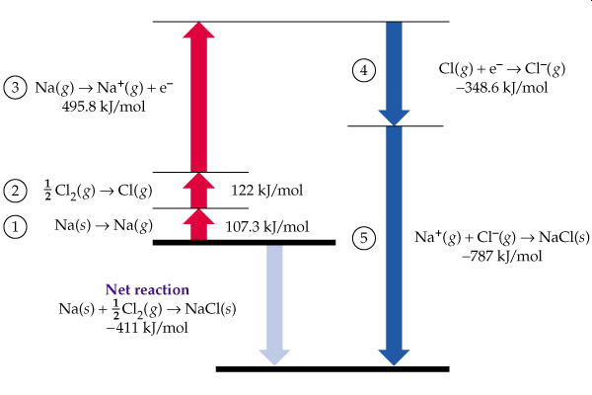
Step | Reaction | Process | Value (kJ/mol)
1 | Na (s) → Na (g) | Sublimation | 107.3
2 | ½ Cl₂ (g) → Cl (g) | BDE | ½ (243)
3 | Na (g) → Na⁺¹ + e⁻ | Ionization Energy | 495.8
4 | Cl (g) + e⁻ → Cl⁻¹ (g) | Electron Affinity | -348.6
5 | Na⁺¹ (g) + Cl⁻¹ (g) → NaCl (s) | Lattice Energy | -787
6 | Na (s) + ½ Cl₂ (g) → NaCl (s) | Enthalpy of Reaction | -411

Slide 19
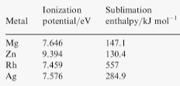
Example
Calculate the Enthalpy of Reaction for MgCl₂ using a Born-Haber Cycle.
Mg (s) + Cl₂ (g) → MgCl₂ (s)
ΔH_{rxn} = ΔH_{sub} + BDE + E_{IE} + E_{EA} + ΔH_{lattice}
*-641.8 = google
*-642.1 = this problem

Slide 20
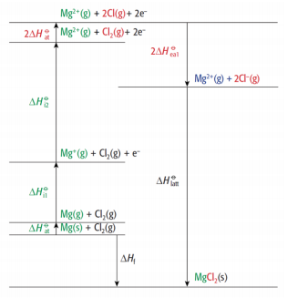
Solution:
Step | Reaction | Process | Value (kJ/mol)
1 | Mg (s) → Mg (g) | Sublimation | 147.1
2 | Cl₂ (g) → 2 Cl (g) | BDE | 243
3a | Mg (g) → Mg⁺¹ (g) + e⁻ | I_{IE1} | 738
3b | Mg⁺¹ (g) → Mg⁺² (g) + e⁻ | I_{IE2} | 1451
4 | 2 Cl (g) + 2e⁻ → 2 Cl⁻¹ (g) | Electron Affinity | 2(-348.6)
5 | Mg⁺² (g) + 2 Cl⁻¹ (g) → MgCl₂ (s) | Lattice Energy | -2524
6 | Mg (s) + Cl₂ (g) → MgCl₂ (s) | Enthalpy of Reaction | -642.1
*-641.8 = google
*-642.1 = this problem

Slide 21
Compare the two problems
Step | Reaction | Process | Value (kJ/mol)
1 | Na (s) → Na (g) | Sublimation | 107.3
2 | ½ Cl₂ (g) → Cl (g) | BDE | ½ (243)
3 | Na (g) → Na⁺¹ + e⁻ | Ionization Energy | 495.8
4 | Cl (g) + e⁻ → Cl⁻¹ (g) | Electron Affinity | -348.6
5 | Na⁺¹ (g) + Cl⁻¹ (g) → NaCl (s) | Lattice Energy | -787
6 | Na (s) + ½ Cl₂ (g) → NaCl (s) | Enthalpy of Reaction | -411
Step | Reaction | Process | Value (kJ/mol)
1 | Mg (s) → Mg (g) | Sublimation | 147.1
2 | Cl₂ (g) → 2 Cl (g) | BDE | 243
3a | Mg (g) → Mg⁺¹ (g) + e⁻ | I_{IE1} | 738
3b | Mg⁺¹ (g) → Mg⁺² (g) + e⁻ | I_{IE2} | 1451
4 | 2 Cl (g) + 2e⁻ → 2 Cl⁻¹ (g) | Electron Affinity | 2(-348.6)
5 | Mg⁺² (g) + 2 Cl⁻¹ (g) → MgCl₂ (s) | Lattice Energy | -2524
6 | Na (s) + ½ Cl₂ (g) → NaCl (s) | Enthalpy of Reaction | -642.1

Slide 22
Compare the two problems
Step 1 – Value always given (not in book)
Step 2 – BDE (depends on how many atoms you need) multiply by ½ or 1…
Step 3 - Ionization Energy (# steps depends on number charge of cation)
Step 4 – Electron Affinity (depends on how many ions you make) multiply by 1 or 2…
Step 5 – Given or Solve for it
Step 6 – Appendix G or Given or Solve for it

Slide 23
Chapter 10
Enthalpies of Physical Change
H₂O (l) → H₂O (g)
ΔH_{Vap} = 44 kJ/mol
H₂O (s) → H₂O (l)
ΔH_{Fus} = 6.01 kJ/mol
44.01
Enthalpies of Solution
Chapter 11

