Slide 1
CHE 111 Fall 2020
Lecture 9b – Enthalpy and Chemical Reactions
Overview/Topics
Endothermic/Exothermic Reactions
Sign conventions
Side of Reaction
High/Low Energy
Diagram
Energy (ΔE) vs Enthalpy (ΔH)
Skills to Master
9b
Read
OER 9.3-9.4

Slide 2
Chemical Reactions
Heat can transfer between substances during chemical reactions
Endothermic
Exothermic
A chemical reaction the absorbs heat
Heat is a reactant
E_{R} < E_{p}
Δ H = +
A chemical reaction the releases heat
Heat is a product
E_{R} > E_{p}
Δ H = -
Heat + A + B

Slide 3
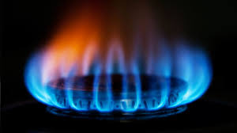
Exothermic
___ CH₄ (g) + _2_ O₂ (g) → ___ CO₂ (g) + _2_ H₂O (g) + Heat
ΔH = -890 kJ/mol

Slide 4
Endothermic
Heat + NH₄NO₃ (s) + H₂O (l)→ NH₄OH (aq) + HNO₃ (aq)
ΔH = +25.69 kJ/mol

Slide 5
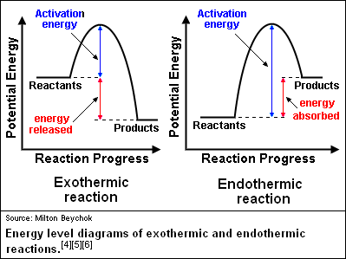

Slide 6
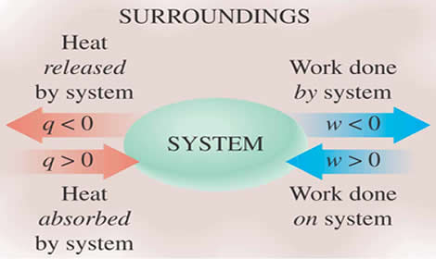
Thermodynamics:
Science that deals with the relationships between heat, work and other forms of energy in the context of chemical and physical processes
Internal Energy
E = U
ΔE = q + w
Ch. 8 – Pistons (PV=nRT)
Ch. 9a q = msΔT
Ch. 16 Electrochemistry
-
-
+
+
Sign Conventions
Expand gas: ΔV +
System lost energy: w = -
w = -PΔV
1 L·atm = 101 J

Slide 7
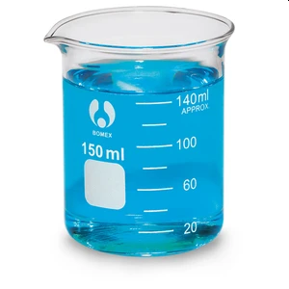
Energy and Enthalpy
Chemical reactions that produce gases perform PV work
ΔE = q + w
In chemistry we focus on heat gained or lost in a reaction.
ΔE = q - PΔV
Constant Volume
ΔV = 0
Constant Pressure
P = 1 atm
q = ΔE + PΔV
q_{v} = ΔE
q_{p} = ΔE + PΔV
Bomb Calorimeter
H = ΔE + PΔV
q_{p} = H

Slide 8
Enthalpy (ΔH)
Lots of Different “Types”
“Open” system (PΔV work allowed)
ΔH_{rxn} = Reaction
ΔH_{sol} = Dissolving
Physical States are Important
ΔH_{comb} = Combustion
ΔH_{fus} = Melting
ΔH_{vap} = Vaporization
ΔH_{sub} = Sublimation
ΔH_{lat} =Lattice
# Mols is important
Standard State (ΔH° )
M/D coeffecients
Fractions are “acceptable”
1 bar (0.987 atm)
25 °C
1 M
Sign Conventions
ΔH = - (Exothermic)
ΔH = + (Endothermic)
Reverse Direction, Reverse Sign

Slide 9
Applications of Enthalpy
ΔH reaction
Heat released
Determine ΔH
Enthalpy of Formation (ΔH_{f}°)
Hess’s Law
Bond Dissociation Energies (BDE) (9.4)
Ionic Bonds/Lattice Energy (9.4)
Born-Haber Cycle (9.4)

Slide 10
ΔH of Reaction
Example:
How much heat (kJ) is released when 2.5 mols of NO (g) react with an excess of O₂ (g):
_2_ NO (g) + _1_ O₂ (g) → _2_ NO₂ (g) ΔH_{rxn} = -114.6 kJ

Slide 11
Example:
How much heat (kJ) is released when 20.0 grams of NO (g) react with 40.0 grams of O₂ (g):
_2_ NO (g) + _1_ O₂ (g) → _2_ NO₂ (g) ΔH_{rxn} = -114.6 kJ

Slide 12
Example:
How much heat (kJ) is released when 3.0 L of NO (g) react with an excess of O₂ (g) at
500.0 mmHg and 25 °C?
_2_ NO (g) + _1_ O₂ (g) → _2_ NO₂ (g) ΔH_{rxn} = -114.6 kJ

Slide 13
Example:
In lab you reacted 1.50 grams of Mg (s) with excess HCl (aq) and produced -28.8 kJ of heat.
What is the ΔH of reaction?
http://chemistry-reference.com/reaction.asp?rxnnum=697

Slide 14
STP
25 °C
1 bar (0.987 atm)
ΔH_{f}° - Enthalpy of Formation
Enthalpy change when 1 mole of pure substance is formed from its free elements in their most stable states under STP.
Tabulated in Appendix G (available on exams)
Easier to tabulate by chemical compound then by reaction
“Unrealistic” for RL
ΔH°_{rxn} = ΔH°_{f} (Products) - ΔH°_{f} (Reactants)

Slide 15
Example:
Calculate ΔH°_{rxn} for the following reaction using ΔH°_{f} values from Appendix G.
_2_ Al (s) + ___ Fe₂O₃ (s) → ___ Al₂O₃ (s) + _2_ Fe (l)
Fe (l) = 13 kJ/mol

Slide 16
Hess’s Law
If a process can be written as the sum of several stepwise process the enthalpy change of the overall process is the sum of the enthalpy’s of the individual steps
Process = ∑ steps
Really just Conservation of Mass and Energy
Useful for difficult/impossible to perform reactions
5 Rules
R always appear on the LEFT
P always appear on the RIGHT
Intermediates = both sides
Reverse Reaction = Reverse Sign
Can M/D Reactions and ΔH values

Slide 17
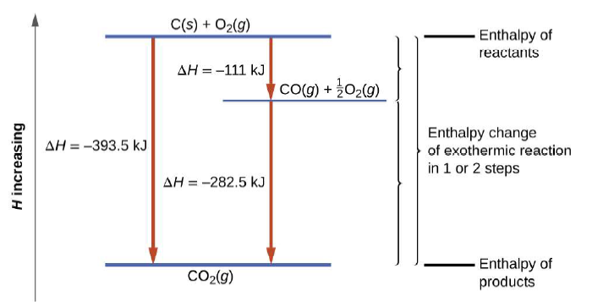
Example:
Which compound is an intermediate?
An example of Hess’s Law: Adding (1) + (2) gives the third reaction
(1)
_1_ C (s) + _½_ O₂ (g) → _1_ CO (g)
ΔH₁° -111 kJ
(2)
_1_ CO (g) + _½ O₂ (g) → _1_ CO₂ (g)
ΔH₂° -283 kJ
∑
_1_ C (s) + _1 O₂ (g) → _1_ CO₂ (g)
ΔH_{r}° -394 kJ

Slide 18
Example:
Given the following reactions determine ΔH°_{rxn} for:
_2_ NO₂ (g) → _1_ N₂O₄ (g)
(1) _½_ N₂ (g) + O₂ (g) → _1_ NO₂ (g)
ΔH₁° 33.85 kJ
(2) _1_ N₂ (g) + _2_ O₂ (g) → _1_ N₂O₄ (g)
ΔH₂° -9.66 kJ

Slide 19
Example:
Given the following reactions determine ΔH°_{rxn} for:
_2_ C (s) + _2_ H₂ (g) → _1_ C₂H₄ (g)
(1) _1_ C (s) + _1_ O₂ (g) → _1_ CO₂ (g)
ΔH₁° -393.5 kJ
(2) _1_ C₂H₄ (g) + _3_ O₂ (g) → _2_ CO₂ (g) + _2_ H₂O (g)
ΔH₂° -1410.9 kJ
(3) _1_ H₂ (g) + _½_ O₂ (g) → _1_ H₂O (g)
ΔH₃° -285.8 kJ

Slide 20
Extra Practice
This is not a required assignment.
If after completing the homework (and/or) to help study for the exam, these additional problems might prove helpful.
Don’t do all the problems, select ones that you feel you might struggle with on the exam
Answer’s/Answer key available on request.
www.chemhaven.org/che111 doesn’t have EP for these topics
OER Textbook
Examples: 9.8-9.15
Problems: 45-50, 52, 56-59, 63-73 75, 77, 78, 80-83

