Slide 1
CHE 111 Fall 2020
Lecture 9a – Energy Basics and Calorimetry
Overview/Topics
Energy
KE and PE
Temperature vs Energy (Heat)
Calorimetry
Solving q=msΔT for any variable
Skills to Master
HW 9a
Read
OER 9.1-9.2

Slide 2
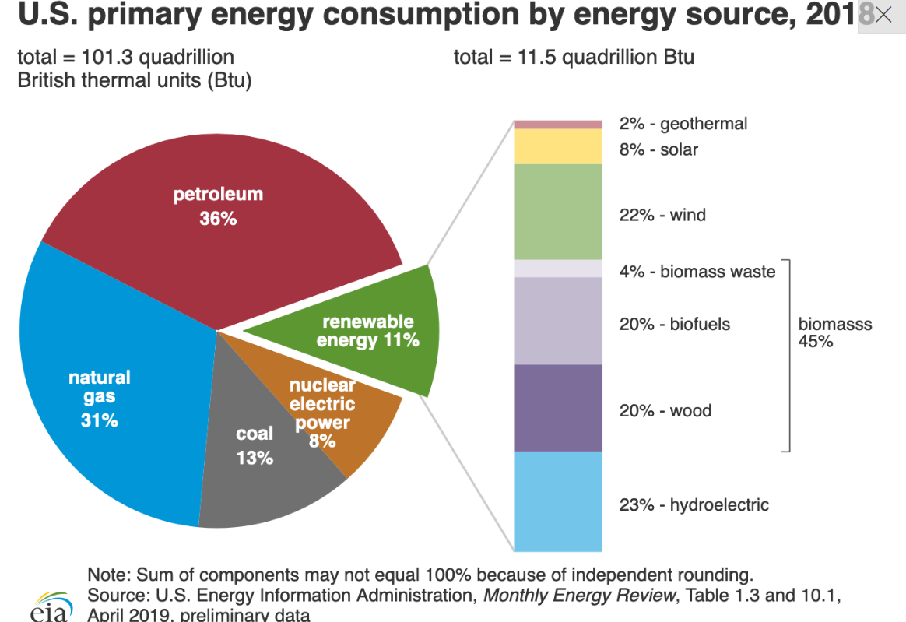
Energy
Gained or lost in all chemical reactions
Essential for life
10 million jobs/8% GDP in USA
https://cleanet.org/clean/literacy/energy4.html

Slide 3
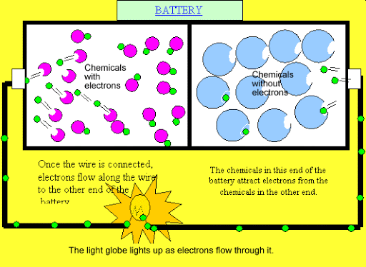
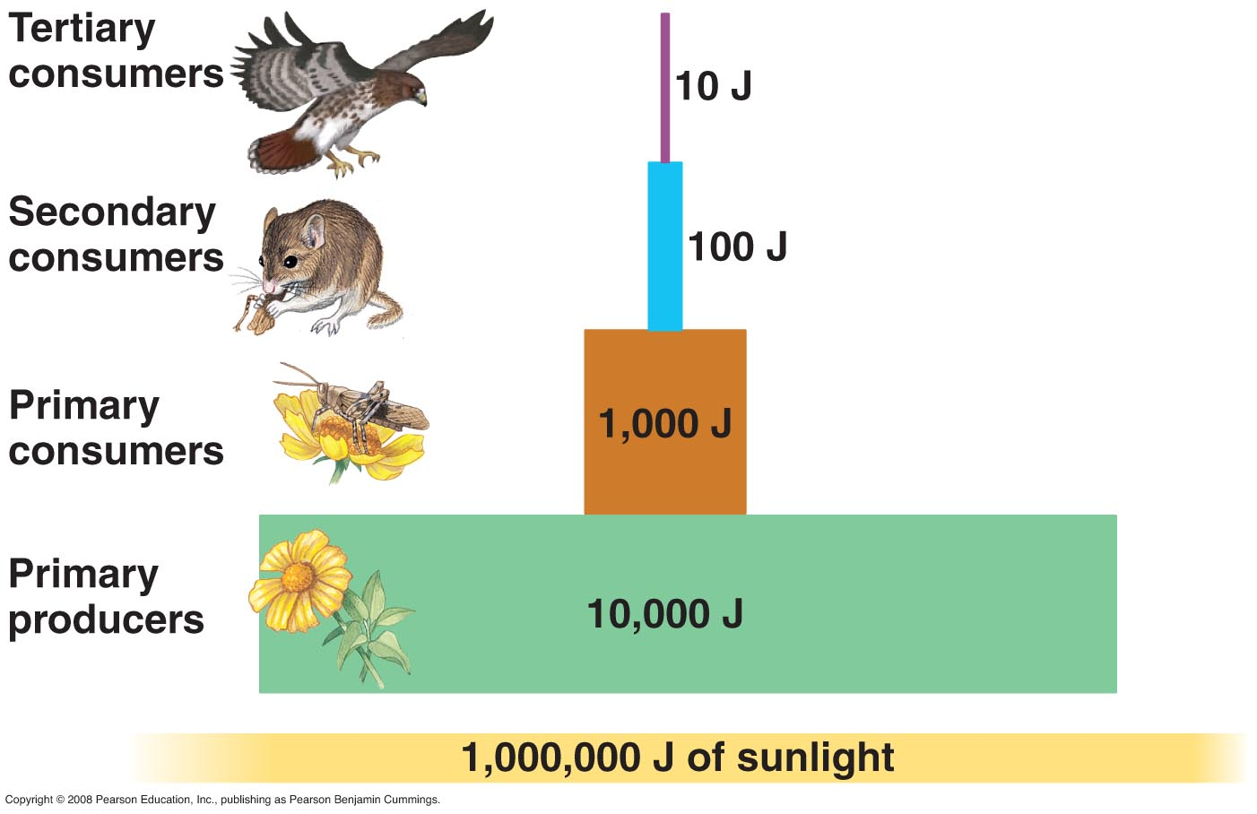
Thermochemistry:
Energy absorbed or released during chemical and physical changes
Energy Industry
Biology
Engineers
Combustion of fossil fuels
Transportation
Batteries
Generation of Electricity
Ecosystems
Metabolism
Food Science
Energy storage/transportation
Energy efficiency
Physics

Slide 4
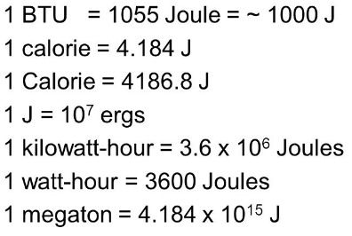
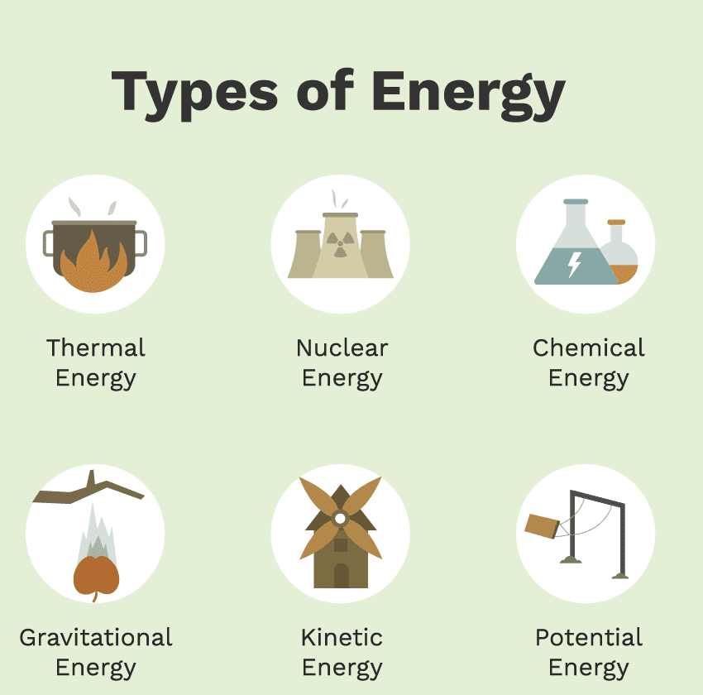
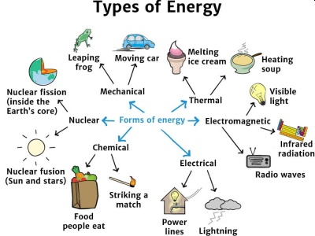
Energy
Capacity to perform work or supply heat.
w = F × D
q = msΔT
Objects posses energy and it is exchanged via work or heat
Cheat Sheet
ΔE = w + q
Units
$\frac{kg∙m^{2}}{s^{2}}$ = J
2 Types: Kinetic Energy (KE or E_{K}) and Potential Energy (PE or E_{P})

Slide 5
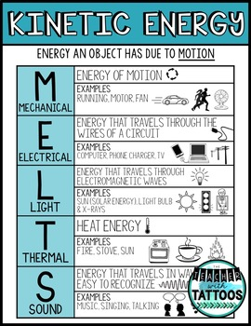
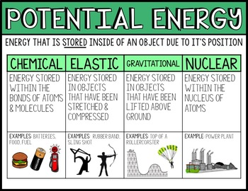
Kinetic Energy (KE or E_{K})
Potential Energy (PE or E_{P})
Energy that matter posses dues to its motion
Energy that is stored or that an object posses due to its relative position, composition or condition

Slide 6
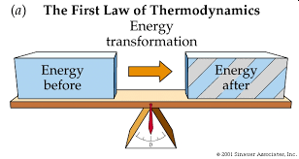
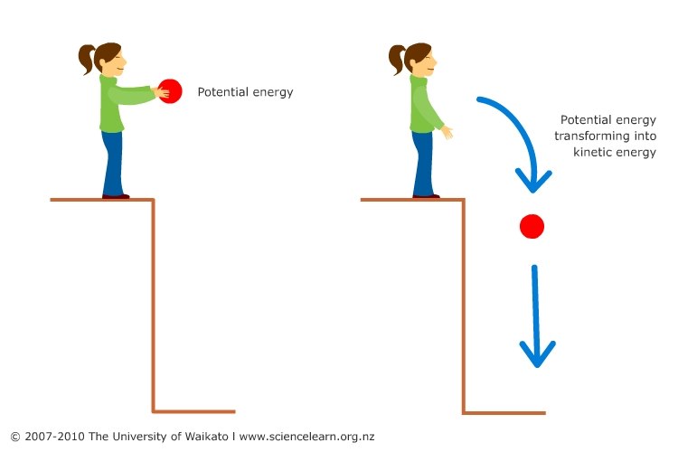
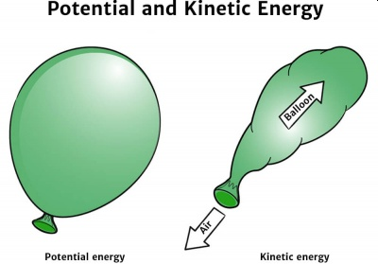
Conservation of Energy
Energy can neither be created nor destroyed but can be converted from one form to another

Slide 7
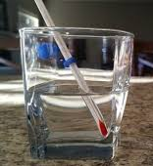
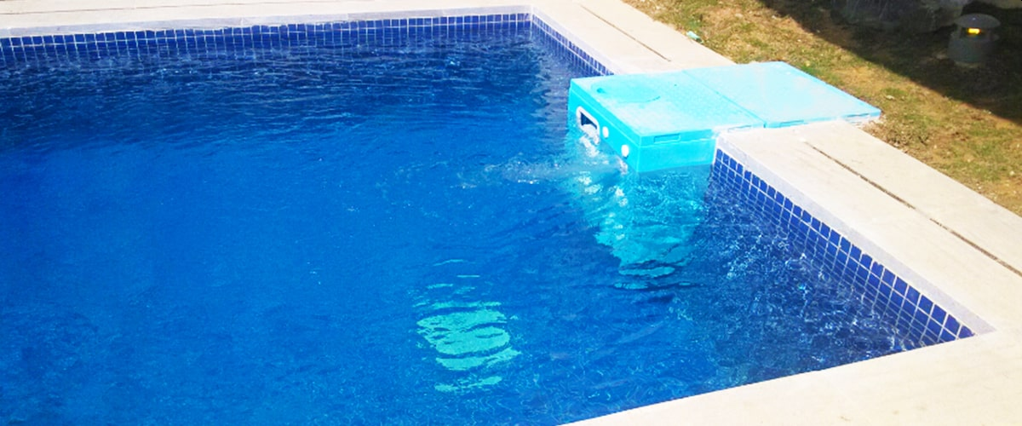
Thermal Energy
KE associated with the random motion of atoms or molecules
Heat (q)
Temperature (T)
Transfer of energy between two objects at different temperature
A quantitative measure of the average KE in a system (motion of molecules)
Heat can be transferred between objects
“Cold” Low Temp. – particles move slower
“Hot” High Temp. – particles move faster
Units – Joules or Calories
Units – °C, °F, or K
Extensive – depends on sample size
Intensive – independent on sample size
Same Temperature
Different Heat

Slide 8
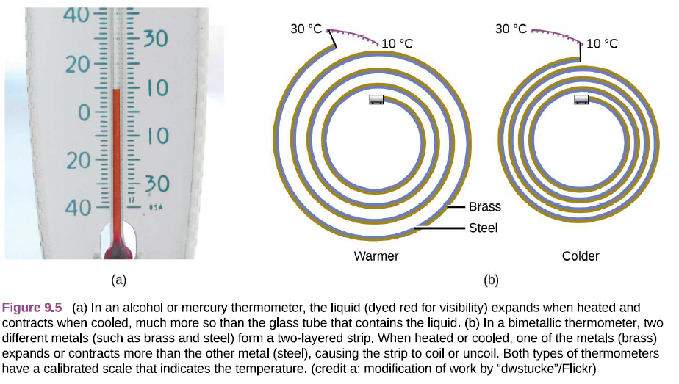
Ch. 10
Heating Curves
Phase Transitions
Miscellaneous
Heat can either increase the KE or cause a phase transition
Add Heat
Add Heat
Remove Heat
Remove Heat
Solid
Liquid
Gas
Heat causes liquids and solids to expand (how thermometers work)

Slide 9
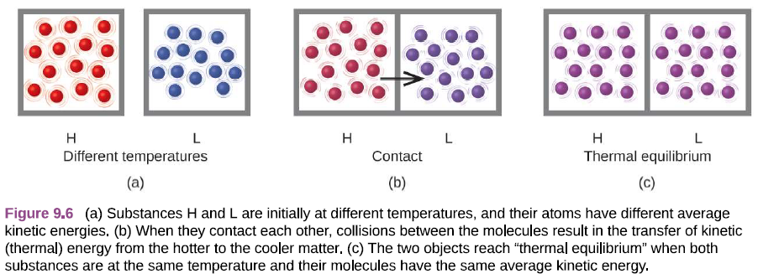
Miscellaneous
Heat can transfer between substances by contact

Slide 10
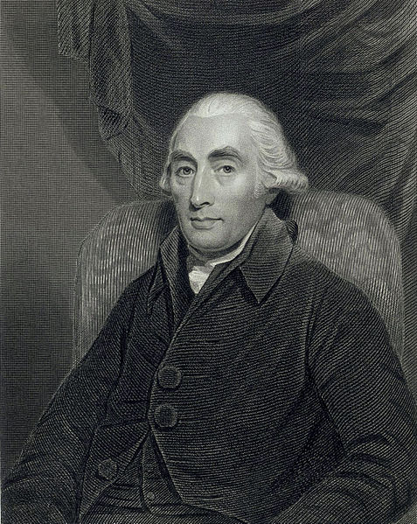
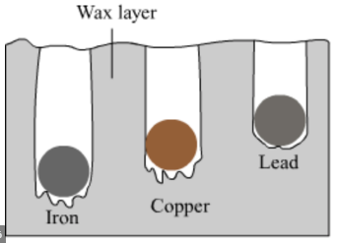
Heat - Quantitative Measurements
Joseph Black (1728-1799)
https://en.wikipedia.org/wiki/Joseph_Black
Analytical Scale
Properties of CO₂
Specific Heat
Metal Spoon = HOT!
Wood Spoon = Cool

Slide 11
Heat - Quantitative Measurements
“Review”
PV=nRT
Different substance store/absorb/transmit heat at different rates
How the atoms/molecules in a substance respond to heat is different
m - mass
g (kg, lbs. etc.)
ΔT - change in temperature
ΔT = T_{f} – T_{i}
°C (K or °F)
q = m s ΔT
Sign Conventions
+ = system absorbs energy
- = system loses energy
q - heat
J or cal
s - specific heat (c)
*Unique for each substance
Amount of heat required to
raise 1 gram of substance 1 °C
Units = J /g °C
s = c

Slide 12
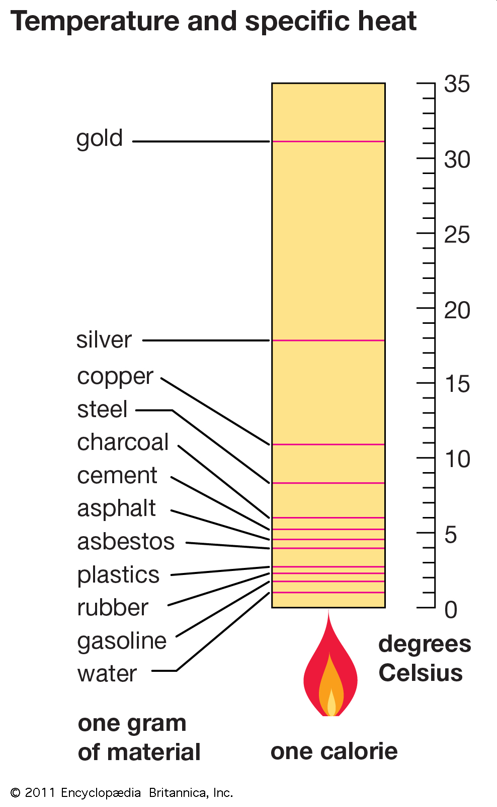
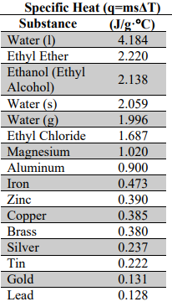
Specific Heat Values
*Unique for each substance
*On your CS!

Slide 13
How to Solve Problems
Q → A
Identify and List all values (based on units)
Identify additional CF needed
Rearrange the equation to solve for a given value
Try!
Types of Problems “Tricks”
Non Standard Units
Energy –
Mass –
Temperature –
Density ??
Extra Steps
Solving for Different Variables
Do the opposite
Do it to both sides
Don’t forget to!
Check/Cancel Units
Keep track of SF
Use SN if needed
Get help if you need it!

Slide 14
Example: Calculate the amount of heat (in J) required to boil a cup of water containing 150 mL from 20. °C to 90.°

Slide 15
Example: What amount of heat is required to boil 100.0 mL beaker of ethanol if the sample starts at 19.5 °C and the boiling point of ethanol is 78.4 °C

Slide 16
Example: What mass of Lead (Pb), in grams, can be heated with 250 kJ of energy from 50.0 °C to 150.°

Slide 17
Example: What is the specific heat of an unknown metal that required 250 kJ to heat 2.5 lbs of metal from 250. °C to 716.°C?

Slide 18
Example: A student supplies 2.50x10⁴ J of energy to a 500.0 grams sample of Silver (Ag). If the sample starts out at 25 °C what is the final temperature of the sample?

Slide 19
Example: A wood stove provides 650 J/min of heat. If you are trying to boil a cup of water that has a volume of 500.0 mL at 25.0 °C, how long (in hours) will it take to boil the water?

Slide 20
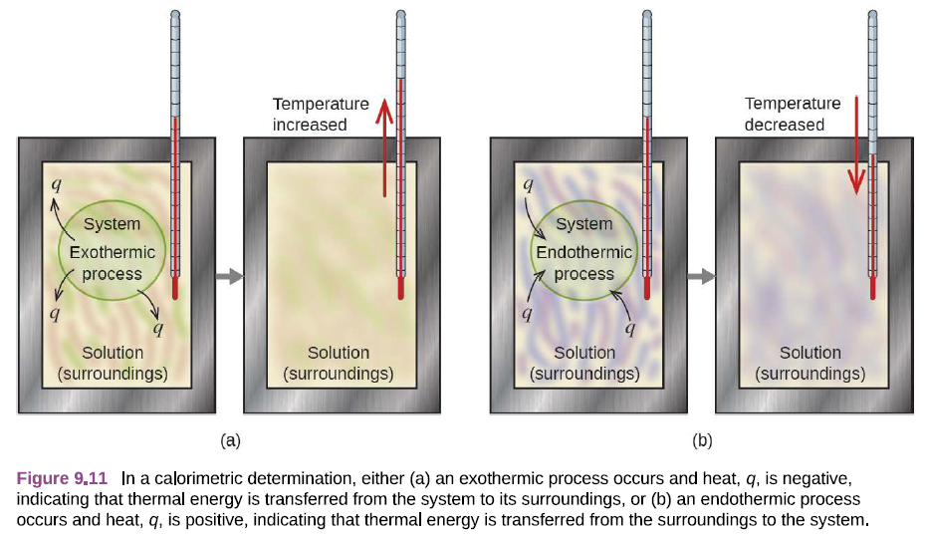
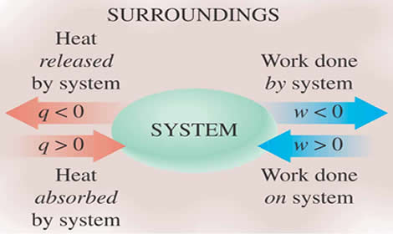
Calorimetry
Measure the amount of heat (gained or lost) in a chemical or physical process
System:
The system studied
Surroundings:
Everything else
-
-
+
+

Slide 21
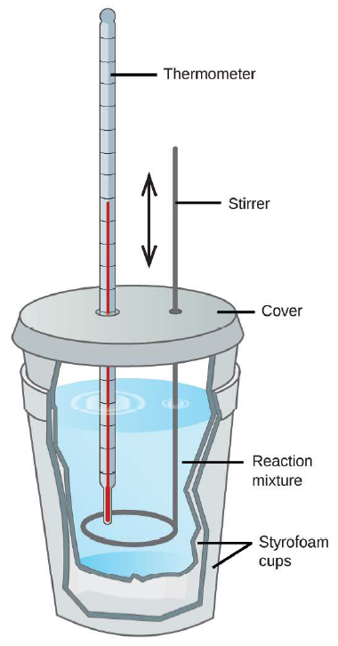
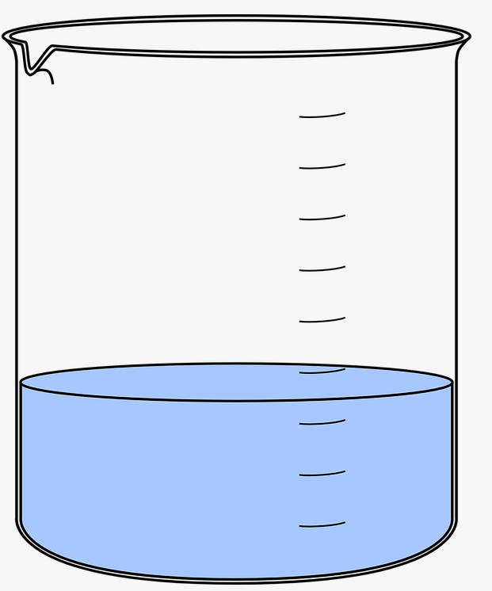
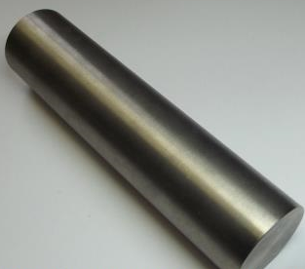
Calorimetry (“Linked Systems”)
Take a known system and “link” it to an unknown system to determine the missing value
Example: What is the specific heat of the unknown metal?
q_{metal} = msΔT
q_{water} = msΔT
Boiling Water = 95.0 °C
Water = 175.0 mL
Mass Unknown = 250.0 g
Water bath start = 20.8 °C
Water bath end = 26.0°C

Slide 22
An unknown metal weighing 250.0 grams was heated to 100.0 °C and placed in a calorimeter filled with 175.0 mL of water at 20.8 °C. The temperature in the calorimeter then rose to 26.0 °C . What is the specific heat of the metal? What metal is it?

