Slide 1
CHE 111 Fall 2020
Lecture 8d – KM Theory and Non-Ideal Gases
Overview/Topics
Kinetic-Molecular Theory of Gases
Boltzmann-Maxwell Distributions
Ideal Gases vs Non-Ideal Gasses
Non-Ideal Gas Correction factors
Skills to Master
HW 8d
Read
OER 8.5-8.6

Slide 2
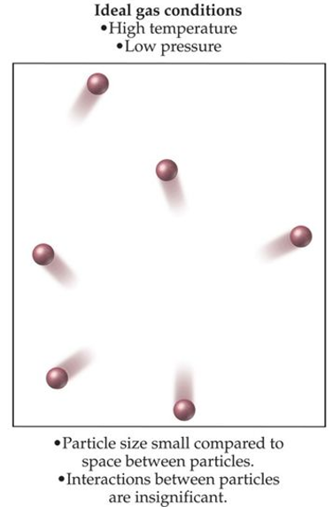
Kinetic-Molecular (KM)
Theory of Gases
“The why behind the math”
Empty Space
Move in straight lines, collide frequently
Distance between particles is large (volume is mostly empty space)
Pressure is caused by collisions between particles and container walls
No attractive forces between particles therefore collisions are elastic (no loss of energy)
Kinetic Energy (KE) is same for all gases and α Temperature (K)
No Attractive
Forces
$$KE=\frac{1}{2}mu^{2}$$
Elastic
Collisions
KE (E_{K}) = Kinetic Energy (J)
m = mass (Kg)
u = speed (m/s)

Slide 3
Boyle’s Law
Volume increases therefore the frequency of collisions with the walls decreases and pressure decreases
Charles's Law
Increasing the temperature increases the KE of the molecules which increases the frequency of collisions and therefore the pressure.
To keep pressure constant the volume must increase which will result in fewer collision and a larger surface area both of which would decrease the pressure.
Gay-Lussac’s/Amonton’s Law
Increasing the temperature increases the KE of the molecules which result in an increase in collision and harder collision both of which increase the pressure

Slide 4
Avogadro’s Law
Increasing the number of mols of gas will increase the number of collisions, thus to keep pressure and temperature constant the volume must increase (to decrease the number of collisions and KE of the collisions)
Daltons’s Law of Partial Pressure
Since gas molecules do not interact (ie no IMF’s) than the identity of the gas molecule hitting the container is irrelevant

Slide 5
https://www.youtube.com/watch?v=njQms6VF63o
KMT→ Ideal Gas Law
https://www.youtube.com/watch?v=1S2qQc8XTlQ
We don’t need to “know” the ugly truth, just be able to use it

Slide 6
Root Mean Square Velocity
Average velocity of a gas molecule
$$KE=\frac{1}{2}mu^{2}$$
KE (E_{K}) = Kinetic Energy (J)
m = mass (Kg)
u = speed (m/s)
$$KE=\frac{3}{2}RT$$
Due to large number of molecules use the average speed and KE
$$KE=\frac{1}{2}mu^{2}=\frac{3}{2}RT$$
OR
M = Molecular Weight
R = 8.31 J/mol·K
1 J = $\frac{Kgm^{2}}{s^{2}}$
Speed DP T
Speed IP MW
u_{RMS} = $\sqrt{\frac{3RT}{M}}= {\left(\frac{3RT}{M}\right)}^{1/2}$
Cheat Sheet to the Rescue!

Slide 7
Example:
What is the speed of an “average” Helium atom in the sun (T= 10,000. K)?

Slide 8
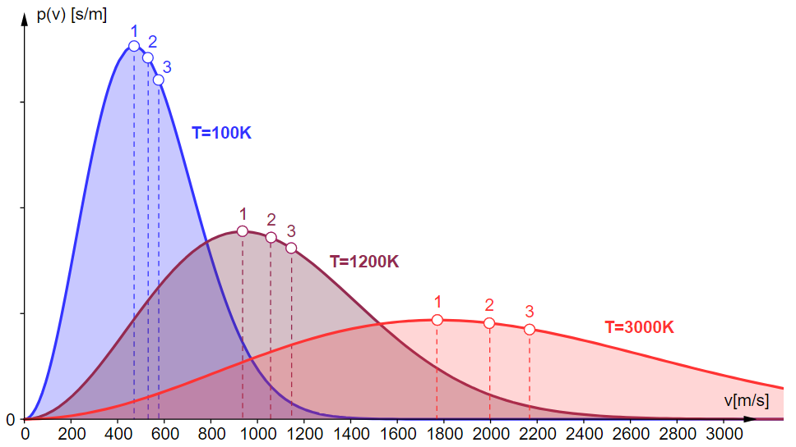
Speed DP T
Speed IP MW
Boltzmann Maxwell
Distributions
Curves are not symmetrical therefore…
U_{mp} < u_{av} < u_{rms}

Slide 9
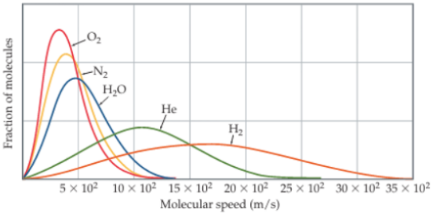
Speed DP T
Speed IP MW
Boltzmann Maxwell
Distributions

Slide 10
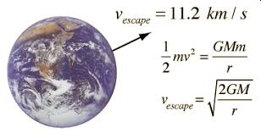
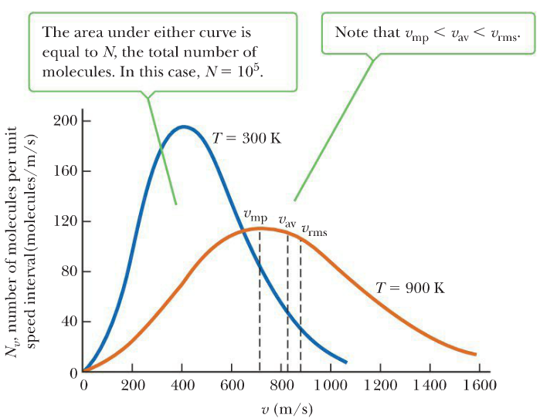
Escape Velocity
Curves are not symmetrical therefore…
U_{mp} < u_{av} < u_{rms}

Slide 11
Works
Low P
High T
Empty Space
Crowded
Attractive
Forces
No Attractive
Forces
Elastic
Collisions
Inelastic
Collisions
Fails
High P
Low T

Slide 12
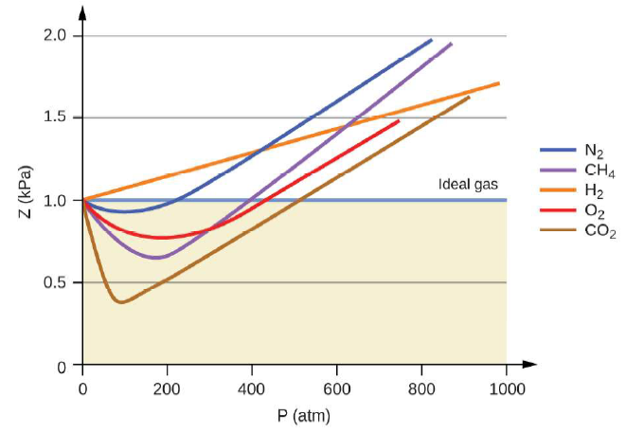
Effect of Pressure on an “Ideal” Gas

Slide 13
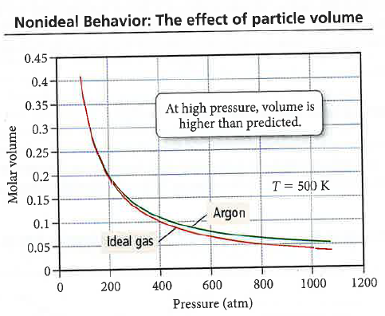
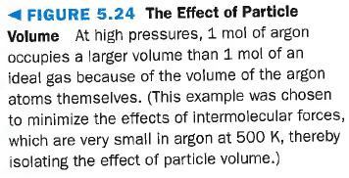
Why the Ideal Gas Law Fails
At 500 atm
V_{atoms} = 20%
High Pressure – molecules take up space V_{ideal} < V_{real}
$$V_{ideal}=\frac{nRT}{P}$$
<
$V_{real}=\frac{nRT}{P}$ + nb
b – size of molec.
n – mols

Slide 14
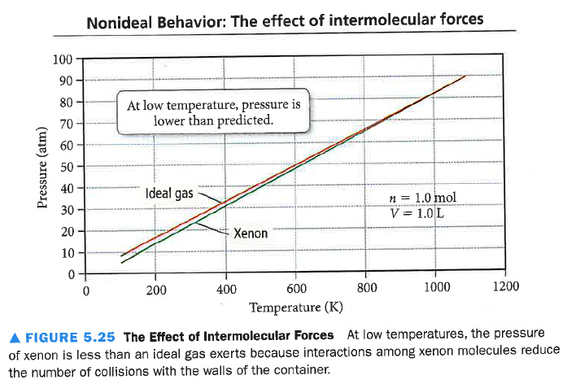
Why the Ideal Gas Law Fails
Low T - Attractive Forces (IMF’s) – decrease #/KE of collisions P_{ideal} > P_{real}
$$P_{ideal}=\frac{nRT}{V}$$
<
$$P_{real}=\frac{nRT}{V} −a{\left(\frac{n}{V}\right)}^{2}$$
a – strength of IMF
n/V – density

Slide 15
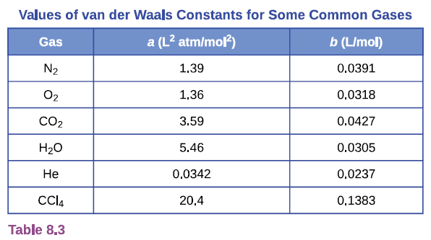
Van der Waal’s Equation
Johannes van der Waals
(1837-1923)
If n is small correction is small
If V is large correction is small
P$=\frac{nRT}{V−nb}−\frac{ab^{2}}{V^{2}}$
a – strength of IMF
b – size of molecule
Cheat Sheet!

Slide 16
P$=\frac{nRT}{V−nb}−\frac{ab^{2}}{V^{2}}$
Example:
A 5.00 L flask contains 6.00 mols of O₂ gas at 250. °C.
Calculate the pressure using the “Ideal” gas law
Calculate the pressure using the van der Waals equation
Fails
Low T
High P
Low V

Slide 17
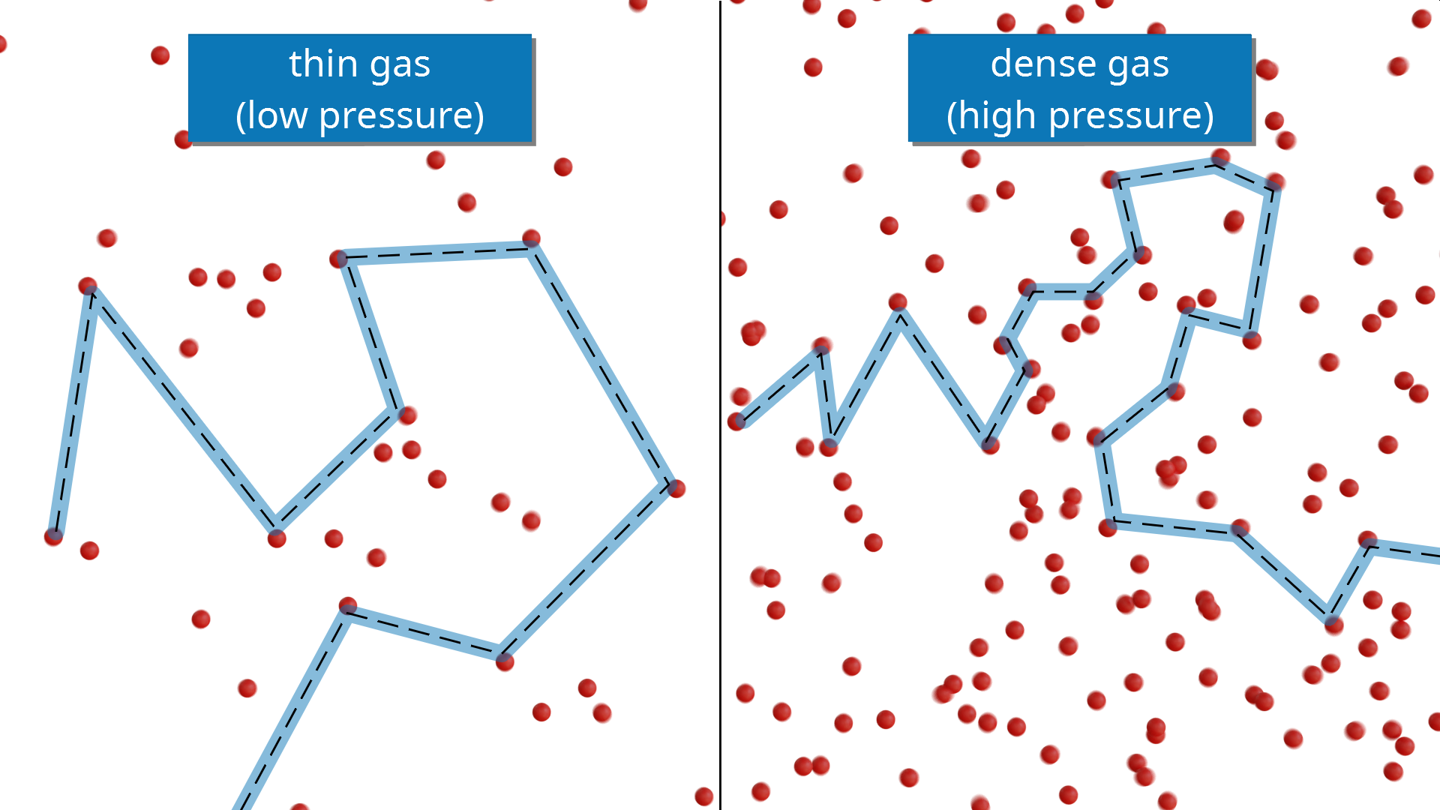
Mean Free Path
How often do collisions occur?
How far between collisions?

