Slide 1
CHE 111 Fall 2020
Lecture 8c – Misc. Topics
Overview/Topics
Daltons Law Partial Pressure
Gas Collection over Water
Mole Fractions (X)
Scuba Diving!
Nitrogen Narcosis
Oxygen Toxicity
Mixed Gas Diving
Effusion
Diffusion
Skills to Master
HW 8c
Read
OER 8.4

Slide 2
Dalton’s Law of Partial Pressure
Just Avogadro’s – All gases are the same
The total pressure of a mixture of gases is the sum of the partial pressures exerted by each of the individual gasses in the mixture
P_{total} = P_{A} + P_{B} + P_{c} …
+
=
or
P_{T} = ∑ P_{i}
Example:
O₂ (g) + H₂O (g)

Slide 3
Example:
A gas mixture made of 6.00 g of O₂ and 10.0 g of CH₄ is placed in a 20.0 L flask at 0.0 °C.
What is the Partial Pressure of each gas?
What is the total pressure in the vessel?

Slide 4
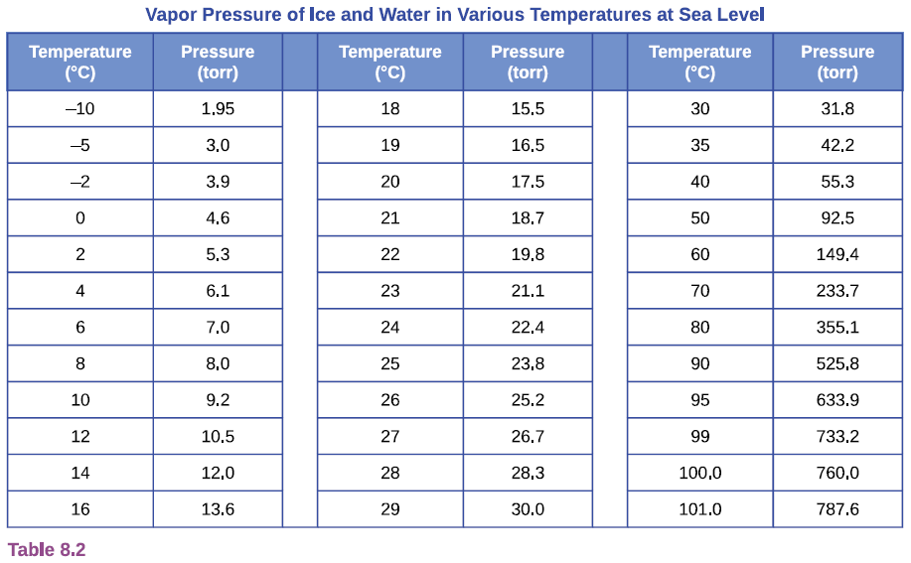
Collecting Gases over Water
Standard technique for isolating gases in a chemical reaction.
Gases are a mixture of desired gas + water vapor
Table 8.2 - OER Textbook
(Given on Exams

Slide 5
Example
Hydrogen gas is collected from a chemical reaction over water at 25 °C. If the total pressure of gas collected was 758.2 mm Hg.
Determine the P_{H2} and P_{H2O}
If the reaction occurred in a 1.0 L flask, how many moles of H₂ were collected?

Slide 6
You Try It:
O₂
In your marine science class you are measuring the rate of photosynthesis if some blue-green algae. In one hour you collected 1.02 L of gas at 755.2 mm Hg and 293 K. How many grams of oxygen/hour does the sample of blue-green algae produce?
O₂
Algae!

Slide 7
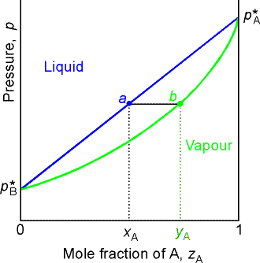
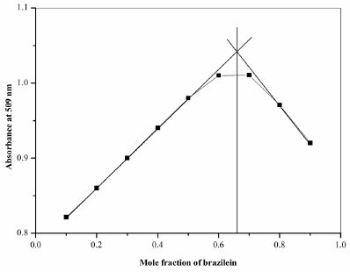
Mol-Fraction (X)
Its just a unit, can also convert to MW, M etc.
Just like a %
# moles component
total number of moles
or
X_{A} = $\frac{n_{A}}{n_{Total}}$
X =
P_{A} ⁼ X_{A} · P_{Total}
Ex: Raoult’s LAw
Ex: Determine LR
Next semester Ch. 10

Slide 8
Example:
A gas mixture made of 6.00 g of O₂ and 10.0 g of CH₄ has a pressure of 0.911 atm.
What is the mol fraction of each gas?
What is the partial pressure of each gas?

Slide 9
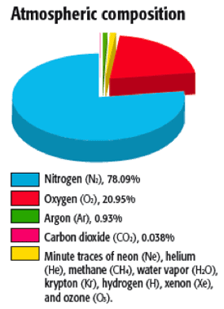
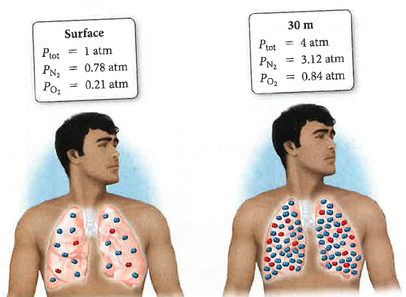
Nitrogen Narcosis
Humans Function Best when:
Humans start to have problems when:
Nitrogen Narcosis
30 meters or 99 ft
Drunk or intoxicated feeling
Slowing of thought processing
Loss of coordination

Slide 10
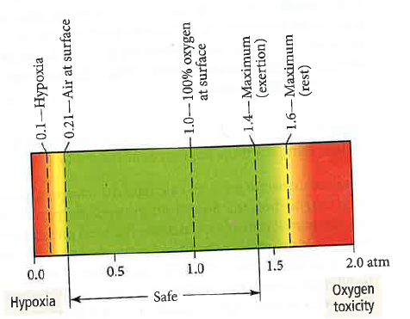
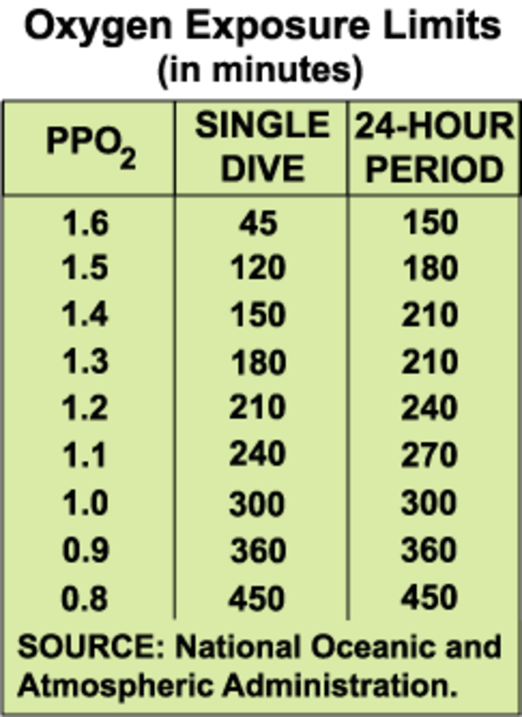
Oxygen Toxicity
Normal P_{O2} = 0.21 atm
Scuba Diving
P_{atm} = ???
P_{O2} = 1.4 atm?
Mount Everest
0.311 atm
P_{O2} = 0.065 atm
Hypoxia – oxygen starvation
Oxygen Toxicity
Mild
Muscle twitching
Tunnel Vision
Convulsion
Death
Severe
Headaches
Dizziness
Shortness of breath
Unconsciousness
Death
At what depth is oxygen toxic?

Slide 11
1 atm = 10 meters
= 33 feet
Example:
At what depth is oxygen toxic ie P_{O2} = 1.4 atm?

Slide 12
Mixed Gas Diving
To avoid oxygen toxicity and nitrogen narcosis when diving deep, can breath specialized mixtures of gases.
Example:
At what depth would a 40% O₂ 60% N₂ Nitrox mixture cause Oxygen Toxicity (P_{O2} = 1.6 atm)?

Slide 13
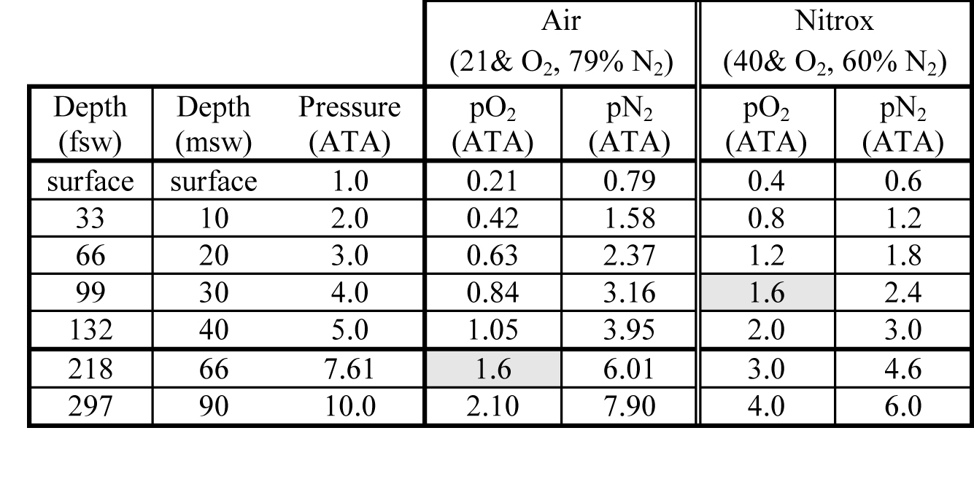
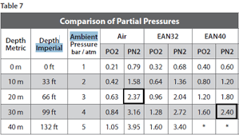
Nitrox Toxicity Table

Slide 14
You Try It:
Heliox is used for deep dives. A 12.5 L scuba tank contains 24.2 grams of He and 4.32 grams of O₂ at 298 K.
What is the mol-fraction of each gas?
What is the Partial Pressure of each gas?

Slide 15
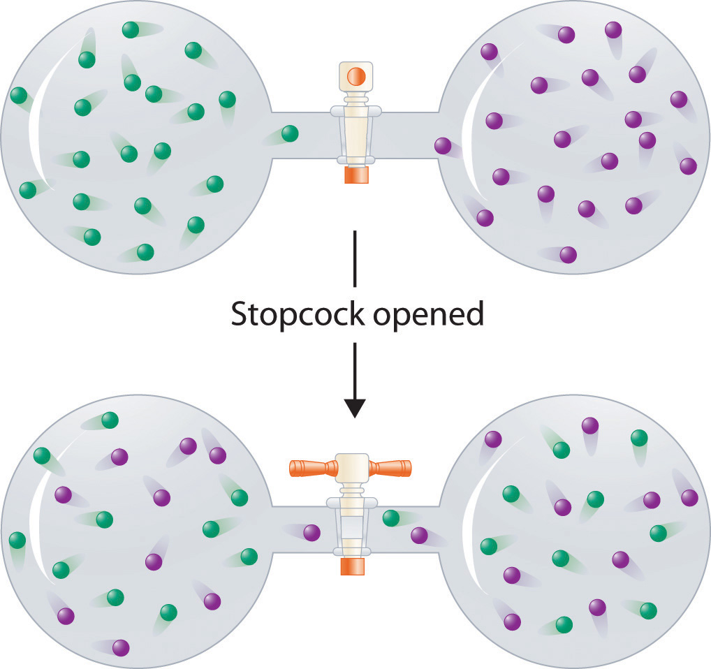
Diffusion
Gases spread out in response to a concentration gradient (high to low)
Gases mix spontaneously to create an uniform mixture
Fill any space

Slide 16
Graham’s Law and Effusion
Gasses will flow (effuse) out a small hole from high pressure to low pressure
$$\frac{rate of effusion A}{rate of effusion B}=\sqrt{\frac{Density B}{Density A}}=\sqrt{\frac{MW B}{MW A}}$$
Rate of Effusion is Inversely Proportional (IP) to Mass
$$Rate ∝\frac{1}{Mass}$$

Slide 17
Example:
An unknown gas effuses at a rate that is 0.462 times that of nitrogen gas.
(a) Is the MW of the gas greater than or less than that of nitrogen gas?
(b) What is the molecular weight of the unknown gas?
(c) What is the identity of the gas?

Slide 18
Review
Dalton’s Law of Partial Pressure
Mol-Fraction (X)
P_{total} = P_{A} + P_{B} + P_{c} …
# moles component
total number of moles
X =
or
or
P_{T} = ∑ P_{i}
X_{A} = $\frac{n_{A}}{n_{Total}}$
P_{A} ⁼ X_{A} · P_{Total}
Ideal Gas Law
Graham’s Law and Effusion
PV=nRT
$$\frac{rate of effusion A}{rate of effusion B}=\sqrt{\frac{Density B}{Density A}}=\sqrt{\frac{MW B}{MW A}}$$

