Slide 1
CHE 111 Fall 2020
Lecture 8b – Combined Gas Law
Overview/Topics
Ideal Gas Law (PV=nRT)
Solving Problems
PV=nRT
Ratio Type I
Ratio Type II
Stoichiometry - g A ↔ mol A ↔ mol B ↔ L B (gas)
Gas Density and MW problems
Skills to Master
HW 8b
Read
OER 8.2-8.3

Slide 2
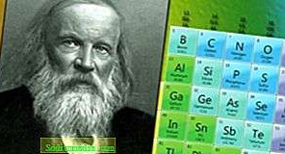
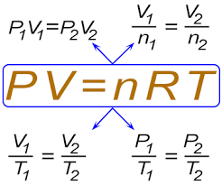
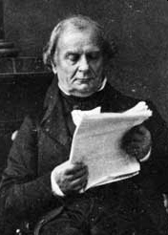
Ideal Gas Law
Combination of all 4 Individual Gas Law
Boyle’s Law (P and V)
Charles's Law (V and T)
Gay-Lussac’s Law or Amonton’s (P and T)
Avogadro's Law (V and n)
Dimitri Mendeleev
(1834-1907)
Benoît Paul Émile Clapeyron
(1799-1864)
Works well for High Temperature/Low Pressure

Slide 3
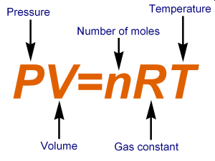
Cheat Sheet!
Ideal Gas Law
Equation Form
Standard Units
R = Gas Constant
P - Pressure (Atm)
V - Volume (L)
T - Temperature (K)
n - Amount (mols)
Standard Temperature and Pressure (STP)
Pressure = 1 Atm
Temperature = 273.15 K (0 °C)
Ratio Form
$$\frac{P_{1}V_{1}}{n_{1}T_{1}}=\frac{P_{2}V_{2}}{n_{2}T_{2}}$$

Slide 4
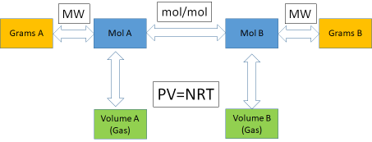
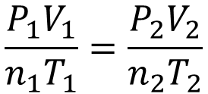
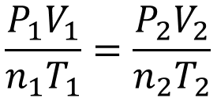
Ideal Gas Law Problems
5 Types of Problems
Equation Problems
Stoichiometry Problems (Ch. 9)
One set of conditions
1 copy of each variable
Includes a chemical equation (or you can write one)
PV=nRT
__A + __ B → __ C + __ D
Ratio Problems
Two sets of conditions
2 copies of 1 or multiple variables
$$\frac{P_{1}V_{1}}{n_{1}T_{1}}=\frac{P_{2}V_{2}}{n_{2}T_{2}}$$
Piston and Box (etc) Problems
Density Problems
Pistons (Up/Down)
Sealed Boxes (P)
“Make up variables”
$$\frac{P_{1}V_{1}}{n_{1}T_{1}}=\frac{P_{2}V_{2}}{n_{2}T_{2}}$$

Slide 5
Stoichiometry Problems (Ch. 9)
Includes a chemical equation (or you can write one)
A + B → C + D
R₁ + R₂ → P₁ + P₂
or
Use Reactants
Make Products
MW
mol/mol
MW
Grams A
Mol A
Mol B
Grams B
PV=NRT
Volume A
(Gas)
Volume B
(Gas)

Slide 6
Equation Problems
One set of conditions
1 copy of each variable
PV=nRT
Example:
A scuba tank is contains 80.0 L of air at 3000. PSI at room temperature of 20.0 °C.
How many mols of air are in the cylinder?

Slide 7
Ratio Problems
Two sets of conditions
2 copies of 1 or multiple variables
$$\frac{P_{1}V_{1}}{n_{1}T_{1}}=\frac{P_{2}V_{2}}{n_{2}T_{2}}$$
Example:
A scuba tank is contains 80.0 L of air at 3000. PSI at room temperature of 20.0 °C. If the scuba cylinder is heated to 100.0 °C what will the pressure in PSI be?

Slide 8
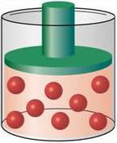
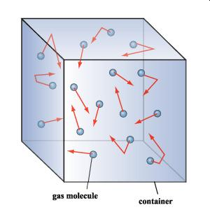
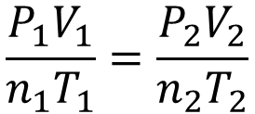
Piston and Box (etc) Problems
Pistons – generally relate a change in P, T, n to Volume
Pistons (Up/Down)
Sealed Boxes (P)
“Make up variables”
$$\frac{P_{1}V_{1}}{n_{1}T_{1}}=\frac{P_{2}V_{2}}{n_{2}T_{2}}$$
Sealed Box – generally relate a change in T, T, n to Volume

Slide 9
Example:
In a piston you increase the temperature 150%, what happens to the volume of the piston?
Example:
In a sealed box you double the number of atoms AND double the temperature, what happens to the pressure in the box?

Slide 10
Stoichiometry Problems (Ch. 9)
Includes a chemical equation (or you can write one)
Example:
If you burn 227 g of Ethanol (C₂H₅OH) at 303 K and 1.0 Atm, how many Liters of O₂ gas will be consumed?
___ C₂H₅OH (s) + ___ O₂ (g) → ___ CO₂ (g) + ___ H₂O (g) + Heat

Slide 11
Example:
If in the previous reaction, you produced 2000.0 L of CO₂ (g) and H₂O (g), how many grams of Ethanol (C₂H₅OH) was combusted at 25.0 °C and 12.5 PSI?
___ C₂H₅OH (s) + ___ O₂ (g) → ___ CO₂ (g) + ___ H₂O (g) + Heat

Slide 12
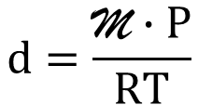
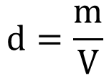
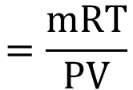
Derivation – OER 8.3
Density Problems
$$d=\frac{\text{M}∙P}{RT}$$
PV=nRT
Can calculate density of any ideal gas at STP
+
$$\text{M}$$
$$=\frac{mRT}{PV}$$
$$d=\frac{m}{V}$$
Can calculate molecular weight of any ideal gas
Variables
d = Density (g/L)
m = mass
M = MW = molecular weight (g/mol)
P = Pressure (atm)
V = Volume (mL)
R = Gas Constant (0.0821 L·atm/mol·K)
T = Temperature (K)

Slide 13
Example:
What is the density of hydrogen gas at STP?

Slide 14
Example:
Given the following data:
82.66 % Carbon, 17.34% H
A sample weighed 4.11 grams at occupied a volume of 1.50 L at 1.25 atm and 50.0°C
Determine the Empirical Formula
Determine the Molecular Weight
Determine the Molecular Formula

Slide 15
You Try It:
A hot-air balloon at sea level holds 2000. L of air at 20.0 °C. If the balloon flies 1.5 miles high the pressure is 0.75 Atm and the balloons volume expands to 2500. L to keep it aloft. What is the temperature of the air inside the balloon?
270 K
You Try It:
How many grams of ethanol (C₂H₅OH) must be combusted to blow up a 50.0 L balloon at 1.00 atm and 20.0 °C using the following reaction.?
19.1 g C₂H₅OH
_1_ C₂H₅OH (s) + _3_ O₂ (g) → _2_ CO₂ (g) + _3_ H₂O (g) + Heat
You Try It:
A propane tank for your grill holds 250 mols of C₃H₈ gas in at 50.0 L tank at 20.0 °C. What is the pressure inside that tank in PSI?
1800 PSI

Slide 16
You Try It:
Experientially you Increase the pressure 3x while decreasing the temperature 2x, what will happen to the volume of a piston?
Volume ↓ to 1/6
You Try It:
Given the following data:
83.62 % Carbon, 16.38 % H
A sample weighed 3.52 grams at occupied a volume of 1.00 L at 1.00 atm and 25.0°C
Determine the Empirical Formula
Determine the Molecular Weight
Determine the Molecular Formula
EF = C₃H₇ MW = 86.17 g/mol MF = C₆H₁₄
You Try It:
Hydrazine (N₂H₄) is used as a rocket fuel. If you burn 500.0 g of Hydrazine, how many Liters of gas will be produced at 700. mm Hg and 50.0 °C?
_1_ N₂H₄ (g) + _3_ O₂ (g) → _2_ NO₂ (g) + _2_ H₂O (g) + Heat
1.80x10³ L
You Try It:
0.666 g/L
What is the density of methane gas (CH₄) at STP?

Slide 17
You Try It:
A hot-air balloon at sea level holds 2000. L of air at 20.0 °C. If the balloon flies 1.5 miles high the pressure is 0.75 Atm and the balloons volume expands to 2500. L to keep it aloft. What is the temperature of the air inside the balloon?
270 K

Slide 18
You Try It:
How many grams of ethanol (C₂H₅OH) must be combusted to blow up a 50.0 L balloon at 1.00 atm and 20.0 °C using the following reaction.?
19.1 g C₂H₅OH
_1_ C₂H₅OH (s) + _3_ O₂ (g) → _2_ CO₂ (g) + _3_ H₂O (g) + Heat

Slide 19
You Try It:
A propane tank for your grill holds 250 mols of C₃H₈ gas in at 50.0 L tank at 20.0 °C. What is the pressure inside that tank in PSI?
1800 PSI

Slide 20
You Try It:
Experientially you Increase the pressure 3x while decreasing the temperature 2x, what will happen to the volume of a piston?
Volume ↓ to 1/6

Slide 21
You Try It:
Given the following data:
83.62 % Carbon, 16.38 % H
A sample weighed 3.52 grams at occupied a volume of 1.00 L at 1.00 atm and 25.0°C
Determine the Empirical Formula
Determine the Molecular Weight
Determine the Molecular Formula
EF = C₃H₇ MW = 86.16 g/mol MF = C₆H₁₄

Slide 22
You Try It:
Hydrazine (N₂H₄) is used as a rocket fuel. If you burn 500.0 g of Hydrazine, how many Liters of gas will be produced at 700. mm Hg and 50.0 °C?
_1_ N₂H₄ (g) + _3_ O₂ (g) → _2_ NO₂ (g) + _2_ H₂O (g) + Heat
1.80x10³ L

Slide 23
You Try It:
0.666 g/L
What is the density of methane gas (CH₄) at STP?

