Slide 1
CHE 111 Fall 2020
Lecture 7f – Chemical Conversions
Overview/Topics
Conversion Factors
Avagadro’s Number (atoms/mol)
Atoms and Molecules
Molecular Weight (g/mol)
Molarity (mol/L)
mol/mol ratio (mol A/mol B)
Conversion problems
grams ↔ mols
atoms ↔ mols
mL ↔ mols
mols A ↔ mols B
g A ↔ mols A ↔ mols B ↔ g B
Problem solving methods
Q → A
1 unit → 1 unit
2 units → 2 units
Never ever ever start with a CF
Road Map to Success!
Skills to Master
HW 7g + EP’s!
of Chemistry Conversions
Read
Chapter 6.1, 6.3 and 7.3

Slide 2
Chemical Reactions and Conversion Factors (CF)
+
_1_O₂ (g)
_2_ MgO (s)
_2_ Mg (s)
+
heat
What really happens –
Atoms and Molecules
atoms
molecule
molecule
energy
Mg
O
O
Mg
O
Mg
Mg
O
Avogadro's Number
mole
mole
mole
mole
Measure by Mass
grams
grams
grams
J or KJ
Measure by Volume
mL
mL
mL
J or KJ
Goal = Convert between EVERYTHING!

Slide 3
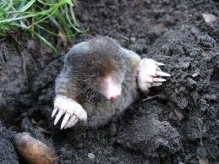
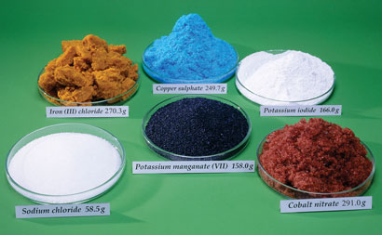
What is a mole?
Atoms are super duper tiny!
Atoms don’t weigh much (1 H = 1.67 x 10⁻²⁷ kg)
Chemical Reactions are between atoms and molecules
Convent unit of measurement
Central Units of Chemistry
Abbreviated: mol
Baking: Mole = Cup
1 mole of many different substances
Central Unit of Chemistry

Slide 4
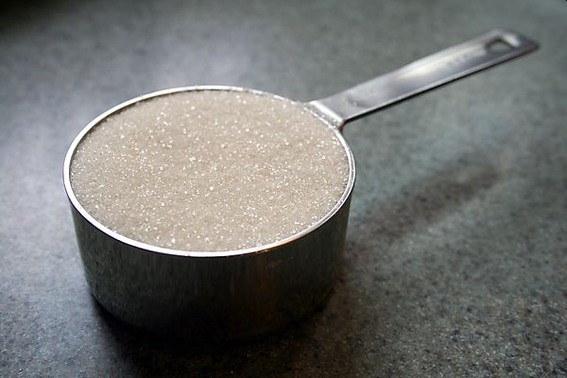
Avogadro's Number (A#)
(mols and atoms or molecules)
It’s a lot like…
1 dozen eggs = 12 eggs
1 dozen donuts = 12 donuts
1 ream paper = 500 sheets
1 cup sugar = a whole lot of
sugar molecules
Avogadro's Number
1 mole = 6.02 x 10²³ anything
Cups
“grains” of sugar
1 mol
Atoms

Slide 5
Lets Try It
If you have 2.5 x 10²⁵ atoms of Au, how many mols of Au atoms do you have?
If you 9.50 mols of Ca₃(PO₄)₂ how many molecules do you have?

Slide 6
Molecules and Atoms
Chemical Formula Conversion Factor (CF CF ugh!)
Ca(NO₃)₂
1 molecule of Ca(NO₃)₂
2 N atoms
1 Ca atom
1 molecule of Ca(NO₃)₂
1 molec. of Ca(NO₃)₂
6 O atoms
If you 1.8 x 10²² molecules of Ca(NO₃)₂ how many oxygen atoms do you have?
Chemical Formula’s are CF’s
(molec. ↔ atoms)

Slide 7
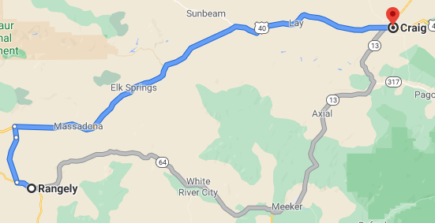
Unit Conversion “Road Map”
Mol A
A
Avagadro’s Number
6.022 x 10²³ items/mol
Atoms
A
Molecules
A
CF
Chemical
Formula

Slide 8
Chemical Reactions and Conversion Factors (CF)
+
_1_O₂ (g)
_2_ MgO (s)
_2_ Mg (s)
+
heat
What really happens –
Atoms and Molecules
atoms
molecule
molecule
energy
Mg
O
O
Mg
O
Mg
Mg
O
Avogadro's Number
mole
mole
mole
mole
Measure by Mass
grams
grams
grams
J or KJ
Measure by Volume
mL
mL
mL
J or KJ

Slide 9
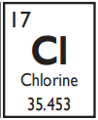
Mols and Grams
Atoms are super duper tiny!
Atoms don’t weigh much (1 H = 1.67 x 10⁻²⁷ kg)
Chemical Reactions are between atoms and molecules
In lab we measure things with scales (grams)
Molecular Weight = Conversion Factor between them
Chemical Reaction
MW
In Chemistry Lab
Na + Cl → NaCl
Na + Cl → NaCl
22.990 g
+
35.453 g
→
58.443 g
“1 atom of Na reacts with 1 atom of Cl to make 1 molecule of NaCl”
“22.990 g Na reacts with 35.453 g Cl to make 58.443 g NaCl”

Slide 10
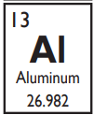
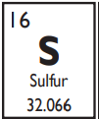
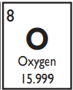
Review – Molecular Weight (MW)
Molecular Weight (MW)
Mass of 1 mole of an Element
Found on the PT
Units = g/mol
Example:
Calculate the MW of Al₂(SO₄)₃
Grams Moles
2 (Al) = 2 × 26.982 = 53.964 g/mol
3 (S) = 3 x 32.066 = 96.198 g/mol
12 (O) = 12 x 15.999 = 191.988 g/mol
342.150 g/mol
Review Ch. 7a

Slide 11
You Try It: Calculate the MW of Ca₃(PO₄)₂

Slide 12
You Try It:
If you have 125.0 g Ag, how many mols do you have?
You Try It:
A reaction requires 3.0 moles of N₂ gas, how many grams do you need?

Slide 13
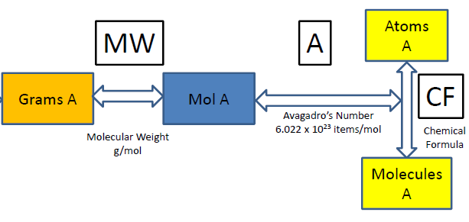
A = Avagadro’s Number (atoms/mol)
CF = Chemical Formula (atoms/molecule)
MW = Molecular Weight (g/mol)
7 Types of problems
atoms → mol
mol → atoms
g → mol
mol → g
g → mol → atoms
atoms → mol → g
g → mol → molecules → atoms
A
MW
A + MW
A + CF + MW

Slide 14
You Try It:
How many molecules of Ca₃(PO₄)₂ are in 25.00 grams of Ca₃(PO₄)₂
You Try It:
Convert 7.25 x 10²⁴ molecules of H₂SO₄ to Kg of H₂SO₄

Slide 15
You Try It:
How many H atoms are in 500.0 g of H₂SO₄

Slide 16
Chemical Reactions and Conversion Factors (CF)
+
_1_O₂ (g)
_2_ MgO (s)
_2_ Mg (s)
+
heat
What really happens –
Atoms and Molecules
atoms
molecule
molecule
energy
Mg
O
O
Mg
O
Mg
Mg
O
Avogadro's Number
mole
mole
mole
mole
Measure by Mass
grams
grams
grams
J or KJ
Measure by Volume
mL
mL
mL
J or KJ

Slide 17
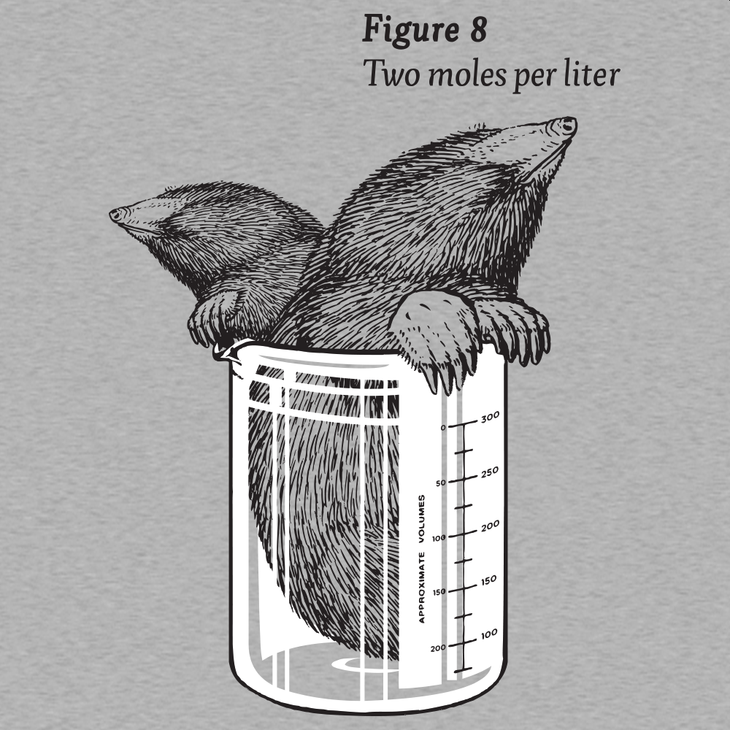
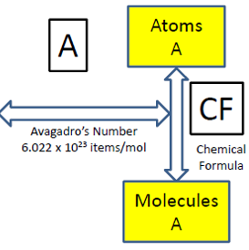
Molarity (M or mol/L)
Most chemical reactions occur in the aqueous phase b/c they occur faster (Kinetics = Ch. 17)
Equivalent of MW for aqueous solutions
CF between mL and mols
Write M but in problems use mol/L

Slide 18
Example 1:
What is the Molarity of a solution in which 50.0 g of NaOH is added to 450 mL of water?
Example 2:
How many mols are in 315.0 mL of 0.25 M NaOH?
Example 3:
How many mL of 0.75 M NaOH can be made with 125.0 g of NaOH?

Slide 19
Chemical Reactions and Conversion Factors (CF)
+
_1_O₂ (g)
_2_ MgO (s)
_2_ Mg (s)
+
heat
What really happens –
Atoms and Molecules
atoms
molecule
molecule
energy
Mg
O
O
Mg
O
Mg
Mg
O
Avogadro's Number
mole
mole
mole
mole
Measure by Mass
grams
grams
grams
J or KJ
Measure by Volume
mL
mL
mL
J or KJ

Slide 20
mol to mol ratio
Allows conversions between different compounds
Ratio of the coefficients used to balance reactions
2 mol Al(OH)₃
3 mol H₂SO₄
or
3 mol H₂SO₄
2 mol Al(OH)₃
_2_ Al(OH)₃
+
_3_ H₂SO₄
+
_6_H₂O
_1_ Al₂(SO₄)₃
6 mol H₂O
3 mol H₂SO₄
or
3 mol H₂SO₄
6 mol H₂O

Slide 21
Chemical Reactions in a Lab
_2_ Al(OH)₃
+
_3_ H₂SO₄
+
_6_H₂O
_1_ Al₂(SO₄)₃
Question: You have 10 mols of Al(OH)₃, how much Al₂(SO₄)₃ can you make?
Question: I need to make 20 mols of H₂O. How many mols of H₂SO₄ do I need?

Slide 22
Chemical Reactions and Conversion Factors (CF)
+
_1_O₂ (g)
_2_ MgO (s)
_2_ Mg (s)
+
heat
What really happens –
Atoms and Molecules
atoms
molecule
molecule
energy
Mg
O
O
Mg
O
Mg
Mg
O
Avogadro's Number
mole
mole
mole
mole
Measure by Mass
grams
grams
grams
J or KJ
Measure by Volume
mL
mL
mL
J or KJ

Slide 23
Tools for Solving Problems I
To go from A to B must use mol/mol ratio
Never start with a CF (MW, M, mol/mol ratio)
When in doubt convert to mols
Conversion Factors
$$\frac{g}{mol}$$
M =
$$\frac{mol}{L}$$
MW =
Q
A
mol/mol ratio =
$$\frac{mol A}{mol B}$$
1 unit → 1 unit
2 unit → 2 unit
A # =
$$\frac{atoms}{mol}$$
or
$$\frac{molec.}{mol}$$

Slide 24
Tools for Problem Solving II
D
D
Volume A
Volume B
Density
g/mL
Density
g/mL
M
Molarity
mol/L
M
Molarity
mol/L
MW
MW
mol/mol
Grams A
Mol A
Mol B
Grams B
Mol to Mol Ratio
from Balanced Eqn
Molecular Weight
g/mol
Molecular Weight
g/mol
A
A
Avagadro’s Number
6.022 x 10²³ items/mol
Avagadro’s Number
6.022 x 10²³ items/mol
Atoms
A
Molecules
A
Atoms
B
Molecules
B
CF
CF
Chemical
Formula
Chemical
Formula

Slide 25
Tools for Solving Problems III
mol/mol
grams
MW
MW
grams
M
_2_ A
+
_3_ B
_1_ C
+
_6_ D
mL
mL
M
atoms
A
A
atoms

Slide 26
Chemical Reactions in a Lab
_2_ Al(OH)₃
+
_3_ H₂SO₄
+
_6_H₂O
_1_ Al₂(SO₄)₃
78.00 g/mol
98.08 g/mol
342.15 g/mol
18.02 g/mol
Question: You buy 500.0 g of Al(OH)₃, how many grams of Al₂(SO₄)₃ can you make?
Question: You need to make 250.0 grams of H₂O, how many grams of H₂SO₄ should you buy?

Slide 27
Chemical Reactions in a Lab
_2_ Al(OH)₃
+
_3_ H₂SO₄
+
_6_H₂O
_1_ Al₂(SO₄)₃
78.00 g/mol
98.08 g/mol
342.15 g/mol
18.02 g/mol
2.0 M solution
5.0 M Solution
Question: How many mL of H₂SO₄ do you need to react with 75 mL of g of Al(OH)₃, ?
Question: How many grams of Al(OH)₃ are required to react with 100.0 mL of 5.0 M H₂SO₄?

