Slide 1
CHE 111 Fall 2020
Lecture 7e – SD and Combustion Reactions
Overview/Topics
Oxidation and Reduction
Calculate oxidation and reduction #’s
Single Displacement Reactions
Cations
Anions
Combustion Reactions
Mix it all up!
Skills to Master
HW 7e + EP’s!
Read
Chapter 7.2
Skip Balancing Redox Reactions via ½ reaction method (will cover in Chapter 16)

Slide 2
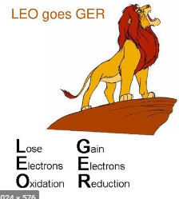
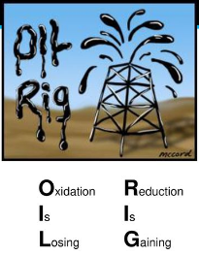
Oxidation and Reduction
aka – Redox, Electron Transfer
Transfer of an e⁻ from one E to another E
Always paired
Many important uses
Batteries
Bioenergetics
Metal Plating
Rust
Oxidation
Reduction
Lose electrons
Lose energy
Addition of H or Loss of O
Oxidation # ↑
Gain electrons
Gain energy
Loss of H or Gain of O
Oxidation # ↓
Ch. 16 Electrochemistry

Slide 3
Oxidation Number
“fictional” or “pretend” charge
the charge its atoms would possess if the compound was ionic
1. Pure Elements in natural state oxidation # = zero charge
Mg (s)
H₂ (g)
Cl₂ (g)
2. Monoatomic ions, oxidation # = ionic charge
Mg⁺² (aq)
H⁺ (aq)
Cl⁻ (aq)

Slide 4
Oxidation number are per atom
3. Elements in a polyatomic ion or molecule
H = +1 (except metal hydrides MH, H = -1)
O = -2 (except peroxides H₂O₂, O = -1)
Halogens = -1
4. Sum of oxidation numbers
Molecules = 0
Polyatomic ion = charge
Examples:
SO₂ vs SO₃ vs SO₄⁻²
H₃PO₄
Fe₃O₄
Can be “fraction”

Slide 5
You Try It:
MgCl₂
N₂
FeSO₃
HClO₄
V₃O₅

Slide 6
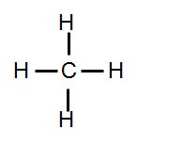
Biological Example
Lose Bonds to H, Gain Bonds to O
High Energy
“Fatty Acid”
“Carbohydrate”
Low Energy
H
H
C
C
C
C
C
C
O
C
O
H
OH
Most Reduced
Most Oxidized

Slide 7
Single Displacement (SD)
Determine type of Reaction
Does it occur
Mechanism
Balance Charges
Diatomics
States
Miscellaneous
Balance atoms (reaction)
AKA – Single Replacement, Oxidation/Reduction, Redox etc
2 Main Types
Cations
Anions
Recognize – E + C
Mechanism – Swap ONE Cation or Anion
Does it occur – Activity Series
The more active species will displace the less active species to make a compound
OR
If the more active species is in the compound nothing happens (NR)

Slide 8
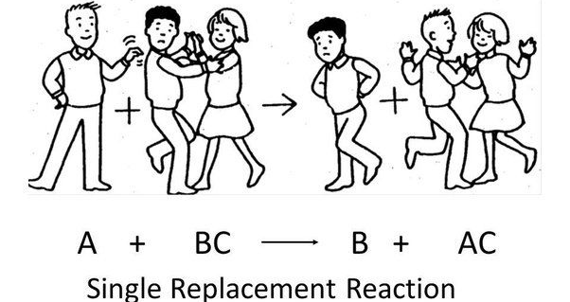
Swap Cations
E + CA → EA + C
E
+
Cation
Anion
+
Cation
Anion
E
Activity Series
Analogy

Slide 9
Examples
___ Mg (s) + ___ HCl (aq)
___ H₂ (g) + ___ MgCl₂ (aq)
Which atom was Oxidized?
Which atom was Reduced?

Slide 10
You Try It:
___ Zn(NO₃)₂ (aq) + ___ Na (s)
___ Pb(C₂H₃O₂)₃ (aq) + ___ Mg (s)
Which atom was Oxidized?
Which atom was Reduced?

Slide 11
You Try It:
___ Mg (s) + ___ Li₂CO₃ (aq)
___ Ba(NO₃)₂ (aq) + ___ K (s)
Which atom was Oxidized?
Which atom was Reduced?

Slide 12
Swap Anions
E + CA → CE + A
E
+
Cation
Anion
+
Cation
Anion
E
___ F₂ (g) + ___ AlCl₃ (aq)
Which atom was Oxidized?
Which atom was Reduced?

Slide 13
You Try It:
___ MgCl₂ (aq) + ___ Br₂ (l)
___ Cl₂ (g) + ___ ZnI₂ (aq)
Which atom was Oxidized?
Which atom was Reduced?

Slide 14
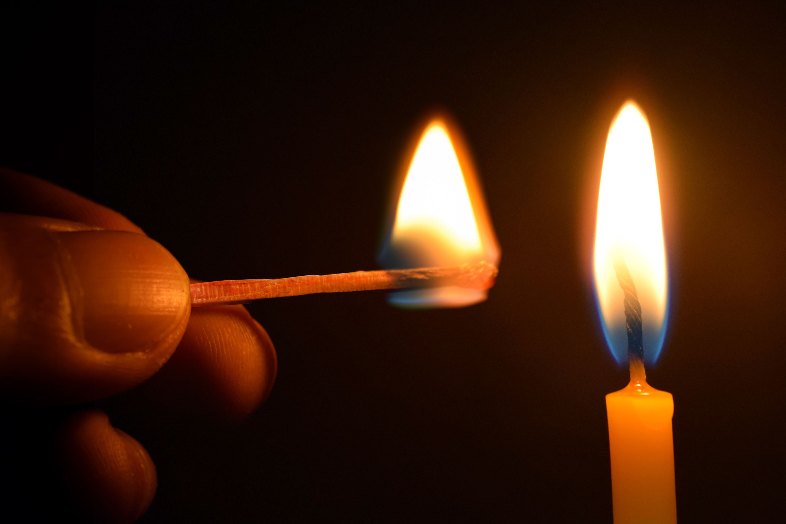
Combustion Reactions
Always Occur
Always Exothermic
Organic Compounds (C,H,O) always combust
Complete vs Incomplete Combustion
Any C,H,O + ___O₂ (g)
___CO₂ (g) + ___ H₂O (g) + Heat

Slide 15
Examples
___ CH₄ (g) + ___ O₂ (g)
___ C₄H₁₀ (l) + ___ O₂ (g)
Which atom was Oxidized?
Which atom was Reduced?

Slide 16
You Try It:
___ CH₃OH (l) + ___ O₂ (g)
Which atom was Oxidized?
Which atom was Reduced?

Slide 17
You Try It – All mixed up!
___ F₂ (g) + ___ NaCl (aq)
___ O₂ (g) + ___ CH₃COOH (aq)
___ FeCl₂ (aq) + ___ Al (s)
___ Mg(C₂H₃O₂)₂ (aq) + ___ H₃PO₄ (aq)
___ H₂ (g) + ___ ZnCl₂ (aq)

Slide 18
You Try It – Answers!
1
2
2
1
___ F₂ (g) + ___ NaCl (aq)
___ NaF (aq) + ___ Cl₂ (g)
2
1
2
2
___ O₂ (g) + ___ CH₃COOH (aq)
___ CO₂ (g) + ___ H₂O (g) + Heat
3
2
2
3
___ FeCl₂ (aq) + ___ Al (s)
___ AlCl₃ (aq) + ___ Fe (s)
3
2
1
6
___ Mg(C₂H₃O₂)₂ (aq) + ___ H₃PO₄ (aq)
___ Mg₃(PO₄)₂ (s) + ___ HC₂H₃O₂ (aq)
___ H₂ (g) + ___ ZnCl₂ (aq)
NR

