Slide 1
CHE 111 Fall 2020
Lecture 7cd – Electrolytes + DD Reactions
Overview/Topics
Review 7ab material to remember
SE, WE, NE
Molecular, Total Ionic and Net Ionic Reactions
Understand Double Displacement Reactions
Standard (ppt)
Formation of gas
Acid/Base (Exothermic)
Skills to Master
HW 7 cd
Write complete chemical reactions
Read
Chapter 7.1-7.2

Slide 2
Lots more in Chapter 10
Aqueous Solutions
Dissolved in water
Ionic Compounds vs Molecular Compounds
Ionic Compounds
Molecular/Covalent Compounds
If dissolved in water
dissociate into ions in solution
If dissolved in water do not
dissociate into ions in solution
Ex: NaCl
Ex: Sucrose (C₆H₁₂O₆)

Slide 3
Aqueous Solutions
A closer look…
Jay’s crappy picture
Ionic Compounds
Molecular/Covalent Compounds

Slide 4
Aqueous Solutions
Strong Electrolytes (SE)
Weak Electrolytes (WE)
Non-Electrolytes (NE)
Dissociate 100% into ions
Conduct electricity
SA, SB, Ionic (aq)
Dissociate < 10% into ions
May conduct electricity
wa, wb
Do not dissociate
Do not conduct electricity
Molecular (nm/nm) + Ionic (s)
NaCl (s) → Na⁺ (aq) + Cl⁻ (aq)
HF (s) → H⁺ (aq) + F⁻ (aq)
C₆H₁₂O₆ (s) → C₆H₁₂O₆ (aq)
0% 100%
90% 10%
0% 100%

Slide 5
Writing Chemical Equations
Molecular Equation
“Normal” equation
All species written as molecules
_1_ Pb(NO₃)₂ (aq) + _2_ NaOH (aq) → _1_ Pb(OH)₂ (s) + _2_ NaNO₃ (aq)
Ionic Equation
“More realistic” equation
SE written as (aq)
WE/NE written as normal
Net Ionic Equation
“Focused” equation
Only include molecules which change
Eliminate “spectator” ions (d/n change)

Slide 6
You Try It
_2_ KOH (aq) + _1_ H₂SO₄ (aq) → _1_ K₂SO₄ (aq) + _2_ H₂O (l)

Slide 7
You Try It
_1_ Zn (s) + _2_ HCl (aq) → _1_ ZnCl₂ (aq) + _1_ H₂ (g)

Slide 8
Overview of Reactions in Chapter 7
Lecture
Double Displacement
Precipitate
Acid/Base
Gas
Oxidation/Reduction
Single Displacement
Combustion
OER Book
Precipitation
Acid/Base (Neutralization)
Oxidation/Reduction
VS

Slide 9
Double Displacement Reactions (DD)
Sometimes called Double Replacement, PPT, Gas, Acid/Base etc
3 main Types
Formation of Precipitate
Formation of Gas
Formation of Heat
Generally occur between ionic compounds
Driving force – lower energy of the atoms (formation of ppt/gas/water)
Recognize – C + C
Mechanism – Swap ONE COPY of Cations and Anions
C = cations (+)
A = anions (-)
AB (aq) + CD (aq)
CB (aq) + AD (s)
Reaction occurs if:
Formation of ppt
Formation of gas
Formation of heat
Formation of water
A and B might “Swap” Places
if it results in lower energy
If No Reaction occurs write NR

Slide 10
A⁺
B⁻
+
C⁺
D⁻
C⁺
B⁻
+
A⁺
D⁻
(aq) = dissolved in water
form individual ions
(s) = is a solid water (ppt)
forms a compound
B⁻
B⁻
A⁺
B⁻
B⁻
D⁻
D⁻
C⁺
C⁺
A⁺
C⁺
C⁺
D⁻
D⁻
A⁺
A⁺
Reactants
Products

Slide 11
Silly Analogy

Slide 12
8 steps for writing a reaction
DD - ppt/gas/heat/water
SD - Activity Series
DD, AB, SD, Comb
Determine type of Reaction
Does it occur
Mechanism
Balance Charges
Diatomics
States
Miscellaneous
Balance atoms (reaction)
DD – swap cations
SD – swap (c or a)
Comb - memorize
Ionic Only
Heat, Decomposition etc

Slide 13
Example:
___ AgNO₃ (aq) + ___ MgCl₂ (aq)

Slide 14
Example:
___ AlCl₃ (aq) + ___ Na₂CO₃ (aq)

Slide 15
Example:
___ NaNO₃ (aq) + ___ Mg(C₂H₃O₂)₂ (aq)

Slide 16
You Try It:
___ (NH₄)₂SO₄ (aq) + ___ CaCrO₄ (aq)
NH₄ = +1
SO₄ = -2
Ca = +2
CrO₄ = -2

Slide 17
You Try It:
___ Na₃PO₄ (aq) + ___ Mg(NO₃)₂ (aq)
Na = +1
PO₄ = -3
Mg = +2
NO₃ = -1

Slide 18
Acids
HCl (aq) → H⁺ (aq) + Cl⁻ (aq)
Dissociate in water to produce H⁺ or H₃O⁺ ions
H⁺ transferred from one substance to another
Generally HX where X = non-metal
HCl (aq) + H₂O (l) → H₃O⁺ (aq) + Cl⁻ (aq)
H⁺ = H₃O⁺
Base
Dissociate in water to produce OH⁻ ions
React with water to produce OH⁻ ions
Generally MOH where M = metal
NaOH (aq) → Na⁺ (aq) + OH⁻ (aq)
NH₃ (aq) + H₂O (aq)→ NH₄⁺ (aq) + OH⁻ (aq)
Lots More in
Chapter 14-15

Slide 19
Review
H__ = Acid
__OH = Base
Acid/Base (AB) Reactions
Just a DD reaction
Acid + Base → Ionic Salt + Water (HOH) + heat
Always occurs, always exothermic
___ NaOH (aq) + ___ H₂SO₄ (aq)

Slide 20
You Try It:
___ HClO₄ (aq) + ___ Ca(OH)₂ (aq)

Slide 21
You Try It:
___ Ba(OH)₂ (aq) + ___ H₃PO₄ (aq)

Slide 22
DD + Gas/Decomposition
Just a normal DD reaction except…
Product decomposes (d) into a gas + water
H₂CO₃ (d) → H₂O (l) + CO₂ (g)
NH₄OH (d) → H₂O (l) + NH₃ (g)
H₂SO₃ (d) → H₂O (l) + SO₂ (g)
Inflammable, Acidic in water
Inflammable, Basic in water
Inflammable, Acidic in water
___ NH₄Cl (aq) + ___ NaOH (aq)

Slide 23
You Try It:
___ H₂SO₄ (aq) + ___ Na₂CO₃ (aq)

Slide 24
You Try It – All mixed up!
___ Zn(C₂H₃O₂)₂ (aq) + ___ AgNO₃ (aq)
___ Ca(OH)₂ (aq) + ___ NaCl (aq)
___ K₂SO₃ (aq) + ___ HCl (aq)
___ KOH (aq) + ___ H₂CO₃ (aq)

Slide 25
You Try It – Solutions!
1
2
2
1
___ Zn(C₂H₃O₂)₂ (aq) + ___ AgNO₃ (aq)
___ AgC₂H₃O₂ (s) + ___ Zn(NO₃)₂ (aq)
NR
___ Ca(OH)₂ (aq) + ___ NaCl (aq)
___ CaCl₂ (aq) + ___ NaOH (aq)
1
1
___ H₂O (l) + ___ SO₂ (g)
1
2
2
___ K₂SO₃ (aq) + ___ HCl (aq)
___ KCl (aq) + ___ H₂SO₃ (d)
2
1
1
2
___ KOH (aq) + ___ H₂CO₃ (aq)
___ K₂CO₃ (aq) + ___ H₂O (aq) + Heat

Slide 26
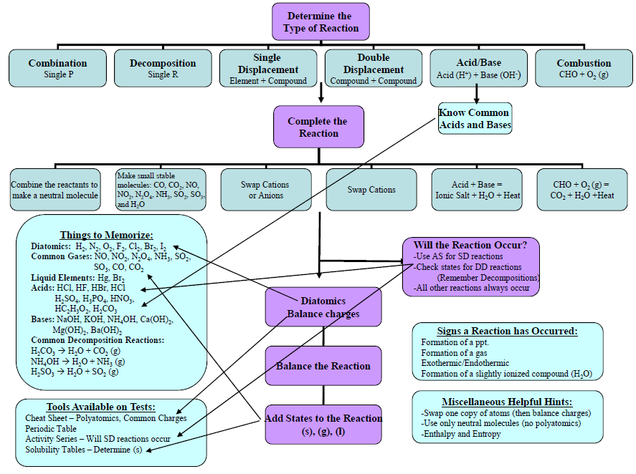
Additional Tools
(download at www.chemhaven.org)
Ignore the “Chapter”

