Slide 1
CHE 111 Fall 2020
Lecture 5 b
Molecular Orbital Theory (MO)
Overview/Topics
Flaw in VBT
Atomic vs Molecular Orbitals
BO vs NBO
Sigma vs Pi Bonds
Paramagnetic vs Diamagnetic
Bond Order
Skills to Master
Homework 5b
Additional Useful Links
https://courses.lumenlearning.com/chemistryformajors/chapter/molecular-orbital-theory/
Google/You Tube
Read
OER – Chapter 5.4

Slide 2
Flaws in VBT
Fails to explain resonance or delocalization well
Fails to predict Magnetic Properties (Example O₂)
Atomic Orbital - e⁻ still belongs to a single atom vs Molecular Orbitals - e⁻ is around both atoms in a molecule
Atomic Orbital
Molecular Orbital

Slide 3
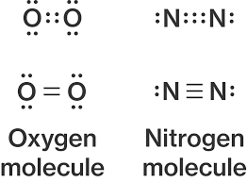
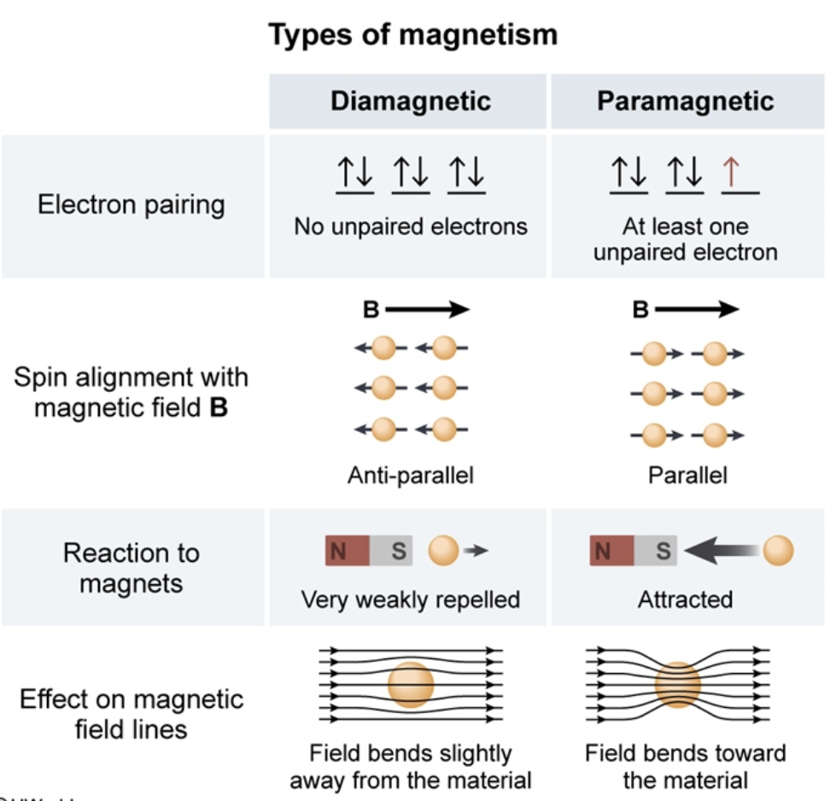
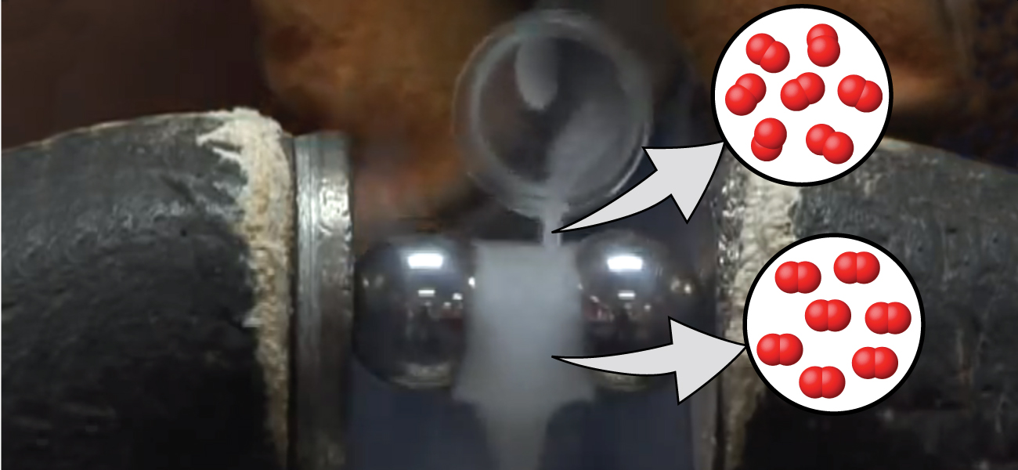
Diamagnetic vs Paramagnetic
Diamagnetic
no unpaired e⁻
Not effected by magnetic field
Paramagnetic
unpaired e⁻
Effected by magnetic field
Theoretically – both are Diamagnetic
Experimentally – O₂ = paramagnetic
https://mediaspace.wisc.edu/media/Paramagnetism+of+liquid+Oxygen+Short+Ver+cropped/1_y4u5ppmq

Slide 4
Molecular Orbital Theory (MO or MOT)
Scary Math!
Molecular Orbital
Atomic Orbital
Electrons in bonds are in “Molecular” orbitals not “Atomic” Orbitals
Computers use a “trial” wave-function and modify it to minimize the energy (repeat until you can’t reach a lower energy)
LCAO – Linear Combination of AO to form MO (weighted average)
Constructive vs Destructive Interference

Slide 5
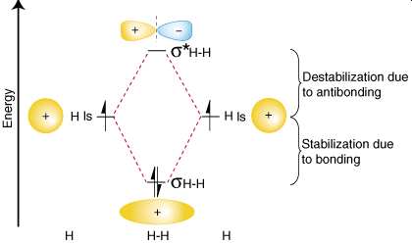
MO Theory – Adding AO to get MO
Non-bonding Orbital (NBO)
*aka Antibonding
Higher in Energy
Node with ZERO e⁻ density
Destructive Interference
σ*_{1s}
AO
MO
AO
σ*_{1s}
σ_{1s}
Bonding Orbital (BO)
Lower in Energy
e⁻ density between atoms
Constructive Interference
σ_{1s}

Slide 6
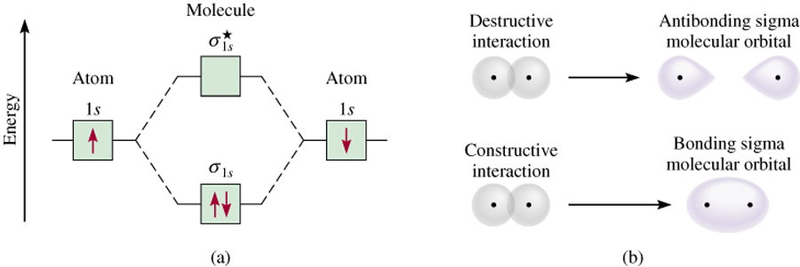
MO – H₂ Molecule
A different perspective

Slide 7
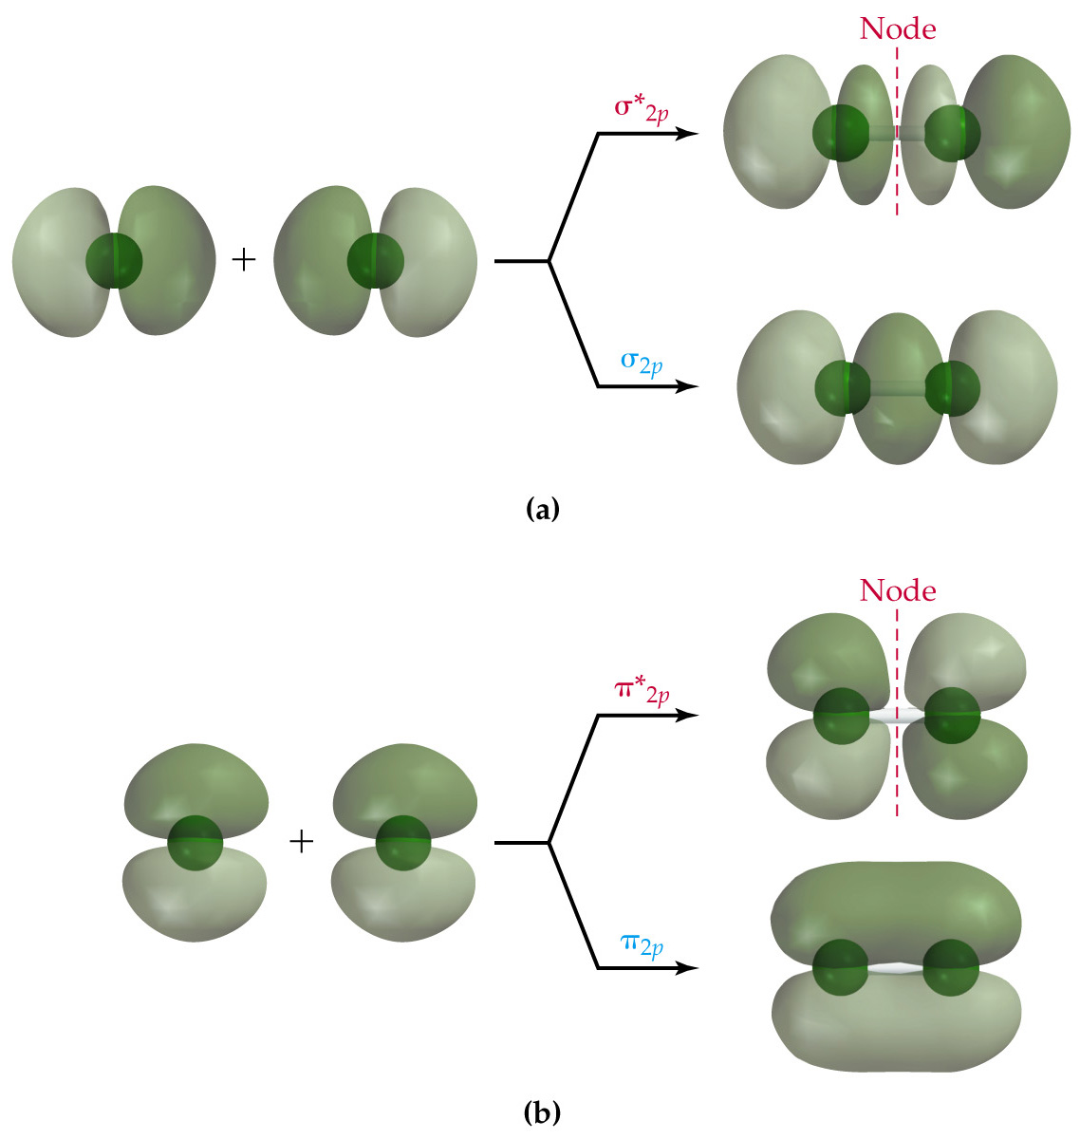
MO – 2p + 2p
Sigma (σ) vs Pi (π)
Sigma (σ) BO
head to head overlap
e⁻ density between atoms
σ*_{2p}
σ_{2p}
Pi (π) BO
overlap is side to side
e⁻ density above and below atoms
π*_{2p}
x2
π_{2p}

Slide 8
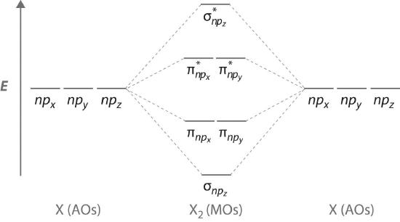
MO – Energy Diagram
(2p – orbitals)
You will be given blank energy level diagrams

Slide 10
MO Rules
You will be given blank energy level diagrams
# of MO = # atomic orbitals
BO = lower energy, more stable
NMO = higher energy less stable
Fill all orbitals low E to high E
Pauli Exclusion – Degenerate orbitals fill separately, spin aligned
#e⁻ in MO = sum of all e⁻ in an atom (though tend to ignore inner shell/core e⁻)
Shorthand Notation
Similar to 1s², 2s² etc.
(σ_{2s})² (σ*_{2s})² (π_{2p})⁴ (σ _{2p})²
Bond Order
Diamagnetic vs Paramagnetic
# of bonds formed between atoms
Can be non-integer values
> 0 = molecule/ion can “exist”
Di = all e⁻ are paired
Para = unpaired e⁻
# bonding e⁻ - # nonbonding e⁻
Bond Order =
2

Slide 11
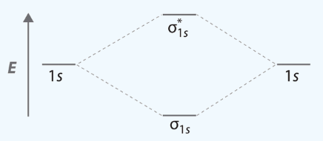
Determine # electron
Fill in AO and MO
Fill low to high E
Calculate Bond Order
Determine # electron
Fill in AO and MO
Fill low to high E
Short hand notation
Calculate Bond Order
Di or Para?
Lets Try It:
Why is H₂ a diatomic but He₂ is not?
H₂
He₂

Slide 12
Determine # electron
Fill in AO and MO
Fill low to high E
Short hand notation
Calculate Bond Order
Di or Para?
You Try It:
Which of the following molecules “exists” H₂⁺ and H₂⁻ ?
H₂⁺
H₂⁻

Slide 13
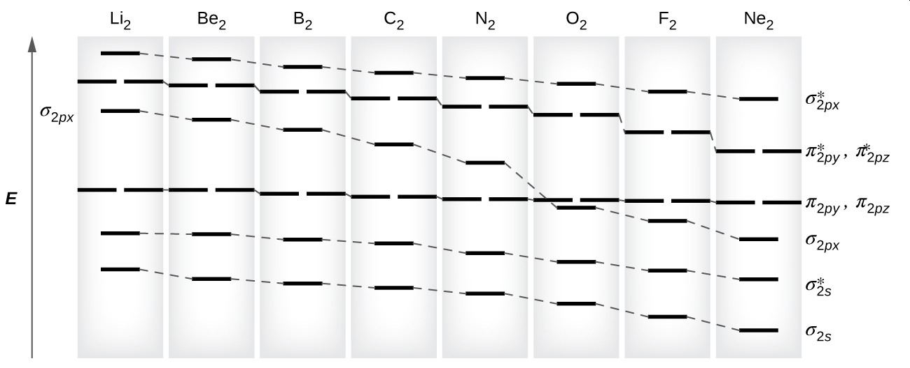
2nd row elements and molecules
It’s been way to easy until now…
LCAO – includes all orbitals (s and p) at once
Changes energy levels of MO orbitals depending on the amount of s-p mixing and how close the levels are in energy.
Swap π_{2p} and σ_{2p} orbitals
Large s-p mixing effect
Small s-p mixing

Slide 14
You will be given blank energy level diagrams

Slide 15
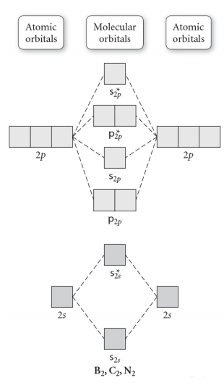
Determine # electron
Fill in AO and MO
Fill low to high E
Short hand notation
Calculate Bond Order
Di or Para?
Lets Try It:
Determine BO of Li₂ and Be₂
Li₂
Be₂

Slide 16
You Try It:
Determine BO of B₂ and C₂
B₂
C₂

Slide 17
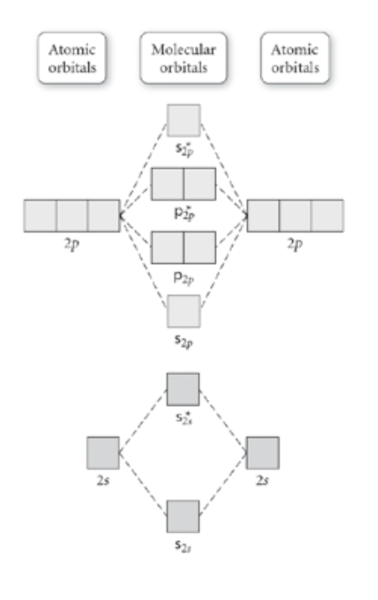
You Try It:
Determine BO of N₂ and O₂
N₂
O₂

Slide 18
A closer look at O₂
Diamagnetic or Paramagnetic
s-p orbital mixing
No s-p orbital mixing

Slide 19
Advanced Topics
Heteronuclear Molecules
Note: Due to differences in EN the energy levels don’t line up

Slide 20
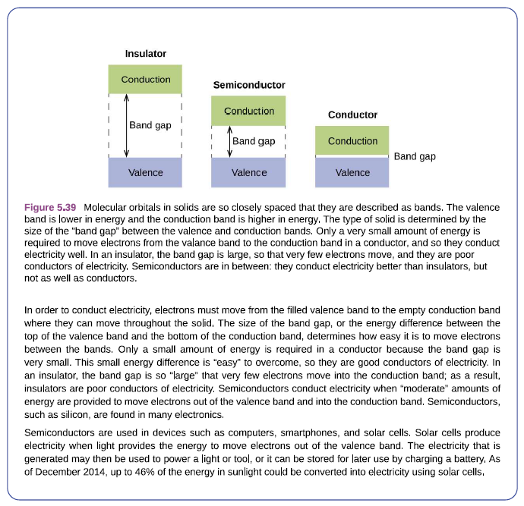
Advanced Topics
Solid State Chemistry

Slide 21
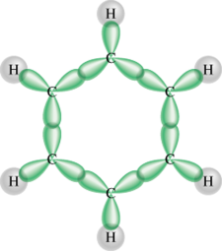
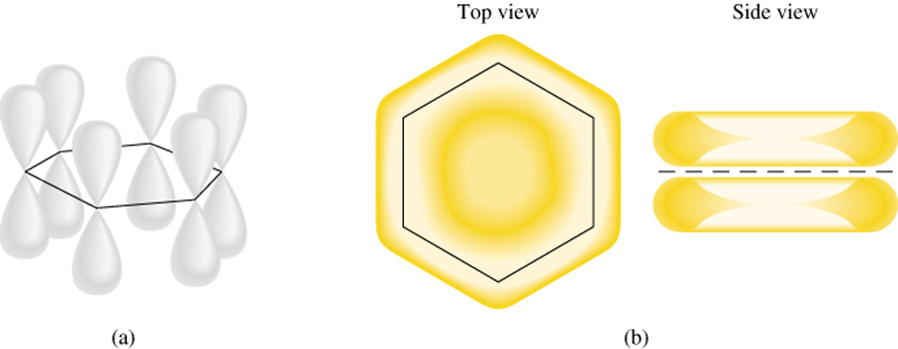
Advanced Topics
Delocalization in Benzene

Slide 22
LS vs VBT vs MO theory
Lewis Structures
Bond – two shared e⁻
Counts dots
All bonds same
VSEPR – predicts shapes
Violations, FC, Resonance etc
Quick and Easy
Not too bad
Pain in the Arse
Annoying: All the MO theory examples are normally just two atoms so its difficult to see the difference between atomic and molecular orbitals

Slide 23
