Slide 1
CHE 111 Fall 2020
Lecture 4 f
Lewis Structures – Advanced Topics
Overview/Topics
Resonance
Formal Charges
Violating the Octet Rule
Skills to Master
Homework 4 f
Additional Useful Links
www.chemhaven.org/che111
Khan Academy
Google/You Tube
Read
OER – Chapter 4.4-4.6

Slide 2
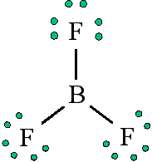
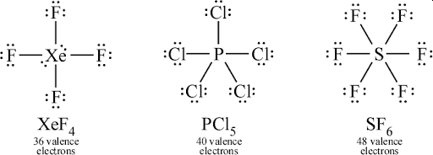
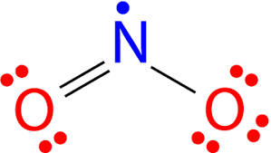
Violating the Octet Rule
3 Cases
Too few electrons (e⁻ deficient)
Odd # of electrons (radicals)
Expanded Octets (hypervalent)

Slide 3
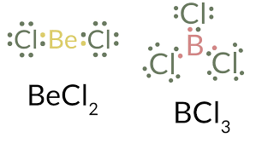
Violating the Octet Rule
Too few electrons
Generally occurs only for Be, B, Al
Fairly Reactive
What is the “best” structure for BF₃

Slide 4
Violating the Octet Rule
Odd Number of Electrons
Often Called “Free Radicals”
Very Reactive
You Try It: NO
You Try It: ClO₂

Slide 5
Violating the Octet Rule
Expanded Octets (Hypervalent)
Central Element Only
n > 3 have access to d-orbitals
Nonmetals (S, P etc)
Highly EN terminal elements
Extra Valence e⁻ go on central atom
Decreases Formal Charges
Two new shape families
# atoms
Bonded
# lone
pair e⁻
Unique for each shape

Slide 6
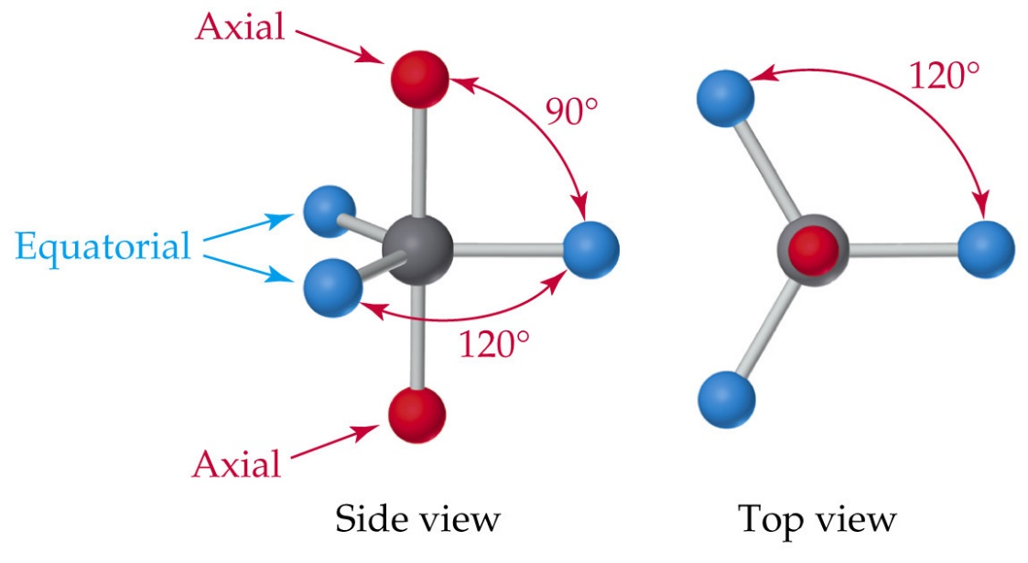
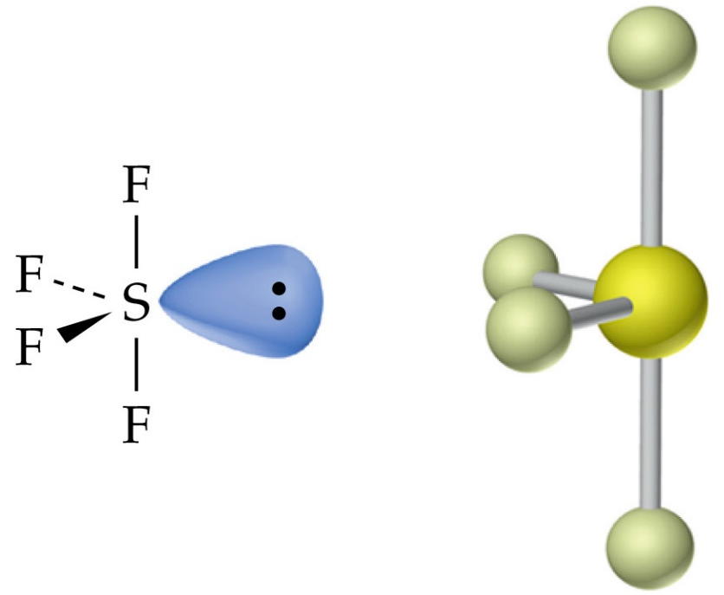
Five Charge Clouds
Trigonal Bypyramidal
90°/120°
(5,0)
See-Saw
90°/120°
(4,1)
*always remove equatorial before axial atoms

Slide 7
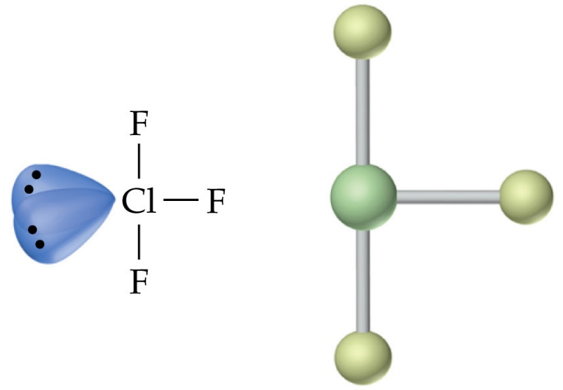
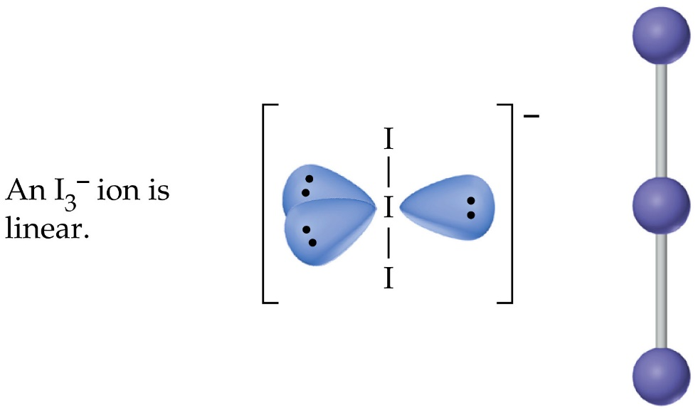
Five Charge Clouds
T-Shape
90°
(3,2)
Linear
180°
(2,3)

Slide 8
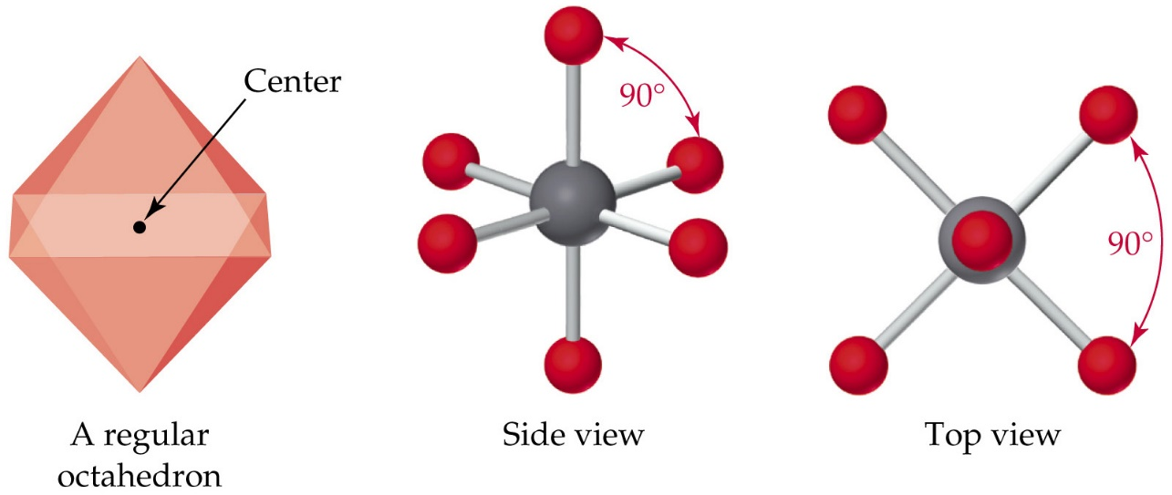
Six Charge Clouds
Octahedral
90°
(6,0)
Square Pyramidal
90°
(5,1)
*always remove axial before equatorial atoms

Slide 9
Six Charge Clouds
Square Planar
90°
(4,2)
Too many electrons to close together, no *know compounds exist with these molecular geometries
*I didn’t find any with a quick google search
T-Shape
90°
(3,3)
Linear
180°
(2,4)
and

Slide 10
You Try It!
Determine the shape + is it NP or DP?
XeF₄
SF₆
PCl₅

Slide 11
You Try It - Answers!
Determine the shape + is it NP or DP?
XeF₄
SF₆
PCl₅
Square Planar
Trigonal Bipyramidal
Octahedral
Nonpolar – all vectors cancel
Nonpolar – all vectors cancel
Nonpolar – all vectors cancel

Slide 12
Formal Charges
What happens if there is more than 1 possible LS? “Tie-Breakers”
The structure with the least FC is the most “correct” structure
Negative FC should reside on the most EN Element
Adjacent FC = same sign or zero
Polyatomic Ions always have FC
Sum FC = overall charge
Other molecules may have FC
Definition: The difference in charge between the valence e⁻ in an isolated atom and the number of e⁻ assigned in the Lewis Structure
Isolated Atom
Valence e⁻ in LS
FC = # Valence e⁻ - # lone pair e⁻ - ½ bonding e⁻

Slide 13
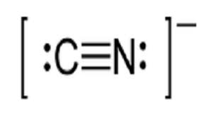
Example:
FC = # Valence e⁻ - # lone pair e⁻ - ½ bonding e⁻

Slide 14
You Try it: NO⁺
Fill out the FC for each structure below
Which structure is the “best”

Slide 15
Favored structure, the + charge is on the least EN element
Answers:
(A) is favored structure, the - charge is on the most EN element

Slide 16
Resonance Structures
Some molecules can not be described by a single LS or there are multiple correct LS
Ozone’s LS predicts 2 different bond lengths but experimentally only 1 is observed
Resonance Hybrid - The “real” structure is the superposition (average) of all possible LS
Really LS are just not 100% correct, need a better theory…VBT and MO Theory!
https://chemistry.stackexchange.com/questions/15665/ozone-resonance-structure-differing-opinions

Slide 17
A more in depth view…
A
B
C
Despite the ↔ the molecule does not go back and forth between A and B
The correct structure is always C.
Each bond is identical and somewhere between a single and double bond
Analogy
It is like colors. Green is the combination of Yellow and Blue. It does not oscillate between yellow and blue and its never just yellow or blue, its ALWAYS Green.
Really LS are just not 100% correct, need a better theory…VBT and MO Theory!

Slide 18
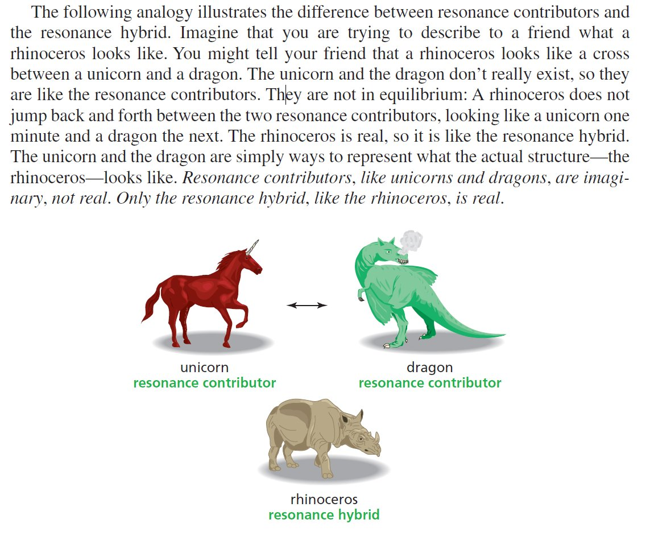
Another, Cooler Analogy!
Really LS are just not 100% correct, need a better theory…VBT and MO Theory!

Slide 19
Why is Chemistry so hard!
Is it better to obey or violate the octet rule?
Case Study: SO₄⁻²
Obey the Octet Rule
Violate the Octet Rule
Obeys Octet Rule
High FC
Violates Octet Rule
Low FC
Another example of why LS are not the 100% answer
*QM calculations suggest structure (a) is “better”

