Slide 1
CHE 111 Fall 2020
Lecture 4 cd
Lewis Structures, Ionic Bonds, and Naming
Overview/Topics
Understand Covalent Bonds
Lewis Structures
Electron Configurations
Words
Polar Covalent Bonds and Electronegativity
Naming Molecular Compounds and Acids
Skills to Master
Homework 4 c,d
Additional Useful Links
www.chemhaven.org/che111
Khan Academy
Google/You Tube
Read
OER – Chapter 4.2-4.4

Slide 2
Covalent or Molecular Bonds
Form between nonmetals and nonmetals
Share electrons
Weaker bond
Lower Melting/Boiling Points
Form Discrete Molecules
Don’t conduct electricity in water (some exceptions)

Slide 3
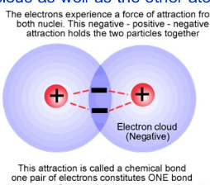
Covalent/Molecular Compounds
Form when gain/losing not possible therefore the share electrons
Form between nonmetals (nm) and nonmetals (nm)
Weak Attractive Force – (not full +/- charges)
Low Melting and Boiling Points
Solubility varies (Low)
Do Not Conduct Electricity
Tend to form discrete molecules

Slide 4
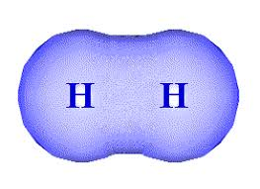
Covalent/Molecular Compounds
-
H
+
H
H
H
1s¹
1s¹
1s¹⁺¹
1s¹⁺¹
Lewis Dot Structures use solid line to indicate shared electrons

Slide 5
Potential Energy of Covalent Bonds

Slide 6
You try it: F + F →

Slide 7
You try it: O + O →

Slide 8
You try it: N + N →

Slide 9
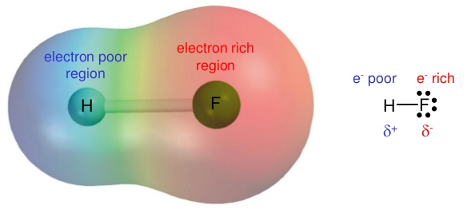
Polar Covalent Bonds
Covalent or Nonpolar Covalent (C or NPC) Bonds = shared equally
Polar Covalent (PC) Bonds = shared unequally
-
H
+
F
H
F
1s¹
1s²2s²2p⁵
1s¹⁺¹
1s²2s²2p⁵⁺¹
[H]⁺
[ ]⁻¹
H
+
F
F

Slide 10
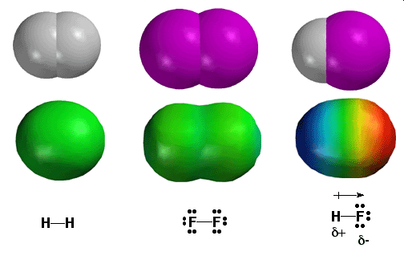
Comparison of several bond types

Slide 11
You try it: H + O →

Slide 12
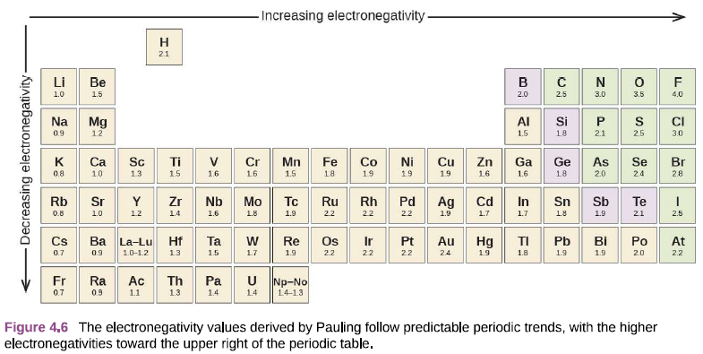
Electronegativity (EN)
Measure of the tendency of an atom to attract the electrons (electron density) in a covalent bond
Lowest = 0.7 (Fr)
Highest = 4.0 (F)
Assign δ⁺ to the least EN element
Assign δ⁻ to the most EN element

Slide 13
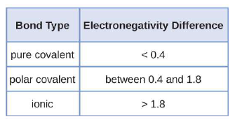
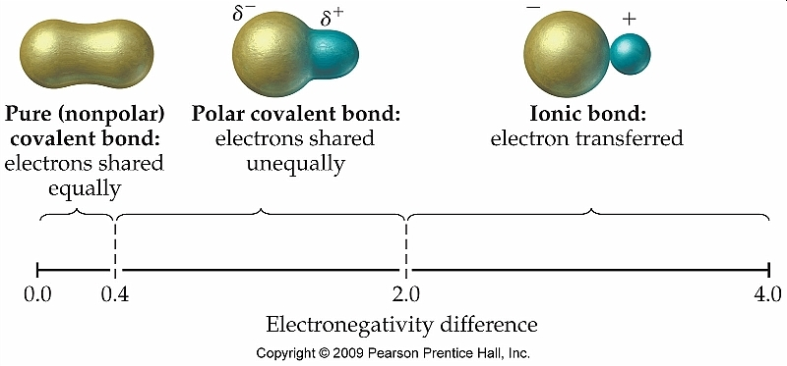
Using EN to Determine Bond Type
$∆EN=|{EN}_{Cation }−{EN}_{Anion}|$
Varies a little by book/web-site
General rule (lots of exceptions)
Best guide is nm/nm vs m/nm

Slide 14
Continuum of Bonding
Similar
nm/nm
Different
nm/nm
m/nm
No Electrostatic Attraction
Weak Electrostatic Attraction
Strong Electrostatic Attraction
Weak Bond
Strength
Medium Bond
Strength
Strong Bond
Strength

Slide 16
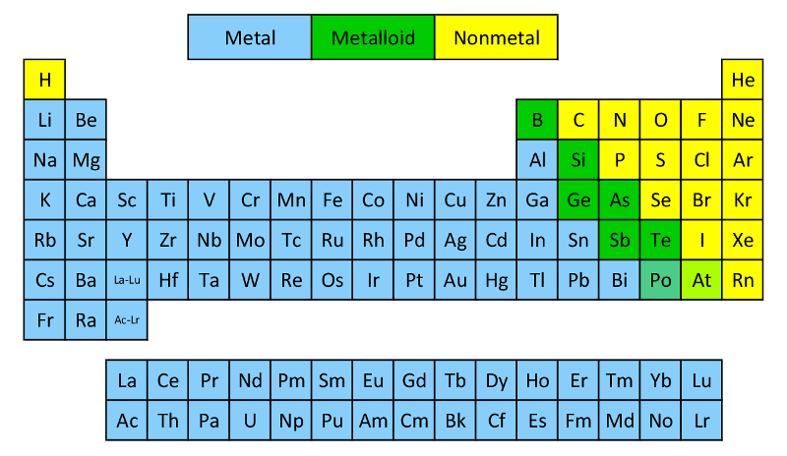
Naming Molecular Compounds and Acids
Know the following:
Metalloids (7*) – B, Si, Ge, As, Sb, Te, Po/At
Metals (left)
Non-metals (right)
No consistent rule for metalloids
Nonmetals – B, Si,
Metals – Ge, As, Sb, Te

Slide 17
Naming Acids
Ch. ?? is all about acids and bases
Acids always start with H_
No consistent rules
_ic Acid
Just memorize 10 most common
H
Anion or Polyatomics
H₂SO₄ = Sulfuric Acid
HNO₃ = Nitric Acid
H₂CO₃ = Carbonic Acid
H₃PO₄ = Phosphoric Acid
HClO₄ =Perchloric Acid
HC₂H₃O₂ = Acetic Acid
HF = Hydrofluoric Acid
HCl =Hydrochloric Acid
HBr = Hydrobromic Acid
HI = Hydroiodic Acid
Note – Just the Halogens
Note – charges do balance
- polyatomic on CS
Memorize them!

Slide 18
Ch. ?? is all about acids and bases
Naming Bases
Bases are always a metal + OH
Named like normal ionic compounds
Metal Atom
OH
NaOH
Mg(OH)₂
Sodium Hydroxide
Magnesium Hydroxide

Slide 19
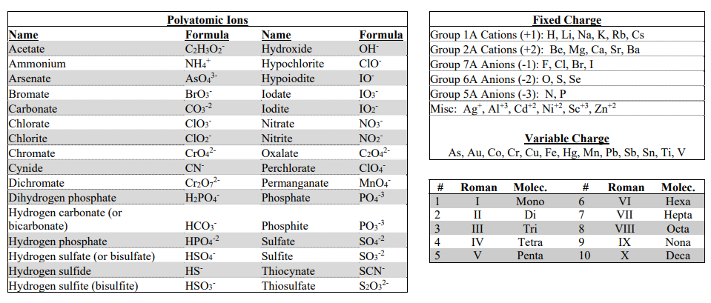
Using your Cheat Sheet
Never leave home without it
Provided on every exam
Fixed Charges
Variable Charges
Roman Numerals
and
Molec. Prefixs
Polyatomic Ions

Slide 20
Naming Molecular Compounds
1 = mono
2 = die
3 = tri
4 = tetra
5 = penta
6 = hexa
7 = hepta
8 = octa
9 = nona
10 = deca
nm/nm
Left most Element goes 1st.
Naming: Prefix – 1st Element – Prefix – 2nd Element (-ide ending)
Prefix
First Element
Prefix
Second Element
Never use mono
-ide ending
CO
CO₂
Carbon monoxide
Carbon dioxide
P₂S₅
S₃Br
Diphosphorus pentasulfide
Trisulfur monobromide

Slide 21
You try it: NO₂
You try it: B₂O₅
You try it: tetraphosphorus hexafluoride
You try it: dioxygen monochloride

Slide 22
Formula to Name
Acids – memorize them!
Prefix-Element Prefix-Element
Oh shit its test time… PANIC!
nm/nm
H_
*what the one exception?
m/nm
Fixed Charge
Variable Charge
Save until last they are the hardest!
Cation Anion (ide/poly)
Cation (charge) Anion (ide/poly)

Slide 23
You try it:
Na₂SO₄
V₂(SO₄)₃
H₂SO₄
SO₃

Slide 24
You try it:
PbPO₄
H₃PO₄
Ba₃(PO₄)₂
P₂O₅

Slide 25
Name to Formula
Acids – memorize them!
Prefix-Element Prefix-Element
-ic acid
Oh shit its test time… PANIC!
mono, di, tri (nm)
*what the one exception?
No ( )
m/nm
Look up charge
(charge on cation)
Balance Charges!
Save until last they are the hardest!

Slide 26
You try it:
Tin (VI) Oxalate
Sodium Oxalate
Dicarbon tetroxide
Carbonic Acid

Slide 27
You try it:
Calcium Acetate
Acetic Acid
Vanadium (III) Acetate
Silver Dihydrogen phophate

