Slide 1
CHE 111 Fall 2020
Lecture 4 ab
Lewis Structures, Ionic Bonds, and Naming
Overview/Topics
Draw Lewis Structures of Elements
Understand Ionic Bonds
Charges
Lewis Structures
Electron Configurations
Words
Skills to Master
Homework 4 a,b
Additional Useful Links
www.chemhaven.org/che111
Khan Academy
Google/You Tube
Read
OER – Chapter 4.4, 4.1, 4.3

Slide 2
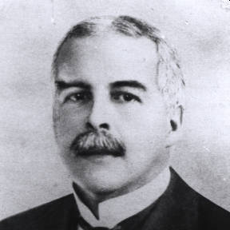
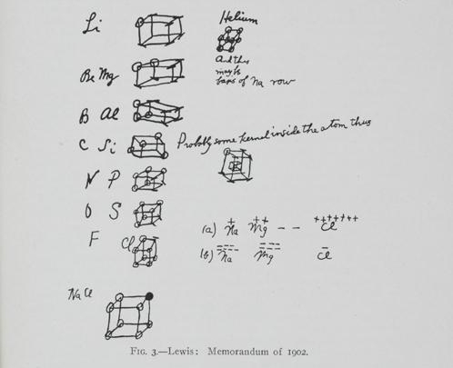
Invented Lewis Structures before QM fully discovered!
Lewis Symbols
Gilbert Lewis Newton
(1875-1946)
Developed Rules for Covalent Bonding
Acid/Base Chemistry
1902 – Chemistry Lecture
1916 – Paper
Nominated 41 times for Nobel Prize (never won)
https://en.wikipedia.org/wiki/Gilbert_N._Lewis
https://www.sciencehistory.org/historical-profile/gilbert-newton-lewis

Slide 3
Lewis Symbols
Lone Electron
Graphical representation of the valence electrons an element has
Shorthand for Electron Configurations
Lone “pair” Electrons
-
Shared Electrons (Covalent Bond)
[ ]
Ions
Li: 1s²2s¹ = 1 valence e⁻ =
You try it: Nitrogen
You try it: O⁻²

Slide 4
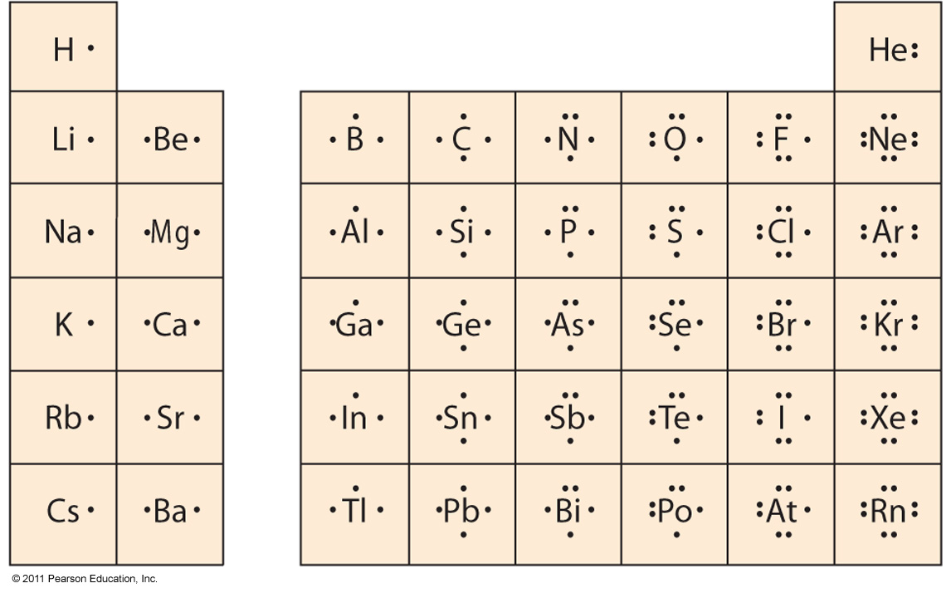
Lewis Symbols
This table is a bit of overkill because…….

Slide 5
Octet Rule
Noted that Noble Gases are unreactive
If positions on PT added to 8 a compound was formed
We know the “real” reason from QM
Elements with completely filled s and p orbitals are stable (s²p⁶)
8 electrons (octet) are stable
Exceptions to Octet Rule – H and He
Row 1 – Alkali Metal + Row 7 – Halogens = 8 (octet!)
NaF KF
NaCl KCl
NaBr KBr
Row 2 – Alkali Earth Metals + Row 6 – Chalcogens = 8 (octet!)
MgO CaO
MgS CaS
MgSe CaSe

Slide 6
Ionic Compounds
Form due to the electrostatic attraction between cations and anions (opposites attract)
Form between metals (cations) and nonmetals (anions)
Gain or lose electrons to achieve an octet
Strong Attractive Force - Coulombs Law
High Melting and Boiling Points
Highly soluble in water
Conduct Electricity
Tend to form lattice structures
Silvery Metal
Very Combustible
Yellow-Green Gas
Very Toxic!
Clear/White Crystals
Very Tasty
Na + Cl
Na⁺Cl⁻
1s²2s²2p⁶3s¹
1s²2s²2p⁶
1s²2s²2p⁶3s²3p⁶
1s²2s²2p⁶3s²3p⁵
Common Charges
QM predicts
Use your CS

Slide 7
Formation of Ionic Bonds
Cation + Anion
metal/nonmetal (m/nm)
Lose or gain electrons to reach an octet (8)
Electrostatic Attraction
Magnesium + Fluorine Magnesium Fluoride
+
MgF₂
Mg
2 F
+
1s²2s²2p⁶
1s²2s²2p⁶3s²
1s²2s²2p⁵
1s²2s²2p⁶
1s²2s²2p⁵
[ ]⁻¹
F
Mg
+
F
F
[Mg]⁺²
[ ]⁻¹
F
Magnesium loses two electrons, one to each fluorine to complete all three octets, the resulting cation and anion form an ionic bond because opposite attract

Slide 8
You try it: Li + S →

Slide 9
You try it: Mg + P →

Slide 10
Naming Fixed Charge
Ionic Compound
Metal
Anion
E - ide
IUPAC Rules
Always write ionic compound: Cation – Anion (or m/nm)
Naming: Cation = metal name
Anion = element change ending to –ide
Polyatomic = name on CS
Writing Formula – Balance Charges
Poly = name
NaCl
NaNO₃
Sodium Chloride
Sodium Nitrate
MgCl₂
Mg₂(PO₄)₂
Magnesium Chloride
Magnesium Phosphate
Formula to Name

Slide 11
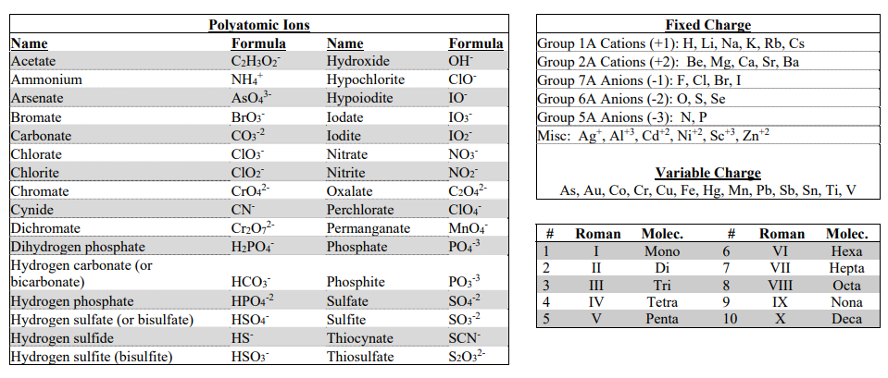
Using your Cheat Sheet
Never leave home without it
Provided on every exam
Fixed Charges
Variable Charges
Roman Numerals
and
Molec. Prefixs
Polyatomic Ions

Slide 12
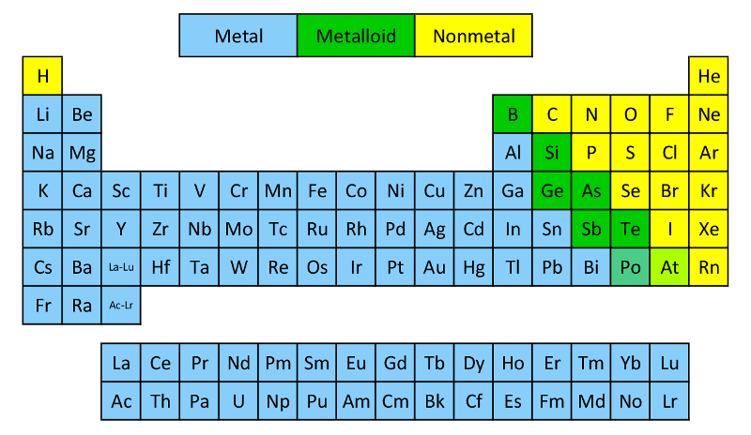
Review – Ch 3
Know the following:
Metalloids (7*) – B, Si, Ge, As, Sb, Te, Po/At
Metals (left)
Non-metals (right)

Slide 13
Review of 6a
3 Methods to Balance Charges
Atoms
Old School Math and CA method
Cross Method + Simplify
You try it: Compound formed between Ca and N
You try it: Compound formed between Na and SO₄
Charges are
on your CS!

Slide 14
You try it: Compound formed between Ca and PO₄
You try it: Compound formed between Al and SO₄
You try it: Compound formed between Na and SCN
You try it: Compound formed between Ag and HPO₄

Slide 15
Method 2 – Math + CA Method
You try it: Compound formed between Mg and P
You try it: Compound formed between K and CO₃

Slide 16
You try it: Compound formed between Ba and S
You try it: Compound formed between Al and CO₃
You try it: Compound formed between NH₄⁺ and NO₃
You try it: Compound formed between NH₄⁺ and PO₄

Slide 17
Naming Variable Charge
Ionic Compounds
Metal
(charge)
Anion
Always write ionic compound: Cation – Anion (or m/nm)
Naming: Cation = metal name
Charge in ( ) using roman numerals
Anion = element change ending to –ide
= Polyatomic name on CS
Variable Charge Listed on CS
Roman Numerals on CS
VCl₃
Fe₃(PO4)₂
Vanadium (III) Chloride
Iron (II) Phosphate
VCl₅
Fe₃PO₄
Vanadium (V) Chloride
Iron (I) Phosphate

Slide 18
Method 3 – Cross Multiply + Simplify
You try it: Compound formed between Sn⁺⁴ and O
You try it: Compound formed between Sn⁺² and CO₃
Compounds always form in the lowest whole number ratio

Slide 19
You try it: Formula for
Lead (IV) Sulfite
You try it: Formula for Chromium (III) Hydroxide
You try it: Name for
Au₂(S₂O₃)₃
You try it: Name for
Hg(SO4)₂

Slide 20
Mix it all up!
You try it: Formula for
Scandium Oxalate
You try it: Formula for Cobalt (II) Oxalate
You try it: Name for
Sb(MnO₄)₅
You try it: Name for
ZnCr₂O₇

