Slide 1
Chemistry 111
Chapter 3 g
Periodic Trends (3.5)
Goals
Explain the following periodic trends
Atomic Size Atoms
Atomic Size Cations and Anions
Ionization Energy
Electron Affinity

Slide 2
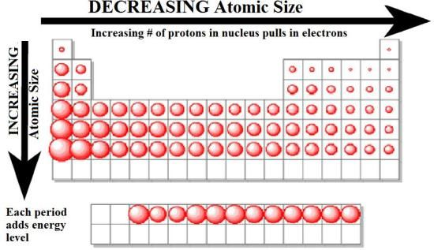
Atomic Size
Columns: Atoms get bigger as you go down a column
Principle QN (n)/size of orbital increases

Slide 3
Atomic Size
Rows: Atoms get smaller as you go across a row
Same orbital ↑ protons ↑ attractions ∴ ↓ size
faster than ↑ electrons ↑ repulsions ∴ ↑ size
Z_{eff} = Z_{actual} - ES

Slide 4
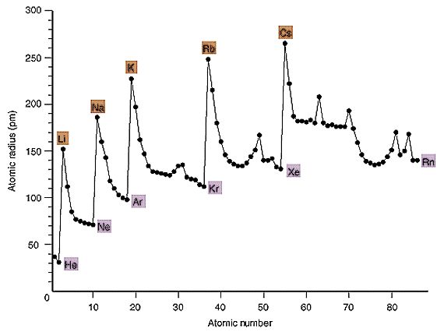
Atomic Size
Bigger Down a Column
Smaller across a row

Slide 5
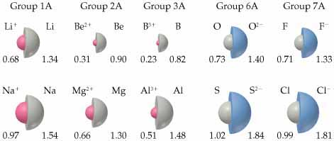
Cations and Anions
Cations get smaller
protons > electrons
Attractions > repulsions (Z_{eff} Increases)
Anions get BIGGER
protons < electrons
Attractions < repulsions (ES increases)

Slide 6
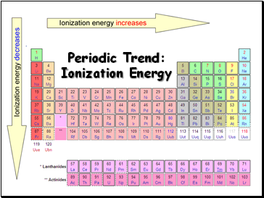
Ionization Energy (IE or E_{IE})
process by which and electron is removed from an atom in the gas state
Na (g) + Ionization Energy → Na⁺ (g) + e⁻¹
Closer an electron is to the nucleus the greater the attractive force therefore greater E_{IE}
IE is always endothermic/+ because it takes energy to remove an electron from an atom
Opposite trend as size
Across a row: Size ↓ Ionization Energy ↑
Down a column: Size ↑ Ionization Energy ↓

Slide 7
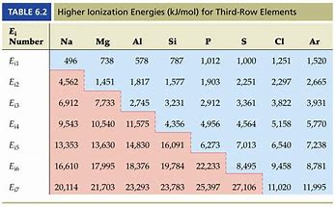
Ionization Energy (IE or E_{IE})
Can have multiple Ionization Energies if removing more than one electron
Noble Gases are very stable (full orbitals octets)
Extra large amount of energy to remove an e⁻ from a noble gas
Mg (g) + IE₁ → Mg⁺¹ (g) + e⁻¹
Mg⁺¹ (g) + IE₂→ Mg⁺² (g) + e⁻¹

Slide 8
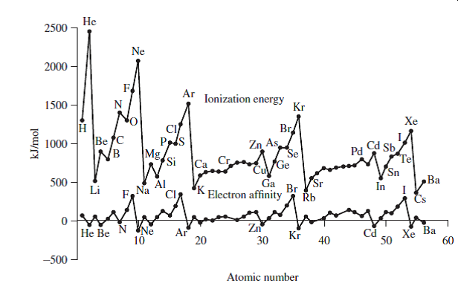
B vs Be
N vs O

Slide 9
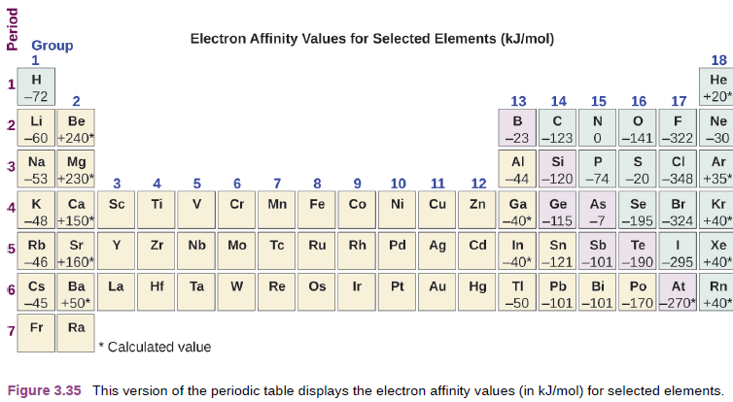
Electron Affinity (EA or E_{A})
Energy change when adding an electron to an atom in the gas phase to form an anion
F (g) + e⁻¹→ F⁻¹ (g)
Can be Endothermic or Exothermic depending on element

Slide 10
No real trends, but can make some observations
Alkali metals – slightly negative, electron goes into existing orbital
Alkaline Earth Metals – very positive, electron goes into new, higher energy orbital
Across Row (B to F) – more negative, electron goes into existing orbitals
Halogens – most negative, complete octets
Noble Gases – positive, electron goes into new, higher energy orbital

Slide 11
Chemistry 111
Chapter 3 h
Ionic and Molecular Compounds (3.7)
Goals
Why compounds form
3 Major types
Ionic
Molecular
Polyatomic Ions

Slide 12
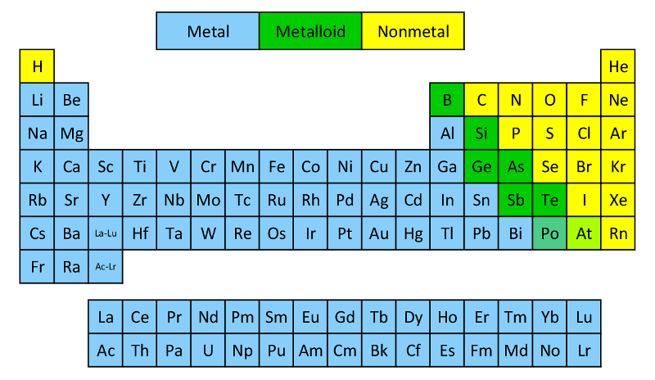
Metalloids
 | Metals | Nonmetals
State | Solid | Solid/Liquid/Gas
Melting Point | High | Low
Density | High | Low
Appearance | High luster | Not lusterous
Conduction (heat/elect) | Good | Poor
Know the following:
Metalloids (7*) – B, Si, Ge, As, Sb, Te, Po/At
Metals (left)
Non-metals (right)

Slide 13
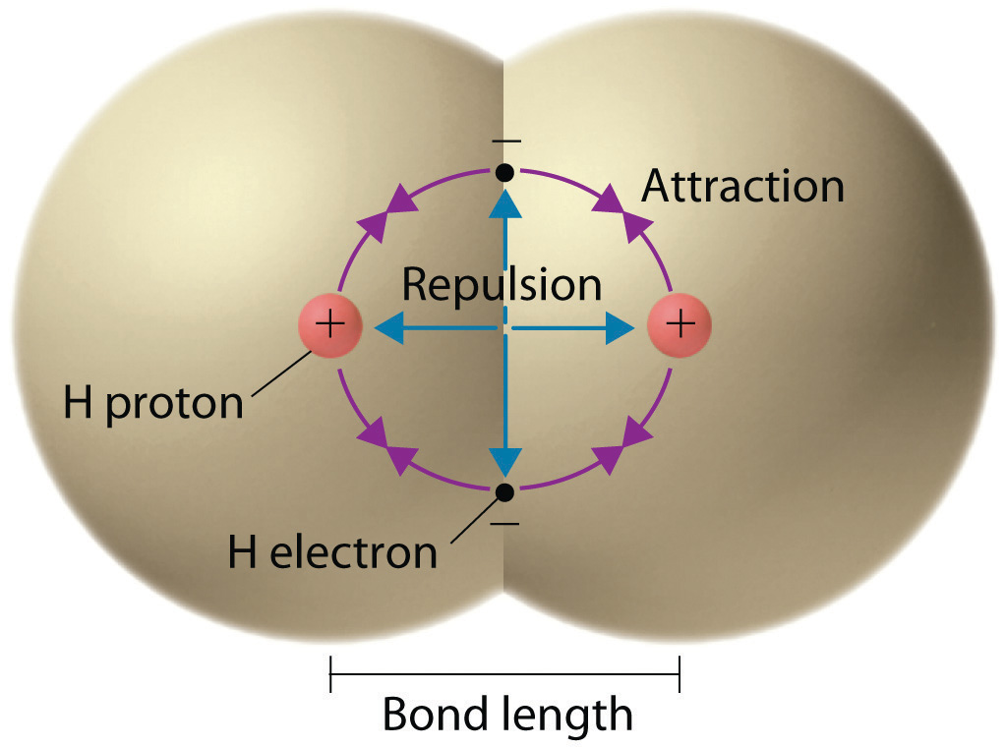
Fundamentals of Bonding
Compound: 2 or more E, chemically combined (bonded) in definite proportions
Compounds form to lower the total energy of the atoms involved
Most stable molecules form to complete octets (fully filled s and p orbitals)
Coulombs Law
Ionic Bond
Atoms
$$E=\frac{q_{1}q_{2}}{r}$$
Covalent/Molecular Bond
Electrons
2 major categories –
Ionic – gain/lose electrons
Covalent/Molecular – share electrons (Ch. 4)
Polyatomic Ions ( ½ Ionic, ½ Molecular fragments)

Slide 14
Ionic Compounds
Form due to the electrostatic attraction between cations and anions (opposites attract)
Form between metals (cations) and nonmetals (anions)
Strong Attractive Force - Coulombs Law
High Melting and Boiling Points
Highly soluble in water
Conduct Electricity
Tend to form lattice structures
Na + Cl
Na⁺Cl⁻
1s²2s²2p⁶
1s²2s²2p⁶3s²3p⁶
1s²2s²2p⁶3s¹
1s²2s²2p⁶3s²3p⁵
Common Charges
QM predicts
Use your CS

Slide 15
Ionic Compounds - II
Common Charges
QM predicts
Use your CS
Stable compounds must be electrically neutral (i.e. can’t be charged)
The total electrons gained or lost must be equal
1s²2s²2p⁶3s²3p⁵
+ Cl
Mg
MgCl₂
1s²2s²2p⁶3s²
+ Cl
1s²2s²2p⁶
1s²2s²2p⁶3s²3p⁶
1s²2s²2p⁶3s²3p⁵
1s²2s²2p⁶3s²3p⁶
You try it: What compound will form between Al and Cl?

Slide 16
You try it: What compound will form between Na and O
You try it: What compound will form between Al and O

Slide 17
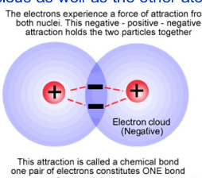
Covalent/Molecular Compounds
Form when gain/losing not possible therefore the share electrons
Form between nonmetals (nm) and nonmetals (nm)
Weak Attractive Force – (not full +/- charges)
Low Melting and Boiling Points
Solubility varies (Low)
Do Not Conduct Electricity
Tend to form discrete molecules
Lots more in Ch. 4!

Slide 18
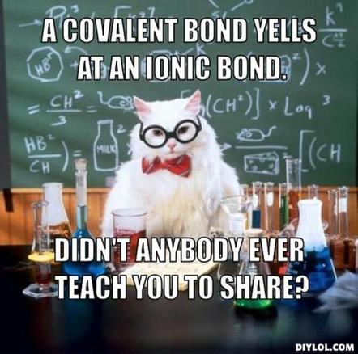
Comparison
 | Ionic | Covalent or Molecular
Formed by | Gain/lose electrons | Share electrons
Between | m/nm | nm/nm
Bond Strength | High | Low
Melting Point | High | Low
Solubility | High | Low
Conductivity | High | Low
Structure | Lattice | Discrete Molecules

Slide 19
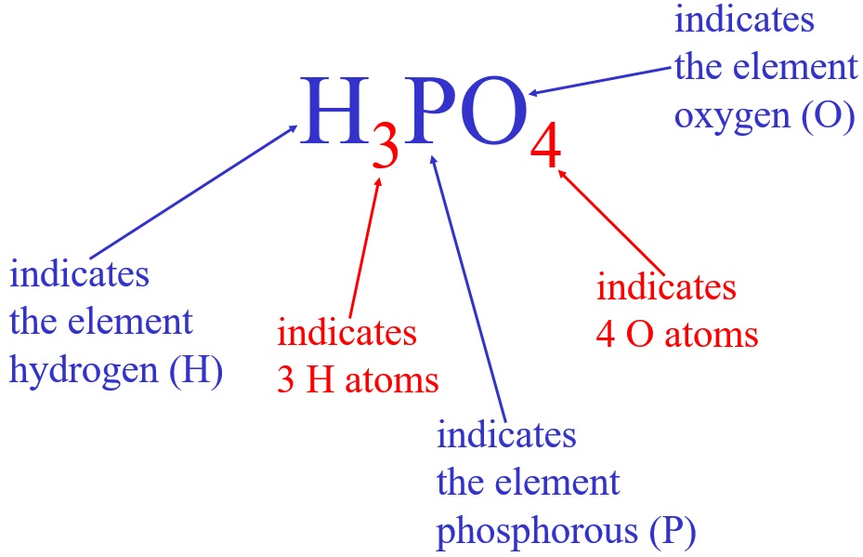
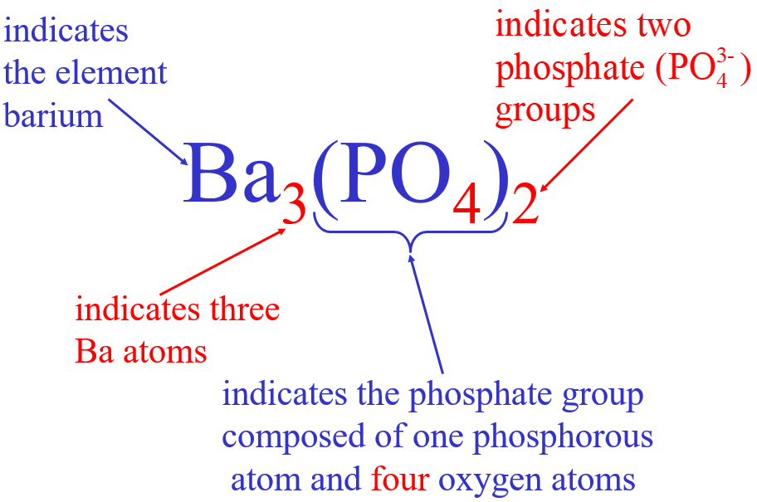
Polyatomic Ions
Contain 2 or more elements
½ Molecular - Held together by covalent/molecular bonds
½ Ionic – gain or lose an electron to be stable
Lots more in Ch. 4!
+1
Ionic
Covalent/Molecular
Polyatomic Ion
Polyatomic Ions and ( )
Don’t memorize
Use your CS!

Slide 20
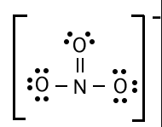
We learn Lewis Structures in Chapter 4.4
Ionic Compounds Containing Polyatomic Ions
Ionic
1
Covalent/Molecular
Na⁺¹
+ NO₃⁻¹
NaNO₃
+ NO₃⁻¹
Mg(NO₃)₂
Mg⁺²
+ NO₃⁻¹

Slide 21
You try it: What compound will form between Na⁺¹ and SO₄⁻²
You try it: What compound will form between Al⁺³ and SO₄⁻²

