Slide 1
Chemistry 111
Chapter 3 d,e
Quantum Mechanics
and the Periodic Table

Slide 2
Goals
4 Quantum Number and what they describe
Energy level diagrams
Coulombs Law
Electron Shielding (Z_{eff})
Penetration
Electron configurations
Periodic Table and QM
Names of various regions
Formation of Cations/Anions
Transitions metals – anomalous configurations and formation of variable charge cations

Slide 3
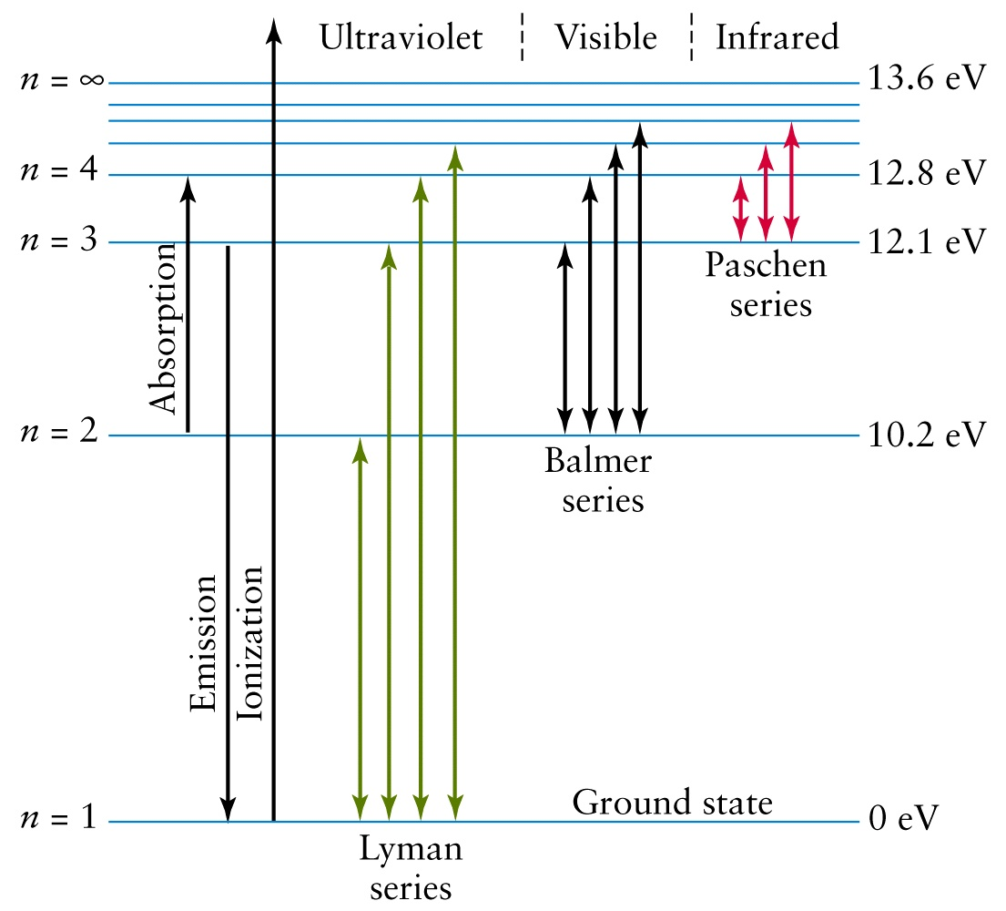
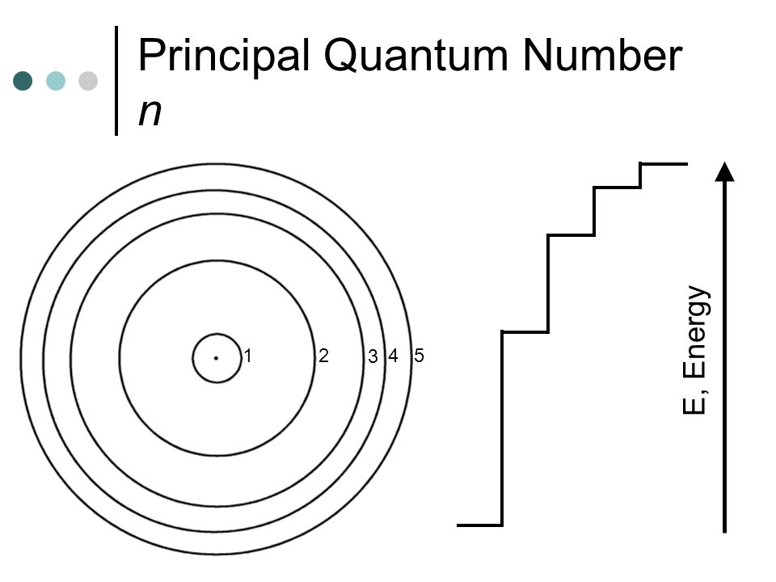
Principle Quantum
Number (n)
Distance from nucleus
Size of orbital
1,2,3 ….
“Shells”
High Energy
Low Energy

Slide 4
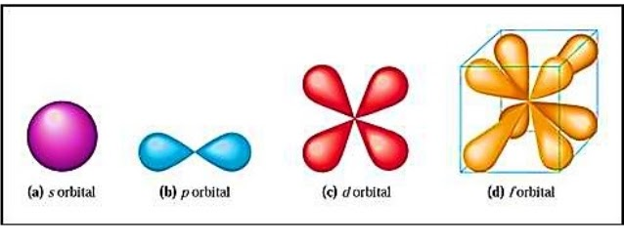
Angular Momentum
Quantum Number (l)
Allowed Values
n = 1 then l = 0
n = 2 then l = 0 and 1
n = 3 then l = 0, 1 and 2
Etc…
3D - shape of an orbital
0, 1, 2, 3 … (n-1)
4 shapes
Use letters since numbers are used for n
l =0
l =1
l =2
l =3

Slide 5
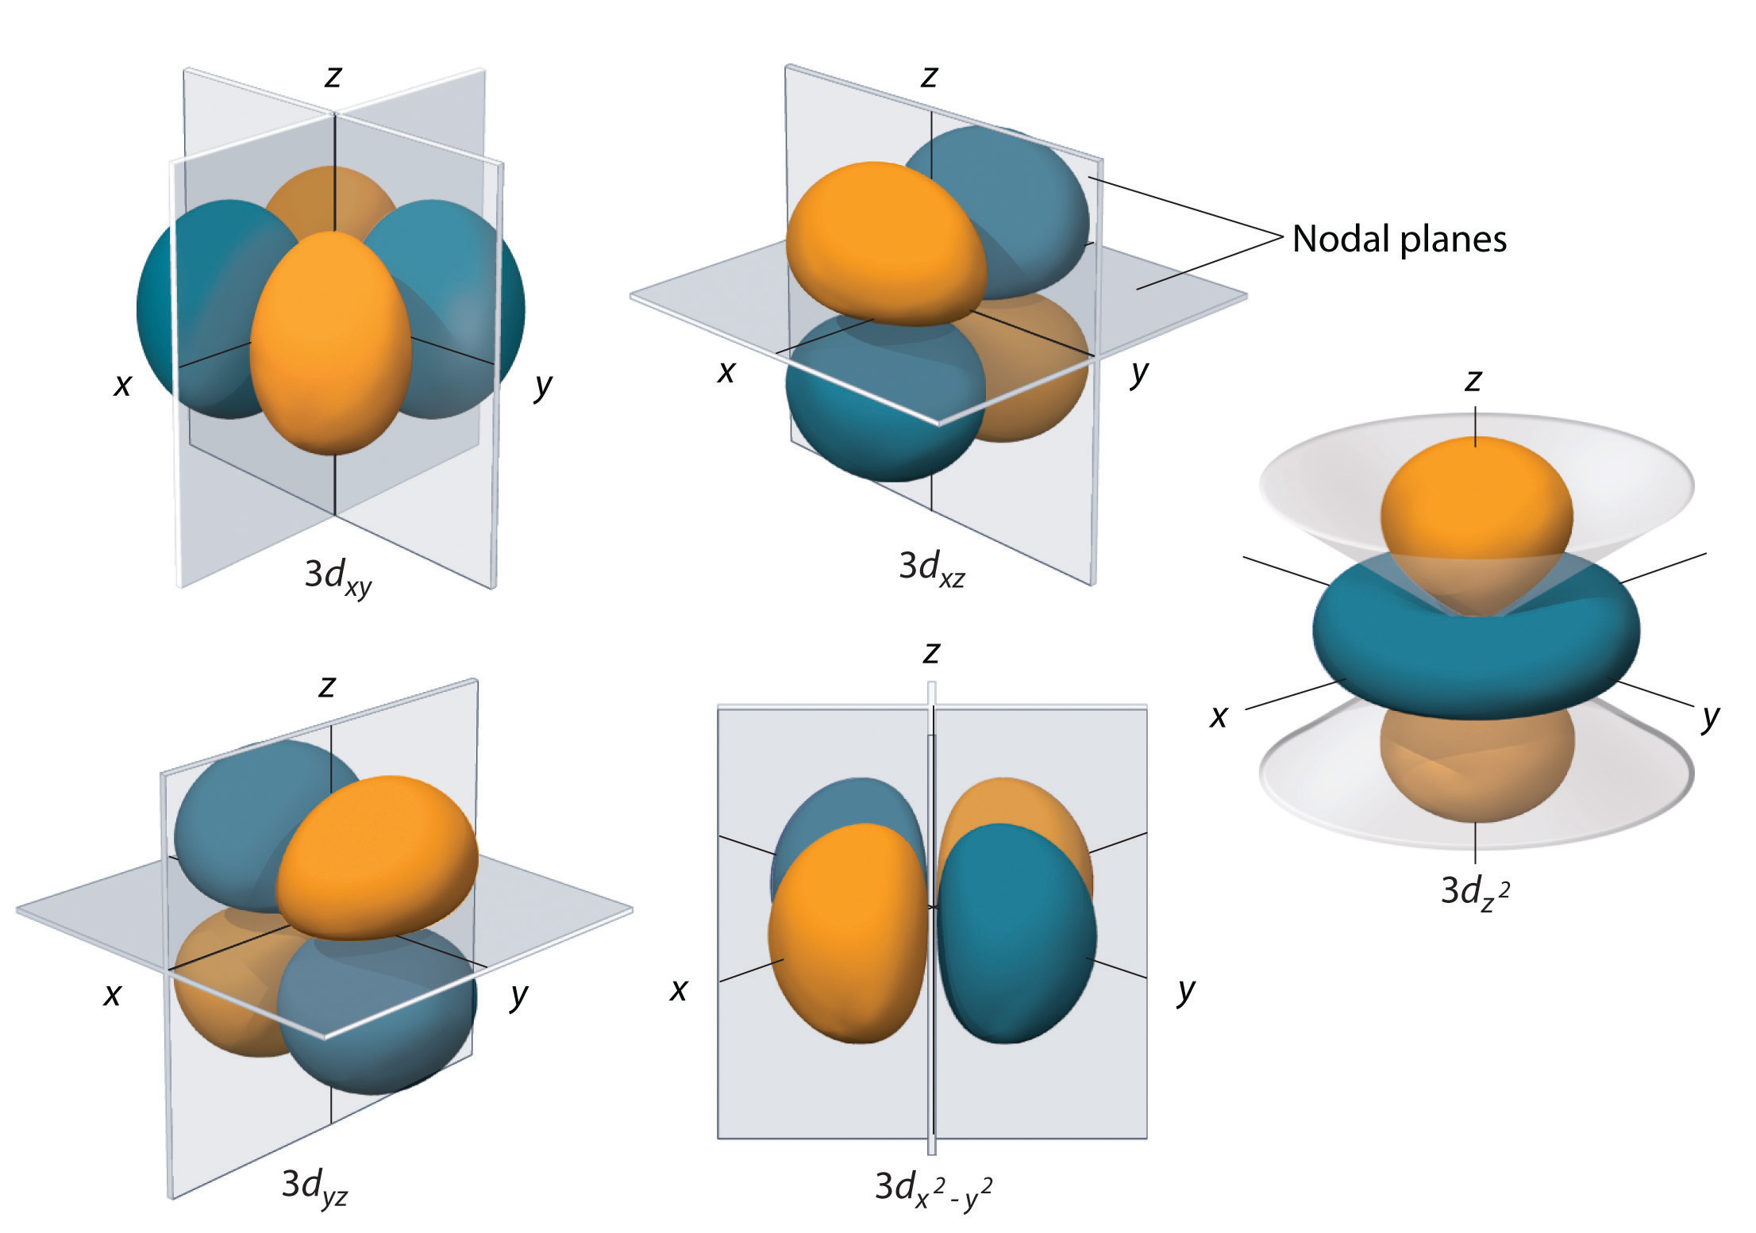
Magnetic Quantum
Number (m_{l})
$0, ±1, ±2 … ±$ l
Orientation of the orbital
# of orbitals
s = 1 orbital
p = 3 orbitals
d = 5 orbitals
f = 7 orbitals
Use subscripts (we will ignore)
Allowed Values
l = 0 m_{l} = 0 ∴ 1 orbital
l = 1 m_{l} = -1, 0, 1 ∴ 3 orbitals
l = 2 m_{l} = -2, -1, 0, 1, 2 ∴ 5 orbitals
l = 0 m_{l} = 0, ± 1, ± 2, ± 3 therefore 7 orbitals

Slide 6
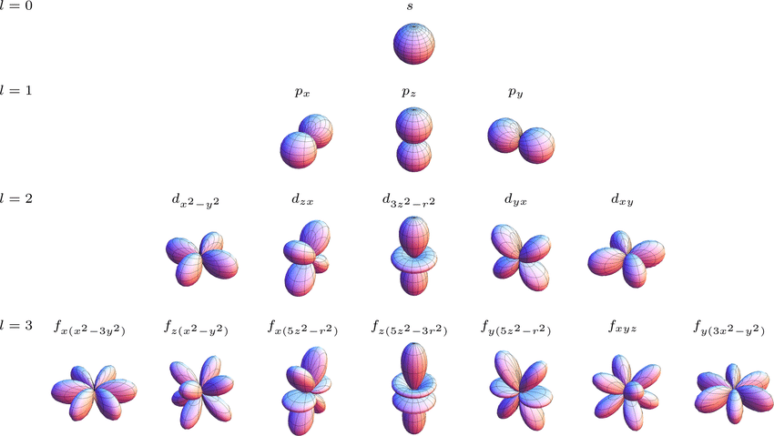

Slide 7
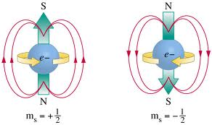
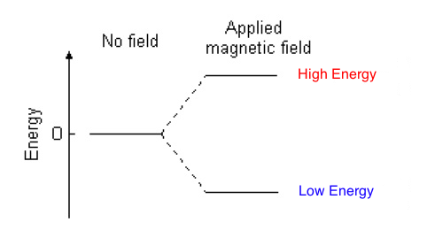
Electron Spin Quantum
Number (m_{s})
M_{s} = $±1/2$
Orbitals can hold 2 electrons $∴$
s = 2 electrons
p = 6 electrons
d = 10 electrons
f = 14 electrons
Leads to techniques like:
NMR – Nuclear Magnetic Resonance
MIR – Magnetic Imaging Resonance

Slide 8
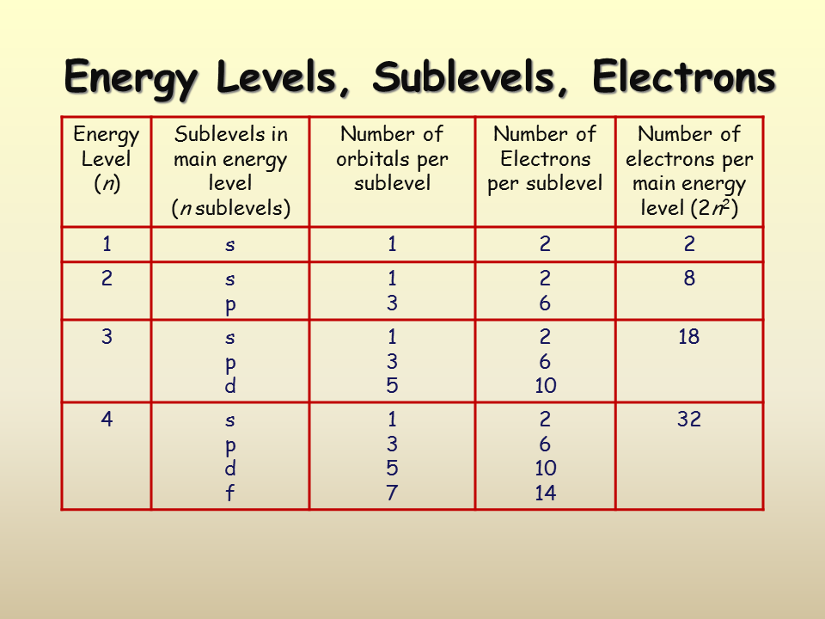

Slide 9
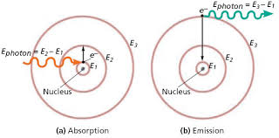
Revisiting Line Spectra
Explains line spectrum because only certain wavelengths (colors) of light can be absorbed or emitted because only certain orbitals are allowed.

Slide 10
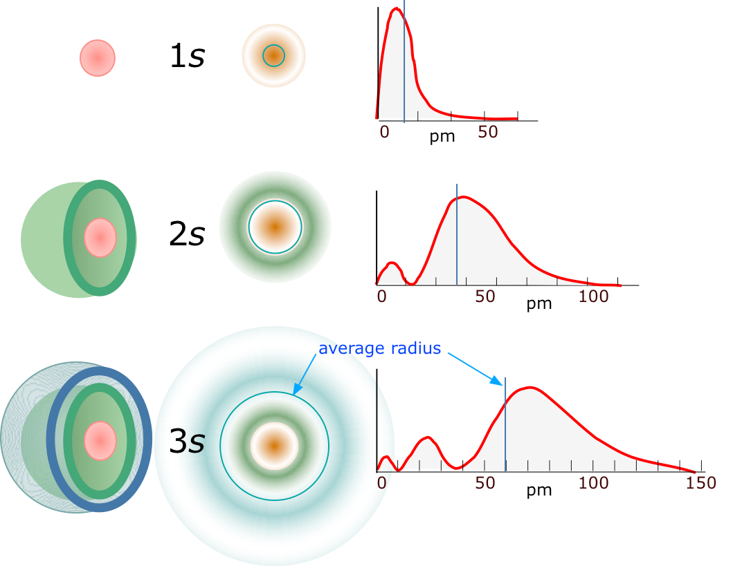
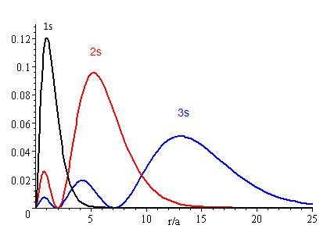
Schrodinger Equation and Radial Distribution Function
Radial Node – location with zero probability of finding an electron (# nodes = n - l - 1)

Slide 11
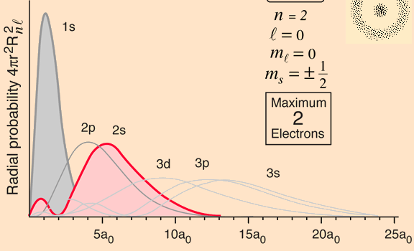
Schrodinger Equation and Radial Distribution Function

Slide 12
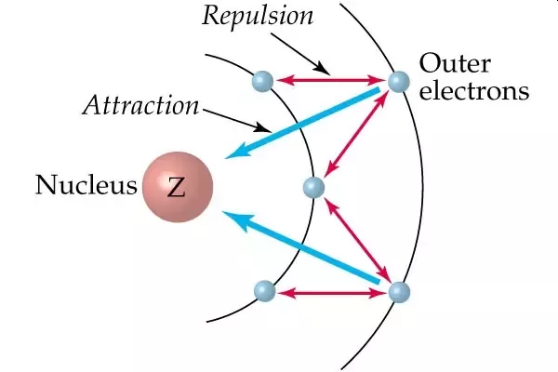
Energy Level Diagrams
$$E=k\frac{q_{1}q_{2}}{r}$$
Coulombs Law
Electron Shielding (electrons in inner orbitals shield outer orbitals)
Electron Penetration + Shape of the orbital effects energy levels (s > p > d > f)
Electron Shielding
Z_{eff} = Z_{actual} - ES
Effective p⁺/e-
Attraction
=
p⁺/e-
attraction
-
e⁻/e⁻
repulsion

Slide 13
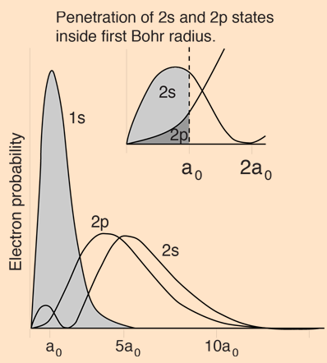
Electron Penetration
2s and 2p orbital are degenerate
Electron Penetration + Shape of the orbital effects energy levels (s > p > d > f)
2s electron spends some time closer to the nucleus than a 2p electron therefore its energy is lower than expected

Slide 14
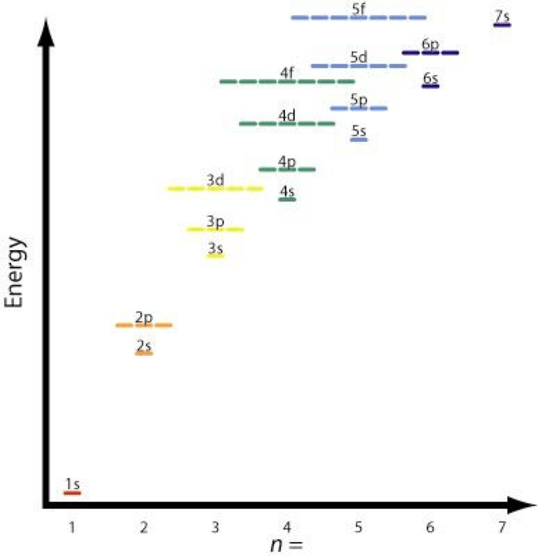
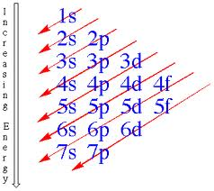
Energy Level Diagrams
1s², 2s², 2p⁶, 3s², 3p⁶, 4s², 3d¹⁰, 4p⁶, 5s², 4d¹⁰, 5p⁶, 6s², 4f¹⁴, 5d¹⁰, 6p⁶, 7s², 5f¹⁴, 6d¹⁰, 7p⁶,

Slide 15
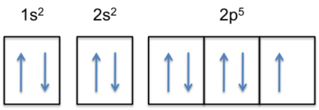
Electron Configurations
Too difficult to draw the diagram a lot
Use several abbreviated methods
1s²
# electrons in orbital
*Ignore Magnetic QN (m_{l})
*Ignore Electron Spin QN (m_{s})
Principle QN (n)
Distance from Nucleus
Angular Momentum QN (l)
Shape of Orbital
Box Diagrams
*Include Magnetic QN (m_{l})
*Include Electron Spin QN (m_{s})

Slide 16
Aufbau Principle's (rules for filling orbitals)
Rule 1 (*Pauli Exclusion Principle) – orbitals hold two electrons with opposite spins
(opposites attract)
Rule 2 (no special name) – fill orbitals from lowest energy level to highest energy level
(electrons are lazy!)
Rule 3 (Hund’s Rule) – each suborbital is occupied by a single electron before adding a second
(electrons don’t pair up until they have to)
*Pauli Exclusion Principle – no two electrons can have the same 4 Quantum Numbers

Slide 17
Don’t lose sight
of the “Goal”
Electron Shell Configurations for Several Elements
Li
Be
B
N

Slide 18
C
O
Fe
Au

Slide 19
Energy Levels of Electrons
Even easier, use the PT!
d’s lag by 1
f’s lag by 2
Remember the PT really looks like this

Slide 20
Exceptions to the Rule…
As energy levels become closer together (4s/3d orbitals) small changes in which orbitals are filled can effect the energy levels
½ filled orbitals and completely filled orbitals are “extra” stable
Example: Chromium
Theoretical: [Ar] 4s² 3d⁴
Experimental: [Ar] 4s¹ 3d⁵
*some easy to predict, some not so obvious

Slide 21
Mendeleev’s Periodic Table
QM Periodic Table
Rows arranged by mass
Columns arranged by similar P and C properties
Rows arranged by # protons/orbital
Columns by similar outer shell e⁻ configurations
s¹
s²
p¹
p²
etc
F: 1s²2s²2p⁵
Cl: 1s²2s²2p⁶3s²3p⁵
Li: 1s²2s¹
Na: 1s²2s²2p⁶3s¹

Slide 22
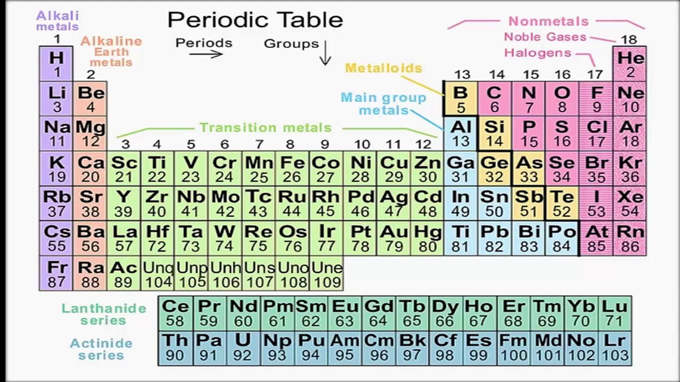
PT Nomenclature
Learn – Alkali metals (except H), Alkaline earth metals, Halogens, Noble Gasses
Main Group (s + p orbitals), Transition metals (d), Lanthanides and Actinides (f)

Slide 23
Valence Electrons
Electrons in the highest energy levels (s and p electrons)
Outer most electrons in an element responsible for chemical reactions
Loss, gain or sharing of valence electrons are responsible for formation of chemical bonds
Na: 1s²2s²2p⁶3s¹
1 Valence electron
You try it: Carbon
You try it: Which element has 6 valence electrons?

Slide 24
Review: Cations are positive because they lose electrons
Cations and Anions
Can explain common charges of ions using electron configurations
Goal = Noble Gas Configuration
Filled s/p orbitals (s²p⁶)
Octet Rule
Na
Na⁺¹ + e⁻¹
1s²2s²2p⁶3s¹
1s²2s²2p⁶
You try it: Aluminum
Common charges are on the CS but you should “know” them

Slide 25
Review: Anions are negative because they gain electrons
Cations and Anions
F + e⁻¹
F⁻¹
1s²2s²2p⁵
1s²2s²2p⁶
You try it: Nitrogen

Slide 26
Transition Metals
Can have multiple energetically favorable charges and therefore form variable charge cations
Tend to lose s electrons before d electrons
½ filled shells are “stable”
Fe
Fe⁺² + 2e⁻
[Ar] 4s²3d⁶
[Ar] 3d⁶
[Ar] 4s¹ 3d⁵
Fe
Fe⁺³ + 3e⁻
[Ar] 4s²3d⁶
[Ar] 3d⁵

Slide 27
Transition Metals
You try it: Copper (Cu)

