Slide 1
Chemistry 111
Chapter 3 a-c
Quantum Mechanics

Slide 2
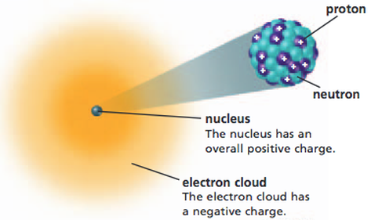
Goals
Appreciate the Scientific Process (success and flaws)
History of Light
7 Main Experiments/Models
Rutherford Model
Line Spectra
Bohr Model
Black Body Radiation/Planck
Photoelectric Effect/Einstein
DeBroglie Model
Quantum Mechanics/Schrodinger Equation
Fundamentals of Quantum Mechanics
4 Quantum Numbers
Shapes of orbitals
Energy levels of orbitals
Review – Chapter 2 (Rutherford Model)
Ernst Rutherford (1911)
James Chadwich (1932)
Don’t!
Memorize dates
Memorize trivia/flavor

Slide 3
Light (Particle or Wave)?
Sir Isaac Newton
(1642-1727)
Christiaan Hugens
(1629-1695)
Corpuscular Theory of Light
Classical Laws of Mechanics (3 Laws of Motion)
“Greatest and most influential scientist to ever live”
Einstein kept a framed picture of him
Wave Theory of Light
Invented Pendulum Clock,
Probability Theory
"Light is never known to follow crooked passages nor to bend into the shadow"

Slide 4
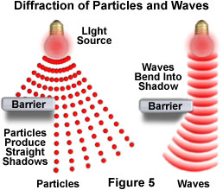
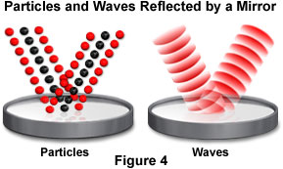
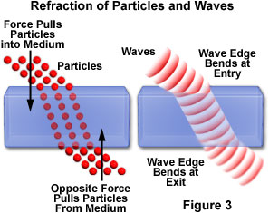
Is Light a Wave or a Particle?
“The great debate”

Slide 5
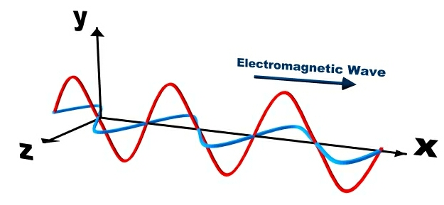
Electromagnetic Radiation
Electromagnetic Radiation – a type of energy embodied in oscillating electric and magnetic fields

Slide 6
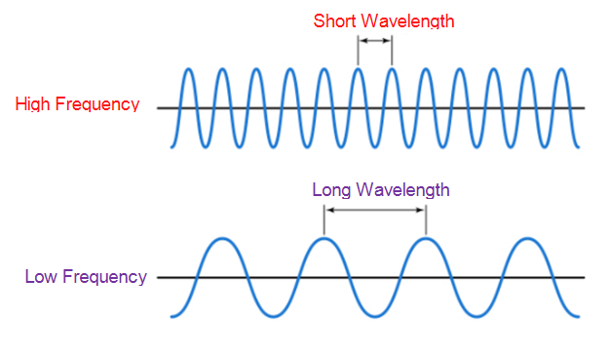
Describing Waves
Wavelength (λ) – distance between peaks or troughs
(meters, nm)
Frequency (ν) – number of waves/sec passing a point
(waves/sec, 1/s, s⁻¹, or Hz)
Amplitude (A) – distance baseline to peak
(N/m²) (*we don’t use this)
Mathematically
$$c= λν$$
c = speed of light (3.00x10⁸ m/s)
Inversely Proportional (IP)
Don’t memorize its on the cheat sheet!

Slide 7
Using equations to solve problems
$$c= λν$$
Example: What is the frequency of light given off by a halogen light with wavelength of 750. nm?

Slide 8
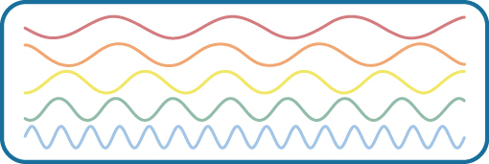

Slide 9
Constructive and Destructive Interference
OER: Figure 3.5 p 120

Slide 10
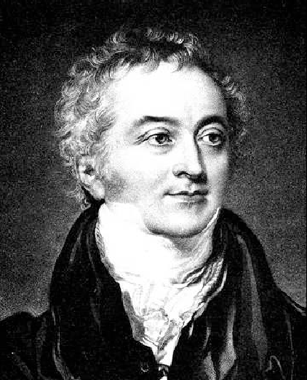
Light (Particle or Wave)?
Thomas Young (1773-1829)
Double Slit Experiment
“Conclusively proves light is a wave”
Constructive and Destructive Inference
Notable scientific contributions to vision, light,
solid mechanics, energy, physiology, language,
musical harmony, and Egyptology.
Interference patterns are due to the wave nature of light and constructive/destructive interference

Slide 11
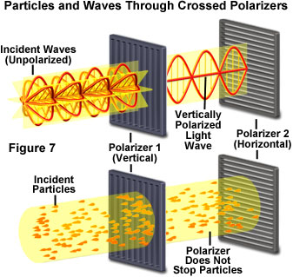
Light (Particle or Wave)
More proof!

Slide 12
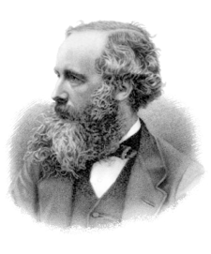
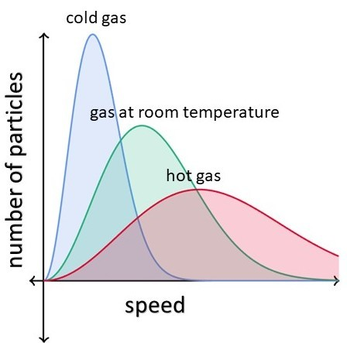
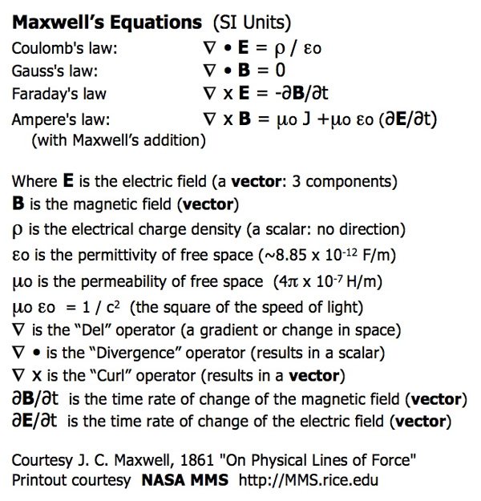
James Clerk Maxwell (1831-1879)
Set of equations to describe Electricity, Magnetism and Optics as a wave.
Kinetic Theory of Gases (Maxwell-Boltzmann Distribution)
3rd Greatest Scientist of All Time

Slide 13
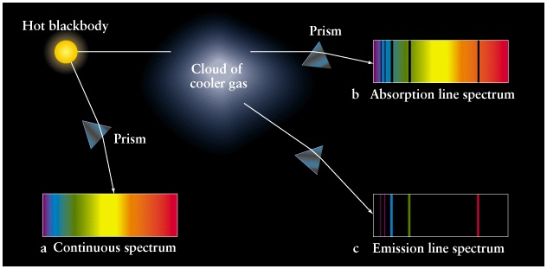
Line Spectra of the Elements
Romans – Prisms
Newton – Prisms + White light
Joseph von Fraunhofer - Spectrophotometer/Sun
Angstrom – measured H₂
+ countless others
When a metal atom is heated, it absorbs energy and the electrons jump to higher energy levels.
When the electrons return to lower levels, they emit this energy in packets of specific energies.

Slide 14
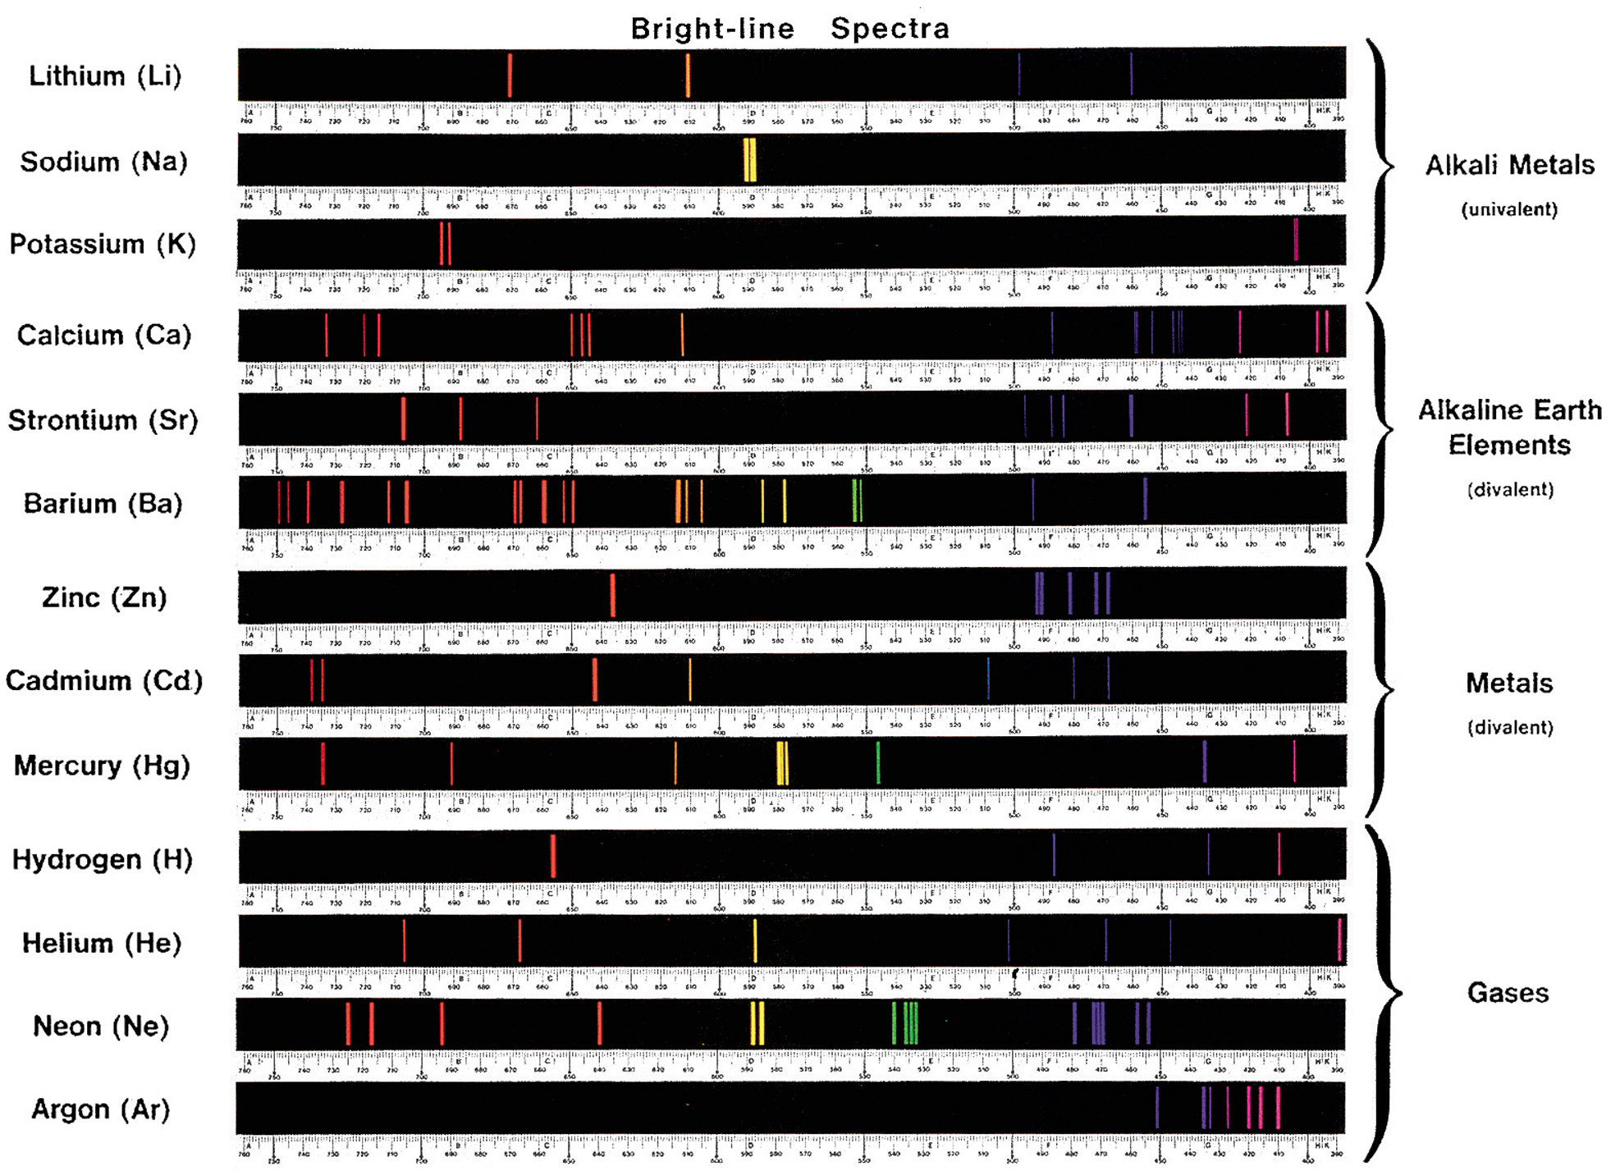

Slide 15
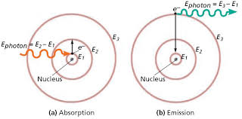
How Line Spectra Work
Excited State
Ground State
Incoming light energy is absorbed as the electron moves from a low energy to high energy (close orbital to larger orbital) from the spectrum leaving black spaces at specific energy levels.
Energy is emitted as electrons fall from high energy to low energy level (far orbital to close orbital), resulting only in light of specific energy being emitted.

Slide 16
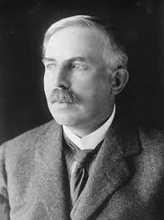
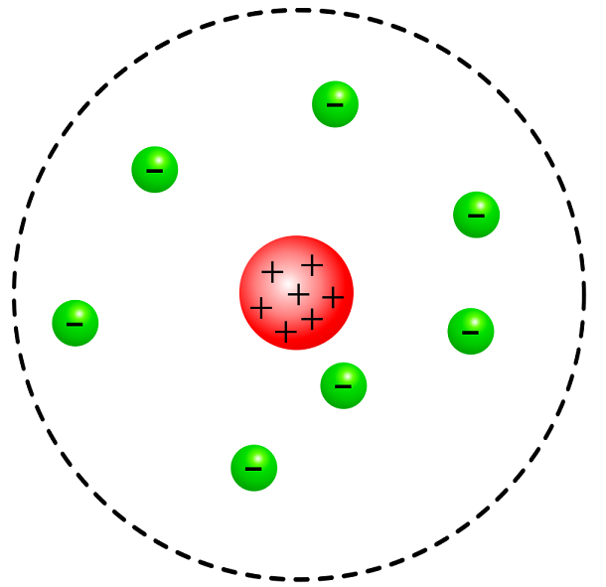
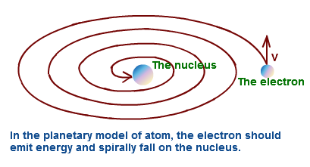
Failure of Rutherford Model
1) Fails to explain line spectra
2) If electrons orbit nucleolus they would lose energy/emit light and spiral into the nucleus
Since electrons can be any distance from the nucleus then they should be able to absorb or emit any color of light leading to either:
All colors of light are absorbed (black spectrum)
All colors of light are emitted (rainbow spectrum)
This is the exact opposite of what is observed!

Slide 17
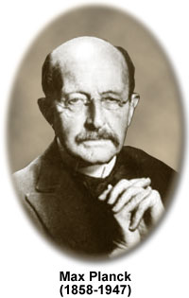
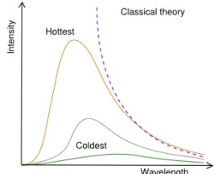
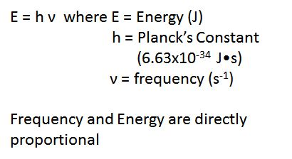
Maxwell Planck
Black Body Radiation
(1900)
Classical Model Fails (UV Catastrophe)
Energy (Light) is quantized
No reason why its quantized

Slide 18
Using equations to solve problems
$$c= λν$$
Example: What is the energy of 1 mol of photons emitted from a halogen light bulb with wavelength = 750. nm in units of kJ/mol.

Slide 19
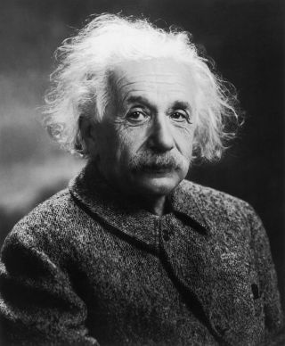
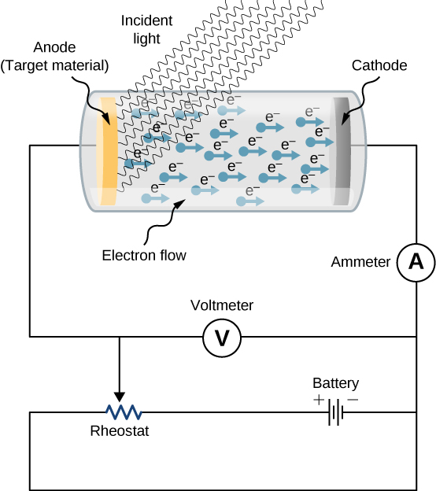
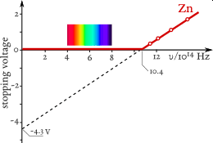
Albert Einstein
Photoelectric Effect
Classical Model Fails (Blue and Red light should eject same number of electrons if they have the same intensity (wavelength and frequency should have no effect)
Energy (Light) is quantized in order to explain why a threshold exists
No reason why its quantized
Classical theory predicts a linear response across the whole spectrum of light, instead a step function is observed

Slide 20
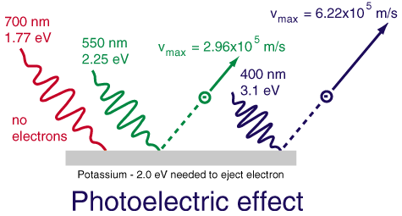
Albert Einstein
Photoelectric Effect
If the energy is Quantized then light with long wavelength (low frequency) won’t have enough energy to eject electrons.
When the wavelength, frequency, energy is high enough then electrons will be ejected

Slide 21
Classical “Wave” Theory
Light transmits energy, ejects electrons
↑ Amplitude ↑ Kinetic Energy
↑ Frequency (Energy) ↑ Current
Experimentally
Light is a particle, minimum energy required
↑ Amplitude ↑ Current
↑ Frequency (Energy) ↑ Kinetic Energy
Analogy: “Glass window”
Ping Pong Balls (low frequency light)
will never break it no matter the number/intensity
Baseballs (high frequency light)
will always break it

Slide 22
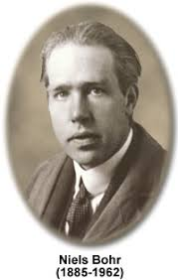
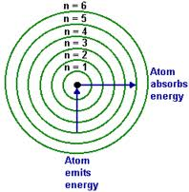
Bohr Model of the Atom
(1913)
Electrons are in quantized orbitals
Mathematical Model (next slide) Predicts line spectrum!
Can calculate Rydberg constant
Flaws (1) No reason its quantized
(2) Does not work for > 1 e
OR
Energy levels quantized
N = 1, 2, 3 …
Explains line spectrum because only certain wavelengths (colors) of light can be absorbed or emitted because only certain orbitals are allowed.
Variations depending on book
Johann Balmer 1885
Johannes Rydberg 1900
Neil's Bohr 1913

Slide 23
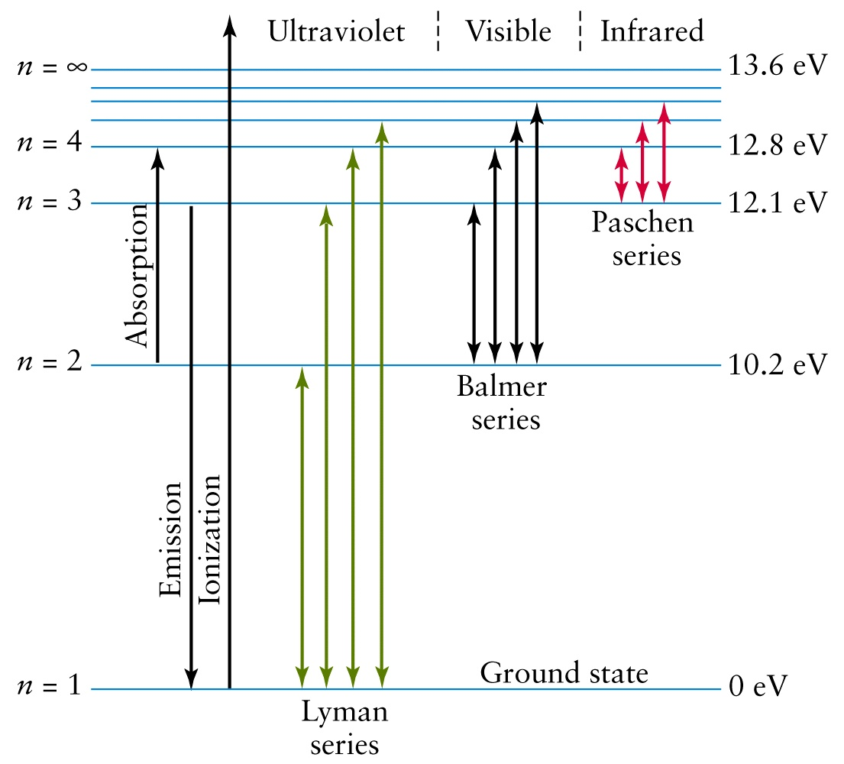
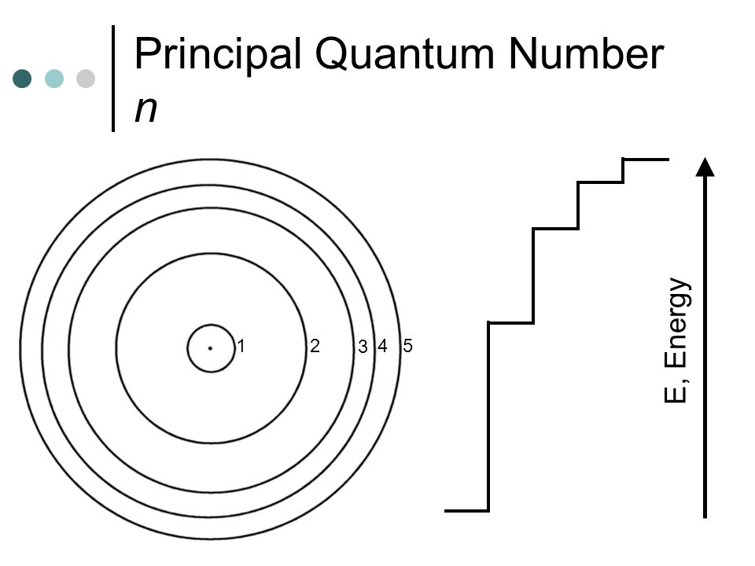
Line Spectra Energy Levels
Cheat Sheet
1 eV = 1.6021 × 10⁻¹⁹ J

Slide 24
Calculating Line Spectra
Rydberg Equation - Energy emitted as an electron changes energy levels
$$∆E=−2.18×{10}^{−18} J \left(\frac{1}{n_{f}^{2}} −\frac{1}{n_{i}^{2}}\right)$$
E = Energy (J)
n = orbital
“Only works for H”
Combine with Planck Equation:
Combine with wave equation:
$$ν=\frac{c}{λ}$$
c = speed of light (3.00x10⁸ m/s)
Inversely Proportional (IP)
$$ν=\frac{E}{h}$$
$λ$ = $\frac{hc}{E}$

Slide 25
Example: Calculate the energy/frequency/wavelength (nm) when an electron in
hydrogen transitions from the n = 4 level to the n= 3 level. (OER Ex 3.5)
Sign Conventions
- emit energy
+ absorb energy
$∆E=−2.18×{10}^{−18} J \left(\frac{1}{3_{f}^{2}} −\frac{1}{4_{i}^{2}}\right)$ = 1.06 x 10⁻¹⁹ J
$$ν=\frac{E}{h}=\frac{1.06 ×{10}^{−19}J}{1}×\frac{s}{6.626×{10}^{−34}J∙s}=1.60 ×{10}^{14}s^{−1}$$
$λ$ = $\frac{hc}{E}= \frac{6.626×{10}^{−34}J∙s}{1}×\frac{3.00×{10}^{8}m}{s}×\frac{1}{1.06 ×{10}^{−19}J}×\frac{1 nm}{1×{10}^{−9 }m}=1,880 nm$

Slide 26
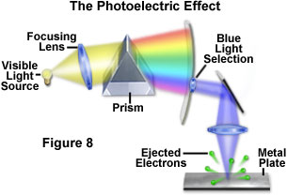
Back to the old debate ….
Is Light a Wave or a Particle?
Black Body Radiation
No
Yes
Wave-Particle Duality

Slide 27
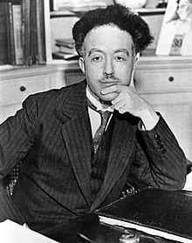
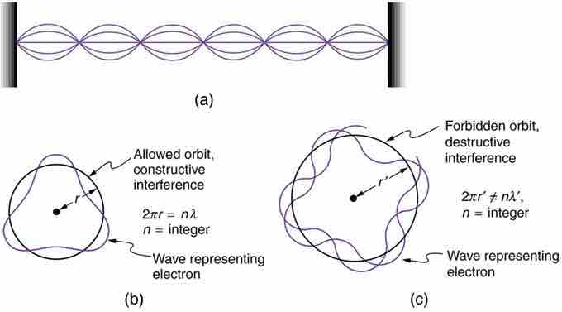
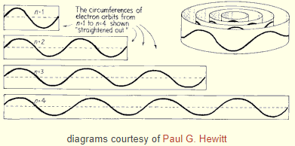
Louis De Broglie Model
“Wave Particle Duality”
If light can behave like a wave and a particle than an electron can behave like a particle and a wave.
Explained Quantization of Electron Orbitals therefore fixing Flaw (1).
Model still fails for > 1 e

Slide 28
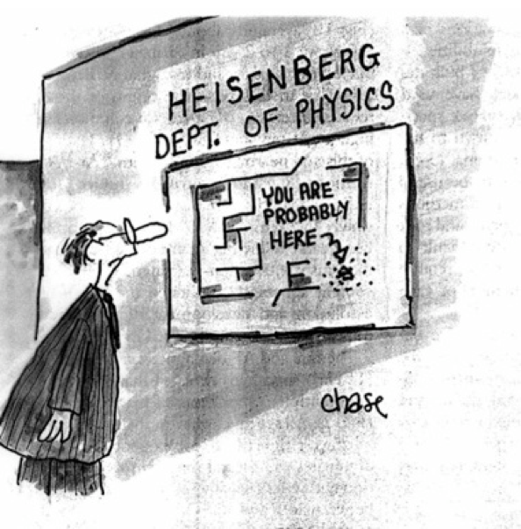
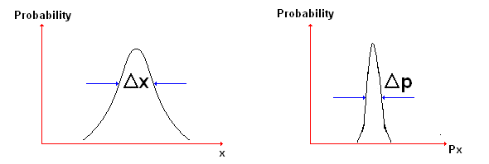
Heisenberg
Uncertainty Principle
(1926)
We can know the position or momentum accurately, but not both simultaneously
$$\left(∆x\right)\left(∆mv\right)≥ \frac{h}{4π}$$
Uncertainty in the position of the electron is larger than the size of the atom → orbitals can’t exist
No model
https://steemit.com/science/@arrjey/the-principle-of-uncertainty-and-the-double-slit-experiment

Slide 29
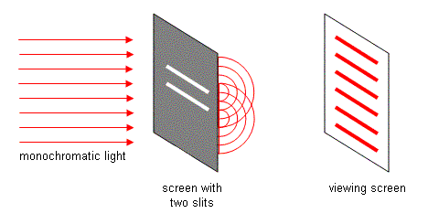
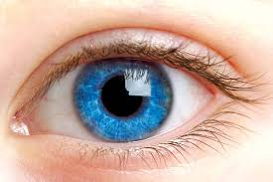
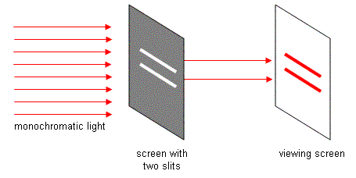
No Observation of Slit
Observation of Slit

Slide 30
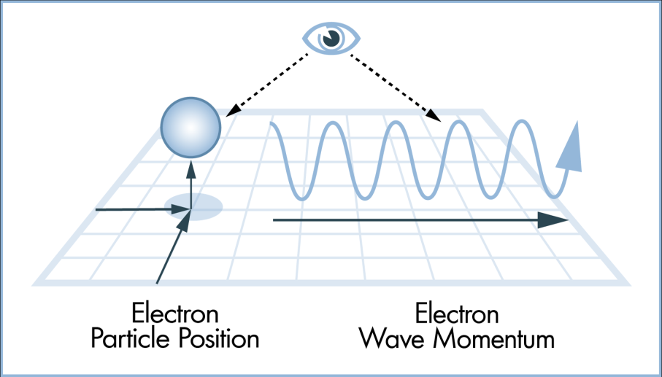
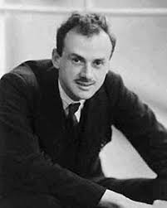
The uncertainty principle does not say we can’t know both momentum and position exactly.
It says by measuring the system we disturb it in such a way that we can’t measure both at the same time.
“There is a limit to the fineness of our powers of observation and the smallness of the accompanying disturbance – a limit which is inherent in the nature of things and can never be surpassed by improved technique or increased skill on the part of the observer.”
- Paul Dirac

Slide 31
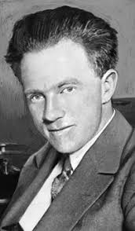
The “real” Heisenberg
Walter White
“Breaking Bad”

Slide 32
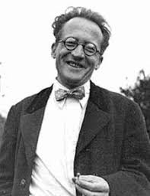
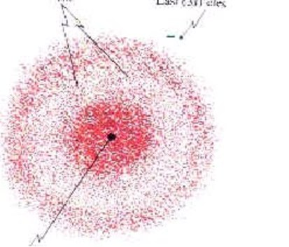
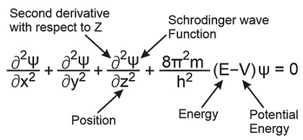
Schrodinger Equation
Statistical model using wave equations to describe the location of the electron.
$$Hφ=Eφ$$
Does not violate Heisenberg
4 Principle Quantum Numbers result
"Anyone who is not shocked by the quantum theory does not understand it." - Niels Bohr

Slide 33
Classical Mechanics
VS
Quantum Mechanics
Macroscopic Phenomenon
Wave or Particle
Continuous (all values allowed)
Nanoscopic Phenomenon
Wave and Particle
Quantized (only some values allowed)

Slide 34
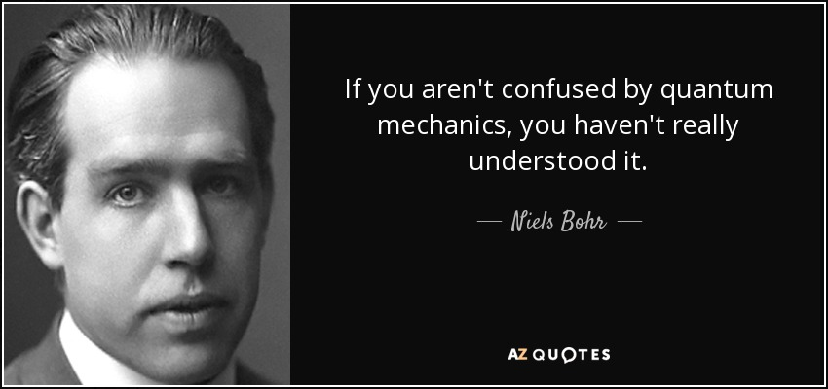
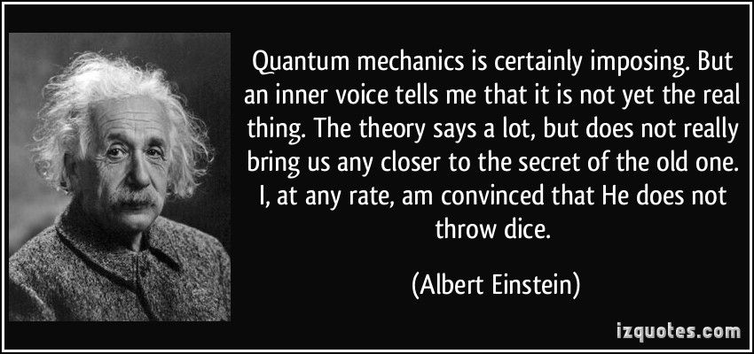
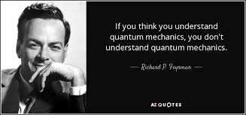

Slide 35
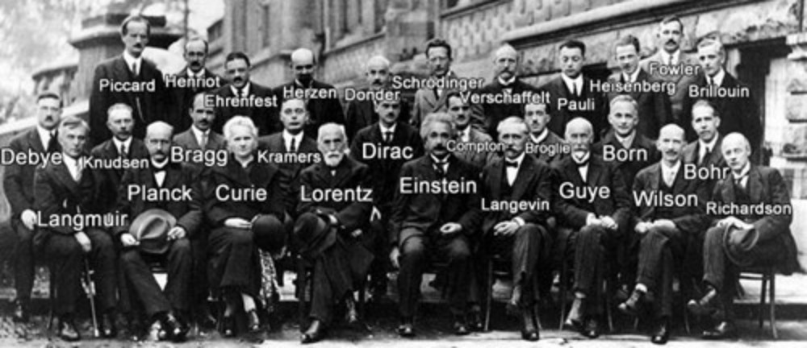

Slide 36
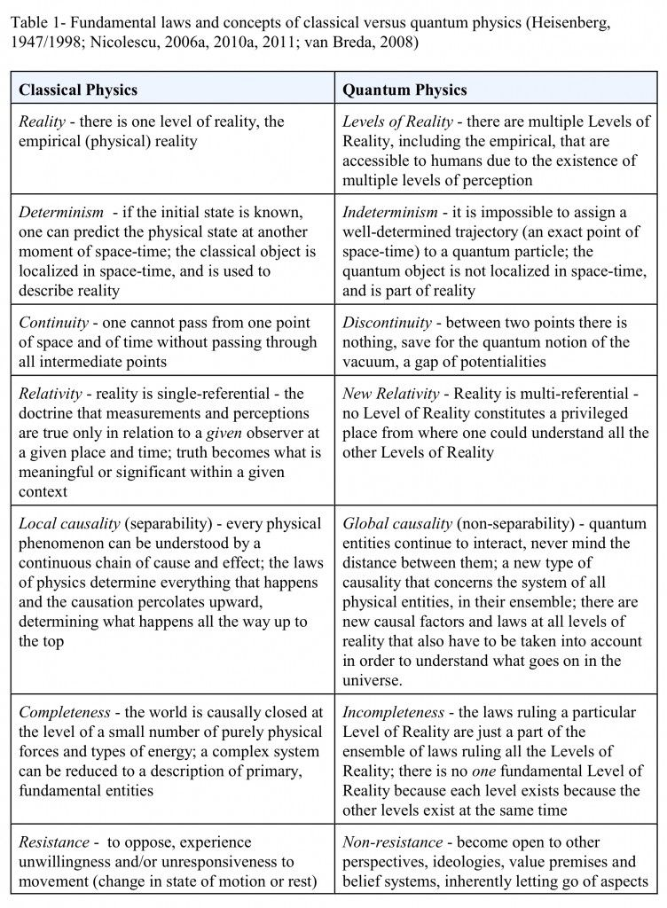
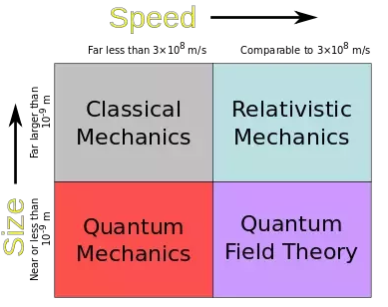
I put this here because I find it interesting, please feel free to ignore it

Slide 37
Chemistry 111
Chapter 3 d
QM Nuts and Bolts

Slide 38
Principle Quantum
Number (n)
Distance from nucleus
Size of orbital
1,2,3 ….

Slide 39
Angular Momentum
Quantum Number (l)
Allowed Values
n = 1 then l = 0
n = 2 then l = 0 and 1
n = 3 then l = 0, 1 and 2
Etc…
3D - shape of an orbital
0, 1, 2, 3 … (n-1)
4 shapes
Use letters since numbers are used for n
l =0
l =1
l =2
l =3

Slide 40
Magnetic Quantum
Number (m_{l})
$0, ±1, ±2 … ±$ l
Orientation of the orbital
# of orbitals
s = 1 orbital
p = 3 orbitals
d = 5 orbitals
f = 7 orbitals
Use subscripts (we will ignore)
Allowed Values
l = 0 m_{l} = 0 ∴ 1 orbital
l = 1 m_{l} = -1, 0, 1 ∴ 3 orbitals
l = 2 m_{l} = -2, -1, 0, 1, 2 ∴ 5 orbitals
l = 0 m_{l} = 0, ± 1, ± 2, ± 3 therefore 7 orbitals

Slide 42
Electron Spin Quantum
Number (m_{s})
M_{s} = $±1/2$
Orbitals can hold 2 electrons $∴$
s = 2 electrons
p = 6 electrons
d = 10 electrons
f = 14 electrons
Leads to techniques like:
NMR – Nuclear Magnetic Resonance
MIR – Magnetic Imaging Resonance

Slide 44
Revisiting Line Spectra
Explains line spectrum because only certain wavelengths (colors) of light can be absorbed or emitted because only certain orbitals are allowed.

Slide 45
Revisiting Line Spectra
Rydberg Equation - Energy emitted as an electron changes energy levels
$$∆E=−2.18×{10}^{−18} J \left(\frac{1}{n_{f}^{2}} −\frac{1}{n_{i}^{2}}\right)$$
E = Energy (J)
n = orbital
“Only works for H”
Combine with Planck Equation:
Combine with wave equation:
$$ν=\frac{c}{λ}$$
c = speed of light (3.00x10⁸ m/s)
Inversely Proportional (IP)
$$ν=\frac{E}{h}$$
$λ$ = $\frac{hc}{E}$

Slide 46
Example: Calculate the energy/frequency/wavelength (nm) when an electron in
hydrogen transitions from the n = 4 level to the n= 3 level.
$∆E=−2.18×{10}^{−18} J \left(\frac{1}{3_{f}^{2}} −\frac{1}{4_{i}^{2}}\right)$ = 1.06 x 10⁻¹⁹ J
$$ν=\frac{E}{h}=\frac{1.06 ×{10}^{−19}J}{1}×\frac{s}{6.626×{10}^{−34}J∙s}=1.60 ×{10}^{14}s^{−1}$$
$λ$ = $\frac{hc}{E}= \frac{6.626×{10}^{−34}J∙s}{1}×\frac{3.00×{10}^{8}m}{s}×\frac{1}{1.06 ×{10}^{−19}J}×\frac{1 nm}{1×{10}^{−9 }m}=1,880 nm$

Slide 47
Schrodinger Equation and Radial Distribution Function

