Slide 1
CHE 111 Fall 2020
Lecture 2c – Miscellaneous
Overview/Topics
“Domains” of Chemistry (1.1)
States of Matter (1.2)
E, C, M (1.2)
Physical and Chemical Properties (1.3)
Intensive/Extensive (1.3)
Chemical Formulas (2.4)
Chemical Structures (2.4)
The mole (2.4)
Skills to Master
Differentiate between s/l/g
Differentiate between E/C/M
Differentiate between P/C properties
Identify Intensive and Extensive properties
Chemical Structures
g ↔Mol ↔ atoms problems
Read
OER 1.1-1.3 and 2.4
Additional Useful Links
Extra practice on www.chemhaven.org/che111

Slide 2
Can you:
Identify and/or Draw a Saturated or Unsaturated FA?
Structure -> Physical Properties -> Biological Property
Cheat Sheet: You will have Table 28.1 on all exams

Slide 3
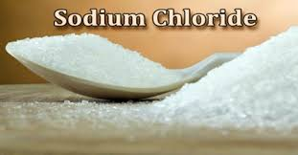
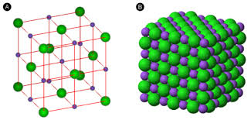
Domains of Chemistry
Macroscopic – large enough to be sensed directly by human sight or touch.
Microscopic – to small to be sensed directly we must use our “imagination”.
Symbolic Domain – use of specialized language to represent macro/micro domains include
chemical symbols, formulas, equations, graphs, drawing calculations
NaCl (s)

Slide 4
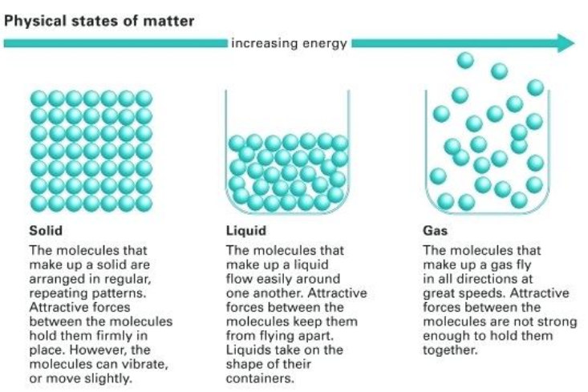

Slide 6
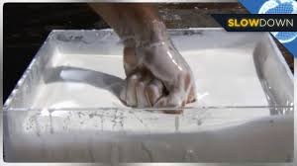
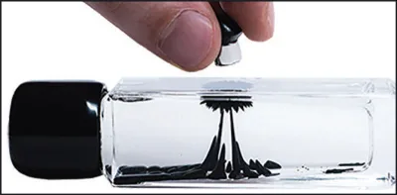
Other States of Matter
Ferro fluids
https://www.youtube.com/watch?v=L8cCvAITGWM
Non Newtonian Fluids
https://www.youtube.com/watch?v=G1Op_1yG6lQ

Slide 8
Pure Substance: | matter with a definite fixed composition chemically mixed together, that can not be physically separated and has the same physical and chemical properties.
Mixture: | matter containing two or more substances physically mixed together with variable composition and variable physical and chemical properties.
 | Pure Substance | Mixture
Seperable | Not Physically Separable | Physical
Composition | Fixed | Variable
P and C Properties | Same | Different

Slide 9
Element: | Singular (fundamental), can’t be broken down. (Nuclear Chemistry)
Compound: | Two or more elements chemically combined (Ionic or Molecular)
 | Element | Compound
Seperability | Not | Chemically
Composition | Fixed | Fixed
Number | Singular | 2 or More

Slide 10
Homogenous:
Heterogenous:
Uniform in appearance (no phase boundaries) and same properties throughout.
(1 phase)
Not Uniform in appearance (visible phase boundaries) and different properties throughout (2 phases)

Slide 11
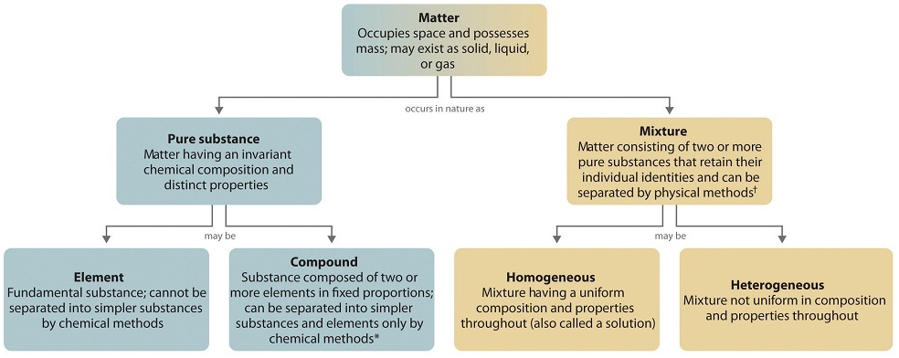
NOT Physically Separable
Physically Separable
Fixed Composition
Variable Composition
NOT Chemically Separable
Chemically Separable
Singular
Two or More
Separable by
Nuclear Reactions
Uniform Appearance
Same Properties Throughout
No Phase Boundary
NOT Uniform Appearance
Different Properties
Phase Boundary

Slide 12
Chemical Properties
Physical Properties
The change of one type of matter to another
Characteristic of matter not associated with a change in its chemical composition
Flammability, Toxicity, Acidity, Chemical Reactivity
Density, color, hardness, melting/boiling point and electrical conductivity
Physical Change
Chemical Change
Change in state of or property without any change in its chemical structure
Change produces a new type of matter (different structure)
Melting/Freezing/Evaporation/Condensation, Dissolving, Magnetization
Rust, Combustion, Cooking, Digesting, Rotting
*Nondestructive and Reversible
*Destructive and Irreversible

Slide 13
Extensive Properties
Intensive Properties
Depends on the amount of matter present
Independent on the amount of matter present
Mass, Volume, Heat/Energy
Density, Temperature
*Preferred types of measurements to make

Slide 14
Chemical Formulas
Molecular Formula – number and type of in a molecule
Structural Formula – number and type of in a molecule + how they are connected
Ball and Stick Model – number and type of in a molecule + how they are connected + shape
Space-filling – number and type of in a molecule + how they are connected + shape + volume

Slide 15
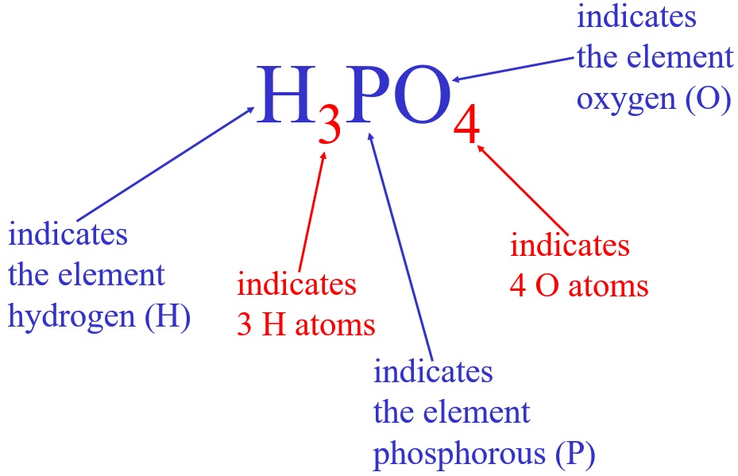
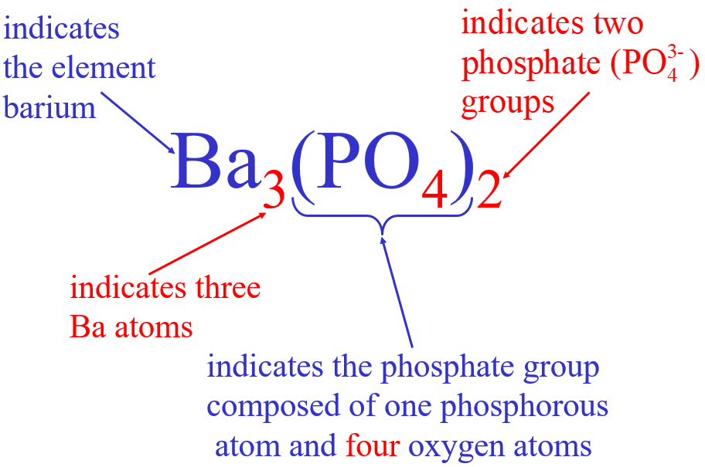
Chemical Formulas
H₂ vs 2 H
Chemical Formulas
Symbols indicate E present
Subscripts = number of atoms
( ) = groups of atoms
# in front = # of molecules

Slide 16
Empirical Formula
-type of atoms + simplest whole
number ratio of atoms
-Ionic Compounds (NaCl)
Molecular Formula
- number and type of in a molecule
- Molecular Compounds (H₂O)
Example: Hexane
Molecular Formula - C₆H₁₂
Empirical Formula – CH₂

Slide 17
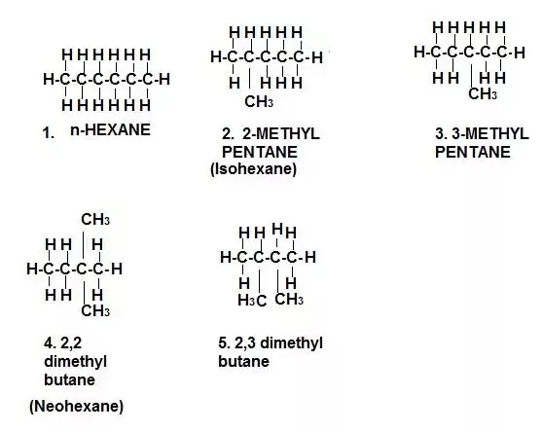
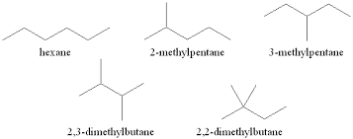
Structural Isomers
- Compounds with same formula but different structures
- Different P and C properties
- Organic Chemistry
Example: C₆H₁₂

Slide 18
Spatial Isomers
- Same Formula, Same Structure, Different Spatial Orientation
- Cis/Trans (R/S)
- Optical
- Organic Chemistry

