Slide 1
CHE 111 Fall 2020
Lecture 2b – Atoms, Cation, Anions and Isotopes
Overview/Topics
General properties of e/p/n
Charge
Relative Mass
Location
Importance in chemistry
Understand the formation of cations and anions
Isotopes and Isotope Notation
Atomic Mass/Weighted Averages
Skills to Master
Role of p/n/e in chemistry
Write a reaction showing the formation of:
Cations
Anions
Isotope Notation
Determine the number of n/p/e
Write the correct isotope notation given n/p/e
Solve for average atomic mass
Read
OER – Chapter 2.1-2.3
Additional Useful Links
www.chemhaven.org/che111

Slide 2
Chapter 2b
Goals
General properties of e/p/n
Charge
Relative Mass
Location
Importance in chemistry
Isotopes and Isotope Notation
Atomic Mass/Weighted Averages

Slide 3
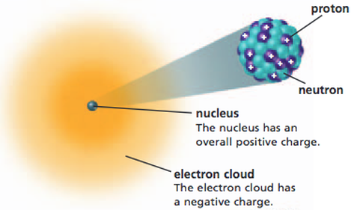
General Properties
Particle | Symbol | Relative Charge | Relative Mass | Location | Important
Electron | e or e⁻ | -1 | 0.0005 | Cloud | Determine Chemistry - Bonding/Molecules/Reactions
Proton | p or p⁺ | +1 | 1 | Nucleus | Determine Element/Properties
Neutron | n or n⁰ | 0 | 1 | Nucleus | Isotopes/little effect on chemistry Big effect nuclear chemistry
Don’t Remember these:
Particle | Actual Charge | Actual Mass
Electron | -1.67 x 10¹⁶ C | 9.11 x 10⁻²⁸ g
Proton | 1.67 x 10¹⁶ C | 1.673 x 10⁻²⁴ g
Neutron | 0 | 1.675 x 10⁻²⁴ g

Slide 4
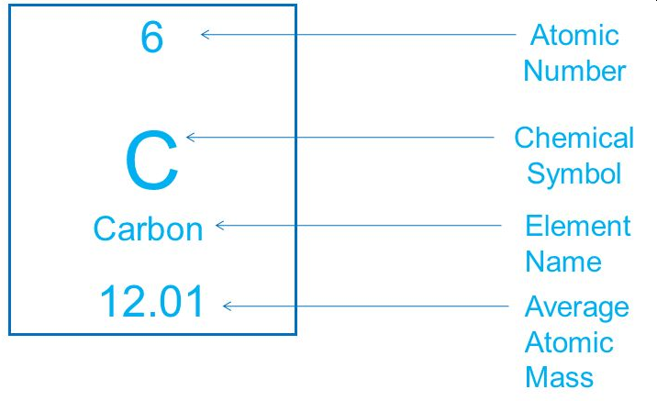
Elements and the Periodic Table
-Building blocks for “Everything”
Abbreviated by 1 or 2 letter symbols
# protons is given by number on top
# neutrons (not given)
# electrons = #protons (neutral atom)

Slide 5
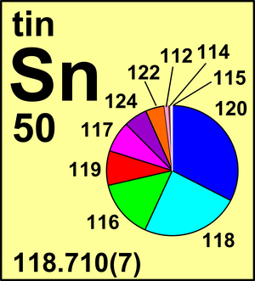
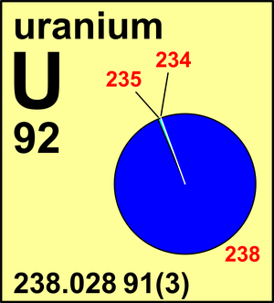
Isotopes:
- same number protons
- different number of neutrons
Isotope Notation
Mass Number = #p + #n
Charge = #p- #e
118
X
+2
A
X
e
50
Z
Atomic Number = #p

Slide 6
You Try It!
23
Na
+1
Protons: _____
Neutron: _____
Electrons: _____
Protons: 13
Neutron: 13
Electrons: 10
11
34
-2
Protons: _____
Neutron: _____
Electrons: _____
S
Protons: 35
Neutron: 40
Electrons: 36

Slide 7
26
Al
+3
23
Na
+1
Protons: 13
Neutron: 13
Electrons: 10
Protons: 11
Neutron: 12
Electrons: 10
13
11
75
Br
-1
34
S
-2
Protons: 35
Neutron: 40
Electrons: 36
Protons: 16
Neutron: 18
Electrons: 18
35

Slide 8
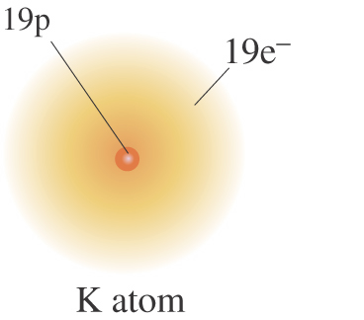
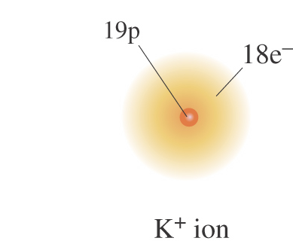
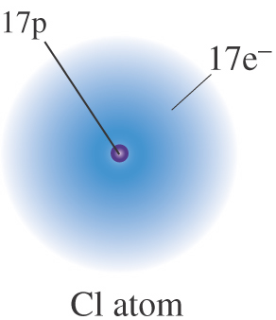
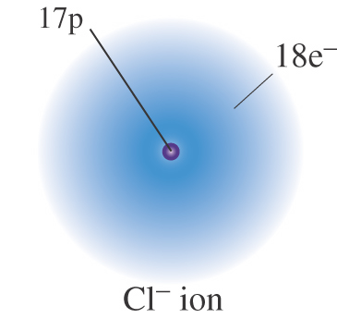
Formation of Ions:
Neutral Atom: # protons = # electrons
Cations - #p > #e (lose an electron)
Anions- #p < #e (gain an electron)
+ e⁻
e⁻ +
K → K⁺¹ + e⁻¹
Cl + e⁻¹ → Cl⁻¹

Slide 9
You Try It!
Example: Write the reaction showing a neural Aluminum atom losing 3 electrons to form an Aluminum Cation
Example: Write the reaction the formation of Nitrogen Anion which has gained 3 electrons.

Slide 10
Example: Write the reaction showing a neural Aluminum atom losing 3 electrons to form an Aluminum Cation
Al → Al⁺³ + 3 e⁻¹
Example: Write the reaction the formation of Nitrogen Anion which has gained 3 electrons.
N + 3 e⁻¹ → N⁻³

Slide 11
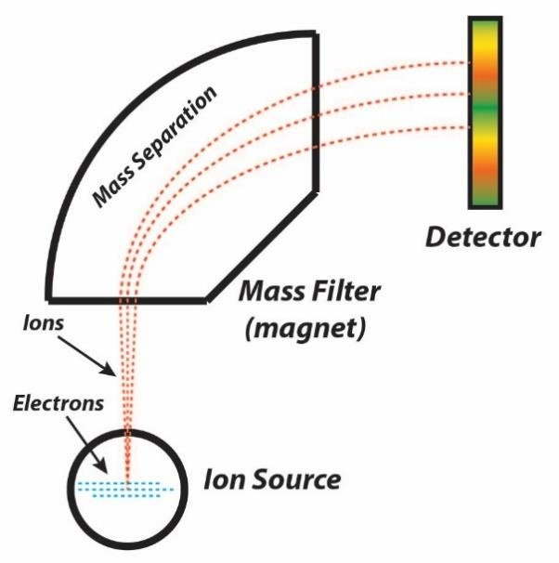
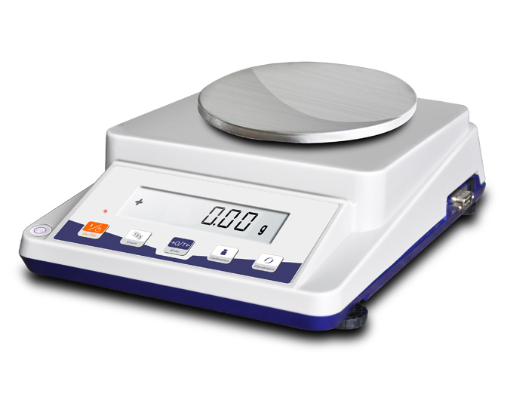
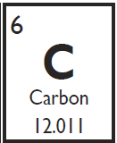
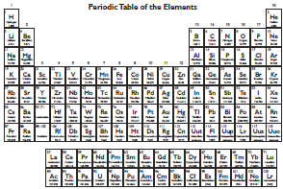
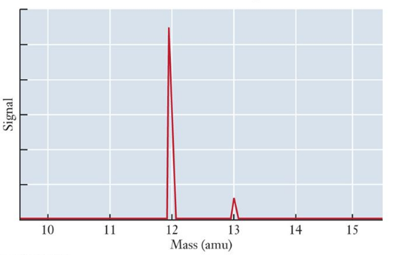
Atomic Mass of Atoms:
1 amu = 1/12 mass of ¹²C
1 H atom = 1.67 x 10⁻²⁴ g
Mass Spectrometer

Slide 12
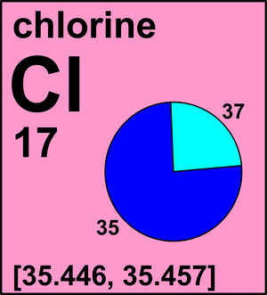
Sum of measurements
M₁ + M₂ + M₃
Average Atomic Mass:
Average =
=
# of measurements
3
Weighted
Average
=
(M₁) x (W₁) + (M₂)(W₂) …
Grade = (70%)x(Tests) + (20%)(Lab) + 10% (HW)

Slide 13
