Slide 1
CHE 111 Fall 2020
Lecture 2a – History of the Atom
Overview/Topics
Appreciate the Scientific Process (success and flaws)
6 Main Experiments
Lavoisier – Conservation of Mass
Daltons – Atomic Model
Faraday/Arrhenius – Discovery of Ions
Thomson – Discovery of electron (6 obs/con)
Goldstein – Discovery of Proton
Rutherford – Au foil Experiment (3 obs/con)
Models of the Atom
Thomson
Rutherford
Chadwick
Skills to Master
Know all 6 major experiments/theories
Fundamental Properties of Atoms
Isotope Notation
Don’t!
Memorize dates
Memorize trivia/flavor
Read
OER – Chapter 2.1-2.3
Additional Useful Links
www.chemhaven.org/che111

Slide 2
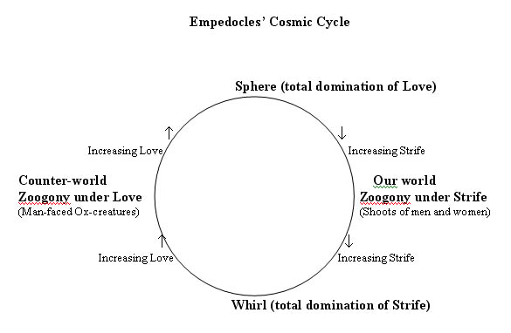
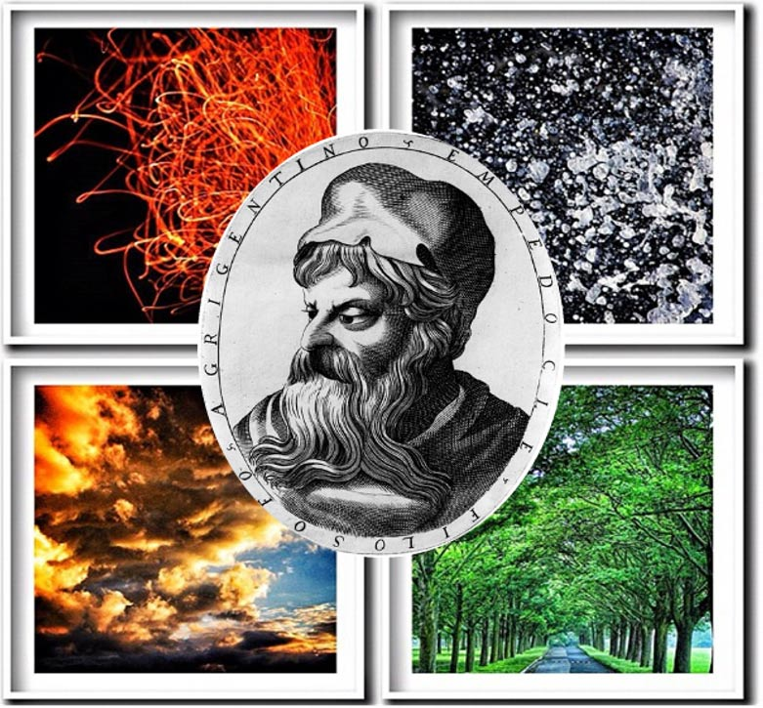
Empedocles
(490-430 BC)
All matter created by mixing 4 Elements like a painter mixes colors
Separation and mixing occur because of Love and Strife
“On Earth, many foreheads without necks sprang forth, and arms wandered unattached, bereft of shoulders, and eyes strayed about along, needing brows. Limbs wandered alone. But as the one divinity became more and more mingled with the other [Love and Strife], these things fell together by chance and many other things were produced … creatures with rolling gait and innumerable hands. … Creatures with a face and breast on both sides; oxen with the faces of men, and men with the faxed of oxen … creatures mixed male and female”

Slide 3
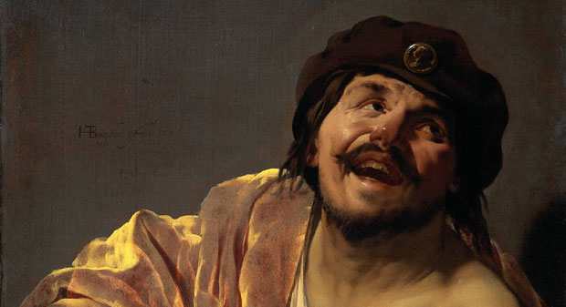
Democritus – “Laughing Philosopher”
(460-371 BC)
“Atomos” are indivisible (like prime numbers)
Can be any size/shape constantly moving, but can and get stuck together “Lego’s!”
“Thus, iron atoms are solid and strong with hooks that lock them into a solid; water atoms are smooth and slippery; salt atoms, because of their taste, are sharp and pointed; and air atoms are light and whirling, pervading all other materials”
Scientific Theory
“We cannot see atoms. So our senses must be an inaccurate way of understanding reality”
Of knowledge there are two forms, one legitimate, one bastard. To the bastard belong all this group: sight, hearing, smell, taste, touch. The other is legitimate and separate from that. Then, preferring the legitimate to the bastard, he continues: When the bastard can no longer see any smaller, or hear, or smell, or taste, or perceive by touch, but finer matters have to be examined, then comes the legitimate, since it has a finer organ of perception

Slide 4
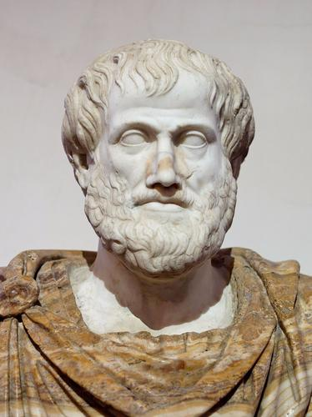
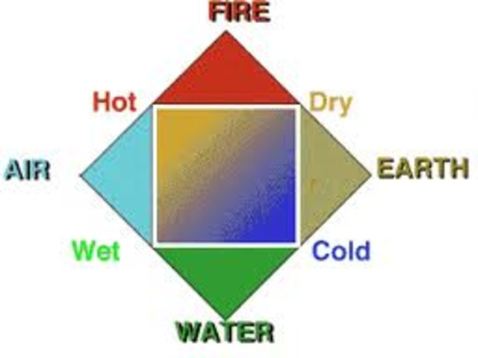
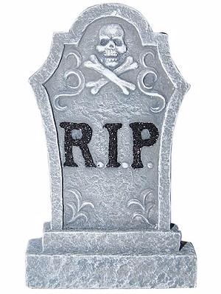
Aristotle
(384-322 BC)
No smallest part of matter
Air/Earth/Fire/Water
Famous Philosopher/Lousy Chemist

Slide 5
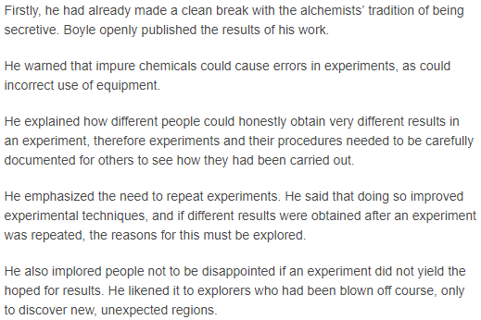
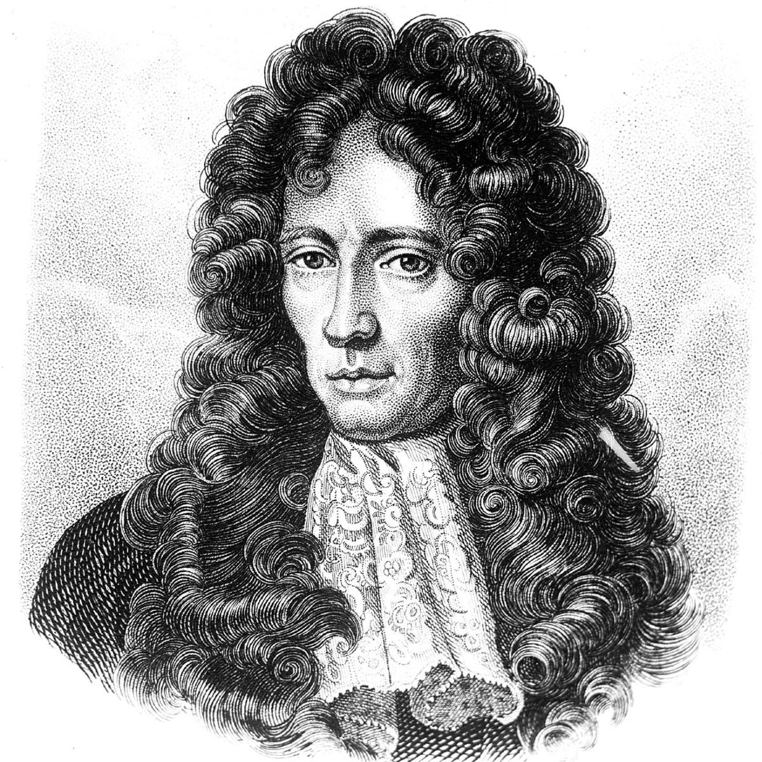
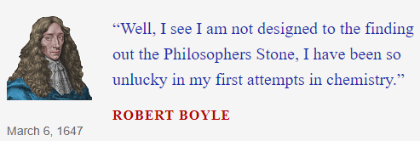
Robert Boyle “Father of Chemistry”
(1627-1691)
Championed “Scientific Method”
Corpuscular Hypothesis = Atoms
Defined E, C, M (Ch. 3)
Boyles Law (Ch. 12)
E
Simplest form of matter, can not be decomposed into other substances
C
2 or more E chemically combined together to form a new substance
Transmutation: Pb Au
M
2 or more E physically mixed together, no new substance is formed

Slide 6
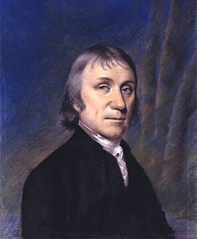
Joseph Priestley
(1733-1804)
Discovered Oxygen
Invented Soda Water
Phlogiston Theory “Essence of Fire”
“invisible fluid that was released when objects burned in the air”
Theologian (helped found Unitarian Church)
Religious freedom (“Dissenters”)
History of Electricity, Science, Christianity
Textbook on English Grammar
Mob burned his house and church down

Slide 7
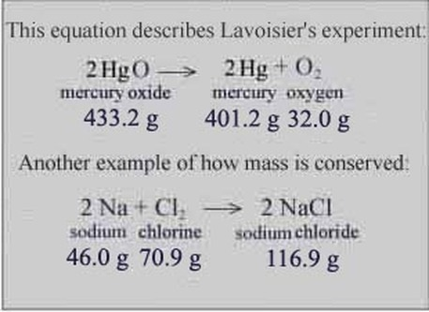
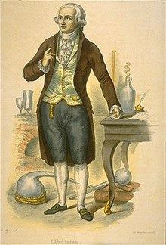
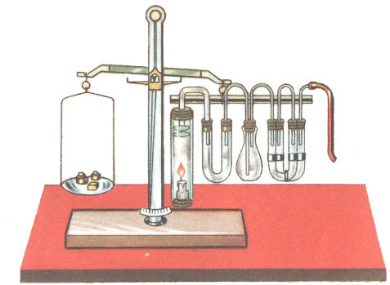
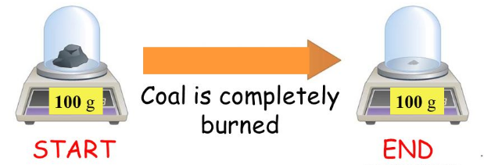
Antoine Lavoisier
(1743-1779)
Conservation of Mass
“Matter is neither created nor destroyed in a chemical reaction it only changes form”
Quantitative vs Qualitative Chemistry
Oxygen required for Combustion
Disproved Phlogiston Theory
Metric System
Tax Collector
Guillotined (found innocent later)

Slide 8
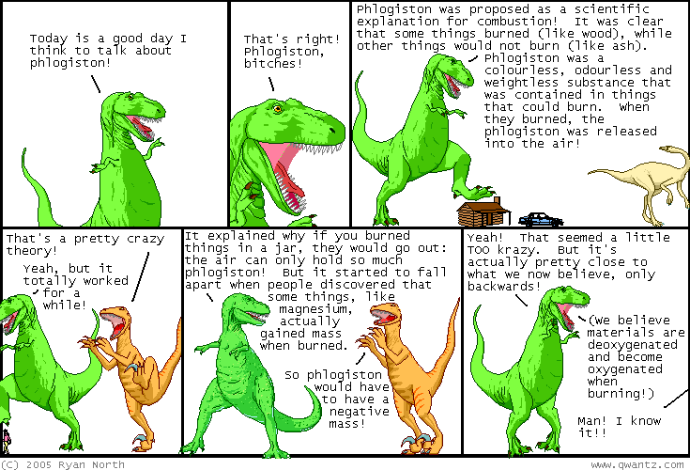

Slide 9
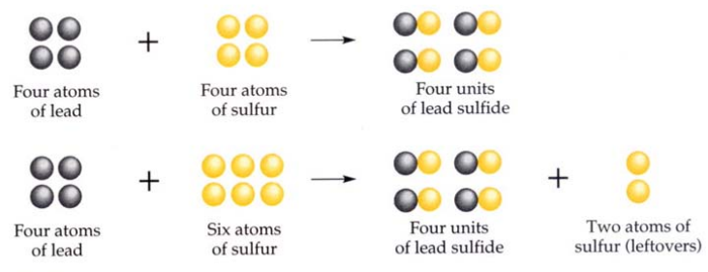
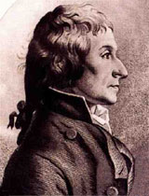
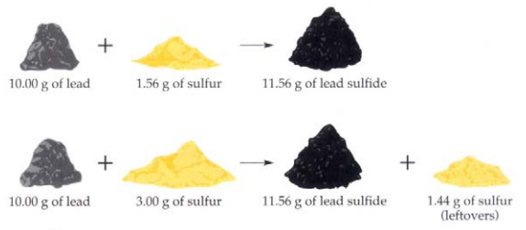
Joseph Proust
(1754-1826)
Law of Definite Proportions
“Substances (Compounds) always combine in constant and definite proportions by mass”
Discovered Glucose (Ch. 27)

Slide 10
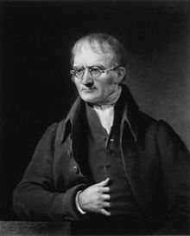
John Dalton
(1766-1844)
1
Democritus
Elements are composed of minute, indivisible particles called atoms
1st Atomic Theory
2
Atoms of the same element are alike in mass and size
3
Atoms of different elements have different masses and sizes
Boyle
4
Chemical compounds are formed by the union of two or more atoms of different elements
5
Atoms combine to form compounds in simple whole number ratios 1:1, 2:1, 2:3 etc
Proust
6
Atoms of two elements may combine in different ratios to form more than one compound
Law of Multiple Proportions
1
Chemically indivisible but can be broken apart in nuclear reactions
2
Not all atoms of a specific element have the same mass (isotopes)
More Tomorrow

Slide 11
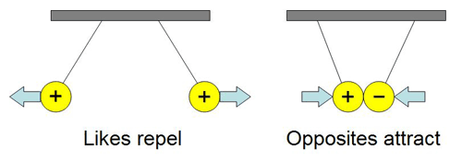
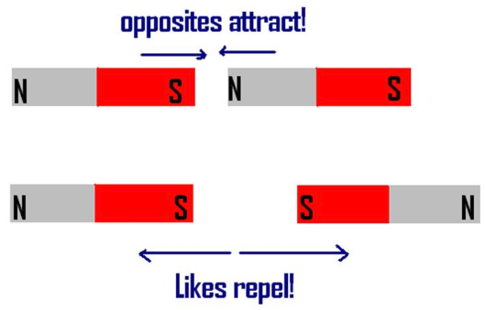
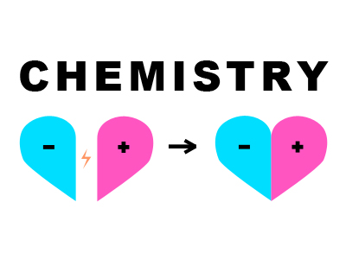
Properties of Electrical Charge
Two types of “charges” (positive/negative) or (+/-)
Opposites attract, likes repel
Charges can be transferred between objects
$F=k\frac{q_{1}q_{2}}{r^{2}}$

Slide 12
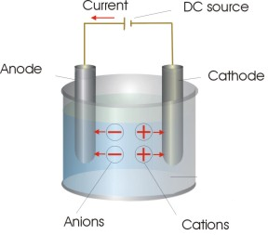
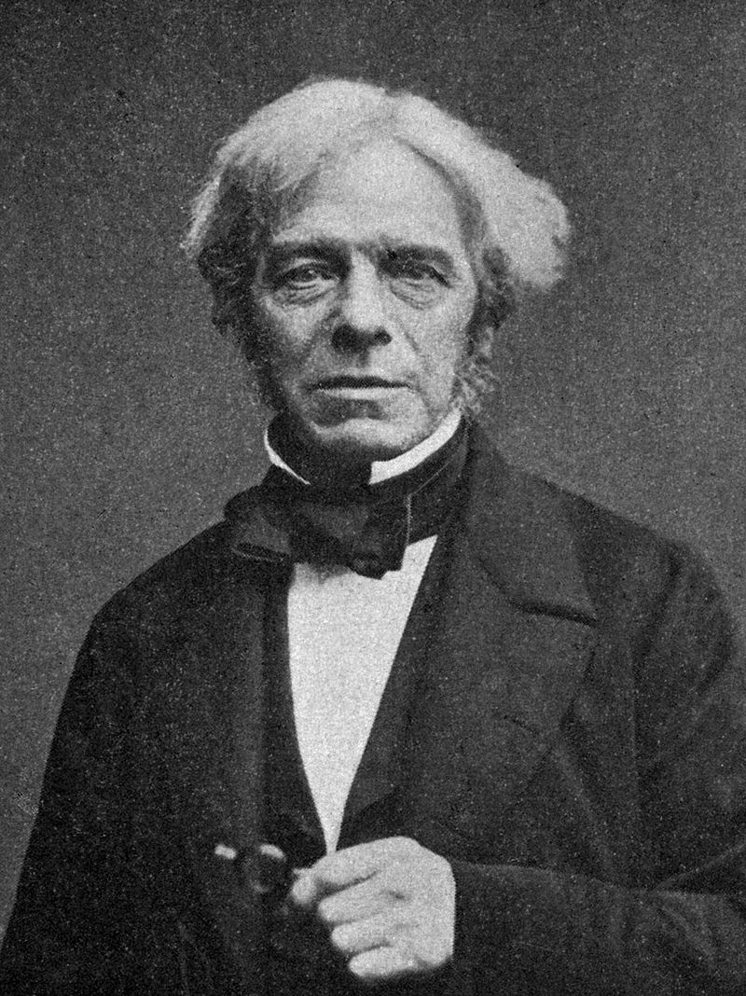
Michael Faraday
(1791-1867)
+
-
Discovery of Ions
Units named after him
Faraday Cage
Certain substance when dissolved in water conduct electricity
Physicist Ernest Rutherford stated; "When we consider the magnitude and extent of his discoveries and their influence on the progress of science and of industry, there is no honour too great to pay to the memory of Faraday, one of the greatest scientific discoverers of all time".

Slide 13
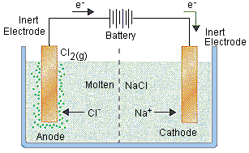
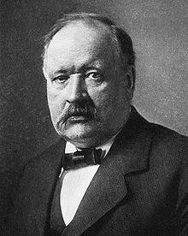
Savante Arrhenius
(1859-1927)
Don’t need water
NaCl → Na⁺ + Cl⁻
Cations (+)
Anions (−)
Acids/Bases (Ch. 15)
Arrhenius Equation
Noble Prize Committee (1903 Nobel Prize)

Slide 14
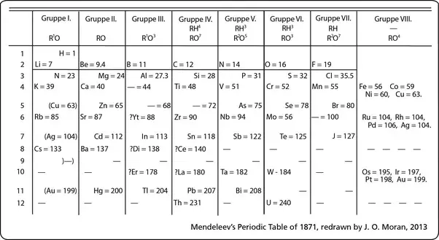
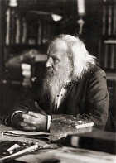
Dmitri Mendeleev
(1834-1907)
Periodic Table (1869)
Rows = atomic mass
Columns = similar Chemical and Physical properties
Wrote definitive textbook on Chemistry
Denied Nobel Prize because Arrhenius disliked him.

Slide 15
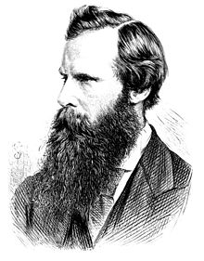
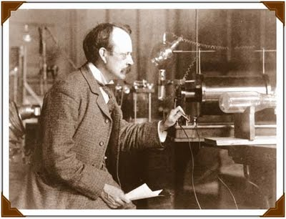
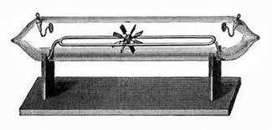
Joseph John (JJ) Thomson
(1856-1940)
William Crookes
(18332-1911)
Crookes Tube
Discovery of the Electron (Corpuscles)
Plum-Pudding Model
Mass Spectrometer and Isotopes
1906 Nobel Prize
Gifted Teacher (7 students won Nobel Prizes, and his son)

Slide 16
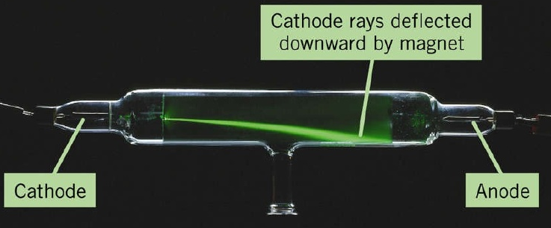
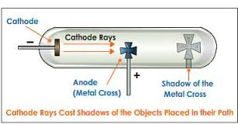
Joseph John (JJ) Thomson
Properties of the Electron
Travel in straight lines
1/2000th mass of H
Same mass no matter source (all electrons are the same) “Universal”
Deflected by magnetic fields (attracted to positive field therefore negatively charged)
Produce Shadows
Have mass (capable of turning a paddle wheel)

Slide 17
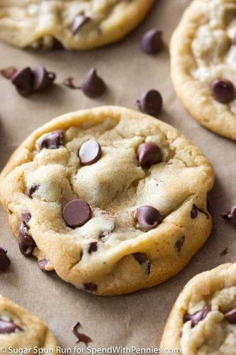
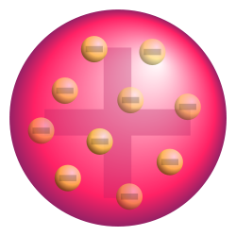
Joseph John (JJ) Thomson
Plum Pudding Model
Aka Chocolate Chip Cookie Model
Corpuscles (electrons) distributed in an even field of positive charge

Slide 18
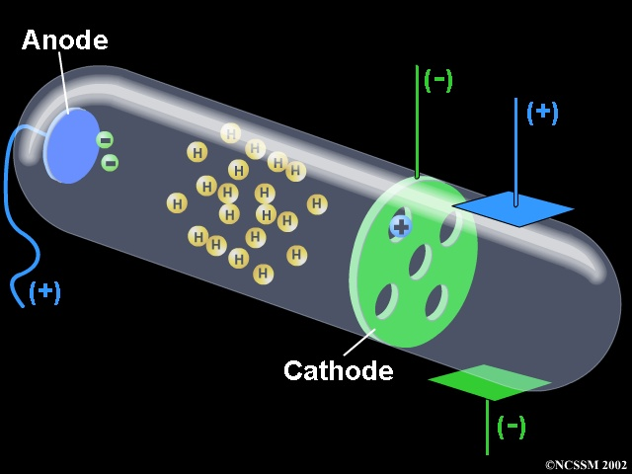
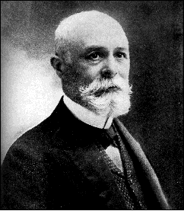
Eugene Goldstein
(1850-1930)
Canal Rays/Protons – emitted opposite cathode rays
Different for each element
Properties measured by Thomson

Slide 19
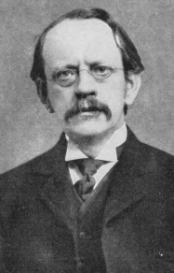
Ernst Rutherford
(1871-1937)
Geiger-Marsden Experiment (Au Foil)
Rutherford Model
1908 Nobel Prize
Atoms are not inseparable
α-particle, β-particle, γ-rays, ½ life,

Slide 20
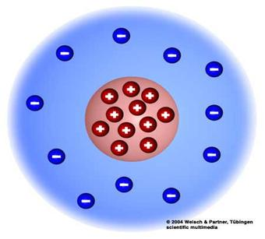
Ernst Rutherford
Model of the Atom
Nucleus very very very small (football in a stadium)
Nucleus is positive and contains most of the mass
“It was quite the most incredible event that has ever happened to me in my life. It was almost as incredible as if you fired a 15-inch shell at a piece of tissue paper and it came back and hit you. On consideration, I realized that this scattering backward must be the result of a single collision, and when I made calculations I saw that it was impossible to get anything of that order of magnitude unless you took a system in which the greater part of the mass of the atom was concentrated in a minute nucleus. It was then that I had the idea of an atom with a minute massive centre, carrying a charge.”
—Ernest Rutherford
Electrons in a “cloud” around the nucleus

Slide 21
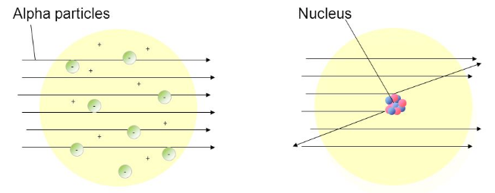
Thomson Model
Vs
Rutherford Model
Thomson Model
“Plum Pudding”
Rutherford Model
“Nuclear Model”

Slide 22
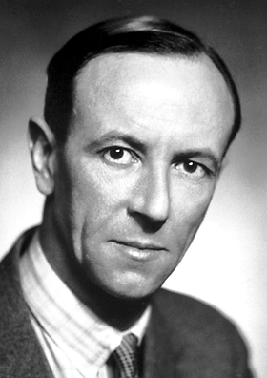
James Chadwick
(1891-1974)
Problem of Missing Mass:
H = 1 proton = 1 amu
He = 2 protons = 4 amu
Discovered Neutron
Rutherford’s Student
Neutral charge, Same mass as proton
Revised Rutherford's theory, proposing that the nucleus contains positively charged protons AND neutrally charged neutrons

